Slide 1
PHY Design for AMP
July 2024
Doc.: IEEE 802.11-24/1199r1
Date: 2024-07-15
Authors:
Name | Affiliation | Address | Phone | Email
Yinan Qi | OPPO |  |  | v-qiyinan@oppo.com
Weijie Xu
Chuanfeng He
Ke Wang

Slide 2
Abstract
Doc.: IEEE 802.11-24/1199r1
In this contribution, we discuss the PHY design for AMP covering the following aspects
PPDU design
Asymmetric UL/DL design
Coding

Slide 3
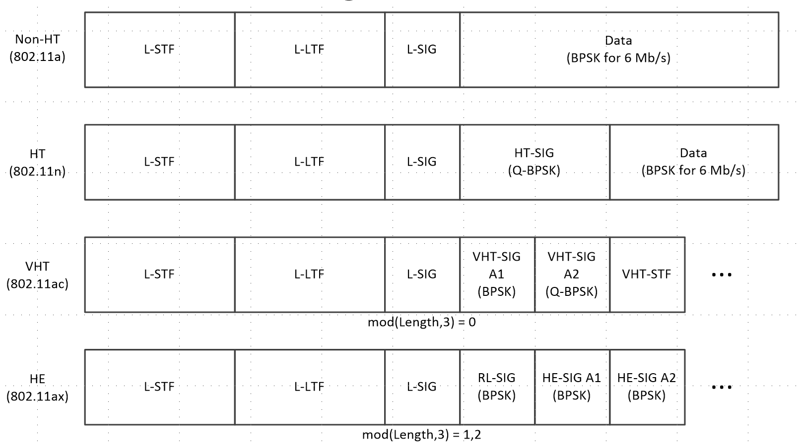
July 2024
Doc.: IEEE 802.11-24/1199r1
Background
Different generations of 802.11 PPDU structures are shown in below.
Two OFDM symbols BPSK-Mark1 and BPSK-Mark2 are inserted after L-SIG for misclassification issues [1].
Slide 3
Yinan Qi (OPPO)

Slide 4
July 2024
Doc.: IEEE 802.11-24/1199r1
PPDU Design for AMP – Legacy Preamble
Main design aspects
Preamble with wider BW
AMP part with narrow BW
The AMP PPDU should also starts with legacy preamble including L-STF, L-LTF and L-SIG.
The MCS should be signalled in L-SIG and for AMP PPDU, MCS should be set as MCS0 so that if MCS is not configured as MCS0, the STA knows the received PPDU is non-HT legacy PPDU.
Q: Whether or not there is a need to differentiate AMP PPDU from other PPDU structures including HT, VHT, HE and WUR?
Slide 4
Yinan Qi (OPPO)

Slide 5
July 2024
Doc.: IEEE 802.11-24/1199r1
PPDU Design for AMP – AMP Preamble
802.11ba HDR-Sync
WUR-sync = $\overline{W}$
WUR Data
802.11ba LDR-Sync
WUR-sync = [W, W]
WUR Data
AMP: Different sync sequence with the same/different length
AMP-sync = G
AMP Data
AMP : Different sync format with the same length
AMP-sync = [W, $\overline{W}$] or [$\overline{W}$, W]
AMP Data
AMP Sync design
New sync sequence: same/different length, correlation property, balance of 1 and 0, etc.
Legacy sync sequence: no commercial deployment of WUR devices yet, thus no need to differentiation, potential new combination
Slide 5
Yinan Qi (OPPO)

Slide 6
July 2024
Doc.: IEEE 802.11-24/1199r1
PPDU Design for AMP – AMP SIG
A SIG part can be inserted between AMP-Sync and AMP Data to explicitly indicate AMP payload configuration [2].
The following parameters can be included in SIG,
Rate: explicit indication of data rate
E.g., 62.5kbps, 250kbps, 500kbps, 1Mbps, 2 bits
UL/DL indication (1 bit):
Asymmetric UL/DL format
Non-AP AMP STAs don’t detect UL PPDU
Length
96-256 bits, up to 64 bytes, 6 bits
Slide 6
Yinan Qi (OPPO)

Slide 7
July 2024
Doc.: IEEE 802.11-24/1199r1
PPDU Design for AMP – AMP SIG (Cont.)
The following parameters can be included in SIG,
Backscatter indication (1 bit)
Indicate if the UL transmission is active transmission or backscattering
If backscattering, the AMP payload part can be CW only
Parity check (1 bit)
Error detection
Coding (1 bit)
Indicate if FEC coding is applied
Reserved (2 bit)
For future enhancements
Total number of bits and overall duration
14 bits
Length: 224 µs @62.5 kbps, 14 µs @1 Mbps
Slide 7
Yinan Qi (OPPO)

Slide 8
July 2024
Doc.: IEEE 802.11-24/1199r1
Asymmetric UL/DL Design
Different supported rates for UL and DL
Low rate can be supported for DL since one DL frame can address multiple AMP devices and thus is transmitted less frequently
High rate is preferred for UL to enhance the transmission efficiency, especially when many AMP devices are deployed
Different PPDU formats
Legacy preamble can be used in DL but may be too complicated for UL
DL is only active transmission but for UL both active Tx and backscattering should be considered, which may not have the same PPDU format as DL
Different waveform/modulation
OOK can be baseline for DL
UL: OOK, FSK, etc., but may converge to one
Slide 8
Yinan Qi (OPPO)

Slide 9
July 2024
Doc.: IEEE 802.11-24/1199r1
Coding for AMP
Line Coding for DL, e.g. Manchester code
AMP can easily decode
No significant complexity, thus power consumption is negligible
Line coding for UL
Consider FEC code for UL
Convolutional code
Low coding complexity
Coding gain with enhanced UL link budget
Slide 9
Yinan Qi (OPPO)

Slide 10
July 2024
Doc.: IEEE 802.11-24/1199r1
Summary
In this submission, we discuss the PHY design aspects for AMP including:
Overall PPDU format including legacy preamble part and AMP part;
AMP part design including sync, SIG and payload;
Asymmetric UL/DL design
FEC Coding
Slide 10
Yinan Qi (OPPO)

Slide 11
Reference
July 2024
Doc.: IEEE 802.11-24/1199r1
[1] Steve Shellhammer, et. al., “PHY Misclassification Issue,” IEEE 802.11-19/0423r1, March 2019
[2] Bin Qian, et. al., “Initial Thought on 2.4 GHz DL AMP PPDU Design,” IEEE 802.11-24/0847r0, May 2024

