Slide 1
Consideration on AMP Coexistence
Date: 2024-07-16
Authors:
Name | Affiliation | Address | Email
Panpan Li | Huawei | Singapore | lipanpan25@huawei.com
Lei Huang |  | Singapore
Bin Qian |  | Shenzhen, China
Wei Lin |  | Shenzhen, China

Slide 2
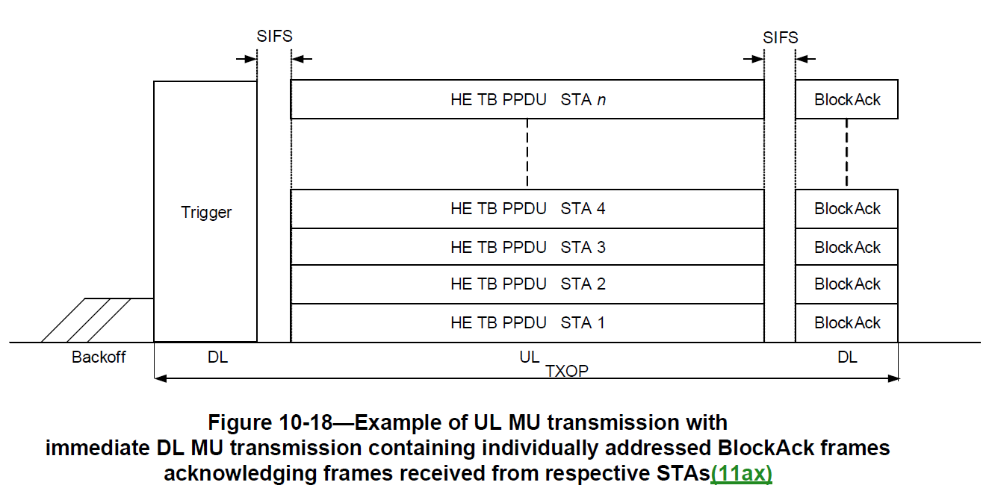
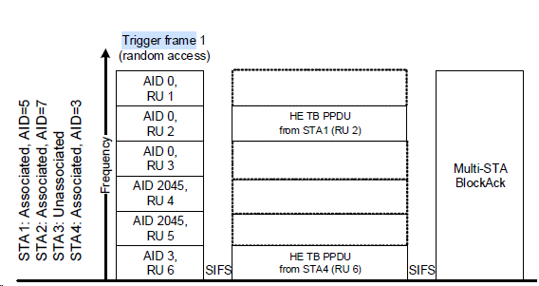
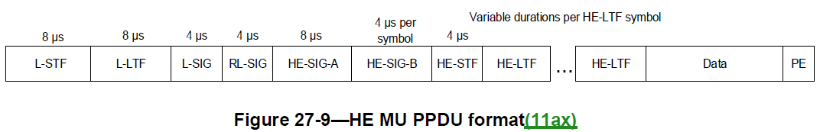
Background
A large amount of AMP STAs may bring negative effect to fair coexistence with regular WiFi devices [1]. AMP TB UL transmission may be a way to handle this issue. AMP UL PPDU need to comprise legacy preamble at the beginning for coexistence [2].
In 11ax UL MU transmission, after receiving the DL Trigger frame, STAs transmit UL HE TB PPDU with legacy preamble.

Slide 3
Problem
In AMP TB UL transmission, some non-AP STAs (for example, non-AP STAs with low power active transmitter) may not be capable of generating the legacy preamble.

Slide 4
Proposal
In AMP TB UL transmission, for non-AP STAs not capable of generating legacy preamble, define a mechanism that allows a third-party STA to generate and transmit the legacy preamble on behalf of those STAs.
  Such third-party STA may be called the Legacy Preamble Transmitting (LPT) STA.
  A LPT STA can be an AP STA or a non-AP STA (energizer, carrier source,…).
  One or more LPT STAs may be triggered by AP STA.

Slide 5
Example: LPT STA is a non-AP STA
After receiving a specific Trigger frame, LPT STA may generate and transmit the legacy preamble, and AMP STA may wait for 20 µs and then immediately transmit AMP preamble and UL data immediately.
UL
TXOP
AMP AP
DL
AMP Trigger frame
S
I
F
S
S
I
F
S
ACK
20 µs
UL
Legacy preamble
LPT STA
DL
AMP UL PPDU
T µs
AMP STA
(not capable of generating legacy preamble)
UL
AMP
preamble
DL
UL Data

Slide 6
AMP Trigger Frame
AMP Trigger frame design principle:
  Indicate to the intended LPT STA for transmitting legacy preamble.
  Indicate to the intended AMP STA for transmitting AMP preamble and UL data immediately after the legacy preamble is transmitted by LPT STA.
Option 1: AMP Trigger frame is a new variant of the 11ax Trigger frame.
Option 2: A brand new AMP Trigger Frame.
We slightly prefer option 2, because AMP STA may not support 11ax Trigger frame, and option 2 may simply the frame design.

Slide 7
Summary
This contribution proposes a mechanism that allows a third-party STA to generate and transmit the legacy preamble on behalf of a AMP non-AP STA that is not capable of generating the legacy preamble in AMP TB UL transmission.

Slide 8
SP
Do you agree that 11bp shall define a mechanism that allows a third-party STA to generate and transmit the legacy preamble on behalf of a AMP non-AP STA that is not capable of generating the legacy preamble in AMP TB UL transmission?
  Yes
  No
  Abstain

Slide 9
Reference
11-23-1168-00-0amp-amp-par-interoperability-and-backward-compatibility.
11-24-0860-01-00bp-coexistence-considerations-of-amp-data-communication.

