Slide 1
Issues on OBSS R-TWT Protection
Date: 2024-09-09
Authors:

Slide 2
Introduction
In 11be, R-TWT was adopted to support low latency (LL) traffic transmission.
  However, in 11be, protection mechanism for R-TWT schedule only considers intra-BSS.
To enhance the protection mechanism, in TGbn, there have been several discussions about protecting R-TWT schedule under multi-BSS scenario [1-8].
  Most of these discussions consider using beacon frame to announce OBSS R-TWT schedule in a BSS.
  However, using beacon frame has some issues.
In this contribution, issues on OBSS R-TWT protection using beacon frame are discussed.
Then, an issue on OBSS R-TWT protection without beacon frame and a possible approach to OBSS R-TWT protection with individually AP controlled mechanism are discussed.

Slide 3
Issues on using beacon frame
Announcing OBSS R-TWT schedules via beacon frame in a BSS has several issues.
  Issue 1. OBSS R-TWT schedule information exchanging delay caused by periodicity.
    When announcing OBSS R-TWT schedules via beacon frames in a BSS, the information exchanging period is dependent on the period of TBTT. This causes some delay when a new OBSS R-TWT schedule occurs between TBTTs.
  Issue 2. Beacon bloating.
    There are some discussions about using beacon frame to announce OBSS R-TWT schedules [6, 9].
    However, because using beacon frame to announce OBSS R-TWT schedules may require substantial amount space in beacon frame, OBSS R-TWT schedule announcement may cause beacon bloating.

Slide 4
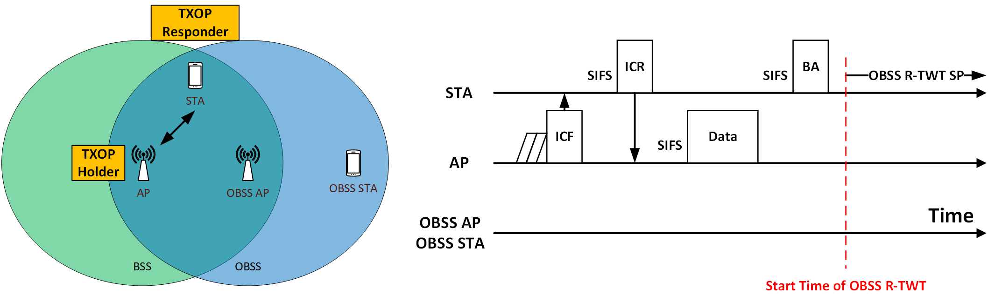
Without broadcasting OBSS R-TWT schedule
Basic assumption: an AP knows OBSS R-TWT schedules through certain mechanisms.
  How an AP knows OBSS R-TWT schedules is out of the scope of this contribution.
If an AP is a TXOP holder, it can adjust its TXOP to protect OBSS R-TWT schedule.

Slide 5
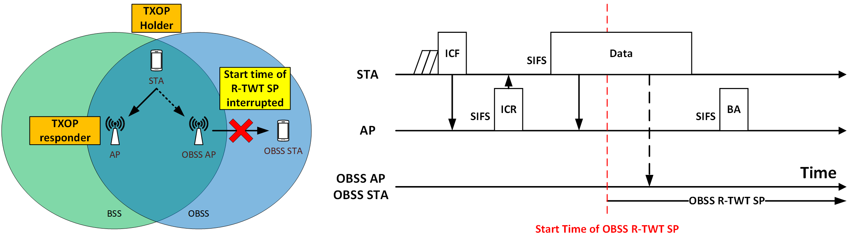
Without broadcasting OBSS R-TWT schedule (cont’d)
However, there is an issue if a non-AP STA is a TXOP holder because the non-AP STA might have no information on OBSS R-TWT SPs.
  When the STA in the BSS obtains a TXOP, STA’s transmission may interrupt the start time of OBSS R-TWT SP.
    Because of ED, NAV, etc.

Slide 6
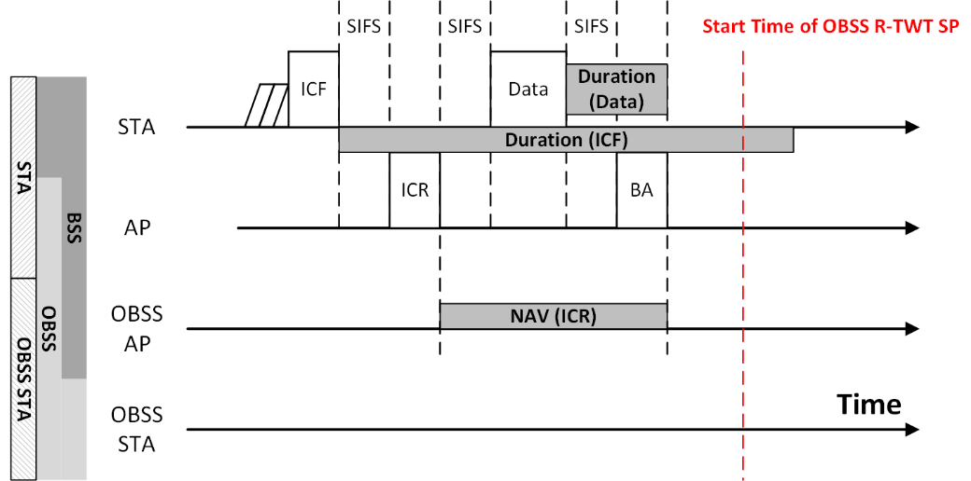
Possible approach
AP controlled CR-TWT protection.
  In [10], TXOP truncation method by TXOP responder was proposed.
  In CR-TWT protection, similarly, AP can employ the TXOP truncation method proposed in [10].
    If the AP knows that non-AP STA’s TXOP overlaps with the OBSS R-TWT SP, then the AP can truncate the STA’s TXOP.
    NAV update rule to update with shorter time has to be discussed together with [10].

Slide 7
Summary
In this contribution, several issues on using beacon frames to protect OBSS R-TWT schedules were discussed.
  The issues were information exchanging delay and beacon bloating.
To address these issues, protection method without broadcasting OBSS R-TWT schedule were discussed.
  When an AP is a TXOP holder, it can adjust its TXOP easily.
  However, when a non-AP STA is a TXOP holder, the OBSS R-TWT schedules may be interrupted.
A possible approach for protection method without broadcasting OBSS R-TWT schedule was discussed.
  The possible approach was AP controlled CR-TWT protection method.
  With this method, the AP can truncate the non-AP STA’s TXOP to protect OBSS R-TWT schedule.

Slide 8
Straw Poll
Do you agree the following?:
  11bn supports AP controlled CR-TWT protection method without broadcasting beacon frame.
  Y / N / A

Slide 9
References
[1] 11-23-0226-02-0uhr-coordination-of-r-twt-for-multi-ap-deployment
[2] 11-23-0250-00-0uhr-ap-coordination-with-r-twt
[3] 11-23-0291-00-0uhr-r-twt-multi-ap-coordination
[4] 11-23-0771-00-0uhr-coordinated-r-twt-protection-in-multi-bss
[5] 11-23-1087-00-0uhr-announcement-for-r-twt-coordination
[6] 11-23-2084-01-00bn-enhanced-r-twt-for-uhr
[7] 11-24-0407-00-00bn-r-twt-multi-ap-coordination-follow-up
[8] 11-24-0827-00-00bn-obss-interference-impact-on-cr-twt-and-enhanced-channel-access-rules
[9] 11-23-2022-01-00bn-r-twt-for-multi-ap-follow-up
[10] 11-23-2002-02-00bn-in-device-coexistence-and-interference-follow-up

