Slide 1
Performance Evaluation of Longer LDPC for 11bn
Date: 2024-07-12
Authors:
Name | Affiliations | Address | Phone | Email
Shengquan Hu | Mediatek | 2840 Junction Ave. San Jose, CA, 95134 |  | Shengquan.hu@mediatek.com
Jianhan Liu |  |  |  | jianhan.liu@mediatek.com
Sin-Yuan Huang
Thomas Pare

Slide 2
Introduction
The goals of next-generation UHR include improving reliability, increasing throughput at different SINR levels, and other advancements
Longer LDPC as one of potential PHY feature was proposed in [1] to achieve the UHR target:
  Simulations in [1] show that 2x1944 code offers 0.5~1.0dB gains for low to medium MCS
  The gains become even larger for higher MCSs
In this contribution, we will share our performance evaluation, observations and views for longer LDPC with codeword length 2x1944 in 11bn

Slide 3
Simulation Configurations
July 2024
BW80, RU996
1T1R1SS, 2T2R2SS, 4T2R2SS, 4T4R4SS
AWGN, D-NLOS, B-LOS
Actual estimated channel
BF: off/on
RF impairment: off/on
LDPC: 1x1944, 2x1944 (proposed in [1])
MCS: 0~13
Packet length: varying for each MCS to make sure enough # of OFDM symbols & CW
Detector: linear detector for 1SS; near ML-type for MIMO
LDPC decoder: modified Min-Sum
Max # of iterations: 20
Channel realizations: up to 2000
The performance gains are calculated at 10% PER & 1% PER
NOTATION: nTmRqSS throughout the slides stands for Ntx=n, Nrx=m, Nss=q

Slide 4
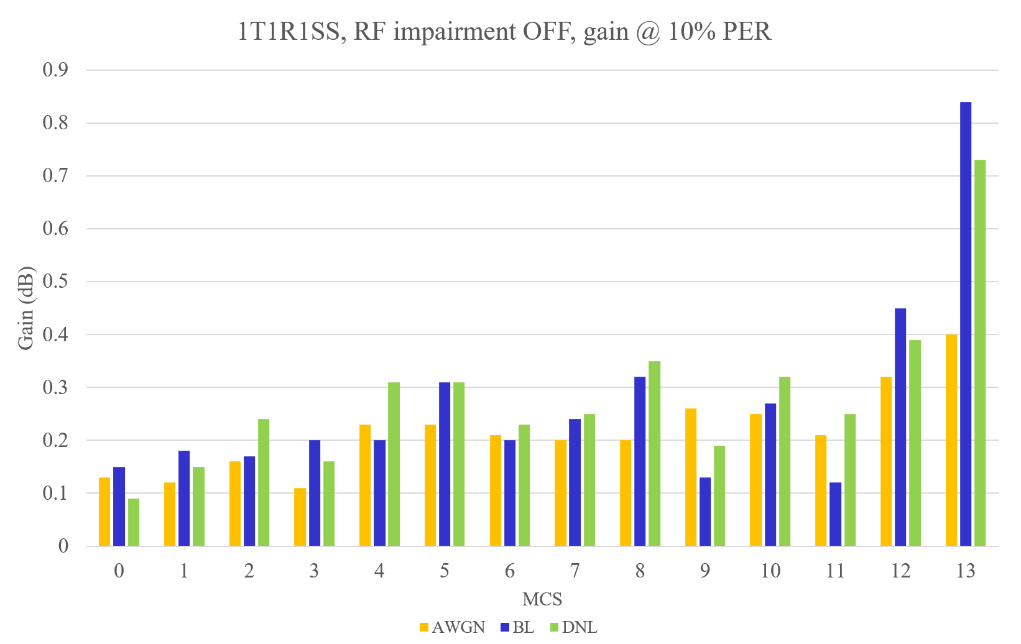
1T1R1SS, RF impairment OFF, gain @ 10% PER
For AWGN: up to 0.4dB gain of 2x1944 over 1x1944 LDPC
For BL: up to 0.8dB gain
For DNL: up to 0.7dB
Slide 4
Shengquan Hu, Mediatek Inc.

Slide 5
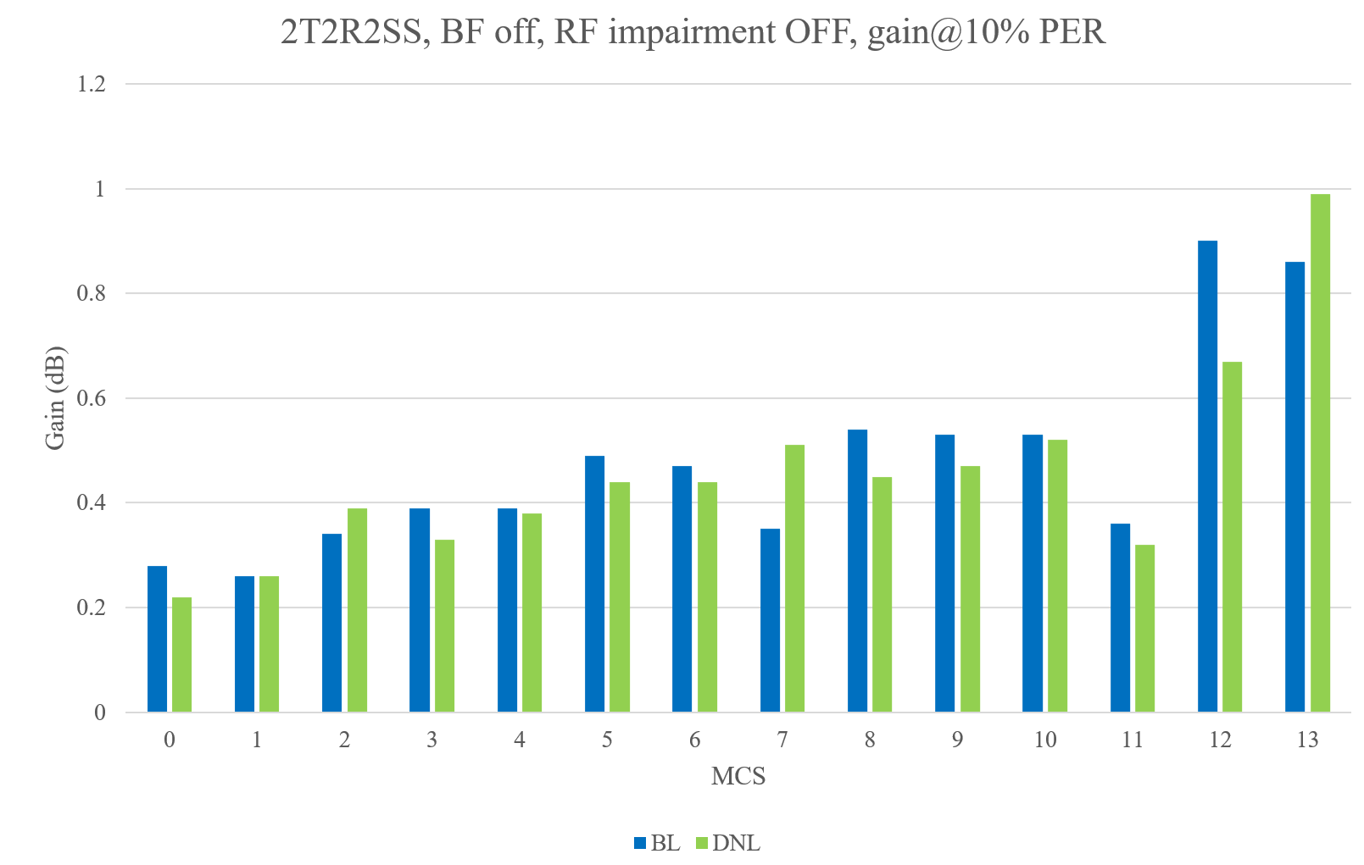
2T2R2SS, BF off, RF impairment OFF, gain @ 10% PER
0.2~1.0dB gain of 2x1944 over 1x1944 LDPC
The higher MCS12/13 harvest larger gain
Slide 5
Shengquan Hu, Mediatek Inc.

Slide 6
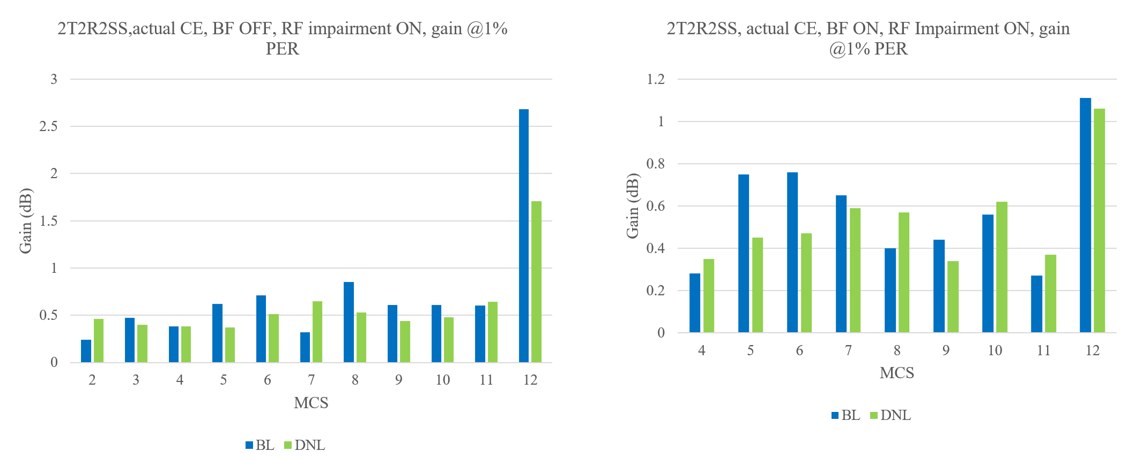
2T2R2SS, BF ON/OFF, RF Impairment ON
2x1944 longer LDPC offers more gains for higher MCSs in presence of RF impairments
Slide 6
Shengquan Hu, Mediatek Inc.

Slide 7
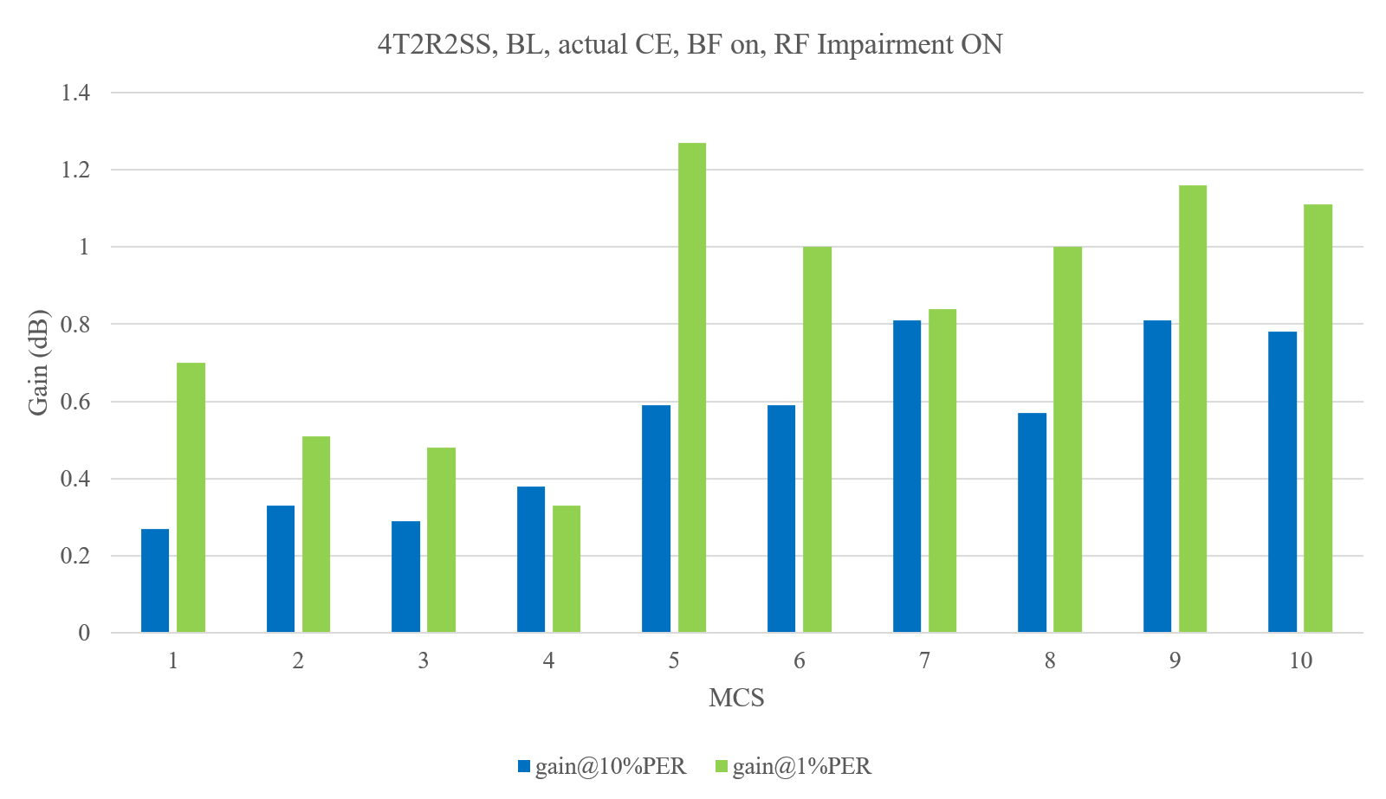
4T2R2SS, BF ON, RF Impairment ON, gain @1% vs 10% PER
2x1944 longer LDPC tends to provide higher gains at 1% PER than at 10% PER for medium to high MCS
Slide 7
Shengquan Hu, Mediatek Inc.

Slide 8
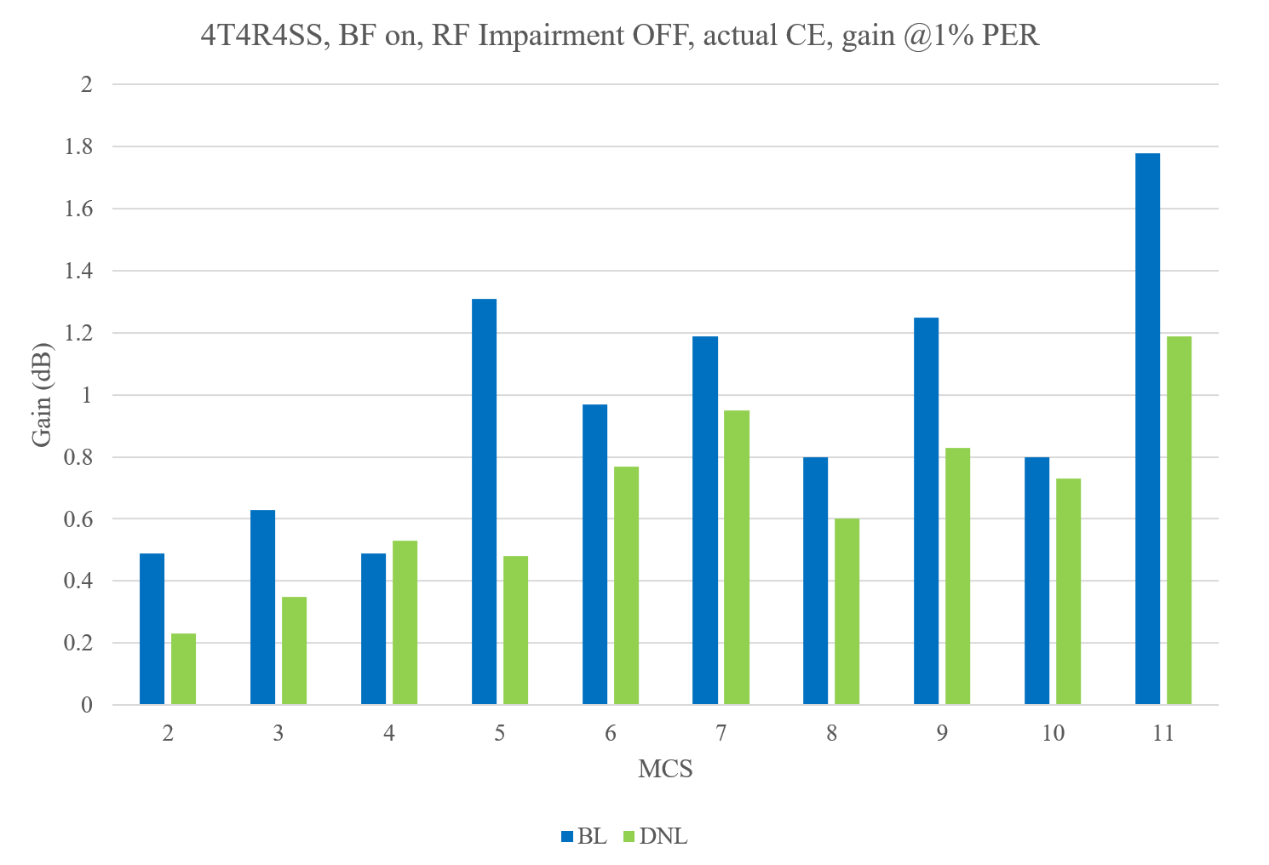
4T4R4SS, BF ON, RF Impairment OFF, gain @1% PER
2x1944 longer LDPC achieves more gains for larger spatial stream MIMO
Slide 8
Shengquan Hu, Mediatek Inc.

Slide 9
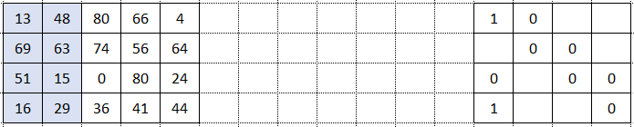
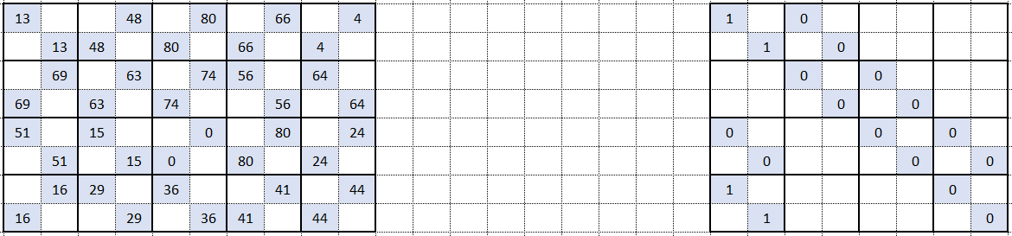
Lifting Structure for 2x1944 LDPC
As described in [1], the new 2x1944 LDPC code is designed by using the existing length-1944 LDPC code as a base graph and re-lifting by 2 on top of 1944 code
The lifting based longer code design offers the flexibility of reusing existing hardware designs for both encoder and decoder with parallel processing capability
e.g. existing 1944 code, R=5/6
Lifted by 2
2x1944 code, R=5/6 in [1]
Slide 9
Shengquan Hu, Mediatek Inc.

Slide 10
Summary
Our studies observed the performance gains of longer 2x1944 LDPC proposed in [1] over existing 1x1944 LDPC:
  In general, the gain in range of 0.2dB ~ 1.0dB
  larger gain for higher MCSs
  More gains for larger number of spatial streams
  Much larger gains for higher MCS in presence of RF impairments
The lifting based 2x1944 longer LDPC code structure proposed in [1] provides the flexibility to reuse the existing 1x1944 LDPC hardware modules for both encoder and decoder

Slide 11
Reference
[1]. 11-23-1985-04-00bn-longer-ldpc-codeword

