Slide 1
DRU Transmission on Frequency Subblocks of Wide Bandwidth PPDU
Date: 2024-07-12
Authors:
Name | Affiliations | Address | Phone | Email
Shengquan Hu | Mediatek | 2840 Junction Ave. San Jose, CA, 95134 |  | Shengquan.hu@mediatek.com
Jianhan Liu
Thomas Pare

Slide 2
Introduction
DRU operation modes and scenarios have been discussed, some motions have been passed, such as:
  DRU is allowed in a punctured UHR TB transmission
  Hybrid mode with DRUs and RRUs in UHR UL TB OFDMA transmission
  In a non-punctured 80MHz PPDU, distribution BW with 20M+20M+40M or 40M+20M+20M is allowed for DRU
In this contribution, we propose a simple method for DRU transmission on frequency subblocks of wide BW PPDU
BW320MHz

Slide 3
Illustration of DRU Transmission in Frequency Subblocks
Hybrid mode of DRU & RRU in an UL TB OFDMA Transmission
80MHz
RRU | RRU | DRU on 3rd 80MHz subblock | RRU
DRU in a punctured UL TB OFDMA Transmission
20MHz
40MHz
80MHz
RRU | DRU | punc | DRU | RRU | DRU on 4th 80MHz subblock
BW320MHz
DRU in a non-punctured 80MHz PPDU Transmission
20MHz
20MHz
40MHz
DRU | DRU | DRU
BW80MHz

Slide 4

DRUs on Frequency Subblocks of Wide Bandwidth PPDU
Any size DRU distribution onto any frequency subblock (with size 20/40/80MHz) of a wider bandwidth (80/160/320MHz) can be simply generated as:
DRU tone plan for BW20/40/80 (e.g. as proposed in [1])
Constant shift value
$$k_{DRU_i} = k_{DRU}+ K_{shift}\left(i\right)$$
K_{DRU}: DRU subcarrier indices from DRU tone plan table for an DRU distributed on BW20/40/80
K_{DRU_i}: DRU subcarrier indices on i-th frequency subblock
K_{shift}(i): constant shift value
i: frequency subblock index of subblock size 20/40/80MHz on BW80/160/320
NOTE:
K_{shift}(i): = 120+K_{1st} for subblock size 20MHz
= 244+K_{1st} for subblock size 40MHz
= 500+K1st for subblock size 80MHz
K_{1st} is the starting tone index of corresponding frequency subblock i of subblock size 20MHz, or 40MHz, or 80MHz ; 120, 244 and 500 are the highest/or the most righthand side subcarrier index number for an DRU in BW20/40/80

Slide 5
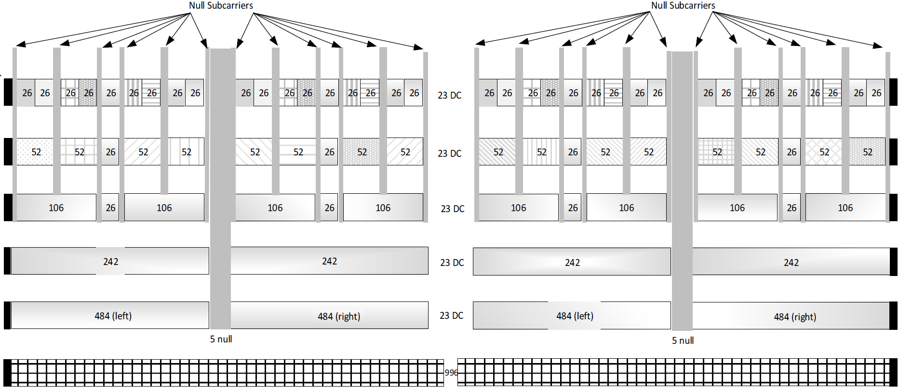
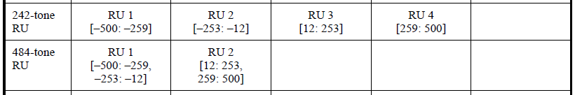
Example of K_{1st} for DRU in 20MHz Subblock of BW80
-500
-259
-253
-12
12
253
259
500
K_{1st}
K_{1st}
K_{1st}
K_{1st}
-500
-253
12
259
-259
-12
253
500

Slide 6
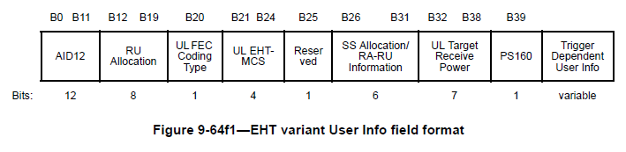
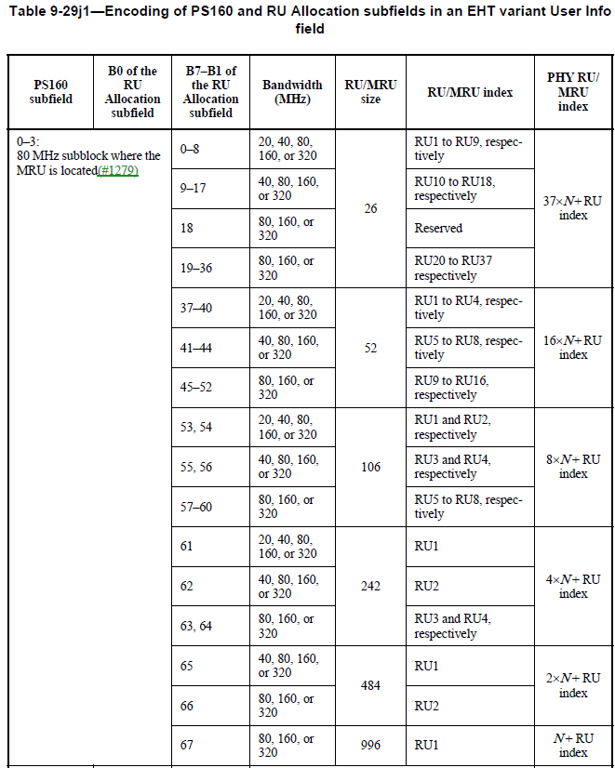
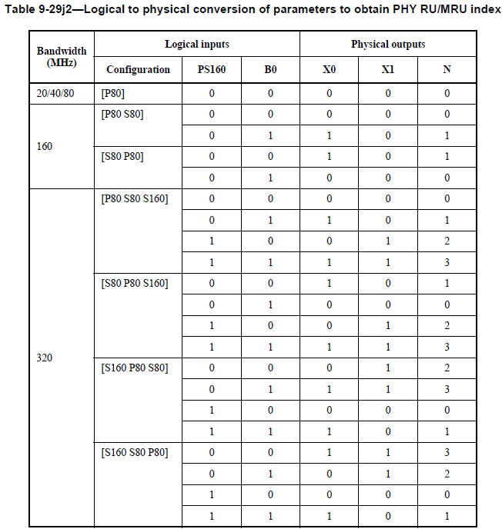
Frequency Subblock Index (1/2)
Assume 11bn follows the same 11be trigger frame structure:
In User Info field, as an example of 11be trigger frame, B7-B1 of RU Allocation subfield defines the RU size and location in 80MHz;
As an example in 11be, Bit of PS160 and B0 of RU Allocation together define the 80MHz frequency subblock Index N for BW80/160/320
It is easy to convert/or map B7-B1 of the RU Allocation subfield to 20/40MHz frequency subblock index as defined in next page
80MHz subblock index N

Slide 7
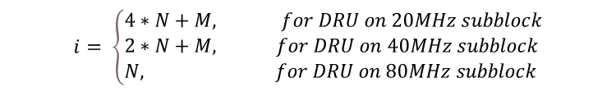
Frequency Subblock Index (2/2)
20MHz subblock index M
inside 80MHz
40MHz subblock index M
inside 80MHz
According to B7-B1 of the RU Allocation subfield, we define the 20/40MHz subblock index M inside 80MHz as shown in the table of this page
Then the global subblock index i in BW80/160/320 can be easily calculated as below
B7-B1 of the RU Allocation subfield | RU size | 20MHz subblock index M in 80MHz | 40MHz subblock index M in 80MHz
0-8 | 26 | 0 | 0
9-17 |  | 1
18 |  | reserved
19-27 |  | 2 | 1
28-36 |  | 3
37-40 | 52 | 0 | 0
41-44 |  | 1
45-48 |  | 2 | 1
49-52 |  | 3
53, 54 | 106 | 0 | 0
55, 56 |  | 1
57, 58 |  | 2 | 1
59, 60 |  | 3
61 | 242 | 0 | 0
62 |  | 1
63 |  | 2 | 1
64 |  | 3
65 | 484 | NA | 0
66 |  |  | 1
$$i= \left\{\begin{aligned}&4∗N+M, for DRU on 20MHz subblock \\ &2∗N+M, for DRU on 40MHz subblock \\ &N, for DRU on 80MHz subblock\end{aligned}\right.$$
(NOTE: we assume index i, M, N start from 0)

Slide 8
K_{shift} Table
Frequency Subblock Size | BW80 | BW160 | BW320
20MHz | 120+[-500,-253,12,259] | 120+[-1012, -765, -500, -253, 12, 259, 524, 771] | 120+[-2036, -1789, -1524, -127,7 -1012, -765, -500, -253, 12, 259, 524, 771, 1036, 1283, 1548, 1795]
40MHz | [-1,1]*256 | [-3,-1,1,3]*256 | [-7,-5,-3,-1,1,3,5,7]*256
80MHz | 0 | [-1,1]*512 | [-3,-1,1,3]*512
Frequency Subblock Size | BW80 | BW160 | BW320
20MHz | [-380,-133,132,379] | [-892,-645,-380,-133,132,379,644,891] | [ -1916, -1669, -1404, -1157, -892, -645, -380, -133, 132, 379, 644, 891, 1156, 1403, 1668, 1915]
40MHz | [-256, 256] | [-768,-256,256,768] | [-1792,-1280,-768,-256,256,768,1280,1792]
80MHz | 0 | [-512,512] | [-1536,-512,512,1536]

Slide 9

Example: DRU on Frequency Subblock in BW320
Frequency Subblock Size | BW80 | BW160 | BW320
20MHz | [-380,-133,132,379] | [-892,-645,-380,-133,132,379,644,891] | [ -1916, -1669, -1404, -1157, -892, -645, -380, -133, 132, 379, 644, 891, 1156, 1403, 1668, 1915]
40MHz | [-256, 256] | [-768,-256,256,768] | [-1792,-1280,-768,-256,256,768,1280,1792]
80MHz | NA | [-512,512] | [-1536,-512,512,1536]
5th 20MHz subblock in BW320, i=4
4th 40MHz subblock in BW320, i=3
4th 80MHz subblock in BW320, i=3
20MHz
40MHz
80MHz
RRU | DRU | punc | DRU | RRU | DRU on 4th 80MHz subblock
BW320M
$$k_{DRU_i} = k_{DRU}+ K_{shift}\left(i\right)$$
(NOTE: we assume index i starts from 0)

Slide 10
Summary
We present a simple method for DRUs transmission on frequency subblocks of wide bandwidth PPDU
The DRU subcarriers on a frequency subblock can be simply generated by a constant shift on DRU tone plan designed for 20,40 and 80MHz distribution BW.

Slide 11
Reference
[1] 11-24-0468-02-00bn-dru-tone-plan-for-11bn

Slide 12
Straw Poll #1
Do you agree to include the following text to the 11bn SFD?
DRUs on frequency subblocks of wide bandwidth PPDU should be defined as DRUs on 20MHz, 40MHz and 80MHz PPDU with the following constant shifts?
Frequency Subblock Size | BW80 | BW160 | BW320
20MHz | [-380,-133,132,379] | [-892,-645,-380,-133,132,379,644,891] | [ -1916, -1669, -1404, -1157, -892, -645, -380, -133, 132, 379, 644, 891, 1156, 1403, 1668, 1915]
40MHz | [-256, 256] | [-768,-256,256,768] | [-1792,-1280,-768,-256,256,768,1280,1792]
80MHz | 0 | [-512,512] | [-1536,-512,512,1536]

Slide 13
Appendix

Slide 14
DRU Tone Plan for BW20 [1]
Data and pilot subcarrier indices for Distributed Tone RUs (DRUs) in a 20 MHz UHR PPDU
DRU type | DRU index and subcarrier range
26-tone DRU i=1:9 | DRU1 [-120:9:-12, 6:9:114] | DRU2 [-116:9:-8, 10:9:118] | DRU3 [-118:9:-10, 8:9:116] | DRU4 [-114:9:-6, 12:9:120] | DRU5 [-112:9:-4, 5:9:113]
 | DRU6 [-119:9:-11, 7:9:115] | DRU7 [-115:9:-7, 11:9:119] | DRU8 [-117:9:-9, 9:9:117] | DRU9 [-113:9:-5, 4:9:112]
52-tone DRU i=1:4 | DRU1 26-tone [DRU1, DRU2] |  | DRU2 26-tone [DRU3, DRU4]
 | DRU3 26-tone [DRU6, DRU7] |  | DRU4 26-tone [DRU8, DRU9]
106-tone DRU i=1:2 | DRU1 26-tone [DRU1~4], [-3, 3] |  | DRU2 26-tone [DRU6~9], [-2, 2]

Slide 15
DRU Tone Plan for BW40 [1]
Data and pilot subcarrier indices for Distributed Tone RUs (DRUs) in a 40 MHz UHR TB PPDU
DRU type | DRU index and subcarrier range
26-tone DRU i=1:18 | DRU1 [-242:18:-26, 10:18:226] | DRU2 [-233:18:-17, 19:18:235] | DRU3 [-238:18:-22, 14:18:230] | DRU4 [-229:18:-13, 23:18:239] | DRU5 [-225:18:-9, 27:18:243] | DRU6 [-240:18:-24, 12:18:228]
 | DRU7 [-231:18:-15, 21:18:237] | DRU8 [-236:18:-20, 16:18:232] | DRU9 [-227:18:-11, 25:18:241] | DRU10 [-241:18:-25, 11:18:227] | DRU11 [-232:18:-16, 20:18:236] | DRU12 [-237:18:-21, 15:18:231]
 | DRU13 [-228:18:-12, 24:18:240] | DRU14 [-234:18:-18, 18:18:234] | DRU15 [-239:18:-23, 13:18:229] | DRU16 [-230:18:-14, 22:18:238] | DRU17 [-235:18:-19, 17:18:233] | DRU18 [-226:18:-10, 26:18:242]
52-tone DRU i=1:8 | DRU1 [-242:9:-17, 10:9:235] |  | DRU2 [-238:9:-13, 14:9:239] |  | DRU3 [-240:9:-15, 12:9:237]
 | DRU4 [-236:9:-11, 16:9:241] |  | DRU5 [-241:9:-16, 11:9:236] |  | DRU6 [-237:9:-12, 15:9:240]
 | DRU7 [-239:9:-14, 13:9:238] |  | DRU8 [-235:9:-10, 17:9:242]
106-tone DRU i=1:4 | DRU1 26-tone [DRU1~4], [-8,5] |  | DRU2 26-tone [DRU6~9], [-6,7] |  | DRU3 26-tone [DRU10~13], [-7,6]
 | DRU4 26-tone [DRU15~18], [-5,8]
242-tone DRU i=1:2 | DRU1 106-tone [DRU1~2],26-tone DRU5, [-244,-4,3,9] |  | DRU2 106-tone [DRU3~4],26-tone DRU14, [-243,-3,4,244]

Slide 16
DRU Tone Plan for BW80 [1]
Data and pilot subcarrier indices for Distributed Tone RUs (DRUs) in a 80 MHz UHR TB PPDU
DRU type | DRU index and subcarrier range
52-tone DRU i=1:16 | DRU1 [-483:36:-51, 17:36:449],[-467:36:-35, 33:36:465] | DRU2 [-475:36:-43, 25:36:457],[-459:36:-27, 41:36:473] | DRU3 [-479:36:-47, 21:36:453],[-463:36:-31, 37:36:469] | DRU4 [-471:36:-39, 29:36:461],[-455:36:-23, 45:36:477]
 | DRU5 [-477:36:-45, 23:36:455],[-461:36:-29, 39:36:471] | DRU6 [-469:36:-37, 31:36:463],[-453:36:-21, 47:36:479] | DRU7 [-481:36:-49, 19:36:451],[-465:36:-33, 35:36:467] | DRU8 [-473:36:-41, 27:36:459],[-457:36:-25, 43:36:475]
 | DRU9 [-482:36:-50, 18:36:450],[-466:36:-34, 34:36:466] | DRU10 [-474:36:-42, 26:36:458],[-458:36:-26, 42:36:474] | DRU11 [-478:36:-46, 22:36:454],[-462:36:-30, 38:36:470] | DRU12 [-470:36:-38, 30:36:462],[-454:36:-22, 46:36:478]
 | DRU13 [-476:36:-44, 24:36:456],[-460:36:-28, 40:36:472] | DRU14 [-468:36:-36, 32:36:464],[-452:36:-20,48:36:480] | DRU15 [-480:36:-48, 20:36:452],[-464:36:-32, 36:36:468] | DRU16 [-472:36:-40, 28:36:460],[-456:36:-24, 44:36:476]
106-tone DRU i=1:8 | DRU1 52-tone [DRU1~2], [-495, 485] | DRU2 52-tone [DRU3~4],[-491, 489] | DRU3 52-tone [DRU5~6],[-489, 491] | DRU4 52-tone [DRU7~8],[-493, 487]
 | DRU5 52-tone [DRU9~10],[-494, 486] | DRU6 52-tone [DRU11~12],[-490,490] | DRU7 52-tone [DRU13~14],[-488,492] | DRU8 52-tone [DRU15~16],[-492,488]
242-tone DRU i=1:4 | DRU1 [-499:4:-19, 17:4:497] |  | DRU2 [-497:4:-17, 19:4:499]
 | DRU3 [-498:4:-18, 18:4:498] |  | DRU4 [-496:4:-16, 20:4:500]
484-tone DRU i=1:2 | DRU1 [-499:2:-17, 17:2:499] |  | DRU2 [-498:2:-16, 18:2:500]

