Slide 1
Global CSD Index Assignment for DRU STF Transmission in 11bn
Date: 2024-07-12
Authors:
Name | Affiliations | Address | Phone | Email
Shengquan Hu | Mediatek | 2840 Junction Ave. San Jose, CA, 95134 |  | shengquan.hu@mediatek.com
Jianhan Liu |  |  |  | jianhan.liu@mediatek.com
Thomas Pare

Slide 2
Introduction
Several contributions (e.g. [1~3]) have proposed to apply global CSD for DRU UHR-STF transmission to solve unintentional beamforming issue
In May IEEE meeting, some motions related to UHR-STF for DRU transmission have been passed, such as:
  Global CSD is used for DRU UHR-STF transmission
  Reuse the 8 CSD table/values in 11ax/be for global CSD allocation
  Global CSD is applied in each distribution BW
  UHR-STF for DRU in a TB PPDU uses 11ax/be TB STF sequences
In this contribution, we will propose a simple DRU index based global CSD Index assignment method to achieve:
  Optimized index assignment to minimize overall CSD value collision
  No additional signaling bits needed
  Accurate enough power measurement for AGC

Slide 3
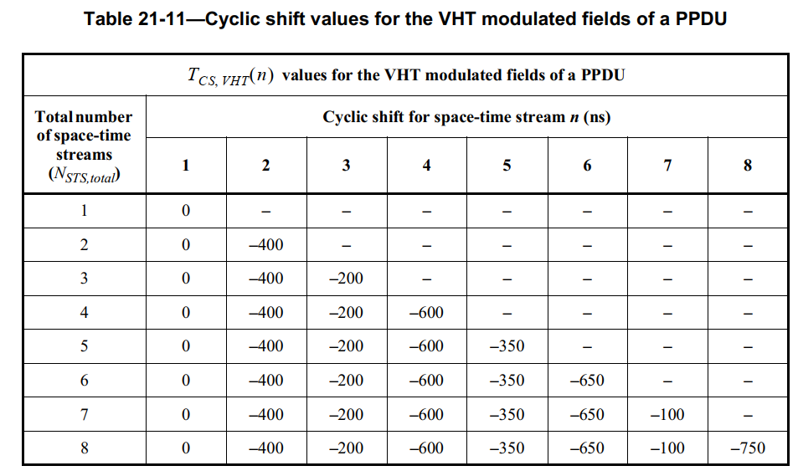
Recap: CSD Table for DRU STF with Global CSD
The 8 CSD value table is shown as below
The global CSD index is 1, 2, …, 8
The 8 CSD values for index 1, 2, …, 8 are [0 -400 -200 -600 -350 -650 -100 -750] (ns)
Slide 3
Shengquan Hu, Mediatek Inc.

Slide 4
General Consideration of Global CSD Index Assignment for DRU
We have limited number of available CSD values. Minimizing CSD collision with simple assignment method is the design target
DRU tone plan preserves the hierarchical structure. To reduce the probability of CSD index overlap, we propose DRU hierarchical structure or DRU index based global CSD start index assignment.
Based on DRU hierarchical structure, the CSD index can be shared between different DRU size, and minimize the sharing among the same size DRU
DRU logical location
DRU Hierarchical Structure for BW20
DRU26_1 | DRU26_2 | DRU26_3 | DRU26_4 | DRU26_5 | DRU26_6 | DRU26_7 | DRU26_8 | DRU26_9
DRU52_1 |  | DRU52_2 |  |  | DRU52_3 |  | DRU52_4
DRU106_1 |  |  |  |  | DRU106_2
DRU Index
DRU hierarchical structure/or DRU index based global CSD index assignment
Global CSD start index for DRU on BW20
CSD start index for DRU26
1 | 2 | 3 | 4 | 5 | 5 | 6 | 7 | 8
2 |  | 4 |  |  | 6 |  | 8
3 |  |  |  |  | 7
CSD start index for DRU52
Global CSD index
CSD start index for DRU106
Global CSD start index
Slide 4
Shengquan Hu, Mediatek Inc.

Slide 5
Optimization of Global CSD Index Assignment
Target: searching for the optimal CSD index assignment to minimize CSD value collision
x2: 1:8 except x1
x1: 1:8
Global CSD index assigned for the corresponding logical location of DRU
x3: 1:8 except x1,x2
x1 | x2 | x3 | x4 | x5 | x6 | x7 | x8 | x9
x1 or x2 |  | x3 or x4 |  |  | x6 or x7 |  | x8 or x9
x1 or x2 or x3 or x4 |  |  |  |  | x6 or x7 or x8 or x9
This row corresponds to 9 DRU26
BW20
This row corresponds to 4 DRU52
This row corresponds to 2 DRU106
y2: 1:8 except y1
BW40
y1: 1:8
y3: 1:8 except y1,y2
x1 | x2 | x3 | x4 | x5 | x6 | x7 | x8 | x9 | y1 | y2 | y3 | y4 | y5 | y6 | y7 | y8 | y9
x1 or x2 |  | x3 or x4 |  |  | x6 or x7 |  | x8 or x9 |  | y1 or y2 |  | y3 or y4 |  |  | y6 or y7 |  | y8 or y9
x1 or x2 or x3 or x4 |  |  |  |  | x6 or x7 or x8 or x9 |  |  |  | y1 or y2 or y3 or y4 |  |  |  |  | y6 or y7 or y8 or y9
x1 or x2 or x3 or x4 or x5 or x6 or x7 or x8 or x9 |  |  |  |  |  |  |  |  | y1 or y2 or y3 or y4 or y5 or y6 or y7 or y8 or y9
Slide 5
Shengquan Hu, Mediatek Inc.

Slide 6
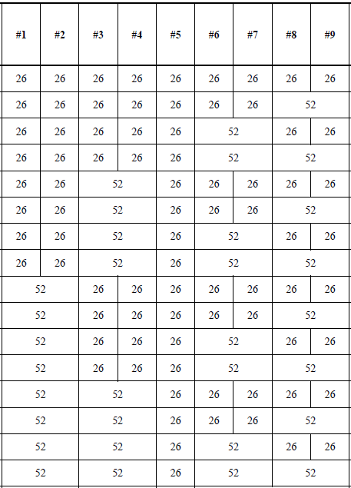
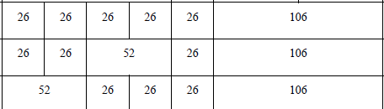
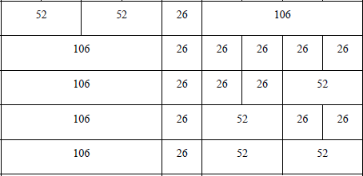

DRU Allocation and Searching Combinations
For BW40:
  total DRU allocation combinations: 25*25+2*25+1=676
25
25
Lower 20M
Upper 20M
25*25
DRU242
Upper 20M
25
Total 25 combinations for DRU on BW20
Lower 20M
DRU242
25
DRU242
DRU242
1
NOTE: this is NOT DRU physical location, it is logical index location for scheduling
Total DRU allocation combinations for BW80 is the same as BW40
Slide 6
Shengquan Hu, Mediatek Inc.

Slide 7
Global CSD Index Assignment Optimizations
The following factors are considered/evaluated/compared for the global CSD assignment design:
  the worst/maximum number of STAs share the same CSD value for Nss=1 & Nss=2;
  total number of collisions over all the DRU allocation combinations for both Nss=1 & 2
  individual total number of collisions for 1-STA (no collision), 2-STA, 3-STA, 4-STA, 5-STA share the same CSD value
  Structure of Global CSD index assignment with implementation friendly
Minimize the worst collision cases
Minimize the total number of collisions
Minimize the total number of a CSD value not used
Design global CSD index assignment table with better structure
Slide 7
Shengquan Hu, Mediatek Inc.

Slide 8
Optimized Global CSD Index Assignment
The optimized, DRU index based global CSD index assignment table is well structured, easy & implementation friendly for scheduling etc
DRU26 on BW20, DRU52 on BW40, DRU106 on BW80 shares similar index assignment
DRU26 on BW40 and DRU52 on BW80 shares the similar index assignment
DRU52 on BW20, DRU106 on BW40 and DRU242 on BW80 shares the same index assignment
DRU106 on BW20, DRU242 on BW40, and DRU484 on BW80 shares the same index assignment
Global CSD index for corresponded DRU Index
For DRU26
For DRU52
For DRU106
1 | 2 | 3 | 4 | 5 | 5 | 6 | 7 | 8
2 |  | 4 |  |  | 6 |  | 8
3 |  |  |  |  | 7
BW20
CSD index 3 for DRU106_1
CSD index 7 for DRU106_2
For DRU26
For DRU52
For DRU106
For DRU242
1 | 5 | 2 | 6 | 3 | 3 | 7 | 4 | 8 | 1 | 5 | 2 | 6 | 7 | 3 | 7 | 4 | 8
1 |  | 2 |  |  | 3 |  | 4 |  | 5 |  | 6 |  |  | 7 |  | 8
2 |  |  |  |  | 4 |  |  |  | 6 |  |  |  |  | 8
3 |  |  |  |  |  |  |  |  | 7
BW40
For DRU52
For DRU106
For DRU242
For DRU484
1 | 5 | 2 | 6 | 3 | 7 | 4 | 8 | 1 | 5 | 2 | 6 | 3 | 7 | 4 | 8
1 |  | 2 |  | 3 |  | 4 |  | 5 |  | 6 |  | 7 |  | 8
2 |  |  |  | 4 |  |  |  | 6 |  |  |  | 8
3 |  |  |  |  |  |  |  | 7
BW80
Slide 8
Shengquan Hu, Mediatek Inc.

Slide 9
CSD Starting Index Table for DRU STF Transmission
DRU size | Global CSD starting index for BW20
DRU26, i=1:9 | {1,2,3,4,5,5,6,7,8}
DRU52, i=1:4 | {2,4,6,8}
DRU106, i=1:2 | {3,7}
DRU size | Global CSD starting index for BW40
DRU26, i=1:18 | {1,5,2,6,3,3,7,4,8,1,5,2,6,7,3,7,4,8}
DRU52, i=1:8 | {1,2,3,4,5,6,7,8}
DRU106, i=1:4 | {2,4,6,8}
DRU242, i=1:2 | {3,7}
DRU size | Global CSD starting index for BW80
DRU52, i=1:16 | {1,5,2,6,3,7,4,8,1,5,2,6,3,7,4,8}
DRU106, i=1:8 | {1,2,3,4,5,6,7,8}
DRU242, i=1:4 | {2,4,6,8}
DRU484, i=1:2 | {3,7}
Slide 9
Shengquan Hu, Mediatek Inc.

Slide 10
Power Measurement Performance Evaluation and Comparison
Using the proposed DRU index based global CSD index assignment, DRU power measurement accuracy is comparable to RRU cases
(simulations are with the assumptions of random phases and random delay [-0.4 0.4]us for each STA PPDU transmissions)
Slide 10
Shengquan Hu, Mediatek Inc.

Slide 11
Power Measurement Performance Evaluation and Comparison
18 users with DRU26 & 2ss per user can be considered as the worst case, from the simulations, DRU index based global CSD index assignment method performs not worse than 16 users RRU MU-MIMO
(simulations are with the assumptions of random phases and random delay [-0.4 0.4]us for each STA PPDU transmissions)
Slide 11
Shengquan Hu, Mediatek Inc.

Slide 12
Global CSD Index Assignment with DRU Index Based vs Signaling Based
Another approach to assign global CSD index by dynamic signaling:
  Need extra 3 bits in User Info field in Trigger Frame
  Make AP scheduler more complicate with one more factor to consider
  Comparing to simple DRU index based CSD assignment method, signaling approach doesn’t offer any performance benefit
Slide 12
Shengquan Hu, Mediatek Inc.

Slide 13
Global CSD Index Assignment with DRU Index Based vs Signaling Based
Both methods achieve similar power measurement accuracy, BUT, DRU index based method doesn’t require extra signalling bits
DRU Index Based CSD assignment:
CSD start index={1, 2, 4, 5, 5, 6, 8}
dRU26 | 1 | 2 | 3 | 4 | 5 | 5 | 6 | 7 | 8
dRU52 | 2 |  | 4 |  |  | 6 |  | 8
dRU106 | 3 |  |  |  |  | 7
BW20
Signaling based dynamic CSD assignment:
CSD start index={1, 2, 3, 4, 5, 6, 7}
7 users: 5xdRU26+2xdRU52
(simulations are with the assumptions of random phases and random delay [-0.4 0.4]us for each STA PPDU transmissions)
Slide 13
Shengquan Hu, Mediatek Inc.

Slide 14
Power Measurement Performance Evaluation and Comparison
Both methods achieve similar power measurement accuracy, BUT, DRU index based method doesn’t require extra signalling bits
BW40
DRU Index Based CSD assignment:
1 | 5 | 2 | 6 | 3 | 3 | 7 | 4 | 8 | 1 | 2 | 3 | 4 | 6 | 5 | 6 | 7 | 8
1 |  | 2 |  |  | 3 |  | 4 |  | 5 |  | 6 |  |  | 7 |  | 8
2 |  |  |  |  | 4 |  |  |  | 6 |  |  |  |  | 8
3 |  |  |  |  |  |  |  |  | 7
dRU26
CSD start index={1, 2, 6, 3, 4, 5, 6, 6, 8}
dRU52
Signaling based dynamic CSD assignment:
dRU106
CSD start index={1, 2, 3, 4, 5, 6, 7, 8, 8}
dRU242
9 users: 4xdRU26+3xdRU52+2xdRU106
(simulations are with the assumptions of random phases and random delay [-0.4 0.4]us for each STA PPDU transmissions)
Slide 14
Shengquan Hu, Mediatek Inc.

Slide 15
Power Measurement Performance Evaluation and Comparison
Part-I of Ref [3] claims up to 5dB power measure accuracy gap for CSD allocation with & without collision for a case of two users, each with DRU52 & 1ss
  User-1:CSD [-400 -400]; User-2: CSD [0 -400]
Our simulations show that Ref [3]’s claim in part-I is NOT true
  Reason: unpractical assumption of perfect/ideal time & phase sync from different STA transmitter in [3] simulations
Our simulations
Simulations of Part-I in Ref [3]
random time error in range of [-0.4 0.4]us for each STA PPDU transmissions. Please refer to section of 11ax/be Spec for “Transmit requirements for PPDUs sent in response to a trigger frame”

Slide 16
Power Measurement Performance Evaluation and Comparison
Part-II of Ref [3] claims up to 3.4dB power measure accuracy gap for CSD allocation with & without optimization for a case of two users, each with DRU52 & 1ss
  User-1: CSD [-600 -650]; User-2: CSD [0 -400]
Our simulations show that Ref [3]’s claim in part-II is NOT true
  Reason: unpractical assumption of perfect/ideal time & phase sync from different STA transmitter in [3] simulations
Our simulations to clarify & compare
Part-I in Ref [3]
random time error in range of [-0.4 0.4]us for each STA PPDU transmissions. Please refer to section of 11ax/be Spec for “Transmit requirements for PPDUs sent in response to a trigger frame”

Slide 17
Summary
In this contribution, we proposed a simple DRU index based global CSD start index assignment method for DRU UHR-STF transmission:
  The global CSD index assignment is optimized from several perspectives such as minimizing total collisions, minimizing the worst case collisions, etc
  The global CSD start index assignment table is well structured, simple for implementation & scheduling
  The proposed method can achieve good power measurement performance
  NO extra signaling requirements

Slide 18
Reference
[1] 11-24-0752-02-00bn-stf-design-consideration-for-dru
[2] 11-24-0749-02-00bn-thoughts-on-stf-design-for-dru
[3] 11-24-1172-01-00bn-csd-indication-design

Slide 19
Straw Poll #1 (merged to SP#2)
Do you agree to include the following text to the 11bn SFD?
  DRU index based global CSD start index assignment will be used for DRU UHR-STF transmission
Slide 19
Shengquan Hu, Mediatek Inc.

Slide 20
Straw Poll #2
Do you agree to include the following text to the 11bn SFD?
  DRU index based global CSD start index assignment will be used for DRU UHR-STF transmission
  Global CSD start index assignment for DRU UHR-STF transmission will be based on the following table
DRU size | Global CSD starting index for Distribution BW 20MHz
DRU26, i=1:9 | {1,2,3,4,5,5,6,7,8}
DRU52, i=1:4 | {2,4,6,8}
DRU106, i=1:2 | {3,7}
DRU size | Global CSD starting index for Distribution BW 40MHz
DRU26, i=1:18 | {1,5,2,6,3,3,7,4,8,1,5,2,6,7,3,7,4,8}
DRU52, i=1:8 | {1,2,3,4,5,6,7,8}
DRU106, i=1:4 | {2,4,6,8}
DRU242, i=1:2 | {3,7}
DRU size | Global CSD starting index for Distribution BW 80MHz
DRU52, i=1:16 | {1,5,2,6,3,7,4,8,1,5,2,6,3,7,4,8}
DRU106, i=1:8 | {1,2,3,4,5,6,7,8}
DRU242, i=1:4 | {2,4,6,8}
DRU484, i=1:2 | {3,7}
Slide 20
Shengquan Hu, Mediatek Inc.

