Slide 1
Low latency, low collision, low power medium access—continued
Date: 2024-07-09
r0 (July 9, 2024): Initial version
r1 (Juy 18, 2024): Added appendix slide (slide 20), providing supporting details for example on slides 11-12

Slide 2
Abstract
A previous presentation [1] introduced the “chirp” as a method for UHR STAs:
to access the medium efficiently (quickly, and without collisions),
outside the scope of pre-scheduled agreements, and
to complete transmissions reliably (low or no loss due to interferers),
even at greatly reduced transmit power levels.
This follow-up presentation adds the following:
What the “chirp” is; why essentially all functionality is already in essentially all STAs
How it is related to but different from other proposals such as the “delay signal”
Numerical illustrations of the performance of future extensions using “chirps”
  Efficient zero-state device identification across BSSs
  Efficient and immediate assessment of Wi-Fi traffic across BSSs
A specific feature that could be added to the TGbn framework immediately
Straw polls

Slide 3
Review—UL medium access—I
Uplink medium access, without pre-negotiated schedule, basic issues:
STA1, low transmit power (say 0 dBm) transmits to 4 SS AP
Co-channel devices are also listening and competing
  Diverse group of devices, often listening with only 1 SS, and spatially scattered
  STA1 must hold all such devices off the air
AP2
AP1
STA1

Slide 4
Review—UL medium access—II
Uplink medium access, without pre-negotiated schedule, time view:
Interference is very likely if deployment is dense
STA1’s best case scenario requires reducing rate significantly to overcome interference
Other STAs suffer interference from STA1, and also usually have significantly reduced rate
STA1 may be unable to achieve any meaningful communication, even if otherwise within range
Not just a latency problem—it’s an interference, power, rate and connectivity problem as well
STA1 wins contention
Co-channel STAs process STA1’s preamble independently
Unless all such STAs defer, STA1’s transmission suffers interference
  Co-channel STAs are often 2 SS devices, listening with 1 SS
  Co-channel STAs distributed spatially, will receive STA1 at varying Rx powers, some low
AP
STA1
UL PPDU
AP1/STAn
Interferer
(“Indirect collision”)

Slide 5
Review—UL medium access—III
4+ μs signals (“chirps”) indicate interest in transmitting but do not seize the medium:
STA1
4+ μs
STA1 contends as usual in EDCA
Transmits in its normal slot
Transmits only 4+ μs part short training
Does not change any EDCA states
(Intended) AP gains medium access later
AP might then:
Poll some known high priority STAs, or
Utilize NFRP, or
Utilize UORA, or
Seek further information, or,
Do any of the above after a delay,
or some combination of the above, etc.
STAn
4+ μs
AP
Direct collision between “chirp” and a regular PPDU?
No worse than if STA1 sent full PPDU
Direct collision between multiple “chirps”?
Looks like a composite “chirp”; should be detectable
AP needs to identify STA(s) anyway
No direct collision?
Some STAs may defer; ≈ no worse than full PPDU case

Slide 6


Review—UL medium access—IV
Summary of PHY and MAC attributes:
Received power of STA transmissions can be very low
Rx power, AP detects 4+ μs AP decodes data from STA other STAs decode preamble
No new PHY functionality required—reuse of existing function
MAC
STA1
Enables unsolicited or unscheduled high reliability medium access by STAs
  … to send initial “device present” signal
No need to rely on APs to arrange polls, or for STAs to await polls
  Use only as needed—no overhead due to polls with no response
Multiple STAs can transmit in one slot
STA2
AP1
PHY
<
<
<
<

Slide 7
Chirp—I
Common attributes of chirp and Delay Signal (DS) [2], and the main difference
DS sets the NAV for legacy devices—so must be a full MAC frame, e.g., CTS [2, slide 5]
Chirp signals no duration, and so, in EDCA, does not set the NAV or seize the medium
DS does more, at the cost of being much longer (44μs for DS versus 4-6μs for chirp)
STA1
Commonality
STA1 and STA2, and maybe many others, may transmit simultaneously
To avoid loss due to collision, they must each send a common signal
Common signal should normally be perceived by others as a common signal in multipath
STA2
AP1
Difference

Slide 8
Chirp—II
The (basic) chirp is an “I’m here” signal—just enough to indicate STA is present
How much is “enough”?
4μs should be enough to signal presence of a STA, according to the spec …
  E.g., “… the start of a 20 MHz HT signal … shall cause the PHY to set PHY.CCA.indication(BUSY) with a probability > 90% within 4 μs”, 19.3.19.6.4, REVme D5.0 p. 3529
… but in any case, detection happens in 9μs in all (11g+) STAs
  ≤ 9μs − processing time − Rx-Tx turnaround time; required for STA to be Listen-Before-Talk
Chirp is (or starts with) whatever allows existing STAs to detect: say 4-6 μs
8μs
STS
8μs
LTFs
4μs
L-SIG
Other SIGs / Data
AP
9μs
9μs
9μs
STA1
UL PPDU
4μs
<
<

Slide 9
Coordinated medium access—I
Example use:
The building block can enable coordination across multiple BSSs:
① AP1 solicits “chirps”, range denotes BSS ② Chirp responses ③ AP1 allocates TxOPs
STA2 transmits directly to AP2—no STA2 data is ever decoded by AP1—only chirp
BSS1
STA1
time
STA2
→ AP2
AP1

Slide 10

Coordinated medium access—II
Illustrative numerical example:
Scenario
AP1 gains medium access, 5ms TxOP, and with no advance agreement, …
Wishes to solicit unscheduled UL traffic, across multiple BSSs
    Say, time-sharing between two (unknown) STAs: 1 in BSS1, 1 outside
    100 STAs in BSS1, 1000 in other BSSs
    Eventual collision probability < 1% each
All STAs can hear AP1, but might not hear each other
  AP1 can detect STAs outside BSS1 for purposes of deferral only; no data
  Assume 5μs chirp slots (4μs + 1μs gap)
  Assume average 50μs for control PPDUs
AP2
AP3
AP1
AP4

Slide 11


Coordinated medium access—III
Numerical example, contd.:
① BSS1: choose slot in (1..100), transmit if in (1..10); other BSSs: (1..1000), (11..20) ③ (For specified slots in ②) BSS1: choose slot in (1..10); others: choose slot in (11..20); ⑤ (For specified slots in ④) same as 3.
BSS1
BSS1
BSS1
STA1
time
STA2
→ AP2
AP1
(Cf. slide 20)

Slide 12
Coordinated medium access—IV
Duration: 498μs
60 mini-slots @ 5μs each, including gap = 300μs
3 control frames + SIFS @ 50μs + 16μs each = 198μs
Collision probability < 1%:
Slots in ② have exactly r STAs with probability ≈ (1−1/n)^{n} / r! ≈ e⁻¹ / r!
I.e., r = 0, 1, 2, 3, 4 have probabilities ≈ 0.37, 0.37, 0.18, 0.06, 0.02, …, etc.
Slots selected by ③ have at least one STA, so probability ≈ (e⁻¹ / (1 − e⁻¹ )) / r!
I.e., r = 1, 2, 3, 4 have probabilities ≈ 0.58, 0.29, 0.10, 0.02, 0.005, etc.
After ④ and ⑥, probabilities of collision are 0, ≈ 0.0029, ≈ 0.0015, etc.
  I.e., probability that r = 2 and there is a collision after ⑥ ≈ 0.0029, etc.
  Each stage after the first reduces collision probability by factor of 10 for r = 2
Sum ≈ 0.0045
(Cf. slide 20)

Slide 13
Channel state information—I
Example: assessing UL traffic levels
Scenario
AP1 wishes to assess the instantaneous number of STAs seeking to access the medium for UL traffic (not necessarily UL to AP1)
There is again no advance agreement
All STAs can hear AP1, but might not hear each other
  AP1 can detect STAs outside BSS1 for purposes of deferral only; no data
  Assume 5μs chirp slots (4μs + 1μs gap)
  Assume average 50μs for control PPDUs
AP2
AP3
AP1
AP4

Slide 14
Channel state information—II
Assessing UL traffic levels, contd.:
① AP1 solicits chirps; STAs to choose chirp slot in range (1 .. N), transmit if in slots (1 .. S)
② STAs transmit
STA1
STA2
AP1 can estimate # STAs from number of empty chirp slots
E.g., N responding STAs would result in fraction ≈ 1/e ≈ 0.37 of the chirp slots empty, on average
Could be restricted to subset of STAs
E.g., STAs in tail latency state, etc.
AP1

Slide 15
Basic chirp operation in EDCA
A mode requiring essentially no spec work:
STA1 contends as usual in EDCA
Transmits in its normal slot
Transmits only 4+ μs part short training
  Does not change EDCA states
(Intended) AP gains medium access later
Required functionality for AP?
(AP response could be optional)
If supported, AP that receives a chirp in an otherwise idle channel, with no pending BSS traffic, shall issue a poll within xx ms
  “Poll” can be any of several options
This is enough to show that the AP can detect a chirp
STA1
4+ μs
STAn
4+ μs
AP
Chirps are detectable but signal no duration
We cannot rely on legacy devices deferring
(Cf. [3], which takes another approach)
Easiest to treat chirp in EDCA as informational
A basic “I’m here” signal that requests a poll
AP(s) can then poll as needed (on request)
  Instead of (each) AP having to poll regularly

Slide 16
Straw polls
SP 1:
Do you support adding in TGbn one or more short common signals?
NOTE: Such short common signals might be used for several purposes, including collision reduction, non-AP STAs with UL traffic soliciting triggers, and others
SP 2:
Do you support adding in TGbn one or more short common signals (enough for legacy 11g+ STAs to detect) that may be sent in EDCA whenever a STA may send a PPDU?
NOTE: Normative requirements on TGbn STAs receiving such short common signals TBD
SP 3:
Do you support adding in TGbn a short common signal (enough for legacy 11g+ STAs to detect) that may be sent in EDCA whenever a STA may send a PPDU, fitting within one slot, and not requiring TGbn STAs to defer?

Slide 17
Conclusion
A framework has been outlined that allows STAs:
to access the medium efficiently (quickly, and without collisions),
outside the scope of pre-scheduled agreements, and
to complete transmissions reliably (low or no loss due to interferers),
even at greatly reduced transmit power levels.
using adaptations of the most basic and well-proven IEEE 802.11 channel access and detection methods.
Essentially no specification development work or interoperability testing should be required for the most basic version.
The framework is highly flexible and can be extended in multiple directions.
In addition to the fundamental usefulness of these goals, they fit the theme of ultra-high reliability.

Slide 18
References
Doc. IEEE 802.11-24/0284r2, “Low latency, low collision, low power UHR medium access”, S. Coffey et al.
Doc. IEEE 802.11-24/0840r0, “Low latency channel access”, D. Akhmetov et al.
Doc. IEEE 802.11-24/0773r0, “CSMA with enhanced collision avoidance”, S. Schelstraete et al.
Doc. IEEE 802.11-23/1192r0, “Overlapped indication to support preemption”, D. Verenzuela et al.
Doc. IEEE 802.11-23/1229r1, “Preemption for Low Latency Application (follow up)”, J. Fang et al.
Doc. IEEE 802.11-23/1242r0, “Considerations on Inter-PPDU based Preemption Scheme”, J. Moon et al.
Doc. IEEE 802.11-23/1886r3, “Preemption techniques to meet low-latency (LL) targets”, G. Chisci et al.
Doc. IEEE 802.11-24/0102r0, “TXOP Level Preemption for Low Latency Application”, J. Fang et al.

Slide 19
APPENDIX I—“UHR in one sentence”
What is “UHR”, in one sentence?
Tying idealized goals to concrete layer 1-2 IEEE 802.11 elements will promote successful deployment and accelerate adoption of the eventual Wi-Fi program.
Better still: having goals, methods, and solutions that are capable of being measured and demonstrated.
“UHR achieves ultra-high reliability by minimizing or eliminating collisions and tightly managing interference, achieving (… among others …) minimum latency and maximum energy efficiency.”
The framework outlined here fits the theme of ultra-high reliability and links the theme to tangible elements of basic IEEE 802.11 design.

Slide 20
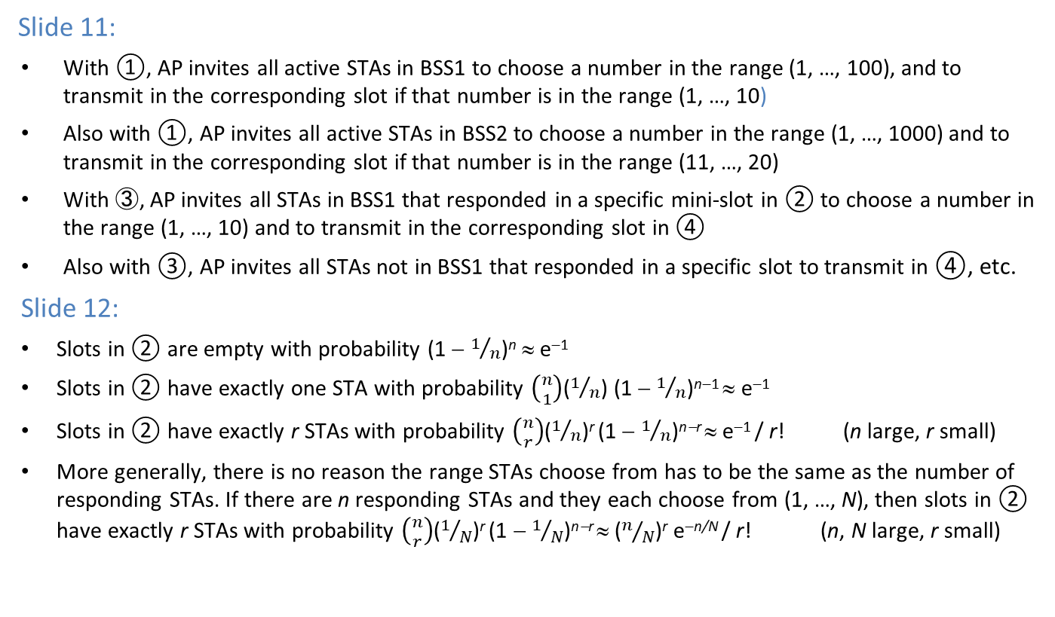
APPENDIX II—Coordinated medium access
Slide 11:
With ①, AP invites all active STAs in BSS1 to choose a number in the range (1, …, 100), and to transmit in the corresponding slot if that number is in the range (1, …, 10)
Also with ①, AP invites all active STAs in BSS2 to choose a number in the range (1, …, 1000) and to transmit in the corresponding slot if that number is in the range (11, …, 20)
With ③, AP invites all STAs in BSS1 that responded in a specific mini-slot in ② to choose a number in the range (1, …, 10) and to transmit in the corresponding slot in ④
Also with ③, AP invites all STAs not in BSS1 that responded in a specific slot to transmit in ④, etc.
Slide 12:
Slots in ② are empty with probability (1 − $1/n$)^{n} ≈ e⁻¹
Slots in ② have exactly one STA with probability $\left({n \atop 1}\right)$($1/n$) (1 − $1/n$)^{n−1} ≈ e⁻¹
Slots in ② have exactly r STAs with probability $\left({n \atop r}\right)$($1/n$)^{r} (1 − $1/n$)^{n−r} ≈ e⁻¹ / r! (n large, r small)
More generally, there is no reason the range STAs choose from has to be the same as the number of responding STAs. If there are n responding STAs and they each choose from (1, …, N), then slots in ② have exactly r STAs with probability $\left({n \atop r}\right)$($1/N$)^{r} (1 − $1/N$)^{n−r} ≈ ($n/N$)^{r} e^{−n/N} / r! (n, N large, r small)

