Slide 1
Trigger frame expansion
Date: 2024-07-27
Authors:

Slide 2
Abstract
This document proposes mechanism for expansion of the Common Info and User Info fields of Trigger frames, for carrying additional information.

Slide 3
Usage of Trigger frames in UHR
Trigger frames are anticipated to be used extensively in 802.11bn.
Several proposals have proposed the use of trigger frames for:
  Multi-AP coordination for obtaining cross-BSS CSI, buffer status, resource allocation etc [1-4].
  Coexistence Indication [5,10]
  Initiating switch to higher capability state in DPS operation [6-7]
  Initiating DSO sub-band switch. [8-9]
  Initiating transmission on backup primary channel in NPCA [10]
The focus has mainly been on the following types of trigger frames: MU-RTS, MU-RTS TXS, BSRP, BQRP and BFRP.
  Existing Trigger frame versions proposed to be re-used to maintain backward compatibility.
Understandably, for enabling such new features, several additional fields will need to be defined for both the Common Info and User Info fields of Trigger frames in 802.11bn.

Slide 4
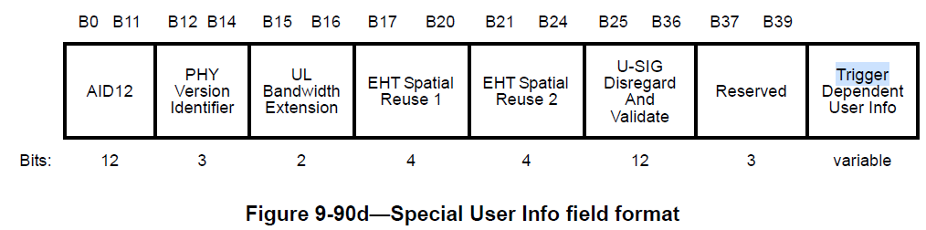
Issues with Common Info field
Too few reserved bits remaining:
For many Trigger frame variants (except for MU-RTS and MU-RTS TXS) there are too few reserved bits remaining in the Common Info field.
  Note: B22, B26, B53, B63, B56–B62 in EHT variant are reserved for backward compatibility.
In 802.11be, a new Special User Info field (AID12=2007) was proposed for expansion of EHT variant Common Info, but also has only 3 reserved bits remaining.
Common Info variant indication is complex:
Current indication mechanism is not easy to expand to new Common Info variants. (similar issue to PPDU version identification)
Common Info B54 | Common Info B55 | Non-AP STA type | Common Info Interpretation
Any | Any | HE | HE
1 | 1 | EHT | HE
Any | 0 | EHT | EHT

Slide 5
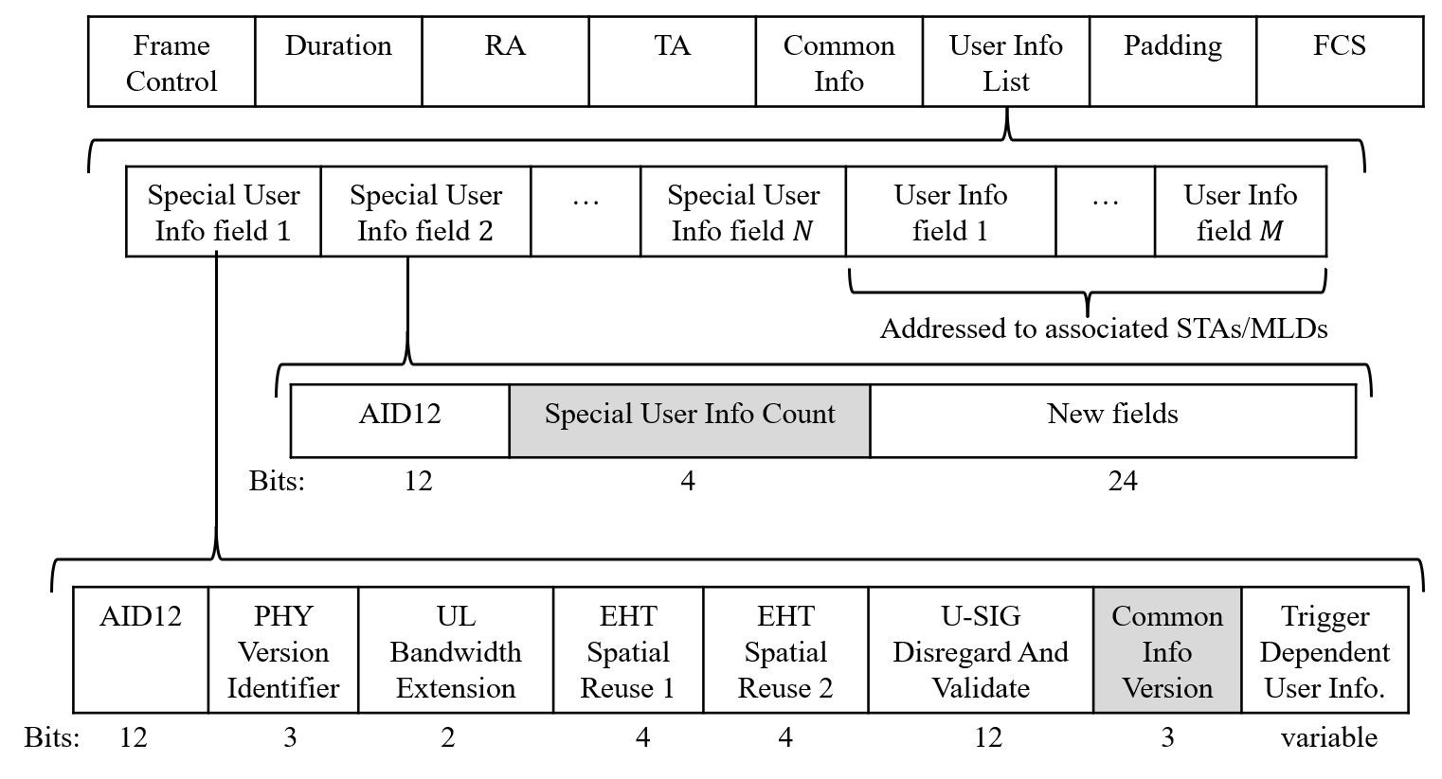
Proposals for Common Info field
Use last 3 remaining bits in Special User Info field (AID12=2007) to indicate Common Info Version (e.g. EHT, UHR, …). Similar idea as PHY Version Identifier in U-SIG.
  HE/EHT STAs shall interpret UHR Common Info field as the HE/EHT Common Info field.
Additional common information can be carried in “follow up” Special User Info fields.
  These fields can carry same AID12=2007 or can be assigned new AID12s (> 2007).
  There can be a unique mapping from Common Info Version to number of Special User Info fields. Alternatively, a Special User Info Count field or Special User Info Control field can be included to indicate number of Special User Info fields present.
Additional common information carried here

Slide 6
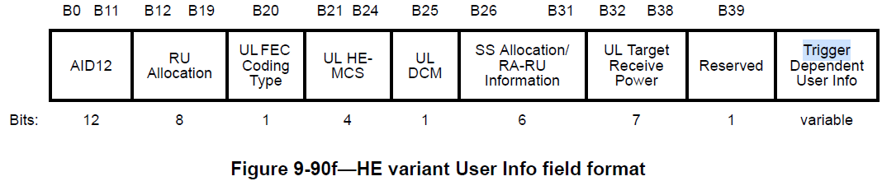
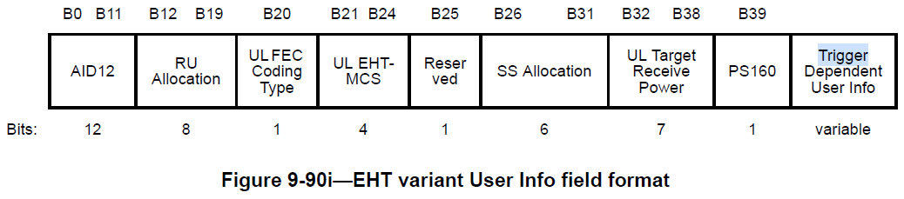
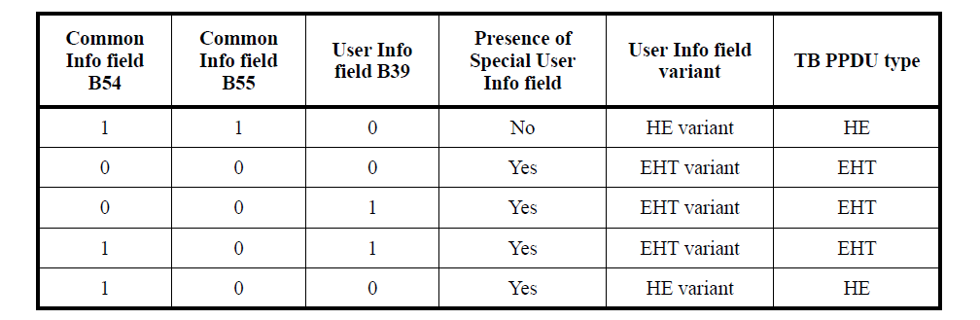
Issues with User Info field
Too few reserved bits remaining:
For many Trigger frame variants (except for MU-RTS and MU-RTS TXS) there are too few reserved bits remaining in the User Info field.
User Info variant indication is complex:
Current indication mechanism is not easy to expand to new User Info variants.

Slide 7
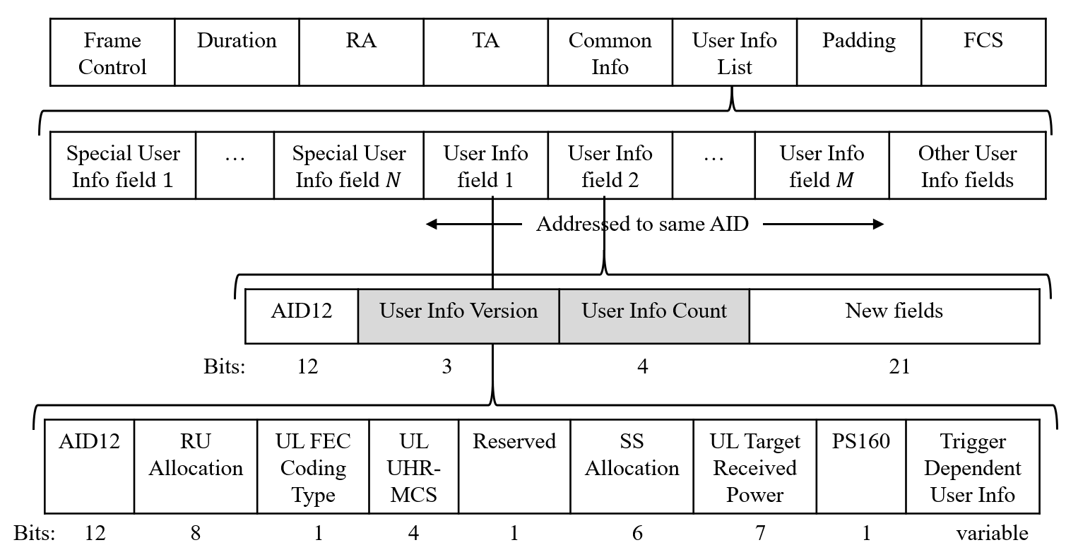
Proposals for User Info field
Additional user-specific information can be carried in “follow-up” User Info fields.
  All User Info fields for a STA shall carry same AID12 (determined by the recipient STAs AID).
  User Info Version field can be used to determine the version of the User Info field.
  There can be a unique mapping from User Info Version to the number of follow-up User Info fields. Alternatively, a User Info Count field can be included to indicate number of User Info fields present for a non-AP STA.
Additional user-specific information carried here

Slide 8
Conclusion
Trigger frames will play a critical role in many new features to be defined in 802.11bn.
Most trigger frame versions have too few reserved fields for carrying additional indications required to support such a diverse set of features.
The current mechanism for indicating the version of Common Info and User Info fields is also not amenable for expansion.
Proposal 1: Follow up Special User Info fields (with AID12=2007 or new) can be used to carry additional common information and also indicate the Common Info version.
Proposal 2: Follow up User Info fields (with same AID12) can be used to carry additional user specific information and also indicate User Info version.

Slide 9
References
11-24-0512-00-00bn-considerations-for-coordinated-tdma.pptx
11-24-0639-01-00bn-mac-protocol-aspects-of-multi-ap-coordination.pptx
11-24-0716-04-00bn-buffer-status-report-in-multi-ap-follow-up.pptx
11-24-1092-00-00bn-multi-ap-coordinated-concurrent-transmission-protocol.pptx
11-24-1221-01-00bn-icf-icr-follow-up.pptx
11-24-0451-00-00bn-ap-state-transitions-in-dps-mode.pptx
11-24-1126-01-00bn-icf-icr-discussion-for-dps.pptx
11-24-0299-01-00bn-initial-ctrl-frame-for-bw-switching-modes.pptx
11-24-0517-00-00bn-preallocation-of-subband-for-dso-follow-up.pptx
11-24-0504-01-00bn-considerations-of-a-unified-initial-control-frame-design.pptx

Slide 10
Straw polls
SP 1: Do you agree to define mechanisms in 802.11bn for expanding the size of the fields for indicating common information and user-specific information in Trigger frames?
  Yes
  No
  Abstain

Slide 11
Straw polls
SP 2: Do you agree to define mechanisms in 802.11bn for indicating the UHR (and beyond) versions of the Common Info and User Info fields in Trigger frames?
  Yes
  No
  Abstain

Slide 12
Backup slides

