Slide 1
Additional Results for Multi-Layer Transmission
Date: 2024-07-11
Authors:

Slide 2
Outline
Brief recap of the Multi-Layer idea, motivation and principle
Additional simulations for various MCSs
Conclusions

Slide 3
Motivation
Although an increase in maximum data rate may be nice, what is believed to be more important is if a significant improvement in reliability could be achieved
The name UHR suggests high reliability would be high on the agenda and the PAR [1] states “Cutting-edge applications offer a wide range of digitally enhanced worlds, realities, and business models that have the potential to revolutionize both personal and enterprise activities in the next decade. These applications require large throughput combined with reduced and predictable worst-case delay and jitter, high reliability, and improved power efficiency.”
The reduced and predictable delay is partially addressed by improved channel access mechanisms, e.g., preemption. However, it typically (implicitly) assumes reliability since if one or more retransmissions are needed, the delay may neither be reduced nor be predictable

Slide 4
Challenges related to achieving high reliability
Achieving Ultra High Reliability is typically not enough, the reliability must be achieved with low latency for the data to be useful
  Relying on retransmissions may not be attractive and may not even be an option for certain applications
In 3GPP this is addressed by URLLC/HRLLC, targeting mission-critical applications such as factory automation, autonomous driving, and virtual/augmented reality
  UHR seems to pretty much target similar use-cases
Operation in license-exempt bands adds yet another challenge
  In licensed bands, the main issue is channel variations (fading) faced by the desired signal
  In license-exempt bands, the major cause for receiver condition variations may instead be interference
The obvious approach to get higher reliability is to reduce the MCS
  This is OK if the data comes relatively seldom, but for “continuous” data high reliability then results in that the spectrum efficiency becomes very low
  The trade-off between reliability and high data rate is of course not new

Slide 5
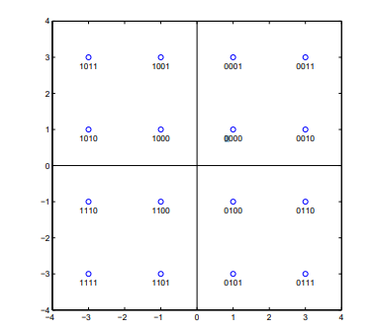













































Multi-layer transmission revisited
Data
Data
Preamble
OFDM Symbols
Preamble
OFDM Symbols
10
00
10
00
11
01
11
01
The idea is to send a number of codewords in parallel, with different robustness, and decode as many as the channel conditions allow for [2]
Compared to the standard “single layer” approach, several layers with different reliabilities are used

Slide 6
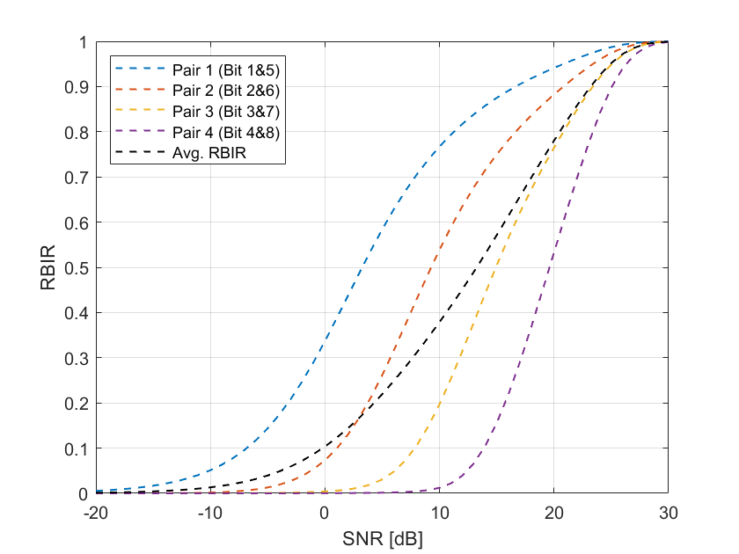
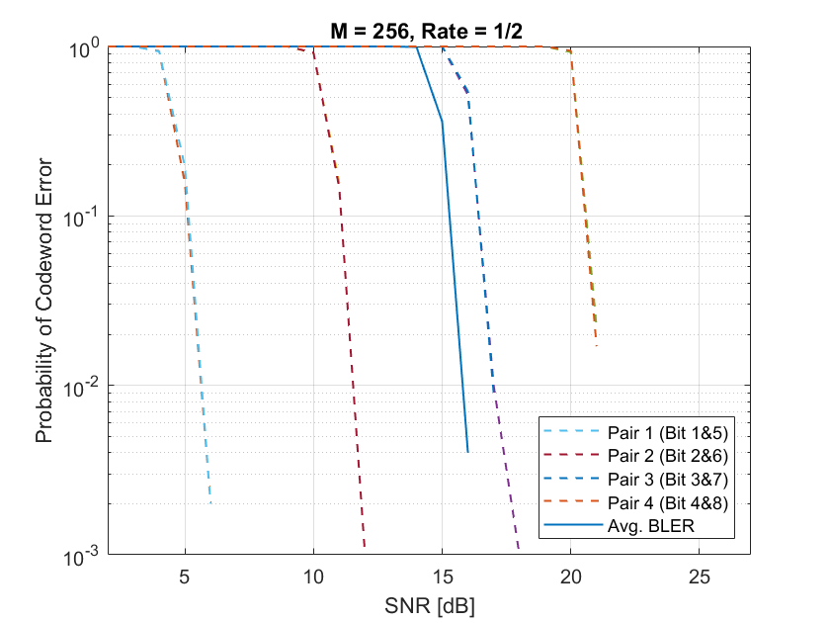
Multi-layer transmission revisited
M = 256, Rate = 1/2
In [3], the gains by using multi-layer transmission and/or HARQ were considered by means of system level simulations
Multi-layer transmission was found more effective than HARQ, and if combined even better performance was obtained

Slide 7
Numerical results: Assumptions
In [4], the simulation results were only for the (1944, 972) LDPC code
Here the corresponding simulations are shown for MCS5-MCS13
To more easily appreciate the basic idea, the simulations are deliberately done for simple conditions
AWGN channel
  Perfect channel knowledge at the receiver, no frequency offset, etc.
  No interleaving included
The results are consistent with what was presented in [4]
  Layer 1 uses one of the most reliable bits in the constellation map for a given modulation
  Layer 2 uses the remaining bits
  The larger the modulation order, the larger the difference in robustness for the layers

Slide 8
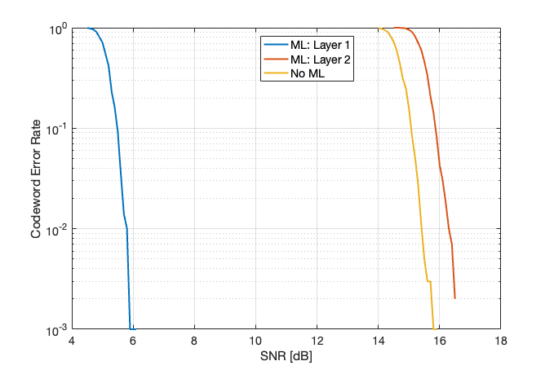
Multi-layer transmission for high reliability [4]
Now, suppose the goal is to replace (enhance) the single layer transmission with a two-layer transmission with the same total data rate, but which has one layer with significantly improved reliability
The natural choice to achieve this is as follows:
  Layer 1 uses only bit 1
  Layer 2 uses bits 2+3+4+5+6+7+8
The result is:
  An increased robustness of roughly 10 dB for Layer 1
  A loss of less than 1 dB for Layer 2

Slide 9
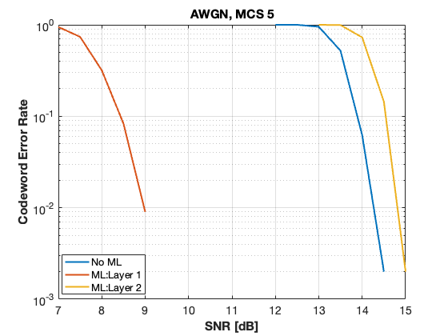
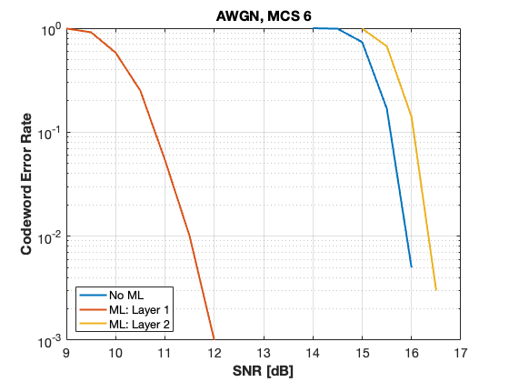
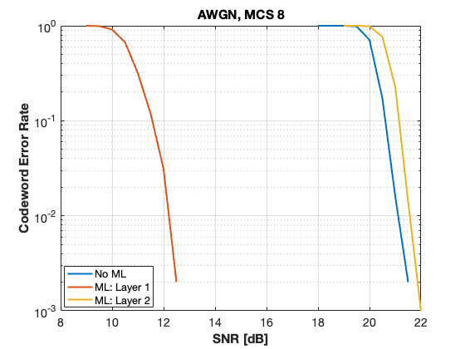
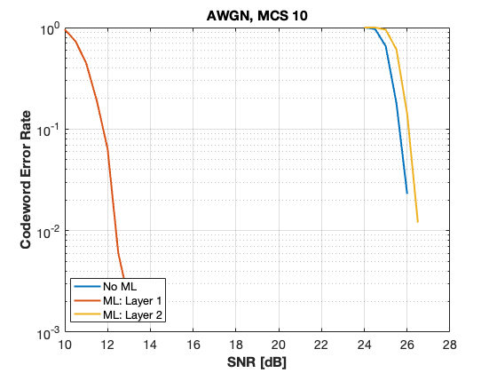
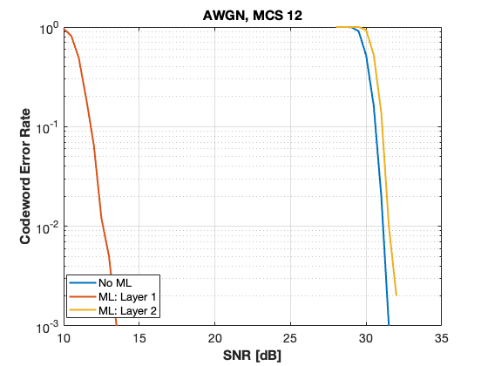
For the same code rate (3/4),
the performance for layer 1
is largely independent of the
modulation

Slide 10
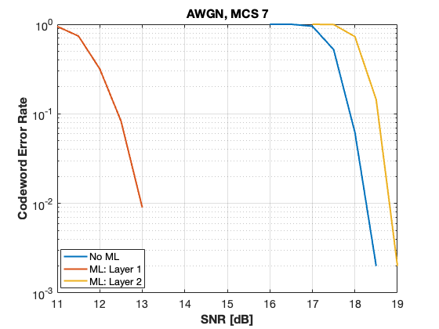
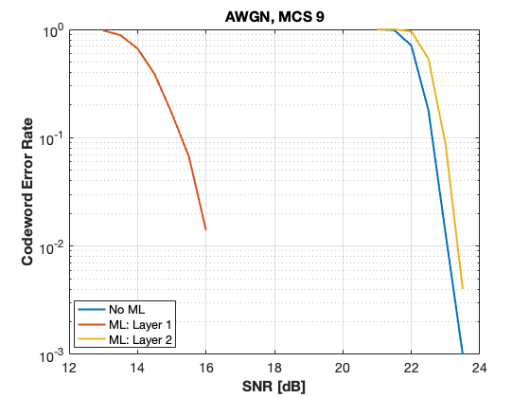
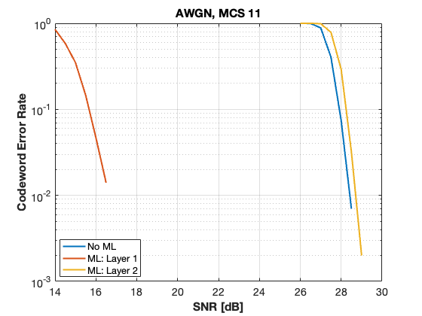
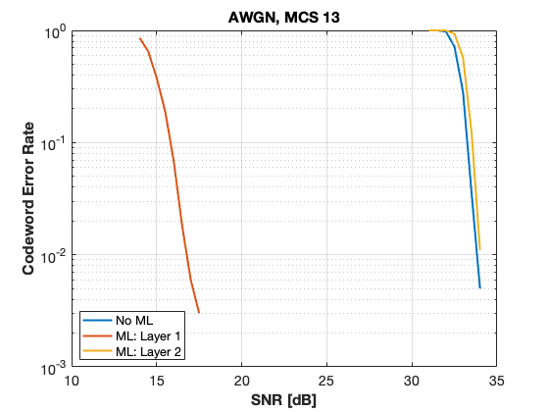
Performance for r = 5/6

Slide 11
Conclusions
It is expected that some highly relevant use cases for UHR would benefit from (or even require) some of the bits to be delivered with high reliability and low latency
An approach for achieving this is proposed, where the overall data rate is kept the same and the performance loss for the remaining bits is small
The approach can be implemented with a single encoder/decoder, with proper buffering

Slide 12
Straw Poll 1
Do you believe IEEE 802.11bn should consider multi-layer transmission as described in this presentation as a means to enhance the reliability?

Slide 13
References
https://mentor.ieee.org/802.11/dcn/23/11-23-1252-04-0uhr-802-11bn-revised-par.docx
https://mentor.ieee.org/802.11/dcn/19/11-19-1133-00-00be-some-results-on-harq-performance-in-dense-deployments.ppt
https://mentor.ieee.org/802.11/dcn/19/11-19-1858-01-00be-harq-system-level-simulation-results.pptx
https://mentor.ieee.org/802.11/dcn/24/11-24-0435-00-00bn-ideas-related-to-achieving-ultra-high-reliability.pptx

