Slide 1
Enhanced DRU Utilization in 40MHz and 80MHz Distributed Bandwidth
Date: 2024-07
Authors:
Name | Affiliation | Address | Phone | Email
Chenchen Liu | Huawei Technologies Co., Ltd | Huawei Base, Bantian, Shenzhen |  | liuchenchen1@huawei.com
Jian Yu
Zhi Mao

Slide 2
Introduction
In each 20MHz sub-channel of the RRU scenario, there exist a 26-tone middle RRU
Those 26-tone mid RRUs cannot be combined to form larger size RRUs, since there are not collocated
In the DRU scenario, tones of each RU are uniformly distributed across the full distributed BW, which enable the combination of middle 26-tone DRU to form larger extra DRUs

Slide 3
Extra DRU in 40 MHz DBW
In a 40 MHz PPDU, if tones of a DRU are distributed evenly, then
  The tone separation distance of a 26-tone DRU is 18
  The tone separation distance of a 52-tone DRU is 9
Based on that observation, there can be at most nine 52-tone DRUs in a 40 MHz PPDU.
  Eight of them follow the same indexing as RRUs, and
  The extra 52-tone DRU should be allocated a new DRU index.
The extra 9th 52-tone DRU can be formed by combining 26-tone DRU 5 and 14[2]
Updated DRU logical structure in 40 MHz PPDU
26-tone dRU | 1 | 2 | 3 | 4 | 5 | 6 | 7 | 8 | 9 | 10 | 11 | 12 | 13 | 14 | 15 | 16 | 17 | 18
52-tone dRU | 1 |  | 2 |  | 9p1 | 3 |  | 4 |  | 5 |  | 6 |  | 9p2 | 7 |  | 8
106-tone dRU | 1 |  |  |  | / | 2 |  |  |  | 3 |  |  |  | / | 4
242-tone dRU | 1 |  |  |  |  |  |  |  |  | 2
484-tone dRU | 1
Based on the tone plan in [1], the tone indices of the 52-tone DRU 9 are: [-234:9:-9, 18:9:243]
The 9th 52-tone DRU have exactly the same power boost gain and relative tone indices as other 52-tone DRUs in 40 MHz PPDU.

Slide 4
Extra DRUs in 80 MHz DBW
In an 80 MHz PPDU,
The first extra 17th 52-tone DRU can be formed by combining 26-tone DRU 5 and 14.
The second extra 18th 52-tone DRU can be formed by combining 26-tone DRU 24 and 33.
The extra (9th) 106-tone DRU can be formed by combining 52-tone DRU 17, 18 and 2 extra tones.
Updated DRU logical structure in 40 MHz PPDU
26-tone dRU | 1 | 2 | 3 | 4 | 5 | 6 | 7 | 8 | 9 | 10 | 11 | 12 | 13 | 14 | 15 | 16 | 17 | 18 | 19 | 20 | 21 | 22 | 23 | 24 | 25 | 26 | 27 | 28 | 29 | 30 | 31 | 32 | 33 | 34 | 35 | 36 | 37
52-tone dRU | 1 |  | 2 |  | 17 | 3 |  | 4 |  | 5 |  | 6 |  | 17 | 7 |  | 8 |  | / | 9 |  | 10 |  | 18 | 11 |  | 12 |  | 13 |  | 14 |  | 18 | 15 |  | 16
106-tone dRU | 1 |  |  |  | 9 | 2 |  |  |  | 3 |  |  |  | 9 | 4 |  |  |  |  | 5 |  |  |  | 9 | 6 |  |  |  | 7 |  |  |  | 9 | 8
242-tone dRU | 1 |  |  |  |  |  |  |  |  | 2 |  |  |  |  |  |  |  |  |  | 3 |  |  |  |  |  |  |  |  | 4
484-tone dRU | 1 |  |  |  |  |  |  |  |  |  |  |  |  |  |  |  |  |  |  | 2
996-tone dRU | 1
The power boost gain and relative tone indices depends on the detailed tone plan

Slide 5
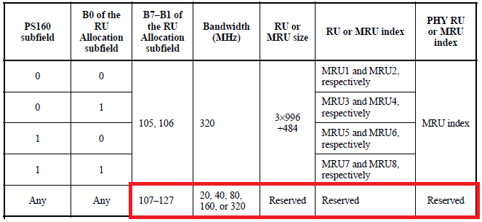
Signaling of Extra DRUs
There are more than 20 reserved entries for the RU Allocation subfield, which can be used to signal the extra DRUs
Alternatively, the MRU entries can be reinterpreted to signal the extra DRUs

Slide 6
Summary
Extra DRUs can be defined to enhance spectrum efficiency in both 40MHz and 80MHz distributed bandwidths to improving Spectrum Efficiency with simple implementation of signaling
The introduction of extra DRUs is a valuable addition to DRU transmission considering its enhanced spectrum efficiency and straightforward signaling .

Slide 7
References
[1] 11-24-0468-01-00bn-dru-tone-plan-for-11bn
[2] 11-24-0790-00-00bn-extra-drus-construction

Slide 8
SP1
Do you agree to include the following into the 11bn SFD?
  The UHR shall define the 9th 52-tone DRU for the 40MHz distributed bandwidth .
    The detailed tone indices are TBD

Slide 9
SP2
Do you agree to include the following into the 11bn SFD?
  The UHR shall define the 17th 52-tone DRU, 18th 52-tone DRU and the 9th 106-tone DRU for the 80MHz distributed bandwidth
    The detailed tone indices are TBD

