Slide 1
CSD Indication Design
Date: 2024-07-11
Authors:
Name | Affiliations | Address | Phone | Email
Bo Gong | Huawei |  |  | gongbo8@huawei.com
Jian Yu (Ross) |  |  |  | ross.yujian@huawei.com
Ming Gan |  |  |  | ming.gan@huawei.com

Slide 2
Background
July 2024
In [1], several motions related to STF transmission for DRU have been passed. They illustrate global CSD is applied in each distribution bandwidth to prevent unintentional beamforming.
In [2], it is suggested that global CSD provides CSD start index i for each DRU. If Nss for this DRU is larger than 1, then it will use CSD[mod(i: i+Nss-1, 8)] for each spatial stream.
In this proposal, we suggest that CSDs for each user are allocated by AP and the CSD start index for each user is indicated in the User Info field of the trigger frame.

Slide 3
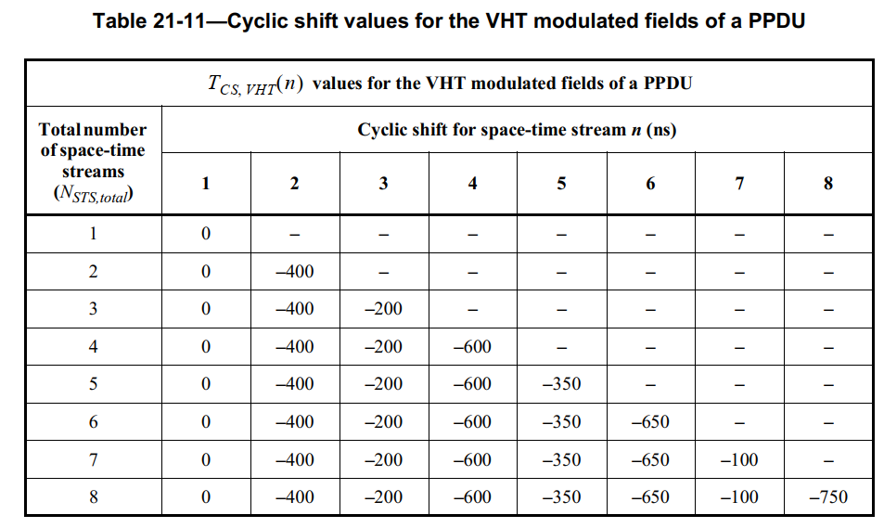
Advantages of Allocating CSDs by AP
July 2024
There exists two direct ideas about CSD allocation. The one is fixing a CSD start index to a RU index or AID12. The other one is allocating CSDs by AP and indicating the start CSD index in User Info field of the trigger frame.
Since DRU selection is up to scheduling algorithms and affected by many factors, such as transmission range, pilot channel and so on, any DRUs combination is possible to be triggered. Based on such consideration, it can be expected that allocating CSDs by AP achieves better AGC performance. The reason is that allocating CSDs by AP guarantees minimum collision and optimized CSD allocation. Here we assume AP allocates CSDs as the current CSD allocation corresponding to Nss.
Minimum collision
It can be verified that if the same CSD is allocated to two users, referred to as collision, the power gap between STF and Data will increase obviously.
Optimized CSD allocation
It can be verified that different CSD allocations correspond to different power gap between STF and Data. Taking Nss = 2 as an example, CSD values of [0, -400ns] brings smaller power gap between STF and Data than [-600ns, -650ns].

Slide 4
Simulation Results: Part I
July 2024
In part I, we compare the performance for CSD Allocation with and without collision.
80MHz, 52-tone DRU, 2 users with 1ss per user, Channel D, SNR=30dB
80MHz, 52-tone DRU, 3 users with 1ss per user, Channel D, SNR=30dB
Observation:
For 2 users with CSD collision, the power gap range is [-3.5, 2]dB;
For 2 users without CSD collision, the power gap range is [-0.2, 0.4]dB;
For 2 users if CSD collision is avoided, the power gap range is reduced by 5dB.
Observation:
For 3 users with CSD collision, the power gap range is [-2.1, 1.6]dB;
For 3 users without CSD collision, the power gap range is [-0.4, 0.3]dB;
For 3 users, if CSD collision is avoided, the power gap range is reduced by 3dB.

Slide 5
July 2024
Simulation Results: Part I
80MHz, 52-tone DRU, 4 users with 1ss per user, Channel D, SNR=30dB
Observation:
For 4 users with CSD collision, the power gap range is [-1.6, 1.4]dB;
For 4 users without CSD collision, the power gap range is [-0.6, 0.4]dB;
For 4 users, if CSD collision is avoided, the power gap range is reduced by 2dB.

Slide 6
July 2024
Simulation Results: Part II
In part II, we compare the performance for non-optimized and optimized CSD allocation.
80MHz, 52-tone DRU, 2 users with 1ss per user, Channel D, SNR=30dB
Observation:
For 2 users with non-optimized CSD allocation [-600, -650]ns , the power gap range is [-2.5, 1.5]dB;
For 2 users with optimized CSD allocation [0 -400]ns, the power gap range is [-0.2, 0.4]dB;
For 2 users with optimized CSD allocation, the power gap range is reduced by 3.4dB.

Slide 7
July 2024
Simulation Results: Part II
80MHz, 52-tone DRU, 3 users with 1ss per user, Channel D, SNR=30dB
Observation:
For 3 users with non-optimized CSD allocation [-600, -350, -650]ns , the power gap range is [-1.7, 1.2]dB;
For 3 users with non-optimal CSD allocation [-600, -650, -750]ns , the power gap range is [-1.8, 1.3]dB;
For 3 users with optimized CSD allocation [0 -400 -200]ns, the power gap range is [-0.4, 0.3]dB;
For 3 users with optimal CSD allocation, the power gap range is reduced by 2.3dB.

Slide 8
July 2024
Simulation Results: Part II
80MHz, 52-tone DRU, 4 users with 1ss per user, Channel D, SNR=30dB
Observation:
For 4 users with non-optimized CSD allocation [-600, -350, -650, -100]ns , the power gap range is [-1.3, 0.9]dB;
For 4 users with non-optimized CSD allocation [-600, -650, -400, -350]ns , the power gap range is [-1.7, 1.1]dB;
For 4 users with optimized CSD allocation [0 -400 -200 -600]ns, the power gap range is [-0.6, 0.4]dB;
For 3 users with optimized CSD allocation, the power gap range is reduced by 1.2~1.8dB.

Slide 9
Summary
July 2024
In this proposal, we suggest that CSDs for each user are allocated by AP and indicated in the User Info field of the trigger frame. In addition, we verify that CSDs allocated by AP achieves better AGC performance.

Slide 10
SP 1
July 2024
Do you agree to add the following text to the TGbn SFD?
In DRU transmission, the CSD start index for each user is indicated in the user info field.

Slide 11
References
July 2024
[1] 11-24-0209-02-00bn-specification-framework-for-tgbn
[2] 11-24-0752-02-00bn-stf-design-consideration-for-dru

