Slide 1
Uplink MU MIMO Precoding – Precoder Message Format
Date: 08-July-24

Slide 2
Introduction
[1, 2] presented uplink MU MIMO precoding for uplink rate and reliability improvement
[3] proposes triggered uplink precoding/beamforming for 802.11bn
This contribution
  Feedback format details
  Evaluation of quantization loss

Slide 3
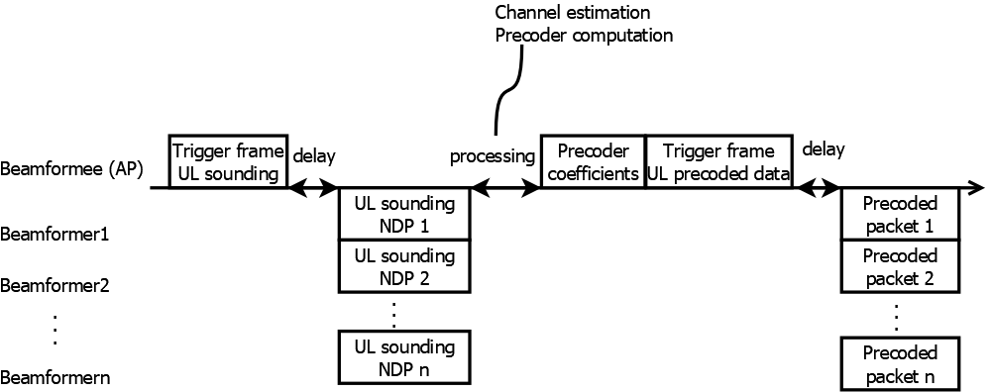
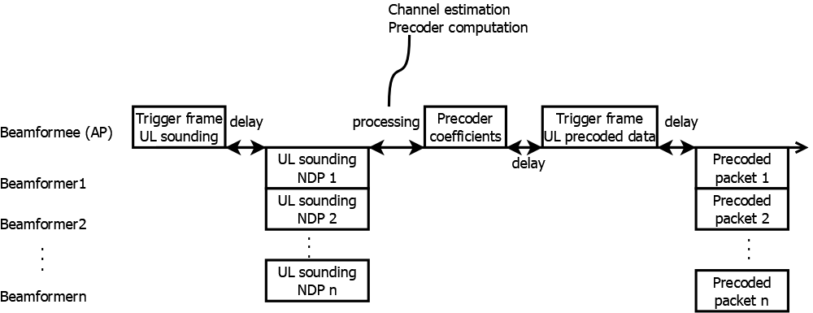
Uplink Precoding Recap
Uplink precoding introduces a new sounding procedure with the following steps
  Sounding trigger frame
  Uplink NDP
  Precoder coefficient message (independent, or merged with trigger frame)
Precoder is calculated at the AP and communicated to the STA, new message needed

Slide 4
Precoder Message Format
Option 1: Real-Imaginary format
Advantages:
  Re-use CSI matrix feedback packet with small changes
Option 2: Compressed feedback report
Advantages
  Re-use beamforming feedback with small changes
  Applicable to uplink coordinated beamforming, too
➔ Option 2 is further evaluated, as it is built on the feedback packet that’s widely used today

Slide 5
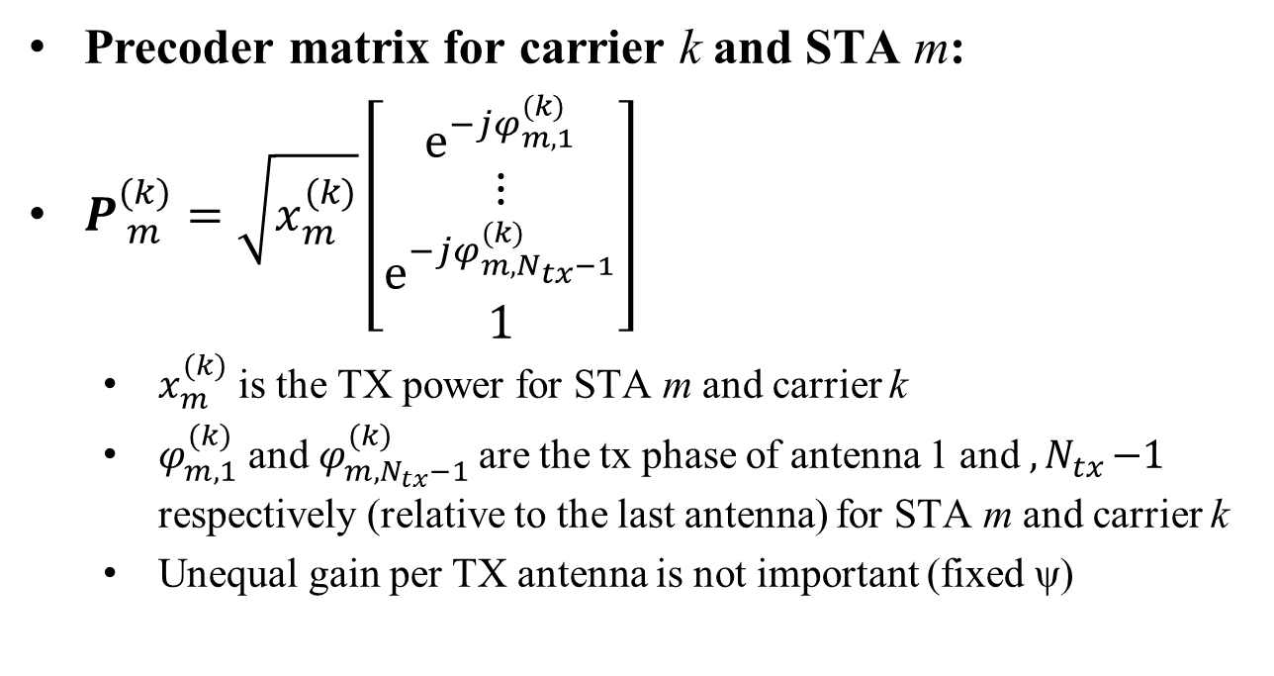
Uplink Precoder
Precoder matrix for carrier k and STA m:
$P_{ m}^{(k)}=\sqrt{x_{m}^{(k)}}\left[\begin{matrix}e^{−jφ_{m,1}^{(k)}} \\ \begin{matrix}⋮ \\ e^{−jφ_{m,N_{tx}−1}^{(k)}}\end{matrix} \\ 1\end{matrix}\right]$
  $x_{m}^{(k)}$ is the TX power for STA m and carrier k
  $φ_{m,1}^{(k)}$ and $φ_{m{,N}_{tx}−1}^{(k)}$are the tx phase of antenna 1 and ${,N}_{tx}−1$ respectively (relative to the last antenna) for STA m and carrier k
  Unequal gain per TX antenna is not important (fixed ψ)
*Example for N_{SS}=1 spatial stream, N_{Tx} transmit antennas (best overall performance [6])

Slide 6
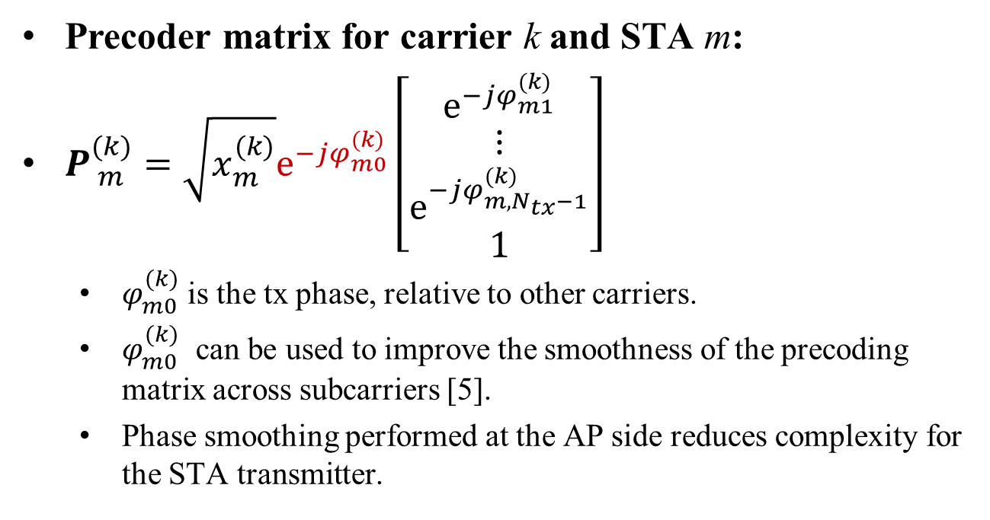
Uplink Precoder (with phase alignment)
Precoder matrix for carrier k and STA m:
$P_{ m}^{(k)}=\sqrt{x_{m}^{(k)}}e^{−jφ_{m0}^{(k)}}\left[\begin{matrix}e^{−jφ_{m1}^{(k)}} \\ \begin{matrix}⋮ \\ e^{−jφ_{m,N_{tx}−1}^{(k)}}\end{matrix} \\ 1\end{matrix}\right]$
  $φ_{m0}^{(k)}$ is the tx phase, relative to other carriers.
  $φ_{m0}^{(k)}$ can be used to improve the smoothness of the precoding matrix across subcarriers [5].
  Phase smoothing performed at the AP side reduces complexity for the STA transmitter.

Slide 7
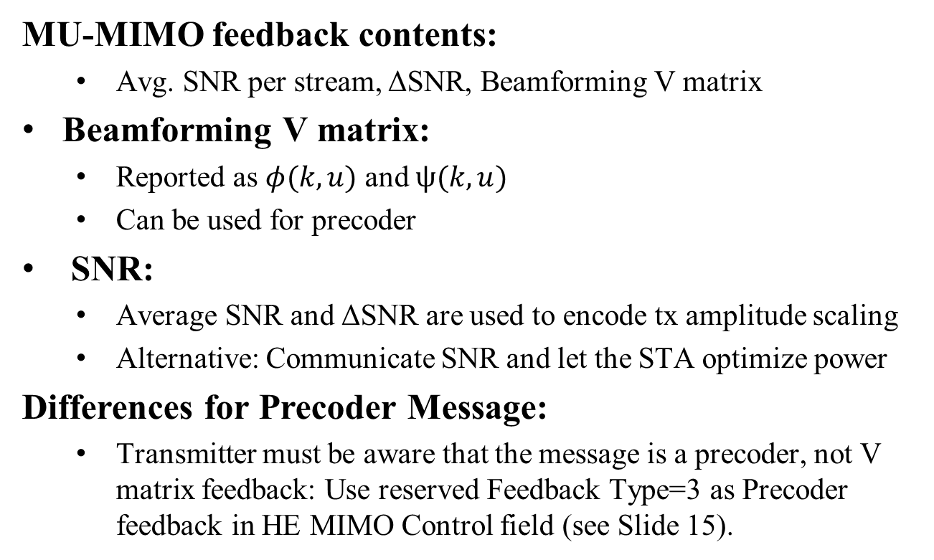
Re-use Compressed Feedback
MU-MIMO feedback contents:
  Avg. SNR per stream, ΔSNR, Beamforming V matrix
Beamforming V matrix:
  Reported as $φ(k,u)$ and $ψ(k,u)$
  Can be used for precoder
SNR:
  Average SNR and ΔSNR are used to encode tx amplitude scaling
  Alternative: Communicate SNR and let the STA optimize power
Differences for Precoder Message:
  Transmitter must be aware that the message is a precoder, not V matrix feedback: Use reserved Feedback Type=3 as Precoder feedback in HE MIMO Control field (see Slide 15).

Slide 8
Performance
Simulation Conditions
Ideal case vs. different quantized formats
4 bit gain+7/5 bit feedback
4 bit gain+6/4 bit feedback
50ms channel aging
1 spatial stream per STA (best overall performance [6])

Slide 9
Conclusion and Further Thoughts
UL MU MIMO Precoding gives significant performance gains
A precoder message, required to enable uplink precoding, can be derived from the existing compressed beamforming feedback
  Transmit gains are communicated instead of SNR

Slide 10
Straw Poll
Do you agree to include the following text to the 11bn SFD:
11bn will define a message to communicate precoder coefficients to non-AP stations for use in triggered uplink transmission
Yes
No
Abstain

Slide 11
Straw Poll 2
Do you agree to include the following text to the 11bn SFD:
11bn will define a message to communicate precoder coefficients to non-AP stations for use in triggered uplink transmission. The precoder message is based on the existing compressed beamforming feedback report.
Yes
No
Abstain

Slide 12
References
[1] IEEE 802.11-23/0027r1, “Uplink MU MIMO Improvements”, 2023-01-17
[2] IEEE 802.11-23/0725r0, “Uplink MU MIMO Precoding – Follow-up”, 2023-04-28
[3] IEEE 802.11-24/0108r0, “Triggered Beamforming in TGbn – Follow Up”, 2024-01-12
[4] IEEE 802.11-22/1392r0, “Beamforming Improvement for UHR”, 2022-09-02
[5] IEEE 802.11-32/1906r1, “Channel Information Feedback for Smooth Beamforming – Follow-Up”, 2023-11-05
[6] Rainer Strobel, Avi Mansour, Ziv Avital. "Uplink and Downlink Precoding for Ultra High Reliability WLAN” ICC 2024-IEEE International Conference on Communications. IEEE, 2024.

Slide 13
Appendix

Slide 14
Backup
Aging loss without quantization
Simulation Conditions
Parameter | Value
TX/RX Antennas | 2/4
Spatial streams | 1 per STA
Bandwidth | 160 MHz
STA TX Power | 21 dBm
Channel model | B LOS [8]
Frequency | 5.25GHz
GI | 1.6µs
TX/RX SNR | 40dB/42dB
Channel aging/Doppler | 1.2km/h, 6Hz
BF quantization | ideal
Feedback carrier grouping | 4

Slide 15
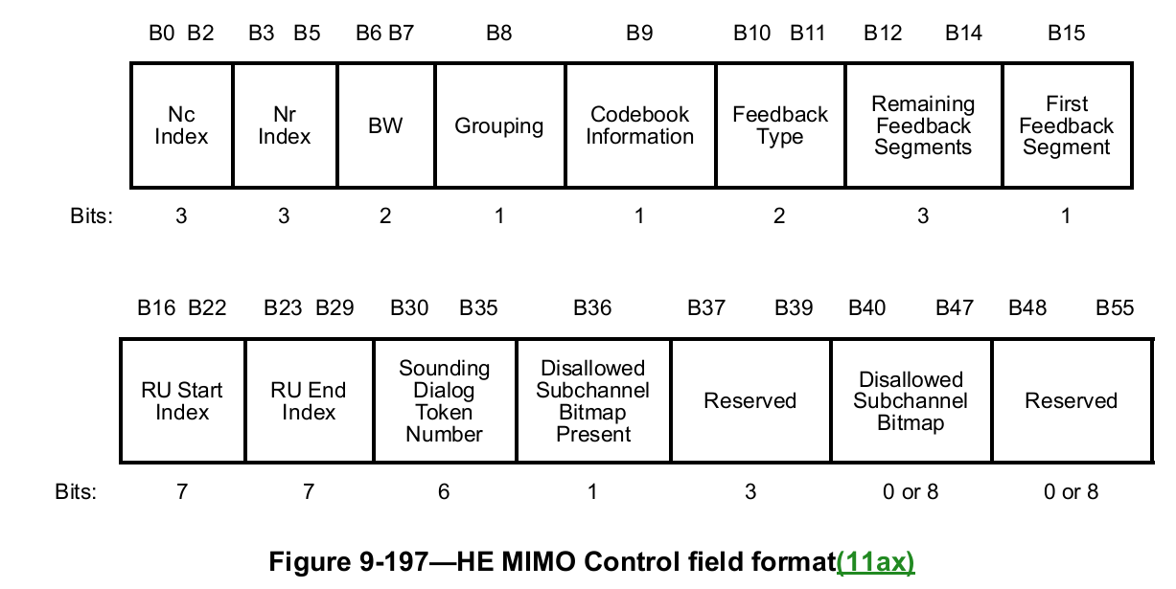
HE MIMO Control Field

