Slide 1
Discussions on Dynamic Subchannel Operation
Date: 2024-10-21
Authors:

Slide 2
Introduction
Dynamic Subchannel (Subband) Operation (DSO) has been proposed for 11bn
DSO allows an AP to allocate RUs outside of the non-AP STA’s operating bandwidth [1]
Some details on DSO are under discussion
Capability signaling [2, 8]
Overhead issues (switching delay) [5, 7, 10]
Formats of the DSO ICF [1, 6, 7]
EMLSR-based DSO [3, 11]
RU indication [9, 11]
In this contribution, we discuss two options for initial control frame for DSO and necessity of DSO primary channel

Slide 3
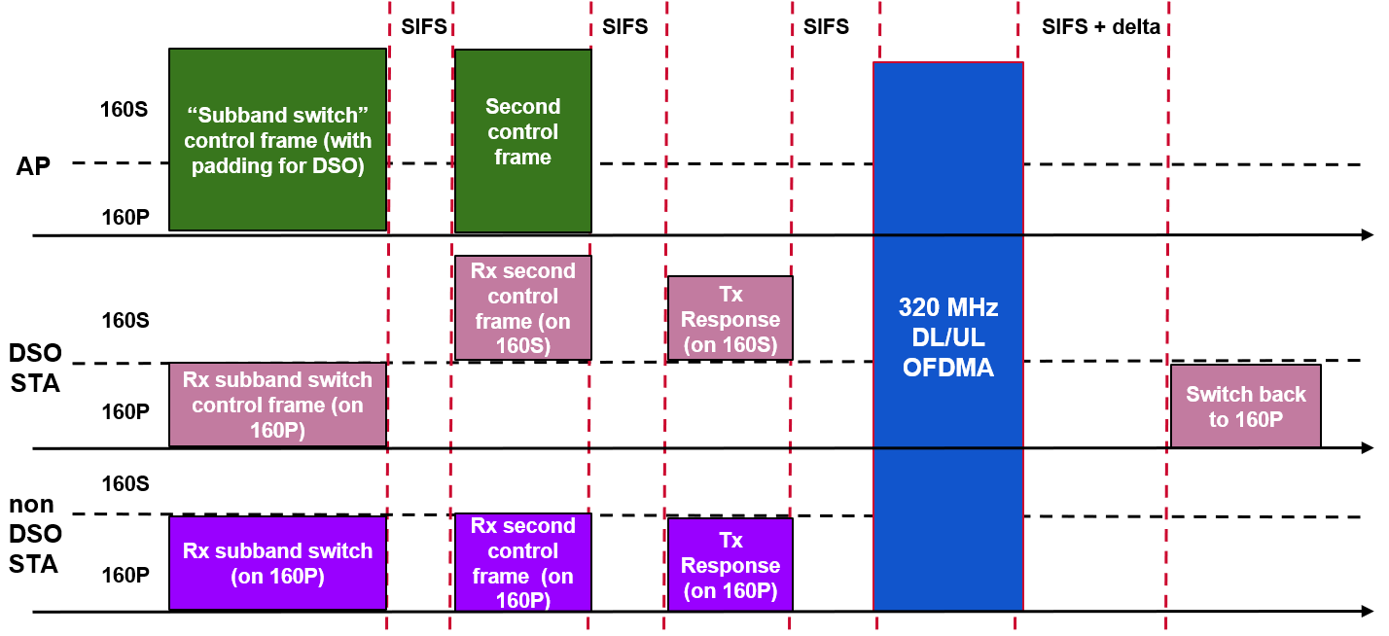
Recap: Dynamic Subband Operation (DSO) [1]
An AP sends a DSO ICF to DSO non-AP STAs at the beginning of a TXOP
The DSO non-AP STAs that have received the DSO ICF switch their operating channel to the secondary channel
The AP and the DSO non-AP STAs perform frame exchanges on the secondary channel during the TXOP

Slide 4
Recap: ICF/ICR for DSO [7][12]
MU-RTS and BSRP trigger frames are discussed as candidates for the initial control frame (ICF) for DSO [7]
MU-RTS and BSRP have several commonalities for DSO
Backward compatibility (previously used as ICF for eMLSR mode in 11be)
Can be contained in non-HT (dup) PPDU format
MU-RTS and BSRP have several differences for DSO
RU Allocation subfield signaling in ICF
MU-RTS: need changes to indicate CTS responses in secondary channels
BSRP: no need to change since the subfield can indicate RUs in secondary channels
NAV protection from legacy STAs [12]
MU-RTS: ICR is CTS frame with non-HT (dup) PPDU format → NAV protection from legacy STAs
BSRP: ICR is QoS Null frame with TB PPDU format → No NAV protection from legacy STAs

Slide 5
1. MU-RTS frame as DSO ICF
Soliciting CTS frame in non-HT (dup) PPDU from DSO non-AP STAs
DSO non-AP STAs need a reference 20MHz channel for CTS frames transmissions
In baseline MU-RTS/CTS, non-AP STAs shall transmit CTS frames that occupy the primary 20MHz channel
If we follow baseline response rule, for DSO non-AP STAs that switched to secondary channel, they require a reference 20MHz channel to transmit CTS frames
By following the baseline CTS response rule, reducing the implementation overhead for DSO STAs
May require simple modification of the RU Allocation indication for DSO non-AP STAs
SIFS
160MHz
CTS frame as DSO ICR on S160
S160
80MHz
DSO
ICF
(MU-RTS)
40MHz
20MHz
ICR from P160
Reference 20MHz channel
P160
Primary 20MHz channel

Slide 6
2. BSRP frame as DSO ICF
Soliciting QoS Null frame in TB PPDU from DSO non-AP STAs
There can be no TB PPDU responses on certain secondary 20MHz channels
Recovery mechanism for the unresponsive secondary channels
[Option A] In the ICF BSRP frame, indicating additional backup DSO non-AP STA(s) that can be assigned to unresponsive secondary channels later
The additional DSO non-AP STAs can be allocated to a specific secondary 20MHz channel in the DSO ICF
[Option B] After ICR, in the following BSRP frame, indicating new DSO non-AP STA(s) in the primary channel to switch to unresponsive secondary channels
We prefer [Option A]
Call DSO STA 4, but no response
Call DSO STA 5 in the primary channel
20MHz
No response
20MHz
DSO STA 4
DSO STA 5
20MHz
S160
20MHz
DSO STA 3
20MHz
DSO STA 3
20MHz
DSO STA 2
DSO STA 2
20MHz
DSO ICF
(BSRP)
DSO STA 1
DSO STA 1
20MHz
Padding
Additional BSRP TF
20MHz
Padding
20MHz
20MHz
ICR from
P160
Resp. from
P160
P160
20MHz
20MHz
20MHz
20MHz
20MHz
SIFS
SIFS
SIFS

Slide 7
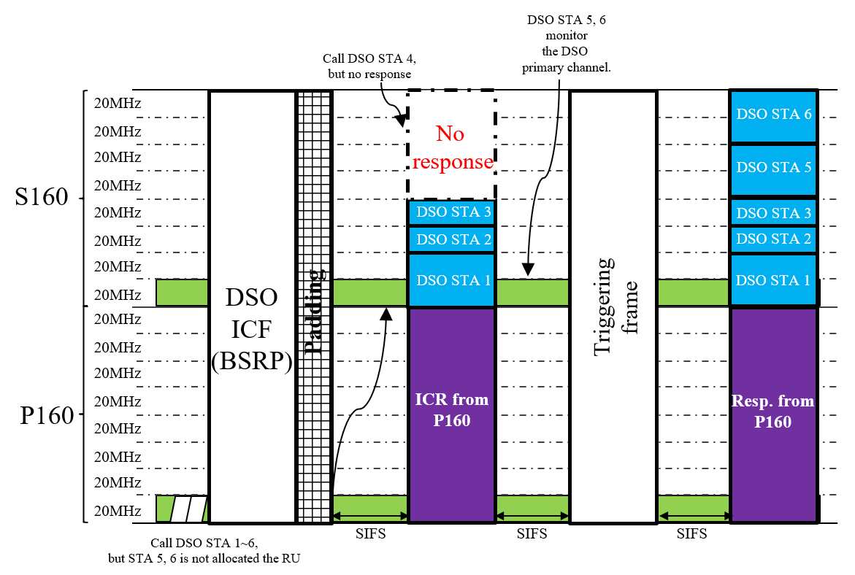
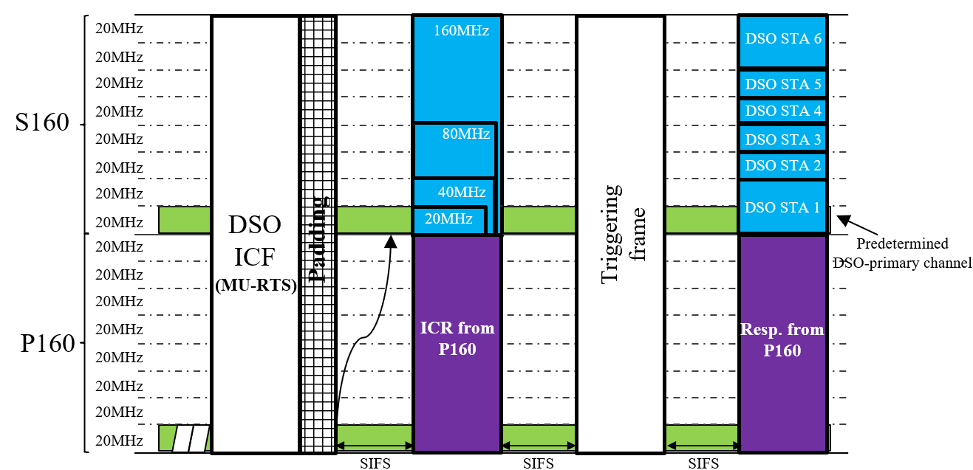
Proposal: DSO primary channel
Propose to define the DSO primary channel
The DSO primary channel is a certain 20MHz channel within DSO secondary channels and set by AP
When MU-RTS ICF frame, DSO non-AP STAs respond with CTS frames occupying the DSO primary channel similar to the baseline rule
When BSRP ICF frame, additional backup DSO non-AP STAs monitor the DSO primary channel to receive data or to be triggered
Call DSO STA 5, 6 at the RU that is no response

Slide 8
DSO primary channel (cont’d)
There could be a case where AP detects the predetermined DSO primary channel as busy, while the other subchannels in the secondary channel are detected as idle
160MHz
S160
80MHz
Busy
status
e.g., OBSS TXOP
ICR from P160
ICR from P160
Predetermined
DSO-primary channel
P160
ICF
SIFS
To enable DSO in this case, the location of the DSO primary channel needs to be dynamically adjusted to one of the idle subchannels

Slide 9
Dynamic indication of the DSO primary channel
DSO-primary channel
indicated by DSO ICF
CTS frame response from DSO STA 1,2,3
20MHz
DSO STA 1
DSO STA 1
20MHz
DSO STA 2
DSO STA 2
20MHz
DSO STA 3
DSO STA 3
S160
20MHz
Busy status at AP side
20MHz
20MHz
20MHz
Punctured
Punctured
20MHz
20MHz
DSO ICF
(BSRP
or
MU-RTS)
20MHz
Triggering frame
20MHz
P160
20MHz
ICR from
P160
Resp from
P160
20MHz
20MHz
20MHz
20MHz
SIFS
SIFS
SIFS
AP indicates the location of DSO-primary channel on the secondary channel
AP allocates RU for each DSO non-AP STAs
A DSO AP can select one of the idle subchannels as the DSO primary channel for a TXOP and indicate it within DSO ICF

Slide 10
Summary
The MU-RTS and BSRP were discussed as candidates of DSO ICF
We discussed several considerations when using MU-RTS and BSRP as DSO ICF
We proposed to define DSO primary channel
To allow DSO non-AP STAs to respond CTS frame occupying the DSO primary channel
To allow DSO non-AP STAs to detect and decode DL PPDU based on the DSO primary channel
To handle the case where the predetermined DSO primary channel is busy, AP can indicate the location of the DSO primary channel in DSO ICF

Slide 11
References
[1] 11-22/2204 Dynamic Subband Operation Sindhu Verma
[2] 11-23/0843 Considerations on Dynamic Subband Operation Liuming Lu
[3] 11-23/1496 EMLSR Dynamic Subband Operation Yongho Seok
[4] 11-23/1892 Thoughts on Dynamic Subchannel Operation Gaurang Naik
[5] 11-23/2027 Considerations for DSO sub-band Switch Delay Vishnu V. Ratman
[6] 11-23/2141 Further discussion on Dynamic Subband Operation Sindhu Verma
[7] 11-24/0299 Initial Control Frame for Bandwidth Switching mode Vishnu V. Ratman
[8] 11-24/0449 Considerations on Dynamic Subchannel Operation follow up Liuming Lu
[9] 11-24/0493 Dynamic Channel Switch Operation Liwen Chu
[10] 11-24/0517 Preallocation of Subband for DSO follow up Vishnu V. Ratman
[11] 11-24/0591 EMLSR Secondary Channel Operation Zhou Lan
[12] 11-24/1550 In-device Coexistence Follow up Abdel K. Ajami

Slide 12
Straw poll 1
Do you agree that TGbn defines a Dynamic Subchannel Operation (DSO) mode of operation where non-AP STAs can be allocated resources dynamically (i.e., on a per-TXOP basis) outside of their current operating bandwidth within the associated AP’s operating bandwidth?
Initial Control Frame for DSO can be MU-RTS and/or BSRP

Slide 13
Straw poll 2
Do you agree that TGbn defines the DSO primary channel for DSO mode of operation?
The DSO primary channel is determined and indicated by AP to DSO non-AP STAs
Within a DSO-enabled TXOP:
DSO AP ensures that DL PPDU occupies the DSO primary channel
DSO non-AP STAs detect and decode DL PPDU based on the DSO primary channel

Slide 14
Straw poll 3
Which option do you prefer for indication of the DSO primary channel?
A: Statically determined by AP and indicated before a DSO-enabled TXOP
B: Dynamically determined by AP per each DSO-enabled TXOP and indicated in the initial control frame of the TXOP
Abstain

