Slide 1
Discussions on Dynamic Subchannel Operation
Date: 2024-07-15
Authors:

Slide 2
Introduction
Dynamic Subchannel (Subband) Operation (DSO) has been proposed for 11bn.
  DSO allows an AP to allocate RUs outside of the non-AP STA’s operating bandwidth [1].
Some details on DSO are under discussion.
  Capability signaling [2, 8]
  Overhead issues (switching delay) [5, 7, 10]
  Formats of the DSO ICF [1, 6, 7]
  EMLSR-based DSO [3, 11]
  RU indication [9, 11]
In this contribution, we propose a method to enable DSO even when there are busy secondary subchannels.

Slide 3
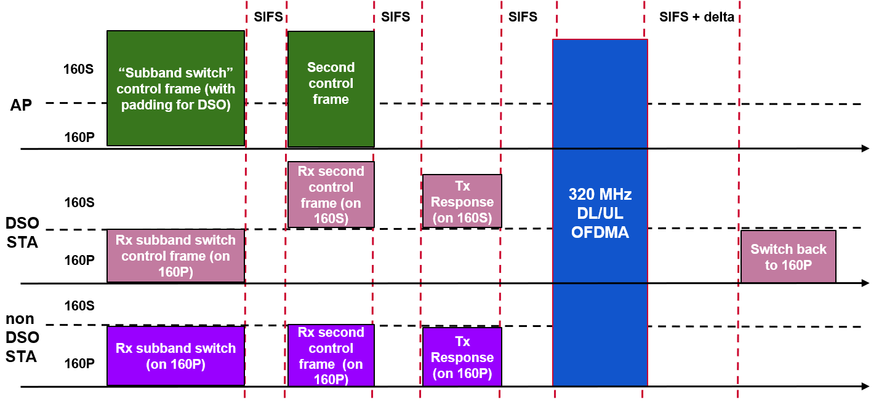
Recap: Dynamic Subband Operation (DSO) [1]
An AP sends a DSO ICF to DSO non-AP STAs at the beginning of a TXOP.
The DSO non-AP STAs that have received the DSO ICF switch their operating channel to the secondary channel.
The AP and the DSO non-AP STAs perform frame exchanges on the secondary channel during the TXOP.

Slide 4
Background: Subchannel Selective Transmission (SST)
SST is defined in the baseline.
  A non-AP STA can operate on the secondary channel during a TWT SP if the non-AP STA and its AP successfully set up SST operation.
    HE/EHT 80 MHz non-AP STA can operate on S80 of the 160/320 MHz BSS.
    HE/EHT 20 MHz non-AP STA can operate on non-P20 subchannel.
  In terms of operating channel, SST and DSO could be considered as the similar mechanisms.
Main differences between SST and DSO will be
  Time duration non-AP STAs operating on the secondary channel
    SST: TWT SP
    DSO: TXOP duration
  Operating channel of non-AP STAs
    SST: S80
    DSO: May cover both S80 and S160

Slide 5
Restrictions on the subchannel operation
The baseline SST does not provide rules for selecting a subchannel to detect the preamble of a PPDU sent from its AP, thus a non-AP STA operating on the secondary channel can use any of the secondary subchannels to detect a PPDU.
  Therefore, the baseline restricts the SST AP from puncturing any subchannel of a DL MU PPDU if the PPDU is addressed to at least one SST non-AP STA.
Because DSO should cover a wider secondary channel than SST, highly probable that the secondary channel has busy subchannels.
  Therefore, if AP cannot utilize preamble puncturing on the busy secondary subchannel during DSO, it will greatly reduce DSO opportunities.
It seems clear that DSO should be enabled even if some of the secondary subchannels are busy at AP side.

Slide 6
DSO primary channel
Propose a subchannel (DSO-primary channel) to be used for preamble detection by the DSO non-AP STAs when operating on the secondary channel.
  The DSO-primary channel is predetermined and indicated by the AP.
Based on busy/idle status of secondary subchannels at AP side, DSO AP can puncture subchannel(s) except the DSO-primary channel during a DSO TXOP.
  AP can ensure that all the addressed DSO non-AP STAs can detect and decode the PPDU based on the DSO-primary channel.
160MHz
ICR from S160
S160
Punctured
80MHz
DSO
ICF
40MHz
20MHz
ICR from P160
Predefermined
DSO-primary channel
P160
SIFS

Slide 7
DSO primary channel (cont’d)
There could be a case where the DSO AP detect the predetermined DSO-primary channel as busy, while the other subchannels in the secondary channel are detected as idle.
160MHz
S160
80MHz
Busy
status
e.g., OBSS TXOP
ICR from P160
ICR from P160
Predefined
DSO-primary channel
P160
ICF
SIFS
To enable DSO in this case, the location of the DSO primary channel needs to be dynamically adjusted to one of the idle subchannels.

Slide 8
Dynamic indication of the DSO primary channel
DSO-primary channel
40MHz
20MHz
ICR from S160
S160
S160
Punctured
Indicating the DSO-primary channel
80MHz
ICR from S160
40MHz
20MHz
Punctured
80MHz
DSO
ICF
DSO
ICF
DSO-primary channel
ICR from P160
ICR from P160
P160
P160
Indicating the DSO-primary channel
SIFS
SIFS
A DSO AP can select one of the idle subchannels as the DSO primary channel for a TXOP and indicate it through DSO ICF.

Slide 9
Summary
The differences between SST and DSO were discussed, where the SST has limitation that secondary subchannel cannot be punctured.
To enable DSO operation even when some secondary subchannel(s) is busy, the DSO primary channel is proposed.
Within a DSO-enabled TXOP:
  DSO AP ensures that DL PPDU occupies the DSO primary channel.
  DSO non-AP STAs detect and decode DL PPDU based on the DSO primary channel.
Furthermore, to handle the case where the static DSO primary channel is busy, dynamic indication of the location of the DSO primary channel in DSO ICF was discussed.

Slide 10
References
[1] 11-22/2204 Dynamic Subband Operation Sindhu Verma
[2] 11-23/0843 Considerations on Dynamic Subband Operation Liuming Lu
[3] 11-23/1496 EMLSR Dynamic Subband Operation Yongho Seok
[4] 11-23/1892 Thoughts on Dynamic Subchannel Operation Gaurang Naik
[5] 11-23/2027 Considerations for DSO sub-band Switch Delay Vishnu V.Ratman
[6] 11-23/2141 Further discussion on Dynamic Subband Operation Sindhu Verma
[7] 11-24/0299 Initial Control Frame for Bandwidth Switching mode Vishnu V.Ratman
[8] 11-24/0449 Considerations on Dynamic Subchannel Operation follow up Liuming Lu
[9] 11-24/0493 Dynamic Channel Switch Operation Liwen Chu
[10] 11-24/0517 Preallocation of Subband for DSO follow up Vishnu V.Ratman
[11] 11-24/0591 EMLSR Secondary Channel Operation Zhou Lan

Slide 11
Straw poll 1
Do you agree that TGbn defines a Dynamic Subchannel Operation (DSO) mode of operation where non-AP STAs can be allocated resources dynamically (i.e., on a per-TXOP basis) outside of their current operating bandwidth within the associated AP’s operating bandwidth?
  DSO operates even if part of the secondary subchannel of AP’s operating bandwidth is busy.

Slide 12
Straw poll 2
Do you agree that TGbn defines the DSO primary channel for DSO mode of operation?
  The DSO primary channel is determined and indicated by AP to DSO non-AP STAs.
  Within a DSO-enabled TXOP:
    DSO AP ensures that DL PPDU occupies the DSO primary channel.
    DSO non-AP STAs detect and decode DL PPDU based on the DSO primary channel.

Slide 13
Straw poll 3
Which option do you prefer for indication of the DSO primary channel?
  A: Statically determined by AP and indicated before a DSO-enabled TXOP.
  B: Dynamically determined by AP per each DSO-enabled TXOP and indicated in the initial control frame of the TXOP.
  Abstain

