Slide 1
Considerations on AP Power Save Mode
Authors:
Date: 2024-7-16
Name | Affiliations | Address | Phone | email
Jerome Gu | Clourney Semiconductor |  |  | jeg150@clourneysemi.com
Shirley Yin
Jason Sheng

Slide 2
Introduction
11bn PAR [1]
  “This amendment provides a mechanism to reduce power consumption for Access Points (APs) (including mobile APs)...”
Motion 9 (MAC) [2]
  TGbn defines a power save mode for a STA that is a UHR Mobile AP or a UHR non-AP STA wherein the STA may transition from a lower capability mode to a higher capability mode upon reception of an initial control frame.
    Lower capability mode (e.g., 20 MHz BW, one SS, limited data rates, PPDU format)
    Higher capability mode (e.g., operating BW, NSS and MCSs, with at least one higher capability than that in the lower power capability mode)
    Initial Control frame is TBD
    Whether that applies for a non-mobile AP is TBD
  In this contribution, we discuss the advertisement of AP power save mode.

Slide 3
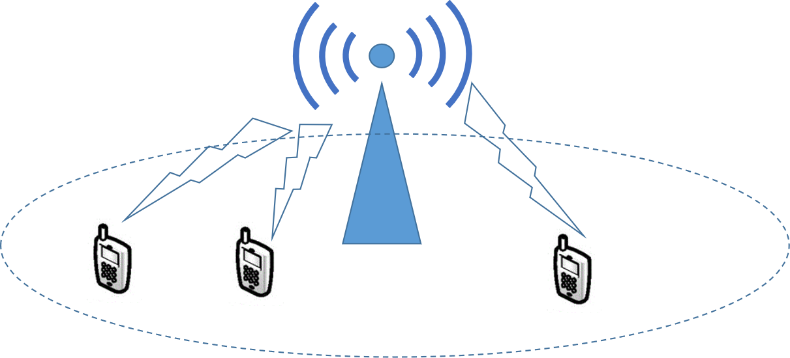
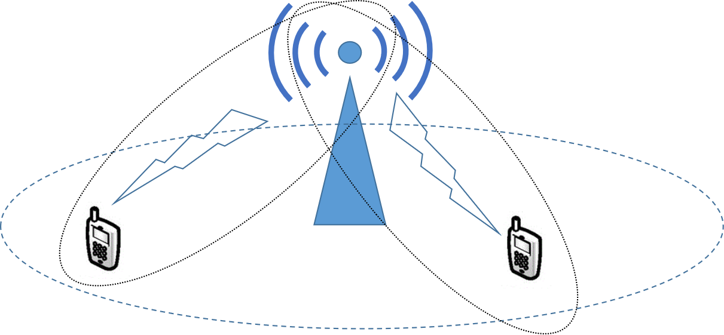
The AP Behaviors for AP Power Save
AP behaviors and related parameter /factors
  Sleep state / wake state → Sleep / wake interval.
  Link enablement / link disablement → Link reconfiguration, ICF, Link ID, etc. .
  Higher capability mode / lower capability mode → Bandwidth, Nss (spatial steam number), MCS, data rates, PPDU format, ...
A major difference between AP power save and non-AP STA power save
AP power save: One-to-many
non-AP STA power save: One-to-one

Slide 4
The Advertisement of AP Capability Mode
For proper operation, the non-AP STAs need to know the details about AP capability mode in AP power save.
  Know either (re)configuration of AP capability mode, or notification of AP capability mode
    Configuration means changing AP capability mode to a new one.
    Notification means notifying the AP current capability mode to the non-AP STA. The AP capability mode is not changed.
    This may cover sleep / wake interval, link enablement, link disablement, bandwidth, Nss (spatial steam number), MCS, data rates, PPDU format, ...
Thus, the AP capability mode shall be advertised, during and after initial access.
  e.g., in beacon, probe response frame, or by ICF etc..

Slide 5
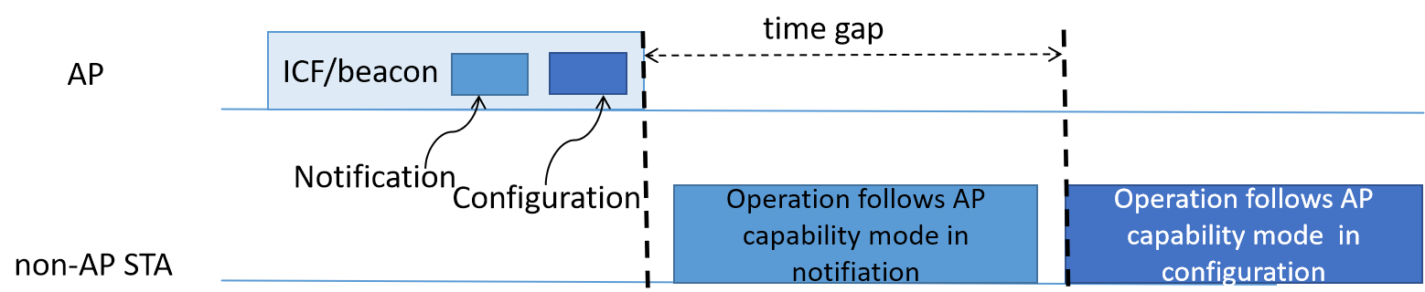
Discussions on the AP Power Save Mode
Notification of the AP capability mode and configuration of the AP capability mode may occur at the same time.
  To reduce the impacts from AP capability mode change, the configuration of AP capability mode should not take effects immediately, until making sure all non-AP STAs are ready for the change. As a result, the ICF/beacon may include two capability modes of the AP, when notification co-occurs with configuration.
    For a newly accessing non-AP STA, the notification co-occurs with configuration in a beacon.
    Notification on non-AP STA’s request of the AP current capability mode, may co-occur with configuration.

Slide 6
Summary
For a non-AP STA works properly, the AP capability mode advertisement is necessary.
To reduce the impact from the configuration of AP capability mode, the configuration of AP capability mode should not take effects immediately, until making sure all non-AP STAs are ready for the change. As a result, two capability modes of the AP in one ICF/beacon needs to be studied.

Slide 7
References
[1] 11-23/0480 P802.11bn.
[2] 11-24/0171 TGbn Motions List.

