Slide 1
Low latency channel access follow up
Date: 2024-07-10
Authors :

Slide 2
Problem statement and solution
EDCA is the main channel access mechanism of today (and future) WiFi standards
Provide channel access opportunities to any traffic type, which defines its weakness
  Cannot guarantee channel access. Even high priority access category may have difficulty obtaining TXOP in a competition among EDCAFs of a lower priority
  Existing EDCA parameters may not provide sufficient traffic separation
  AC_VO by design does scale to support sufficient number of LL streams
  All the above is a reason for the latency spikes
Idea:
  Separate STA(s) with traffic streams that require bounded latency/stringent ETE bounds from the rest of the contention crowd
  Allow such STA(s) to send special signal or MAC frame to announce (Hi)gh (P)riority EDCA contention PRIOR to regular contention start
  Allow such STA(s) to contend only among themselves during the immediately following HiP EDCA period

Slide 3
Recap from previous contributions*
HiP EDCA contention allow to improve tail latency in both isolated and multi-BSS setup
  Provide 2x-4x latency improvements for LL traffic vs legacy EDCA
  Provide better traffic separation for LL traffic vs BE traffic
  Provide necessary scalability to serve larger number of LL clients vs legacy EDCA
  Naturally integrates into channel access state machine
Key findings from previous extensive simulations/experiments
  Better to exclude AC_BE/lower priority EDCAFs and focus of AC_VO\LL streams only:
  When applied to AC_VO, HiP EDCA has limited impact on legacy devices performance
  Scales better than legacy EDCA AC_VO allowing to support for a larger LL clients
  For simplicity it is better to have DS signal it in a form of short MAC frame with duration field and TA address
  Potential DS/CTS misalignment and potential inability of 3rd party device to set NAV or EIFS have insignificant impact to Hip EDCA benefits
  We observe no major impact on DL performance
*11-23/2126r0, 11-23/1065r0, 11-24/0467r1 and 11-24/0840r0

Slide 4
Current proposal
Focus only on using HIP EDCA on AC_VO and possibly extend it to AC_VI for some SCS-negotiated traffic (that get authorization to use HIP EDCA if requested in SCS request and accepted by AP)
  AC_VO with its bounded Cw values may/will saturate quickly in a presence of multiple LL clients
  AC_VO may struggle to obtain the medium in contention with multiple BE contenders. We observe from multiple simulations that a single failure for AC_VO leads to increased chance of consecutive second failure. HiP EDCA help to control that as well as withstand saturation for longer
  Focusing on only AC_VO/LL streams will help to control number of eligible clients to use HiP EDCA
STA always use regular EDCA and can only send DS for the first retransmission
  we can also make it 2 retransmissions if we see that the gains are still good
Make DS a generic CTS frame that sets NAV for just to protect HiP EDCA contention
  if necessary, we may add rules for further regulation, such as a minimum delay to wait before being allowed to send DS again, once a STA gains a TxOP with HIP EDCA or limit a number of attempts to announce HiP EDCA
If we see that we need to compensate AP access (currently we see not such need with AC_VO restrictions)
  a range of solutions exist, for example - reverse direction in TxOP gained by DS can be one of them
If we see that we need to ensure sync on overlapping DS, we can impose that DS is sent only when the STA detected the last PPDU from the previous TxOP

Slide 5
Straw poll 1
Do you agree to improve EDCA to reduce tail access delay of Low Latency traffic in multi-BSS dense scenarios in presence of best effort traffic?
  • The solution to improve EDCA is distributed
  • The impact on legacy device has to be balanced
  • Low Latency traffic is treated as AC_VO traffic. Other cases are TBD

Slide 6
Proposal major details
Eligibility – who/when can initiate/use HiP EDCA
  A STA with LL traffic after experiencing 1st failure
    Why: Cw increase from CwMin=3 to CwMax=7 make AC_VO traffic even more vulnerable to contention with any other traffic types
    Increasing # of failures does not seem to be feasible as second attempt will be already with CW will be set to a max value which diminish a value of HiP EDCA
Time to send
  AIFSN=2=DIFS
    Why: AIFSN=2 provides best opportunity to cut vast majority of STAs from initiating transmission or initiating contention process
Contention parameters
  Duration field set to the value that is not less than EIFS duration
    EIFS is a really big value, depending on parameters (Ack)28-68+(sifs)16+(difs)34 =78-118us which can protect a range of 9-20 slots easily
Retransmissions
  STA that failed to win the medium through HiP EDCA announce another round of HiP EDCA at a next contention

Slide 7
Straw poll 2’
Do you agree to define HIP EDCA in UHR where a STA with Low Latency traffic may be allowed, based on TBD conditions, to send a Defer Signal (e.g. CTS frame or RTS) to start a protected short contention for pending LL data
  Conditions to be allowed to send a Defer Signal is TBD
  STA in HiP EDCA always use RTS/CTS as initial frame exchange and retry.
  Duration of protected short contention is TBD.
  Access parameters (AIFSN, CW and the expansion rules) used to transmit the Defer Signal are TBD. The retry count where the Defer Signal is allowed to be sent is TBD
  Contention parameters for the protected short contention are TBD. The STAs that transmitted a Defer Signal but did not win the protected short contention will initiate a new retry.
  Low Latency traffic is treated as AC_VO traffic. Other cases are TBD.
  The solution would provide control on the degree of collisions that may occur while using it and, allows for autonomous randomness or/and controlled by the AP
  No new synchronization requirement on STA side

Slide 8
Simulation configuration
80meters
Enterprise-like layout
  1, 2 or 4 BSSes with variable number of STAs: 4, 8, 12 and 16
  Out of which 1, 2, 3 or 4 are ULL STAs
  Other STA has bidirectional full buffer BE traffic.
  RTS/CTS is ON
2x2x20Mhz @ MCS7
TXOP limit = uniform (1.5ms; 5ms)
  New TXOP limit is selected each time when STA/AP won contention
  Randomization is only to introduce “burstiness” and extra randomness into channel occupancy time
  STA Cw = 15/1023; AP Cw=15/63
  TxPower: STA = 17dBm; AP=23dBm
Location
  STAs assigned on a grid across four 4x4 cube islands, AP in the middle of the island
  Overall area size is 80x80meters
28m
D=9
50m
80meters
31m
4
3
2
1

Slide 9
HiP EDCA for AC VO, Multi-BSS setup in 80x80 area
Traffic:
  VO traffic (LL) is in UL direction
    160 bytes every average 16ms =uniform (10ms, 22ms) ~ 96Kbps
    1600 bytes every average 16ms =uniform (10ms, 22ms) ~ 768Kbps
    16000 bytes every average 16ms =uniform (10ms, 22ms) ~ 7.6Mbps
    32000 bytes every average 16ms =uniform (10ms, 22ms) ~ 15.3Mbps
  BE traffic (legacy) is bi-directional full buffer traffic, TXOP = uniform (1.5ms, 5ms)
DS usage policy:
  An LL STA use regular AC_VO to deliver buffered traffic
  A STA is eligible to use DS if it experience 1 failure after obtaining EDCA TXOP
  A STA switches back to normal EDCA operation after it successfully obtained TXOP using HiP EDCA

Slide 10
DS transmission times
What if boundary is randomized?
  DS boundary randomly selected between 2 and 3
  DS boundary randomly selected between 2 and 4
What if DS transmitted after 2nd retry
vs. DS transmitted after first retry and at AIFSN=2

Slide 11
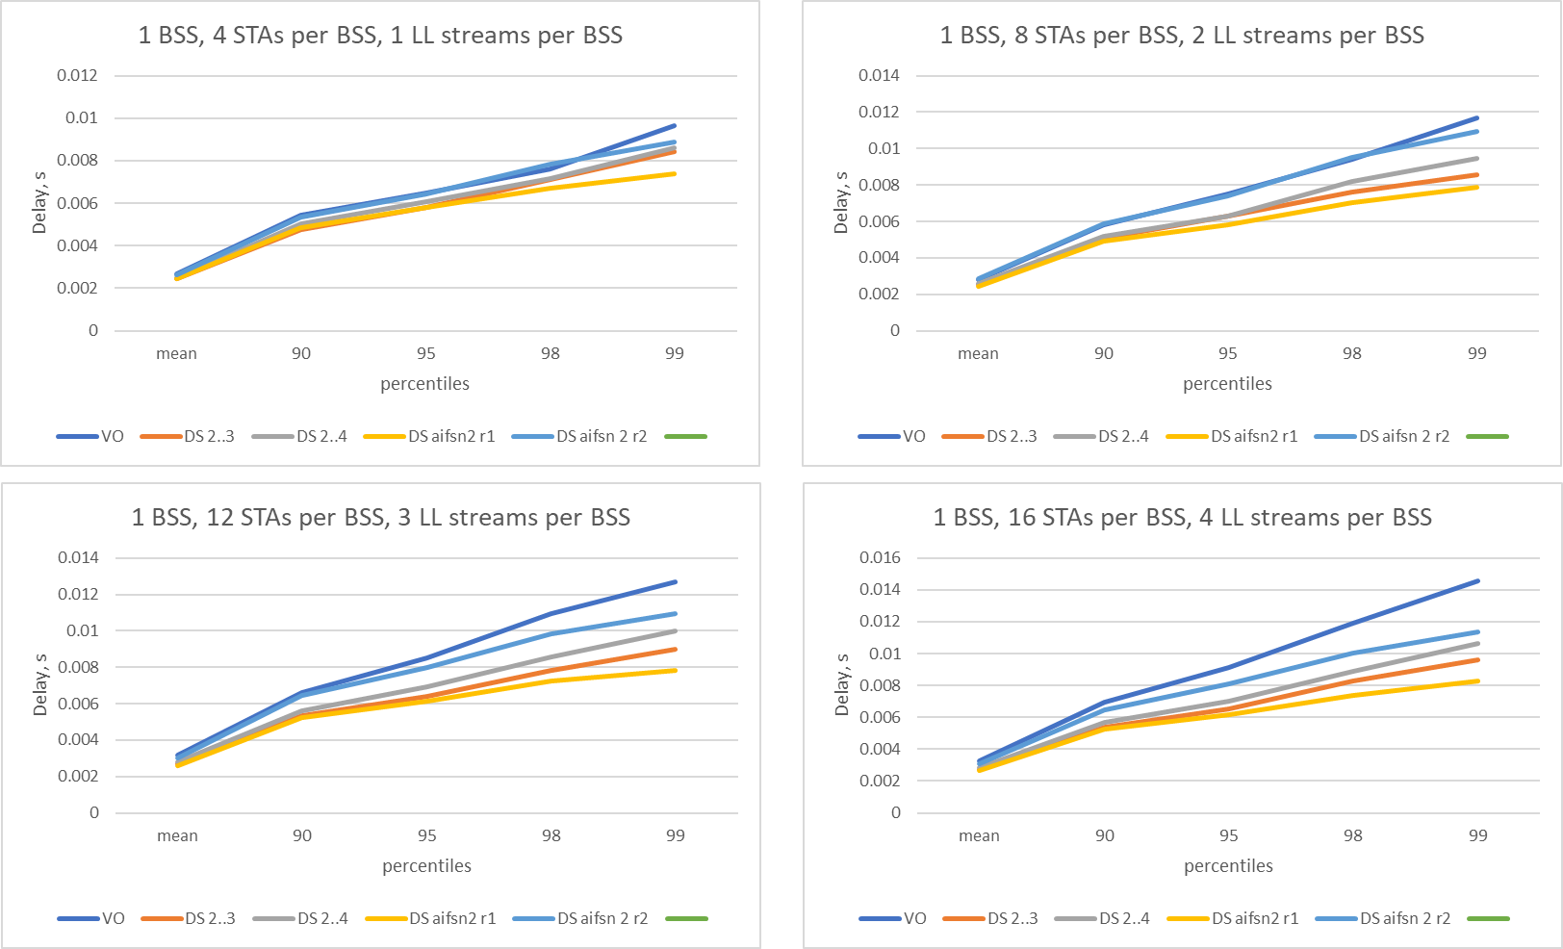
1 BSS case, LL packet size =1600

Slide 12
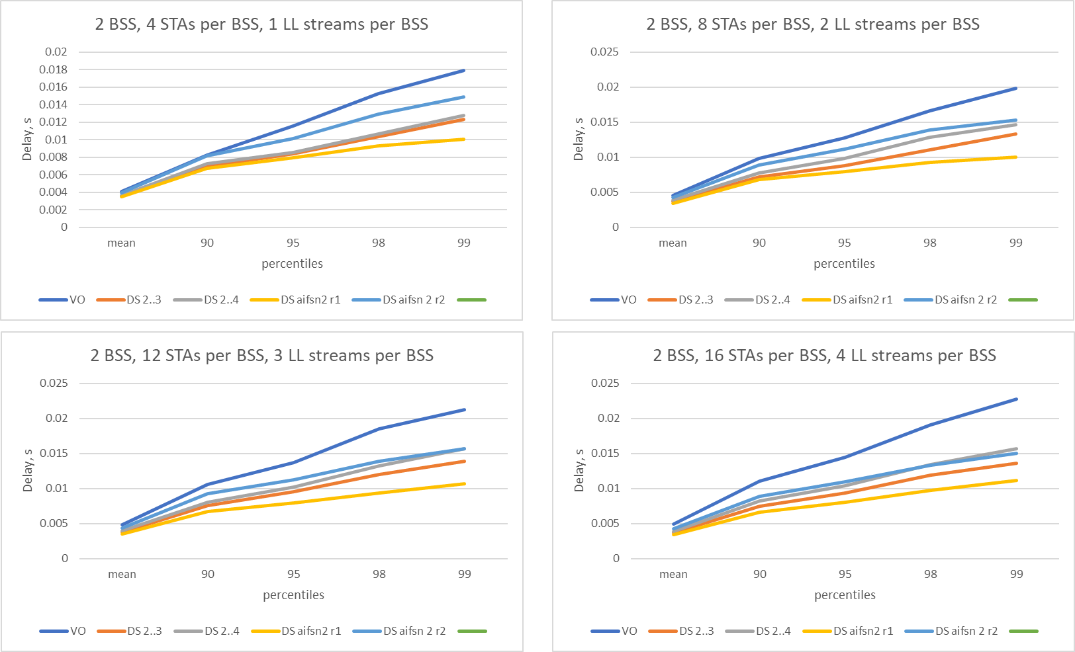
2 BSS case, LL packet size =1600

Slide 13
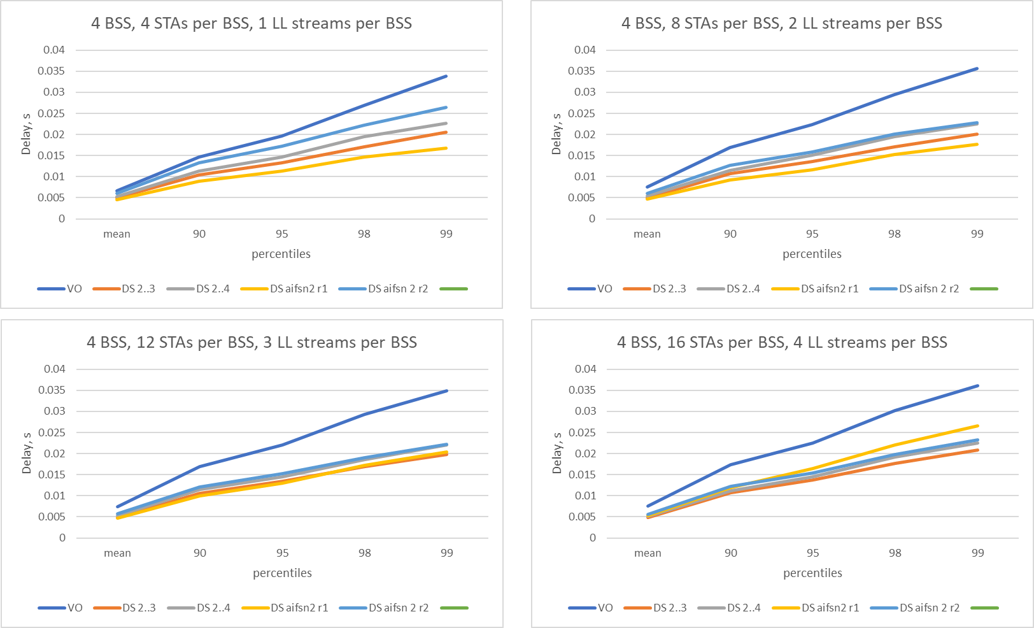
4 BSS case, LL packet size =1600

Slide 14
Observations
Delaying DS transmission reduce overall HiP EDCA performance improvements
We still observe improvements in comparison vs legacy EDCA mode of operation

Slide 15
backup

Slide 16
Illustration
Previous TXOP
EDCA contention period
TxOP gained by STA3
PIFS
SIFS
DIFS
Last frame of TXOP
STA1
Legacy
AIFSN
Idle
Busy
EIFS mode/NAV
Busy
STA2
Legacy
AIFSN
Busy
Idle
Busy
EIFS mode/NAV
Busy
DS
or
frame
STA3
PPDU transmission
BO: rand(0,7)=4
Busy
Idle
Idle
DS
or
frame
STA4
BO: rand(0,7)=5
Busy
Idle
Idle
Busy

