Slide 1
NB Update
Date: 2024-07-16
Authors:

Slide 2
Background: Europe 6 GHz NB vs 802.11 VLP spectrum
NB with 14 dBm EIRP is 15/18/21 dB stronger than 802.11 VLP with 80/160/320 MHz
10 dBm/MHz
NB
-5 dBm/MHz
80 MHz 802.11
-8 dBm/MHz
160 MHz
802.11
-11 dBm/MHz
320 MHz 802.11
Note that skirts associated with NB spectrum are not shown and affect many 802.11 sub-carriers
Carlos Aldana, Meta Platforms

Slide 3
Channel Plan for 802.15.4ab using 2.5 MHz wide chanels
Channels 0 to 49 span UNII-3 and channels 50 to 249 span UNII-5

Slide 4
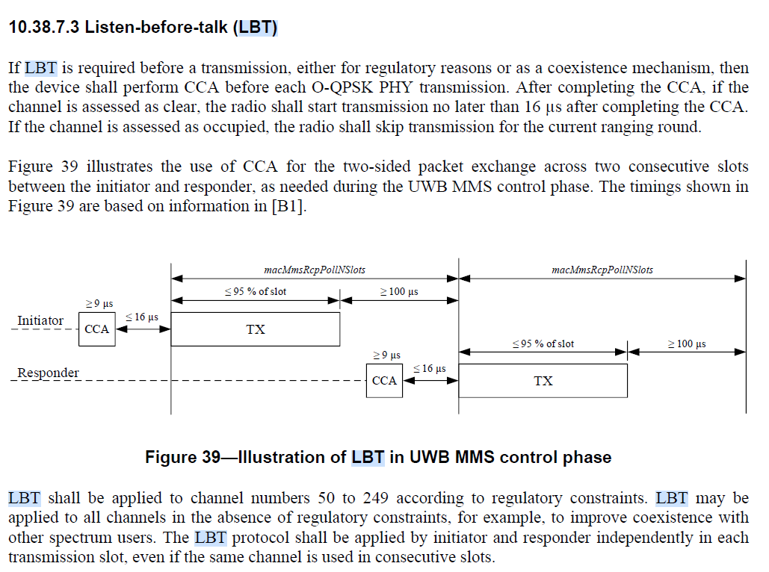
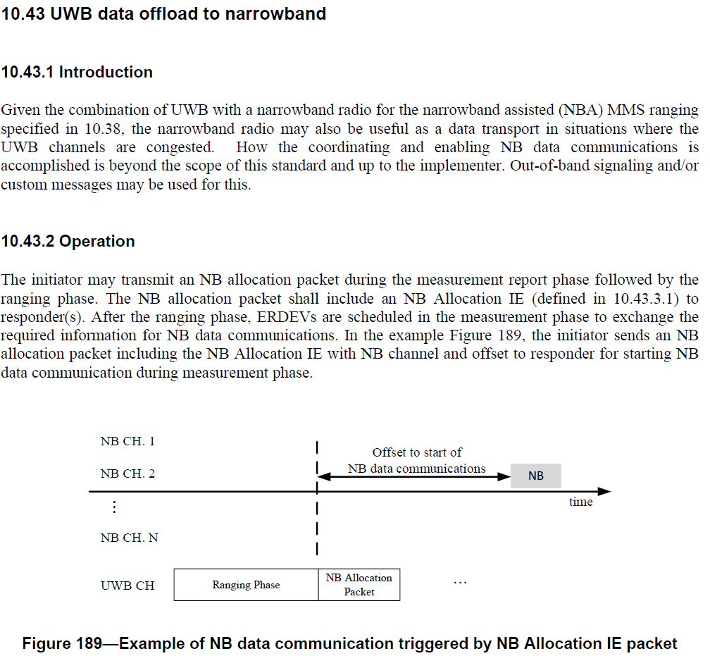
802.15.4ab Draft 1.0 Update
Draft 1.0 published, but coexistence concerns remain in Sections 10.38.7.3 and 10.43.

Slide 5
Typical Ranging round for one-to-one ranging
1ms
Initiator
NB
Poll
UWB
UWB
UWB
UWB
UWB
UWB
UWB
NB
Report 2
NB
Resp
UWB
UWB
UWB
UWB
UWB
UWB
UWB
NB
Report 1
Responder
10 dBm/MHz PSD
Optional w/ 10 dBm/MHz PSD
-41.3 dBm/MHz PSD
Carlos Aldana, Meta Platforms

Slide 6
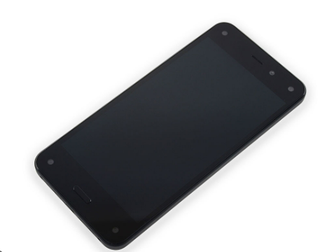
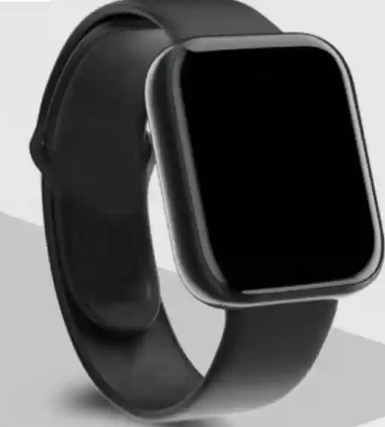
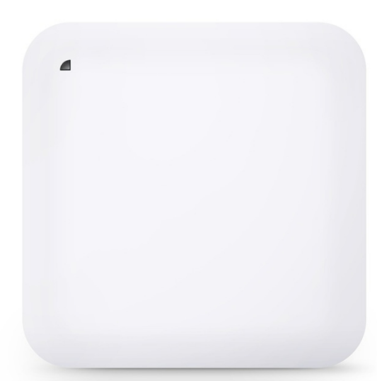
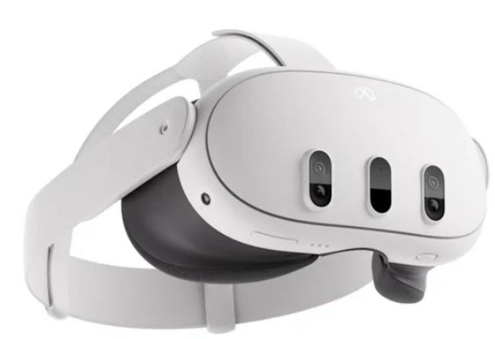
Data Offload: Train Use Case
Someone waiting for the train downloading their
favorite music playlist to their watch
(3,2)
22
1
(0,1)
(2.5,1)
10
(5,1)
9
802.11 soft AP
802.15.4ab Gate2
802.15.4ab Gate3
UL/DL 802.11
802.15.4ab Gate1
NB UWB
Gate
(0,0)
Gate
(2.5,0)
Gate
(5,0)
Gate
(-0.7,-0.7)
(0.7,-0.7)
(1.8,-0.7)
(3.2,-0.7)
(4.3,-0.7)
(5.7,-0.7)
5
6
14
15
19
20
2
3
4
11
12
13
16
17
18
(-1,-1)
(0,-1)
(1,-1)
(3.5,-1)
(-3,-1)
(1.5,-1)
(2.5,-1)
(4,-1)
(5,-1)
(6,-1)
(-3,-2)
7
802.11 soft AP
Someone waiting for a friend
while using MR headset
Carlos Aldana, Meta Platforms

Slide 7
Background in Coex SC
11-24-148r0 concluded that NB should adopt a mandatory coex mechanism to enable shared use of the spectrum and adequate performance for both 802.11 and NB. This mandatory mechanism should consist of one or more of LBT or other techniques.
11-24-360r4 (coauthored by 8 individuals from Meta, BCA, Qualcomm, Cisco, Intel, HPE, and Mediatek) recommends to make either CSMA-CA (with CCA mode 1) or SSBD with a provided set of parameters mandatory for NB-Data and NBA-MMS transmissions.

Slide 8
Background in 802.15.4ab
15-24-212r5 proposes a possible technical solutions for discussion:
CSMA-CA with CCA mode 1 (i.e., LBT) shall be used as the channel access mechanism before every TX
15-24-295r2 (coauthored by individuals from Mediatek, QC, HPE, Cisco, and Meta) suggests 802.15.4ab adopt a baseline channel access mechanism for NB and proposes to withdraw LBT related comments
802.15.4ab is working through 1471 comments received on Draft 1.0.
802.19 voted 11 Y, 10 N on Coex document from 802.15.4ab (15-23-452r7)
47 comments received
Comments consolidated can be found in 15-24-371r1
Carlos Aldana, Meta Platforms

Slide 9
Possible Way Forward
Adopt SSBD as baseline mechanism as suggested in comment with CID 988.

Slide 10
References
IEEE 802.15-22/486r5 (Spectrum Sensing Based Deferral (SSBD))
IEEE 802.15-23/243r2 (NB Assisted Data Communications)
IEEE 802.15-22/381r5 (NBA-UWB MMS Ranging Text Proposal for 15.4ab)
IEEE 802.11-23/1259r1 (Effect of no-LBT NB on 802.11 devices)
IEEE 802.11-24/130r0 (Effect of no-LBT NB on 802.11 devices: Part 2)
IEEE 802.11-24/148r0 (NB Simulation Results Comparison)
IEEE 802.11-23/1279r0 (NB with LBT)
IEEE 802.15-23/243r2 (NB Assisted Data Communications)
IEEE 802.15-21/593r2 (More on NBA-MMS)
IEEE 802.15-21/292r0 (Opportunities for improved UWB/NB coordination)
Carlos Aldana, Meta Platforms

