Slide 1
Narrowband Frequency-Hopping blocking Wideband
Date: 2024-07-17
Authors:

Slide 2
Abstract
We analyse the probability of a wideband link being blocked from the channel access by multiple active narrowband frequency hopping (NBFH) links due to continuously received energy.
Then, a mitigation is proposed, based on a dynamic Energy Detection Threshold (EDT).

Slide 3
Narrowband FH blocking Wideband
f
Single NBFH link:
Transmissions are spread over the available spectrum
Connection events are filled to some extend
t

Slide 4
Narrowband FH blocking Wideband
f
Wideband becomes active in one wideband channel
NBFH detects energy via short listen-before-talk
NBFH May quickly jump to another freq for the connection event
Probability that NBFH starts in a wideband gap is low
t

Slide 5
Narrowband FH blocking Wideband
f
Multiple NBFH links:
Wideband starts LBT, but has to defer
Wideband continues to sense the channel – it remains busy at all times
wideband starts CCA
t
channel occupancy of lower wideband channel

Slide 6
Narrowband FH blocking Wideband
Blocking probability of the wideband depends on
NBFH spectrum usage
  Spectrum / number of channels
  Number of active links
  Duty cycle
Wideband spectrum usage
  Required portion of idle spectrum

Slide 7

Experiment
Narrow-Band Frequency Hopping
  230 channels (approx. full lower 6 GHz spectrum)
  [n] links located in 20 m×20 m area
    Each link has a central & peripheral device
    Random distance 0.5 m ... 1.5 m
    n = 1 ... 50
  [rate] B packet per user every 10ms
    Rate = 10 B ... 800 B
    Mapped to [load]: load ≅ 1 %...80 %
  Connection Interval 10ms, tx power 10 dBm
One wideband transmitter attempts to access a [bw] MHz channel every [0 … 1] s to transmit one 1 B packet
  EDCA, access category best effort
  Located at (10 m, 10 m)
KPI Wideband
  Channel access delay: time from packet arrival to start of transmission
  Here: 99-percentile
20 m
20 m

Slide 8
Experiment Result Visualization
Load parameter:
  [n] × [load]
  n = 1 ... 50
  load = 1 % ... 80 %
  210 results
Result per load: 99-percentile of channel access delay
Plot contour lines for
[1, 5, 10, 20, 50, 100, 200, 500, 1000] ms
14 × 15 results
(interpolated) contour lines for 99-percentile [ms]

Slide 9
Wideband Channel Access Delay [ms]
20 MHz
40 MHz
80 MHz
160 MHz

Slide 10
Conclusion & Solution Options
Wideband channel access may be delayed in the presence of high NBFH load.
Solutions under discussion:
Do nothing
Limit the duty cycle
  To what value?
  If triggered dynamically, what is the trigger?
Require Adaptive Frequency Hopping (AFH)
  How to describe requirements, when to trigger?
  Permitted convergence time, false positive/negative triggers, sampling
  Requirements on re-allocating channels classified as “bad”
Wideband supports frequency-adaptive transmission bandwidth
  Dynamic Bandwidth / Fully flexible puncturing (see for example 11-24/603r2)
    Channel access delay is the same as for 20 MHz, but average bandwidth is higher
  No restriction on primary 20 MHz
Introduce Dynamic EDT for Wideband

Slide 11
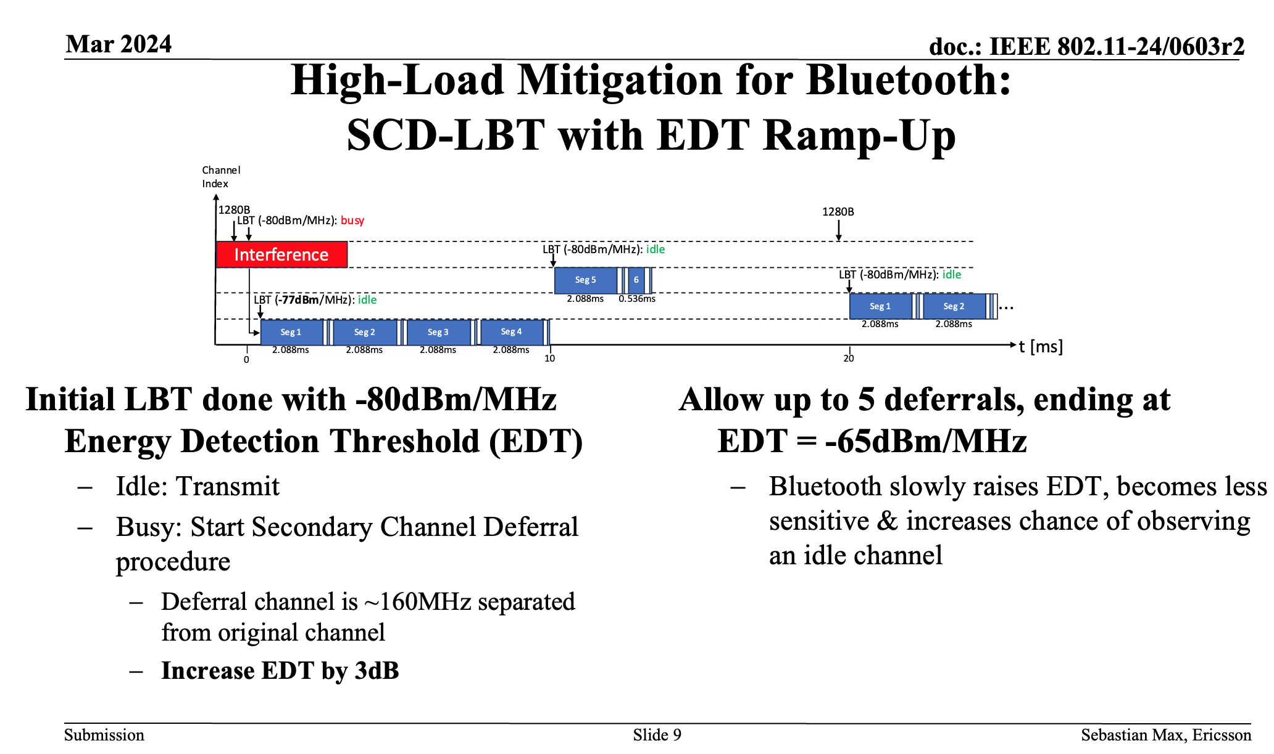
Interlude: Dynamic EDT for NBFH
(from 11-24/0603r2)
Mitigate impact to delay of NBFH in the presence of high duty-cycle Wideband

Slide 12
Wideband with Static EDT
f
wideband starts CCA
Multiple NBFH links:
Wideband starts LBT, but has to defer
Wideband continues to sense the channel – it remains busy at all times
t
channel occupancy of lower wideband channel
P_{rx}
busy
EDT
idle
t

Slide 13
Wideband with Dynamic EDT
f
wideband starts CCA
Trigger:
No idle channel detected for a significant duration
Longer than a TXOP
If triggered, EDT is slowly increased
1 dB/1 ms while channel remains busy
EDT reset to default after successful transmission
t
channel occupancy of lower wideband channel
P_{rx}
CCA reports idle, backoff starts
busy
fall back to default
EDT
idle
t
Trigger

Slide 14
Results: Wideband uses 20 MHz
[ms]
Static EDT
Dynamic EDT

Slide 15
Results: Wideband uses 40 MHz
[ms]
Static EDT
Dynamic EDT

Slide 16
Results: Wideband uses 80 MHz
[ms]
Static EDT
Dynamic EDT

Slide 17
Results: Wideband uses 160 MHz
[ms]
Static EDT
Dynamic EDT

Slide 18
Conclusion
EDT-boosting for Wideband mitigates the channel access delay increase in the presence of high duty-cycle NBFH links
Can be combined with dynamic bandwidth selection to achieve optimum channel usage
Dynamic EDT is also applicable to other high noise floor conditions
  Essentially introduces a time-limited floating noise floor
Parameters to be discussed:
  Waiting time [here: 10 ms]
  EDT-boost after waiting time [here: linear 1 dB/1 ms]
  Maximum EDT-boost [here: none]

