Slide 1
Proposal on Data offload using WLAN in connected vehicle case
Authors:
Jing Ma (Toyota)

Slide 2
Abstract
Needs, example use cases, potential gaps between current IEEE specification and the requirements of WLAN data offload for automotive have been introduced in several contributions[1~3]
We propose to form a Topic Interest Group (TIG) to discuss use cases, requirements and technical concepts and 802.11 standard gaps related to WLAN Data Offload for Automotive (WDOA)
Jing Ma (Toyota)

Slide 3
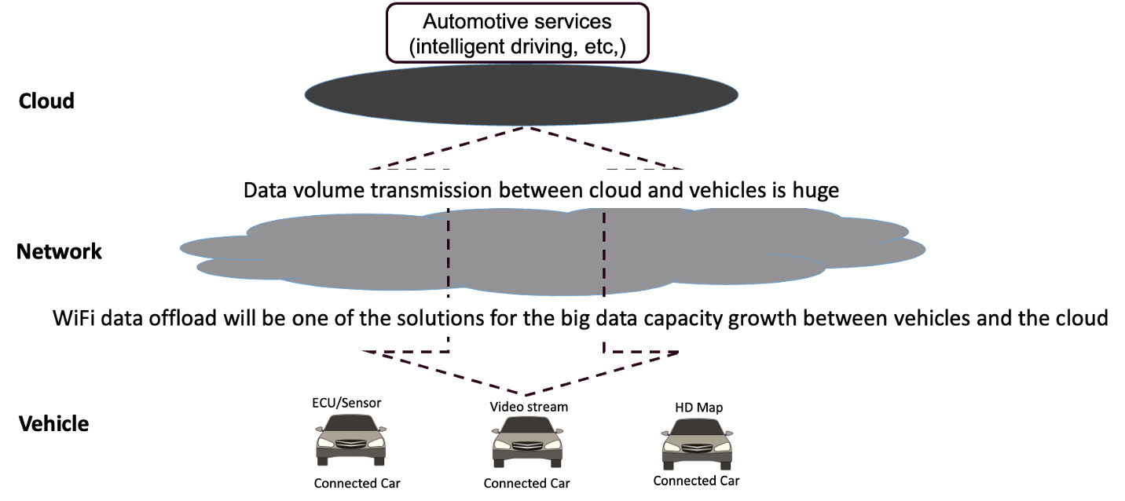
Background
Connected vehicles have become large procurers and consumers of data
Offloading data from cellular to WLAN
may offer a faster and more cost-effective
solution for connected vehicles
Requirements such as fast association & authentication, seamless AP handover, optimized roaming algorithm, etc., are essential for WLAN data offload for automotive
However, current IEEE standards still has gaps to satisfy the WLAN data offload for automotive
100 petabytes of data is transferred to the cloud monthly
      Camera generates data (500~3500) Mbit/s/camera
      RADAR generates data (0.1~15) Mbit/s/RADAR
Jing Ma (Toyota)

Slide 4

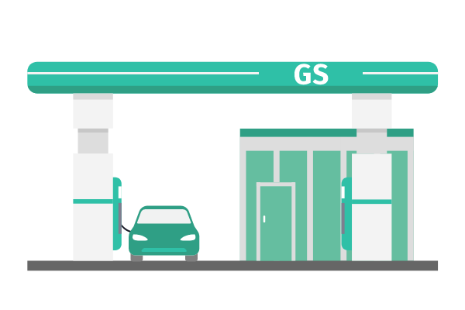





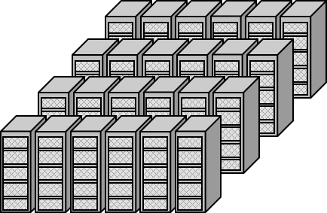
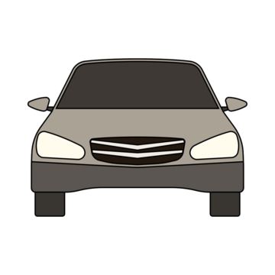

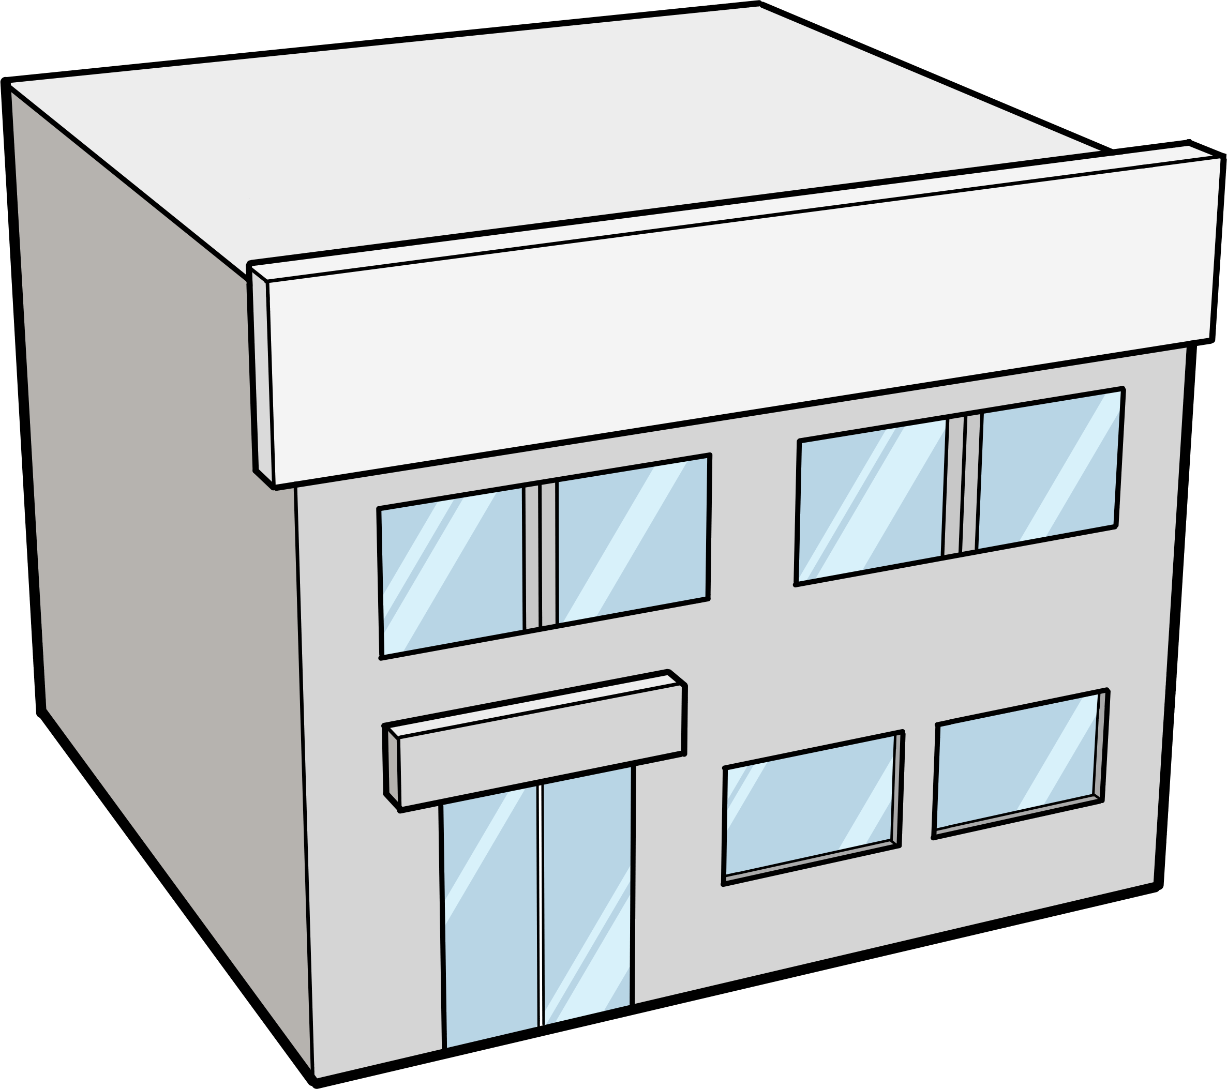
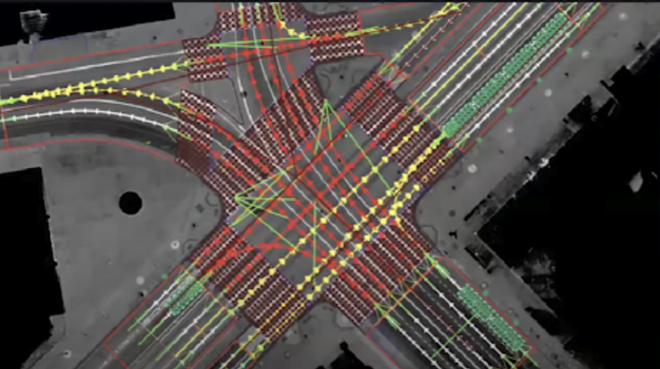


Applications
WLAN can provide efficient local connectivity for transferring large amounts of data between vehicles and the cloud for automotive applications such as Reginal HD Maps and remote diagnostics.
Core & network
Local data exchange between vehicle and WLAN AP
Remote Diagnostics
Data center
Reginal HD MAP
Jing Ma (Toyota)

Slide 5
Previous WNG presentations
Several presentations have been made to WNG on WDOA
  At the March session (2): 24/415r1
  At the May session (1): 24/792r1
  These presentations have introduced the needs, example use cases, potential gaps between current IEEE specification and the requirements of WDOA
Jing Ma (Toyota)

Slide 6
Previous WNG presentations
Summarize of initial analysis of current solutions & gaps
Requirements | Relevant current IEEE802 specifications | Relevant features | Gaps
Network discovery/ selection | 11u | ANQP, etc. | No faster network discovery, selection
Fast association & authentication | 11ai | FILS | Link unstable on the move may cause delay on link setup, failure on handover
Seamless handover among APs | 11r | Fast BSS Transition
 | 11k | Radio Resource Measurement
 | 11bn | Seamless roaming
Jing Ma (Toyota)

Slide 7
WLAN Data Offload for Automotive: scope of work
Discuss contributions in the areas of, but not limited to:
  Use cases and requirements
  Key performance indicators
  Technical approaches and 802.11 standard gaps in the areas such as protocols in association & authentication, seamless AP handover, optimized roaming algorithm etc.
  Alternative solutions
These discussions will inform the TIG on the need and timing of requesting formation of a SG at a future 802.11 meeting
Jing Ma (Toyota)

Slide 8
Straw poll
Do you agree to form a TIG of WLAN Data Offload for Automotive (WDOA) to investigate use cases, requirements, technical approaches and 802.11 standard gaps to support requirements.
Y
N
A
Jing Ma (Toyota)

Slide 9
References
[1] 11-24/415r1 Data offload using WLAN in connected vehicle case, March, 2024
[2] 11-24/793r1 Follow-up of Data offload using WLAN in connected vehicle case, May, 2024

