Slide 1
Frequency Domain UEQM
Date: 2024-07-10
Authors:
Name | Affiliations | Address | Phone | email
Mengshi Hu | Huawei |  |  | humengshi@huawei.com
Ross Jian Yu
Ming Gan

Slide 2
Background
UEQM (Unequal Modulation) is a promising feature enabling different modulation orders in the resource allocated to a user. It can provide obvious gains if there exists a large SNR difference [1]. In general, there are mainly two kinds of UEQM [2]:
  Spatial domain UEQM (Different modulations are applied to different spatial streams)
  Frequency domain UEQM (Different modulations are applied to different subcarriers)
The spatial domain UEQM is discussed in many contributions, where the benefits, UEQM combinations, number of spatial streams, etc. are talked about [3-6].
  In this contribution, the frequency domain UEQM is further discussed.

Slide 3
Frequency UEQM
  Regarding the frequency domain UEQM, some related simulation results and benefits are mentioned in [2].
  Take advantage of the channel selective gains.
  Good for the interference case where some of the subcarriers suffer from a relatively strong interference.
Fig. 1 A use case of frequency UEQM

Slide 4
How to Divide the Frequency Resource?
  To enable frequency domain UEQM, a resource division process similar to the spatial domain UEQM is needed to convey different modulation orders.
  In spatial domain UEQM, the resource allocated to a user is divided into multiple spatial streams.
  Regarding the frequency domain UEQM, subcarriers can be divided into different frequency parts corresponding to different modulation orders. In the subsequent slides, two division processes are discussed:
  Division of an MRU
  Division of an RU

Slide 5
Division of an MRU
  Regarding the frequency domain UEQM, one natural thought in the case of MRU is to divide the resource into different RUs.
  Each parts after division corresponds to an existing RU. There is no need to define new frequency resources.
  Some examples are shown below：
Fig. 2a Divide a 484+242-tone MRU into 2 parts
Fig. 2b Divide a 3*996-tone into 3 parts
Fig. 2c Divide a 3*996-tone MRU into 2 parts

Slide 6
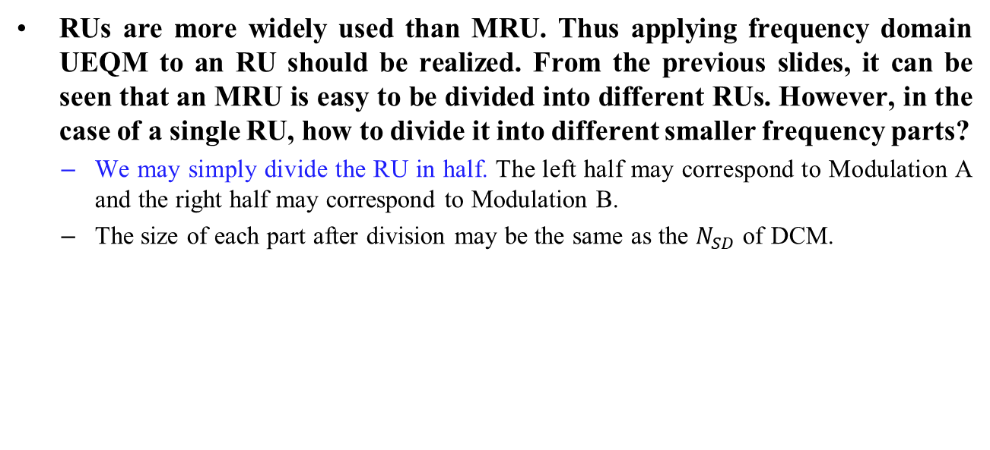
Division of a Single RU
  RUs are more widely used than MRU. Thus applying frequency domain UEQM to an RU should be realized. From the previous slides, it can be seen that an MRU is easy to be divided into different RUs. However, in the case of a single RU, how to divide it into different smaller frequency parts?
  We may simply divide the RU in half. The left half may correspond to Modulation A and the right half may correspond to Modulation B.
  The size of each part after division may be the same as the $N_{SD}$ of DCM.

Slide 7
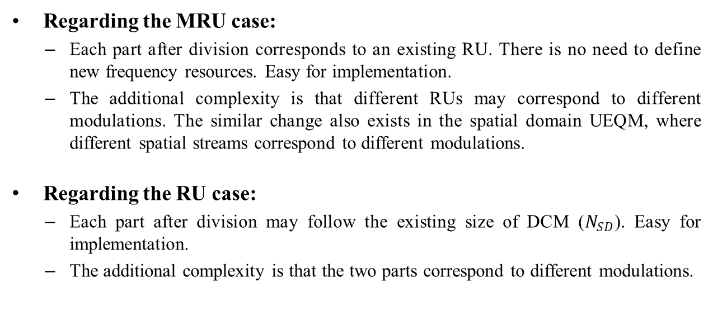
Discussion on Complexity
  Regarding the MRU case:
  Each part after division corresponds to an existing RU. There is no need to define new frequency resources. Easy for implementation.
  The additional complexity is that different RUs may correspond to different modulations. The similar change also exists in the spatial domain UEQM, where different spatial streams correspond to different modulations.
  Regarding the RU case:
  Each part after division may follow the existing size of DCM ($N_{SD}$). Easy for implementation.
  The additional complexity is that the two parts correspond to different modulations.

Slide 8
Summary
In this contribution, the frequency domain UEQM is discussed.
  An MRU could be divided into different RUs to convey different modulations.
  An RU could be divided into two parts corresponding to different modulations.
  Suggest enabling frequency domain UEQM for the interference case.

Slide 9
References
[2] 11-24-0438-00-00bn-ueqm-benefit-analysis
[1] 11-24-0433-00-00bn-analysis-on-ueqm-and-ueq-mcs
[3] 11-24-0117-01-00bn-improved-tx-beamforming-with-ueqm
[4] 11-24-0439-00-00bn-ueqm-evaluation-and-simulation-results
[5] 11-24-0507-02-00bn-ueqm-further-details
[6] 11-24-0734-01-00bn-on-ueqm-and-ueq-mcs

Slide 10
Straw Poll #1
Do you agree to include the following into the 11bn SFD?
  11bn defines frequency domain unequal modulation (UEQM).
    Different subcarriers allocated to a user may correspond to different modulation orders.
    Y
    N
    A

Slide 11
Straw Poll #2
Do you agree to include the following into the 11bn SFD?
  11bn defines spatial domain unequal modulation (UEQM) and frequency domain UEQM.
    Spatial domain UEQM: Different spatial streams allocated to a user may correspond to different modulation orders.
    Frequency domain UEQM: Different subcarriers allocated to a user may correspond to different modulation orders.
    Y
    N
    A

