Slide 1
UHR-LTF Design for DRU
Date: 2024-07-04
Authors:

Slide 2
Abstract
In this contribution, we share our insights about the design of the UHR-LTF for DRU. Particularly, we
  Discuss the possibility of reusing existing EHT-LTF types and sequences for DRU in TB PPDU.
  Propose two different methods for the selection of the LTF sequence for DRU
  Share results for the PAPR performance of the UHR-LTF for DRU and discuss our recommendations.

Slide 3
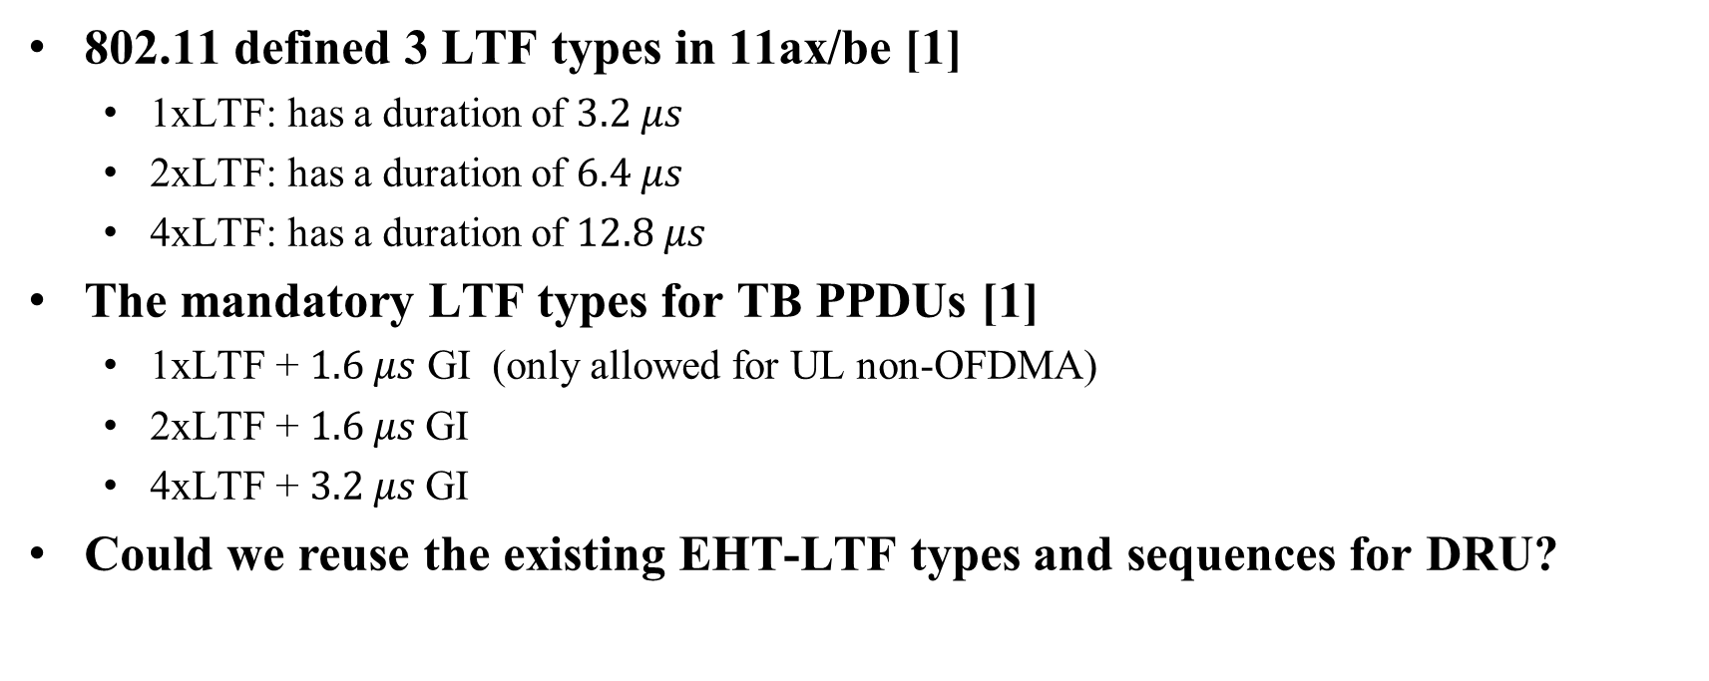
LTF Types in 802.11ax/be
802.11 defined 3 LTF types in 11ax/be [1]
  1xLTF: has a duration of $3.2 μs$
  2xLTF: has a duration of $6.4 μs$
  4xLTF: has a duration of $12.8 μs$
The mandatory LTF types for TB PPDUs [1]
  1xLTF + $1.6 μs$ GI (only allowed for UL non-OFDMA)
  2xLTF + $1.6 μs$GI
  4xLTF + $3.2 μs$GI
Could we reuse the existing EHT-LTF types and sequences for DRU?

Slide 4
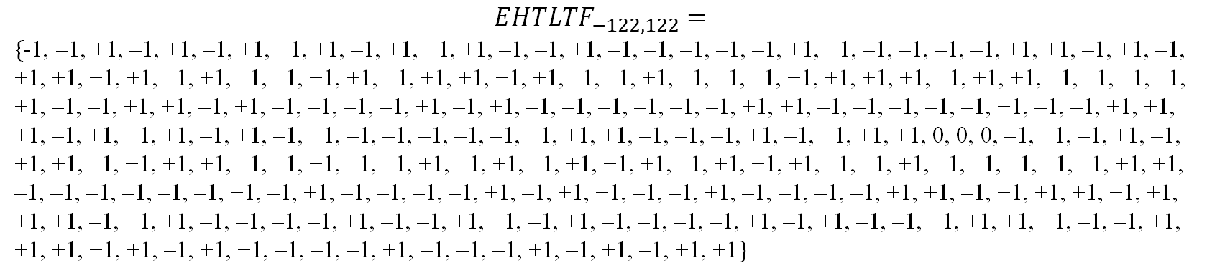
Reusing EHT-LTF for DRU
Example of a 4xLTF for 26DRU20
$$EHTLTF_{−122,122}=$$
$\{$-1, –1, +1, –1, +1, –1, +1, +1, +1, –1, +1, +1, +1, –1, –1, +1, –1, –1, –1, –1, –1, +1, +1, –1, –1, –1, –1, +1, +1, –1, +1, –1, +1, +1, +1, +1, –1, +1, –1, –1, +1, +1, –1, +1, +1, +1, +1, –1, –1, +1, –1, –1, –1, +1, +1, +1, +1, –1, +1, +1, –1, –1, –1, –1, +1, –1, –1, +1, +1, –1, +1, –1, –1, –1, –1, +1, –1, +1, –1, –1, –1, –1, –1, –1, +1, +1, –1, –1, –1, –1, –1, +1, –1, –1, +1, +1, +1, –1, +1, +1, +1, –1, +1, –1, +1, –1, –1, –1, –1, –1, +1, +1, +1, –1, –1, –1, +1, –1, +1, +1, +1, 0, 0, 0, –1, +1, –1, +1, –1, +1, +1, –1, +1, +1, +1, –1, –1, +1, –1, –1, +1, –1, +1, –1, +1, +1, +1, –1, +1, +1, +1, –1, –1, +1, –1, –1, –1, –1, –1, +1, +1, –1, –1, –1, –1, –1, –1, +1, –1, +1, –1, –1, –1, –1, +1, –1, +1, +1, –1, –1, +1, –1, –1, –1, –1, +1, +1, –1, +1, +1, +1, +1, +1, +1, +1, –1, +1, +1, –1, –1, –1, –1, +1, –1, –1, +1, +1, –1, +1, –1, –1, –1, –1, +1, –1, +1, –1, –1, +1, +1, +1, +1, –1, –1, +1, +1, +1, +1, +1, –1, +1, +1, –1, –1, –1, +1, –1, –1, –1, +1, –1, +1, –1, +1, +1$\}$
Method 1
The UHR-LTF sequence of a DRU is picked from the EHT-LTF sequence corresponding to the data/pilot subcarrier indices of the DRU
Note: The set of 7 elements of the selected LTF sequence in the blue boxes is a subset of the 26-elements LTF sequence corresponding to a 26-tone DRU
Method 2
The UHR-LTF sequence of a DRU is the EHT-LTF sequence of a corresponding RRU. Specifically, the EHT-LTF sequence of the first RRU is used as the UHR-LTF sequence for the first DRU, the EHT-LTF sequence of the second RRU is used as the UHR-LTF sequence for the second DRU and so on and so forth

Slide 5
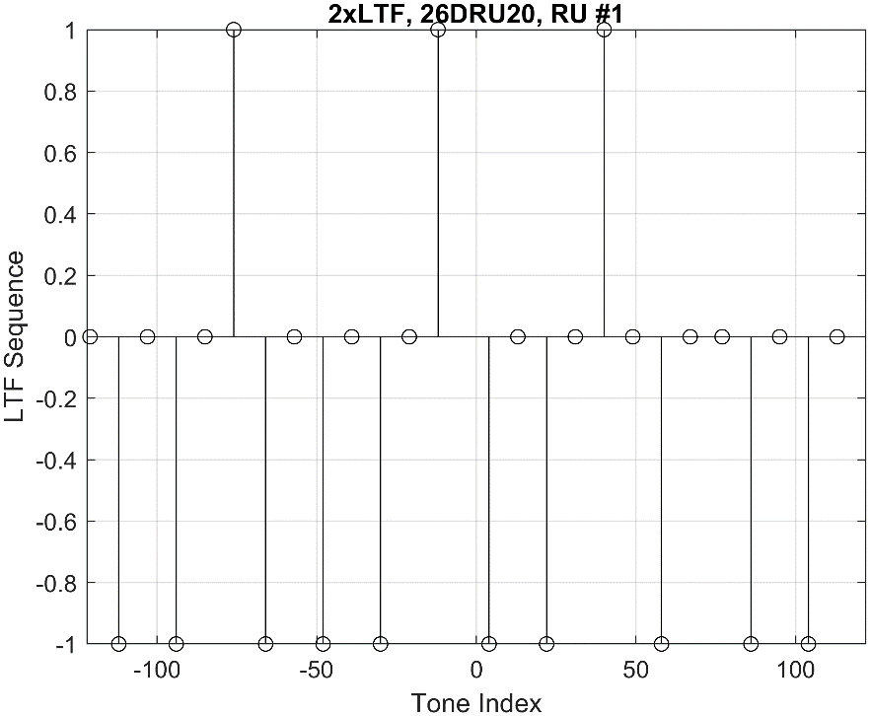
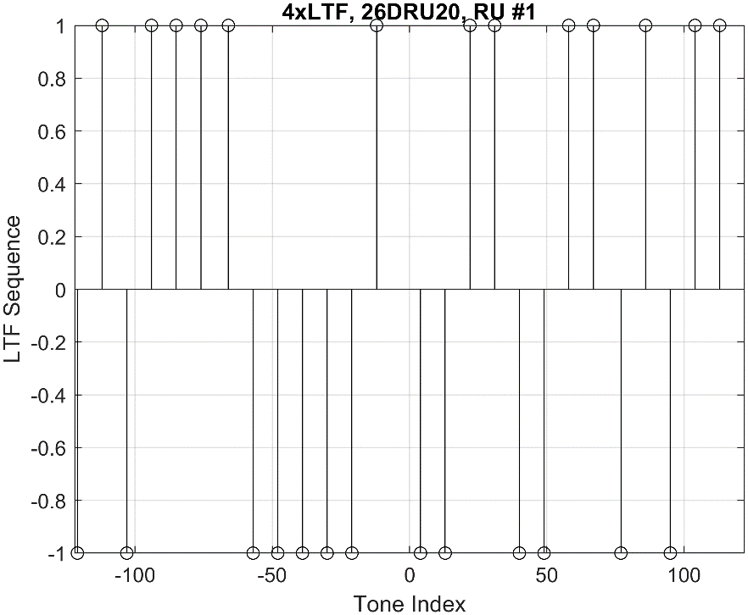
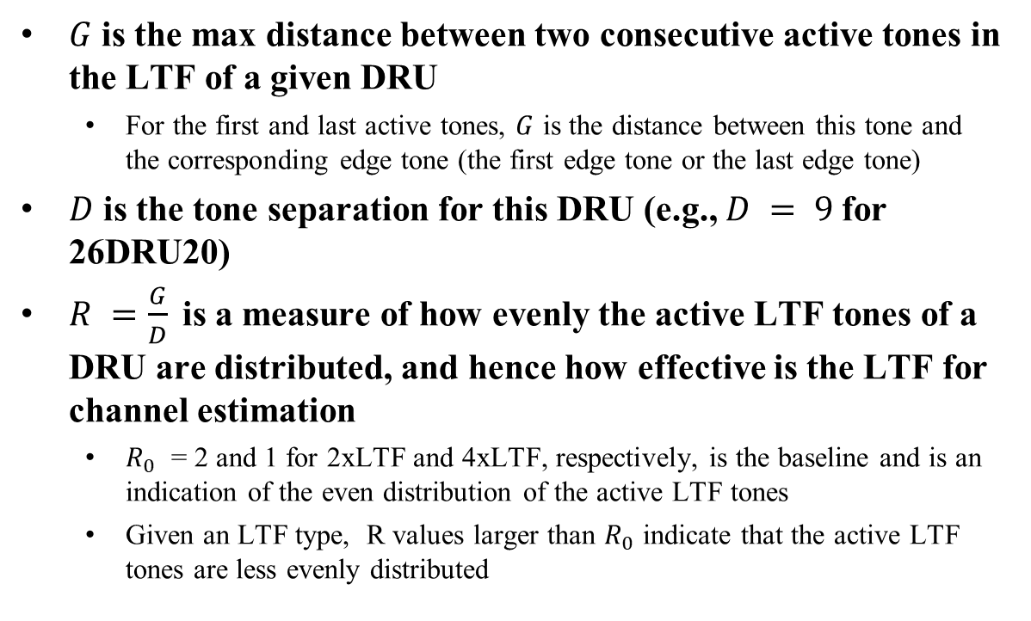
Distance between Active Tones of the LTF in DRUs (Method 1)
$G$ is the max distance between two consecutive active tones in the LTF of a given DRU
  For the first and last active tones, $G$ is the distance between this tone and the corresponding edge tone (the first edge tone or the last edge tone)
$D$ is the tone separation for this DRU (e.g., $D = 9$for 26DRU20)
$R =\frac{G}{D}$is a measure of how evenly the active LTF tones of a DRU are distributed, and hence how effective is the LTF for channel estimation
  $R_{0}$ = 2 and 1 for 2xLTF and 4xLTF, respectively, is the baseline and is an indication of the even distribution of the active LTF tones
  Given an LTF type, R values larger than $R_{0}$ indicate that the active LTF tones are less evenly distributed
G
G

Slide 6
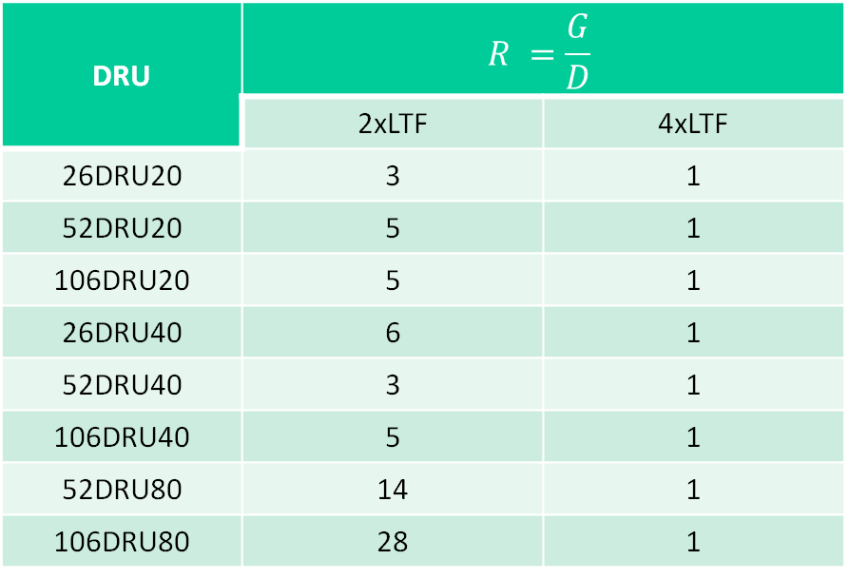
Applying Different LTF Types to DRU (Method 1)
The R values of several DRU sizes and distribution bandwidths are listed in the table below
  These values are for the first DRU in each DRU size
DRU | $$R =\frac{G}{D}$$
 | 2xLTF | 4xLTF
26DRU20 | 3 | 1
52DRU20 | 5 | 1
106DRU20 | 5 | 1
26DRU40 | 6 | 1
52DRU40 | 3 | 1
106DRU40 | 5 | 1
52DRU80 | 14 | 1
106DRU80 | 28 | 1

Slide 7

Applying Different LTF Types to DRU (Method 1)
The R value is plotted for all DRUs corresponding to all combinations of DRU sizes and distribution bandwidths for each LTF type.
For 4xLTF, the R value is 1 indicating that the LTF sequence for 4xLTF mode is almost evenly distributed for all DRU sizes
For 2xLTF, the CDF of the R value is spread over a large range
  The LTF sequence for 2xLTF is far less evenly distributed
  The uneven distribution of the active LTF tones results in a clustering problem
$R_{0}$

Slide 8
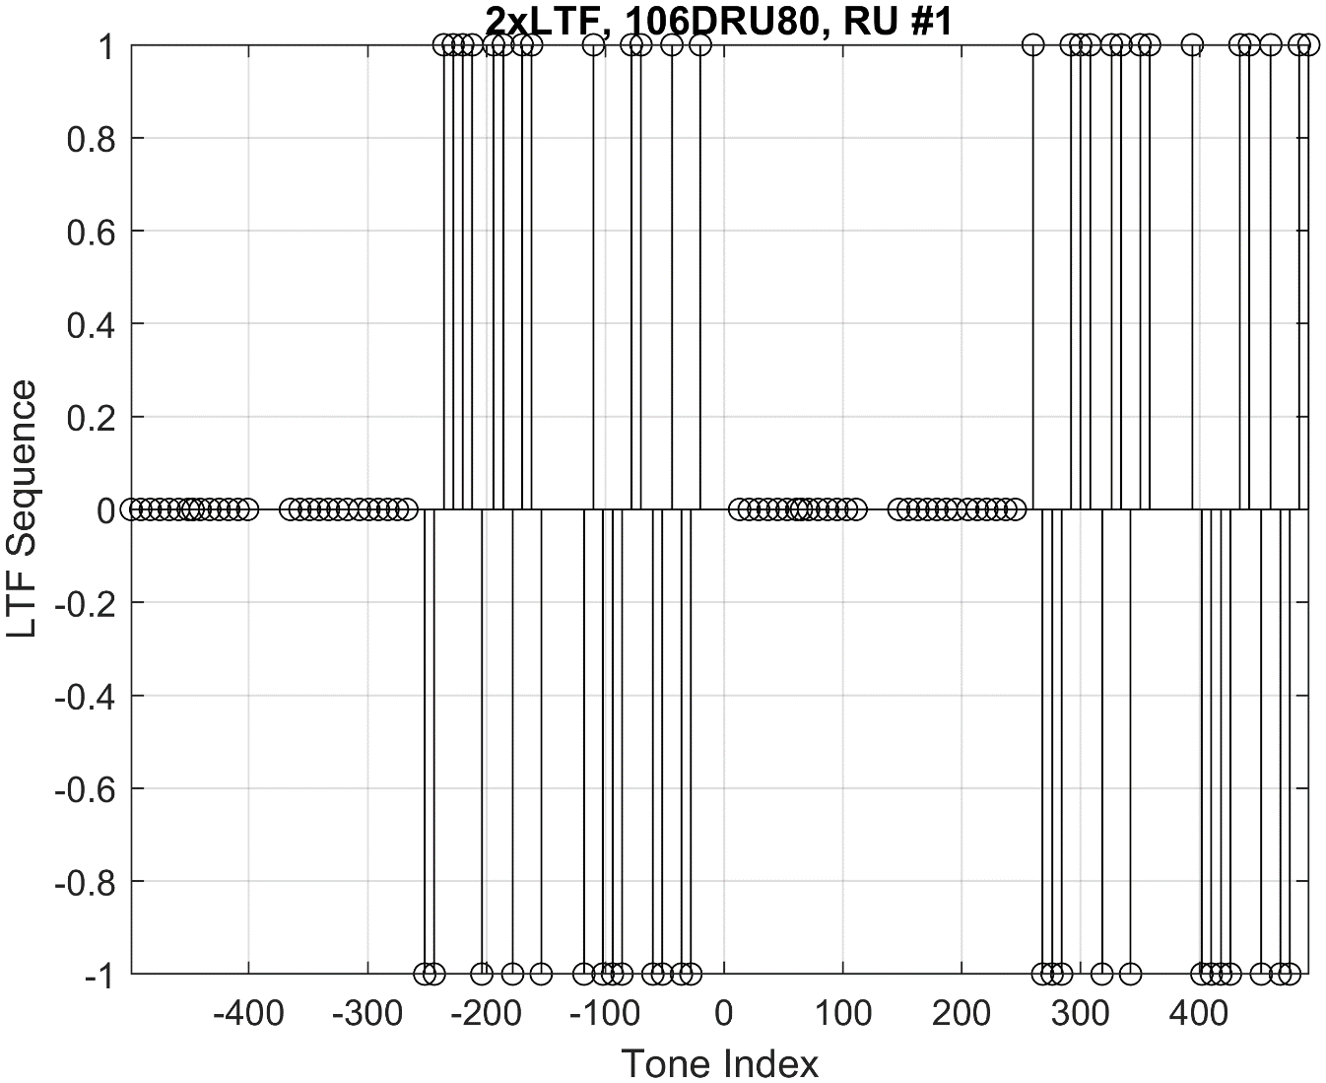
Clustered LTF Tones
For some DRU sizes and distribution bandwidths, the tones are clustered in parts of the distribution bandwidth
  This leaves other parts of the distribution bandwidth with no active tones.
  Interpolation and extrapolation may be needed to fill the missing gaps.
  The accuracy of channel estimation of such LTF sequence is not adequate.
Cluster

Slide 9
Applying Different LTF Types to DRU (Method 2)
Method 2 provides even distribution of the LTF active tones for all LTF types.
Method 2 may not require extra implementation burden since the same LTF sequences for an RRU can be reused for a DRU of the same RU size.
In the next slides, we further investigate the PAPR performance of the LTF sequence for the two methods.

Slide 10
Simulation Parameters for PAPR Performance
Tone Plan: The tone plan proposed in [2]
MCS = 1
OSF = 8
Distribution bandwidth = 20 MHz and 40 MHz
All DRUs for the corresponding distribution bandwidth are considered
LTF Mode: 2xLTF and 4xLTF
Simulation length: 1000 packets
APEP length: 100 Bytes

Slide 11
PAPR Performance of DRU (2xLTF)

Slide 12
PAPR Performance of DRU (4xLTF)

Slide 13
Discussion on PAPR Performance
The PAPR of the LTF of DRU is considerably larger than the PAPR of the LTF of RRU.
  However, PAPR of the LTF is still lower than PAPR of the data
In general, Method 2 reduces the PAPR of the LTF of DRU when compared to Method 1
In some cases, the PAPR of the LTF of DRU approaches the PAPR of the LTF of RRU.
  For example, 2xLTF for 52DRU40.

Slide 14
Conclusions and Way Forward
Two methods of reusing EHT-LTFs for DRU are proposed
  Method 1: The LTF sequence of a DRU is picked from the LTF sequence corresponding to the distribution bandwidth at the subcarrier indices of the DRU
    Method 1 results in uneven distribution of the active LTF tones for 2xLTF type
  Method 2: The LTF sequence of a given DRU is the LTF sequence of the corresponding RRU. Specifically, the LTF sequence of the first RRU can be used for the first DRU, the LTF sequence of the second RRU can be used for the second DRU and so on and so forth
    Applying Method 2 to 2xLTF types avoids the above-mentioned problem
PAPR of DRU is generally larger than PAPR of RRU
  Method 2 shows PAPR reduction in most DRU sizes and distribution bandwidths when compared to Method 1
Recommendations:
  If Method 1 is used for the selection of LTF sequence of DRU, make 4x EHT-LTF the mandatory mode for channel estimation for DRUs
  If Method 2 is used for the selection of LTF sequence of DRUs, both 2x EHT-LTF and 4x EHT-LTF can be used for channel estimation for DRUs

Slide 15
SP 1
Do you agree to add the following to 11bn SFD:
UHR supports the use of 2xEHT-LTF for DRU in TB PPDU, i.e., the element of the LTF sequence for each DRU tone is selected from 2x EHT-LTF
- The LTF sequence selection method is TBD
- The element of the LTF sequence could be +1, -1, or 0

Slide 16
SP 2
Do you agree to add the following to 11bn SFD:
UHR supports the use of 4xEHT-LTF for DRU in TB PPDU, i.e., the element of the LTF sequence for each DRU tone is selected from 4x EHT-LTF
- The LTF sequence selection method is TBD
- The element of the LTF sequence could be +1 or -1

Slide 17
References
[1] IEEE P802.11be™/D6.0 - Amendment 2: Enhancements for extremely high throughput (EHT), May 2024
[2] 11/24-0402r1 20 MHz Tone Plan and Pilot Design for DRU

