Slide 1
Periodic IDC signaling for UHR AP
Date: 2024-07-16
Authors:
Name | Affiliation | Address | Phone | Email
Hongwon Lee | LG Electronics | 19, Yangjae-daero 11gil, Seocho-gu, Seoul 137-130, Korea |  | hongwon.lee@lge.com
Insun Jang |  |  |  | insun.jang@lge.com
Geonhwan Kim |  |  |  | geonhwan.kim@lge.com
Jinsoo Choi |  |  |  | js.choi@lge.com
Sunhee Baek |  |  |  | sunhee.baek@lge.com
Yelin Yoon |  |  |  | yl.yoon@lge.com
Dongju Cha |  |  |  | dongju.cha@lge.com
HanGyu Cho |  |  |  | hg.cho@lge.com
Sanggook Kim |  | 10680 Treena St, San Diego CA 92131 , USA |  | sanggook.kim@lge.com

Slide 2
Introduction
Many presentations [1]-[8] already addressed the importance of handling unavailability due to in-device-coexistence (IDC) and several methods to resolve the IDC issues
According to several contributions[1][3][4][6][8], IDC information should be signaled to avoid collision in IDC status
There is a discussion on how to handle periodic IDC for non-AP STA [9]
In this contribution, we share our view on how to handle the periodic IDC issue for UHR Mobile AP in detail

Slide 3
Recap: Periodic IDC signaling – information [9]
IDC Information
  Unavailable time
    IDC start time: When “unavailability” starts (i.e., start time)
    IDC duration: How long “unavailability” lasts (i.e., duration)
    IDC interval: Interval between Periodic IDC Service Period(SP)s
    * Periodic IDC SP refers to the recurring unavailable time due to IDC
  Frequency / Channel
    IDC Channel: Unavailable (or available) channels during IDC duration
      One useful piece of information to improve Wi-Fi latency during the IDC period(e.g. The IDC device may use some available channels during the IDC SP)
  Other information’s
    Available number of Spatial Stream can be considered information to avoid IDC situation

Slide 4
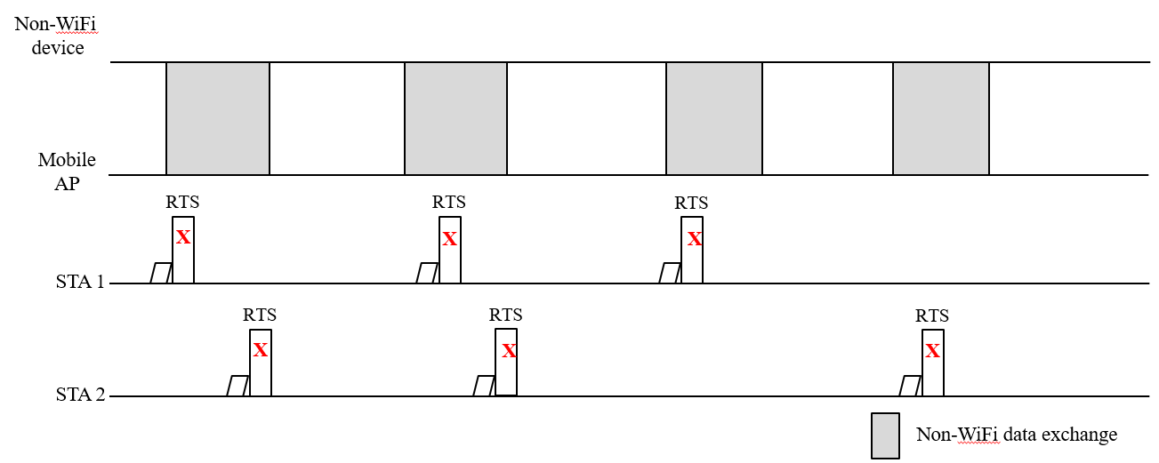
In-device-coexistence in Mobile AP(1/2)
Smart device such as Smartphones and laptops can have a Mobile AP role, and non-WiFi wireless technology such as Bluetooth, UWB and others can be applied together
  E.g. A Smart Phone user listens to music via Bluetooth while using Wi-Fi tethering
We may need to consider some issues due to IDC in Mobile AP
  There may be some failures in transmitting data between the Mobile AP and non-AP STA if there are periodic IDC events in the Mobile AP

Slide 5
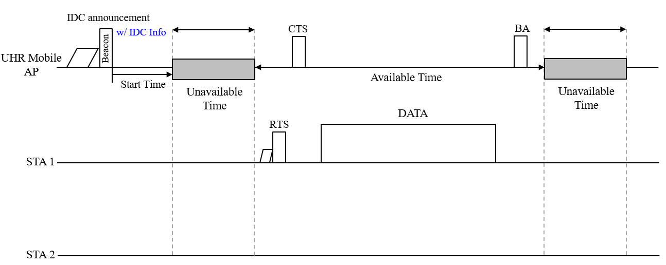
In-device-coexistence in Mobile AP(2/2)
UHR Mobile AP can announce it’s periodic in-device-coexistence(IDC) information to STAs
  Using this information, STAs can avoid collision with Non-WiFi data exchange in UHR Mobile AP

Slide 6
IDC use cases for infrastructure APs (?)
Should we really not consider the IDC mechanism for infrastructure APs? If not, why?
It is true that most infrastructure APs are standalone in the field currently
Can it be guaranteed that infrastructure APs will always remain standalone in the field in the future?
There may be an answer if we look at the smart home industry; other industries can also be considered

Slide 7
Infrastructure AP in the future
The requirements for multiple connectivity technologies in infrastructure APs are necessary due to the evolution of various industries; Wi-Fi may be no longer the only connectivity technology for infrastructure APs
An infrastructure AP that has both Wi-Fi and non-WiFi connectivity (e.g., Thread Border Router, BLE, UWB, Zigbee, and more) can be deployed in specific environments such as smart homes and smart factories
  Multiple connectivity technologies are already applied to some Wi-Fi AP products such as Nest Wifi pro, Amazon eero Pro 6 and Edge-corE Wi-Fi Access Point, etc.
We can also predict that an infrastructure AP with multiple connectivity will be feasible in the future by studying the architecture defined by the Matter standard (CSA)
  Matter considers Wi-Fi, Bluetooth/BLE, Thread(802.15.4) as connectivity technologies
  Some Matter devices can have the functionalities of Wi-Fi AP and Thread Border Router(to connect with Matter controlees)

Slide 8




Wi-Fi Access Point types example
The IoT products (e.g., IoT gateways) and Matter standard can currently cover Type A and/or Type B
Type C may be feasible based on evolving standards and/or implementations aligned with future IoT requirements
Type A | Type B | Type C
Time
Current
Increasing IDC issues
√
Wi-Fi AP
Wi-Fi AP
Wi-Fi AP
Thread Border Router
BT/BLE
UWB
Device 1
Thread Border Router
Thread Border Router
Device 1
Device 1
Device 2
Device 3
Device 2
Device 3
Device 2
Device 3
Device 4
Notes:
*

Slide 9
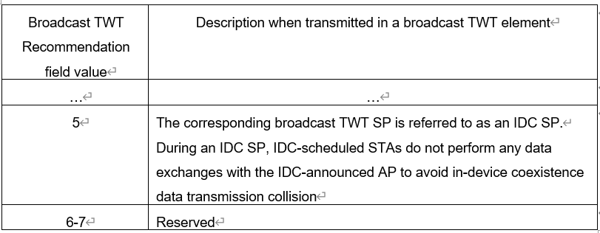
Periodic IDC signaling for Mobile AP(1/3)
TWT element variant to include IDC information
  Broadcast TWT element is one of the good options to indicate periodic IDC events of UHR Mobile AP
  New Broadcast TWT Recommendation field value in the Request type subfield can be defined for Periodic IDC signaling for UHR Mobile AP

Slide 10
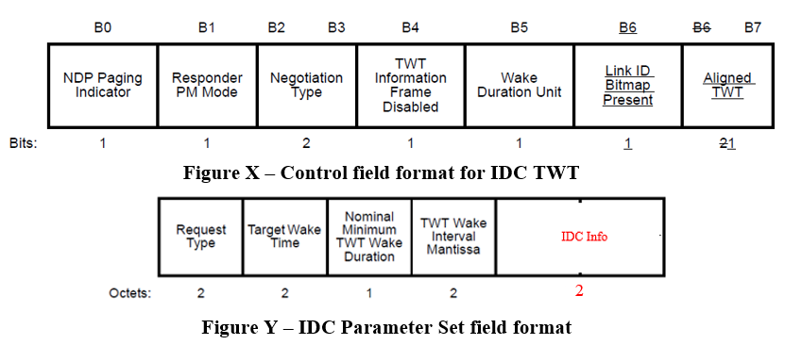
Periodic IDC signaling for Mobile AP(2/3)
TWT element variant to include IDC information (continue)
  Negotiation Type in the Control field should be set to 2 to reuse the Broadcast TWT Parameter set
    Broadcast TWT Recommendation subfield value is allowed to set to 5 only if the Negotiation Type subfield is set to 2
  IDC Information(IDC Info) can be included in the IDC Parameter Set if the Broadcast TWT Recommendation subfield value is set to 5
= 2
* Request Type can be redefined for the IDC parameter set(see next slide)

Slide 11
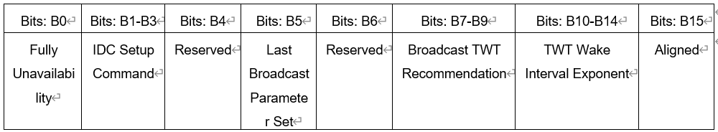
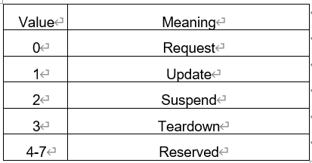
Periodic IDC signaling for Mobile AP(3/3)
TWT element variant to include IDC information (continue)
  Request Type variant can be defined for IDC announcement
    Fully unavailability field indicates whether IDC SP is fully unavailable or not. If it is set to 1, IDC SP is fully unavailable. If it is set to 0, IDC SP is partially unavailable.
    * If the IDC SP is partially unavailable, Wi-Fi data exchange may be performed using other methods such
    as using another available channel, spatial stream, and so on.
    IDC Setup Command indicates IDC TWT command
Reserved
Reserved
Reserved
= 5

Slide 12
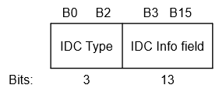
Periodic IDC signaling for Mobile AP(3/3)
TWT element variant to include IDC information(continue)
  IDC Info may include ID, IDC Channel, Available NSS, etc.
  There is a size restriction for including IDC info in the IDC parameter set if legacy STA(s) are considered (2 octets)
  IDC Info example
    Multiple IDC Parameter sets can be contained in the TWT Parameter information to include more IDC Info(indicated by the Last Broadcast Parameter Set in the Request Type)
IDC Type value | Meaning
0 | ID + Persistence
1 | IDC Channel 1(primary 160MHz)
2 | IDC Channel 2(secondary 160MHz)
3 | Available NSS + Tx/Rx Only
4 | Tx/Rx Parameter
5 - 7 | Reserved
If IDC Type value is 1,
the last bit can indicate
the continuity of the
channel bitmap to cover
up to 320MHz

Slide 13
Conclusion
We discussed the periodic IDC announcement for UHR Mobile AP
There may be some cases which should handle IDC situation in Mobile AP
  E.g. A Smart Phone user listens to music via Bluetooth while using Wi-Fi tethering
We should also consider applying the IDC mechanism to infrastructure APs
The IDC information of UHR Mobile AP can be announced by reusing the TWT element
  Broadcast TWT may be reused to include IDC info
  The reused TWT element for IDC can be signaled through a broadcast frame such as Beacon for UHR Mobile AP

Slide 14
Straw Poll 1
Do you agree to include the following into the 11bn SFD?
  11bn defines or reuse/update existing mechanism for a UHR AP to report long term (periodic) unavailability
    Applies when the peer STA(s) supports the mechanism

Slide 15
Straw Poll 2
Do you agree to include the following into the 11bn SFD?
  11bn reuses the TWT element in which a UHR AP announces and updates a periodic unavailability due to in-device-coexistence in time to its peer STAs
    Signaling detail is TBD

Slide 16
References
[1] 11-23/293r0, Improved reliability in presence of interference or other device activities
[2] 11-23/816r1, Enhancements for latency sensitive traffic and in-device-coexistence - Part 1
[3] 11-23/1103r0, In-Device Interference Discussion
[4] 11-23/1934r0, In-Device Interference Mitigation Follow Up
[5] 11-23/1964r1, Coexistence Protocols for UHR
[6] 11-23/2002r2, In-device Coexistence and P2P – follow-up
[7] 11-24/420r0, Enabling Flexible Coexistence Operation
[8] 11-24/436r0, SP Based In-Device Coexistence
[9] 11-24/831r0, Periodic IDC use cases and considerations for signaling

Slide 17
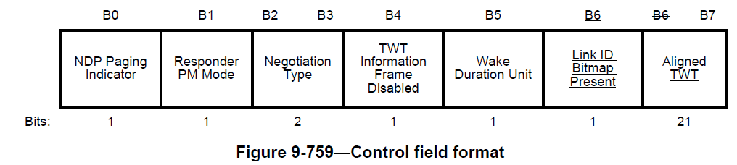
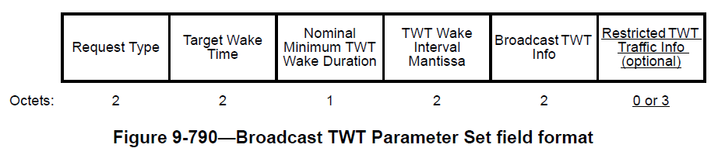
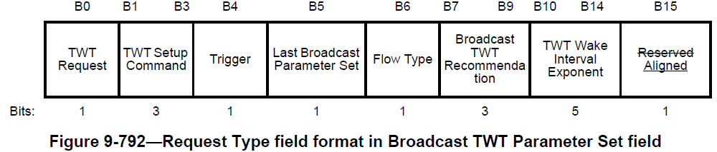
Appendix. Broadcast TWT element

