Slide 1
Periodic IDC signaling for UHR Mobile AP
Date: 2024-07-xx
Authors:
Name | Affiliation | Address | Phone | Email
Hongwon Lee | LG Electronics | 19, Yangjae-daero 11gil, Seocho-gu, Seoul 137-130, Korea |  | hongwon.lee@lge.com
Insun Jang |  |  |  | insun.jang@lge.com
Geonhwan Kim |  |  |  | geonhwan.kim@lge.com
Jinsoo Choi |  |  |  | js.choi@lge.com
Sunhee Baek |  |  |  | sunhee.baek@lge.com
Yelin Yoon |  |  |  | yl.yoon@lge.com
Dongju Cha |  |  |  | dongju.cha@lge.com
HanGyu Cho |  |  |  | hg.cho@lge.com
Sanggook Kim |  | 10680 Treena St, San Diego CA 92131 , USA |  | sanggook.kim@lge.com

Slide 2
Introduction
Many presentations [1]-[8] already addressed the importance of handling unavailability due to in-device-coexistence (IDC) and several methods to resolve the IDC issues
According to several contributions[1][3][4][6][8], IDC information should be signaled to avoid collision in IDC status
There is a discussion on how to handle periodic IDC for non-AP STA [9]
In this contribution, we share our view on how to handle the periodic IDC issue for UHR Mobile AP in detail

Slide 3
Recap: Periodic IDC signaling – information [9]
IDC Information
  Unavailable time
    IDC start time: When “unavailability” starts (i.e., start time)
    IDC duration: How long “unavailability” lasts (i.e., duration)
    IDC interval: Interval between Periodic IDC Service Period(SP)s
    * Periodic IDC SP refers to the recurring unavailable time due to IDC
  Frequency / Channel
    IDC Channel: Unavailable (or available) channels during IDC duration
      One useful piece of information to improve Wi-Fi latency during the IDC period(e.g. The IDC device may use some available channels during the IDC SP)
  Other information’s
    Available number of Spatial Stream can be considered information to avoid IDC situation

Slide 4
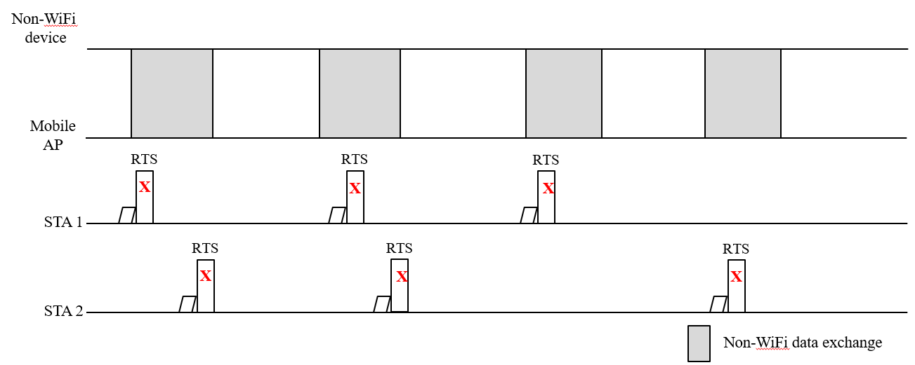
In-device-coexistence in Mobile AP(1/2)
Smart device such as Smartphones and laptops can have a Mobile AP role, and non-WiFi wireless technology such as Bluetooth, UWB and others can be applied together
  E.g. A Smart Phone user listens to music via Bluetooth while using Wi-Fi tethering
We may need to consider some issues due to IDC in Mobile AP
  There may be some failures in transmitting data between the Mobile AP and non-AP STA if there are periodic IDC events in the Mobile AP

Slide 5
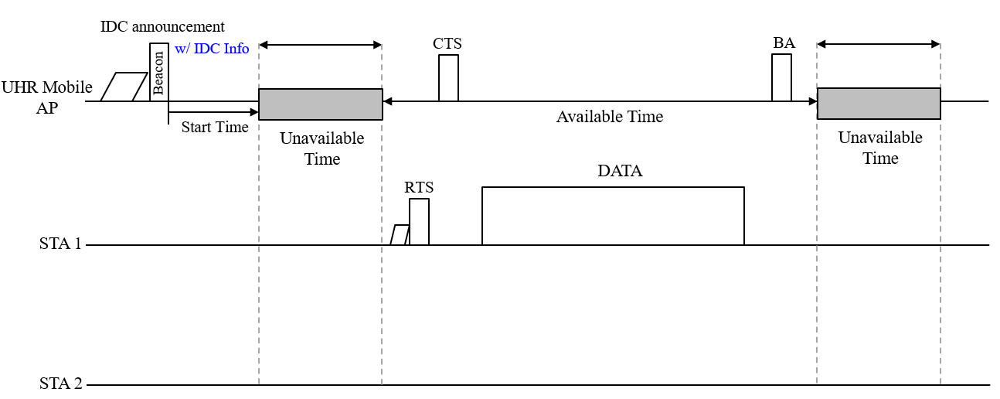
In-device-coexistence in Mobile AP(2/2)
UHR Mobile AP can announce it’s periodic in-device-coexistence(IDC) information to STAs
  Using this information, STAs can avoid collision with Non-WiFi data exchange in UHR Mobile AP

Slide 6
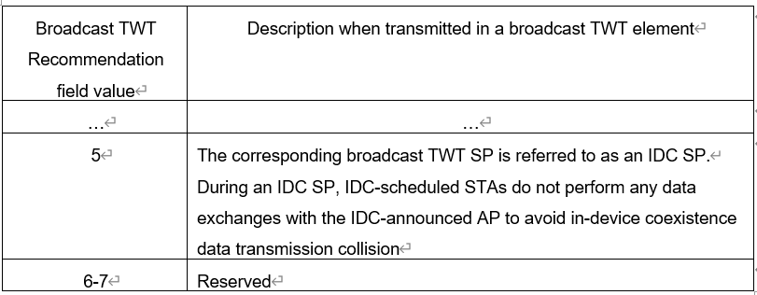
Periodic IDC signaling for Mobile AP(1/3)
TWT element variant to include IDC information
  Broadcast TWT element is one of the good options to indicate periodic IDC events of UHR Mobile AP
  New Broadcast TWT Recommendation field value in the Request type subfield can be defined for Periodic IDC signaling for UHR Mobile AP

Slide 7
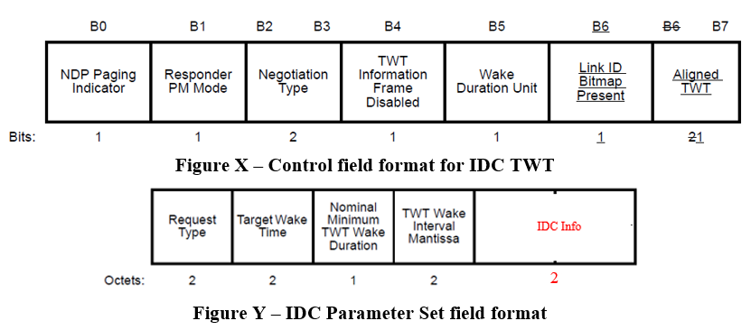
Periodic IDC signaling for Mobile AP(2/3)
TWT element variant to include IDC information (continue)
  Negotiation Type in the Control field should be set to 2 to reuse the Broadcast TWT Parameter set
    Broadcast TWT Recommendation subfield value is allowed to set to 5 only if the Negotiation Type subfield is set to 2
  IDC Information(IDC Info) can be included in the IDC Parameter Set if the Broadcast TWT Recommendation subfield value is set to 5
= 2
* Request Type can be redefined for the IDC parameter set(see next slide)

Slide 8
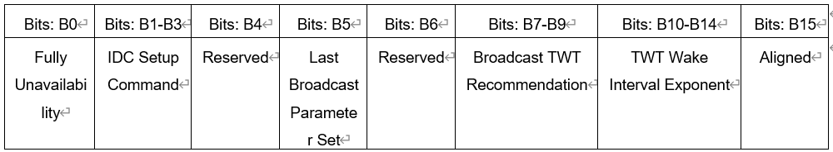
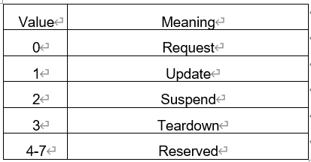
Periodic IDC signaling for Mobile AP(3/3)
TWT element variant to include IDC information (continue)
  Request Type variant can be defined for IDC announcement
    Fully unavailability field indicates whether IDC SP is fully unavailable or not. If it is set to 1, IDC SP is fully unavailable. If it is set to 0, IDC SP is partially unavailable.
    * If the IDC SP is partially unavailable, Wi-Fi data exchange may be performed using other methods such
    as using another available channel, spatial stream, and so on. If the Fully unavailability field is set to 0,
    other IDC information (e.g., Channel, NSS or other information) can be included
    IDC Setup Command indicates IDC TWT command
Reserved
Reserved
Reserved
= 5

Slide 9
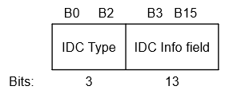
Periodic IDC signaling for Mobile AP(3/3)
TWT element variant to include IDC information(continue)
  IDC Info may include ID, IDC Channel, Availabe NSS, etc.
  There is a size restriction for including IDC info in the IDC parameter set if legacy STA(s) are considered (2 octets)
  IDC Info example
    Multiple IDC Parameter sets can be contained in the TWT Parameter information to include more IDC Info(indicated by the Last Broadcast Parameter Set in the Request Type)
IDC Type value | Meaning
0 | ID + Persistence
1 | IDC Channel 1(primary 160MHz)
2 | IDC Channel 2(secondary 160MHz)
3 | Max NSS + Tx/Rx Only
4 | Tx/Rx Parameter
5 - 7 | Reserved
If IDC Type value is 1,
the last bit can indicate
the continuity of the
channel bitmap to cover
up to 320MHz

Slide 10
Conclusion
We discussed the periodic IDC announcement for UHR Mobile AP
There may be some cases which should handle IDC situation in Mobile AP
  E.g. A Smart Phone user listens to music via Bluetooth while using Wi-Fi tethering
The IDC information of UHR Mobile AP can be announced by reusing the TWT element
  Broadcast TWT may be reused to include IDC info
  The reused TWT element for IDC can be signaled through a broadcast frame such as Beacon for UHR Mobile AP

Slide 11
Straw Poll 1
Do you agree to include the following into the 11bn SFD?
  11bn defines a mechanism to allow a UHR Mobile AP to announce a periodic unavailability in time

Slide 12
Straw Poll 2
Do you agree to include the following into the 11bn SFD?
  11bn defines a mechanism to allow a UHR Mobile AP to update a periodic unavailability in time

Slide 13
Straw Poll 3
Do you agree to include the following into the 11bn SFD?
  11bn reuses the TWT element in which a UHR Mobile AP announces and updates a periodic unavailability in time to its peer STAs
    Signaling detail is TBD

Slide 14
References
[1] 11-23/293r0, Improved reliability in presence of interference or other device activities
[2] 11-23/816r1, Enhancements for latency sensitive traffic and in-device-coexistence - Part 1
[3] 11-23/1103r0, In-Device Interference Discussion
[4] 11-23/1934r0, In-Device Interference Mitigation Follow Up
[5] 11-23/1964r1, Coexistence Protocols for UHR
[6] 11-23/2002r2, In-device Coexistence and P2P – follow-up
[7] 11-24/420r0, Enabling Flexible Coexistence Operation
[8] 11-24/436r0, SP Based In-Device Coexistence
[9] 11-24/831r0, Periodic IDC use cases and considerations for signaling

Slide 15
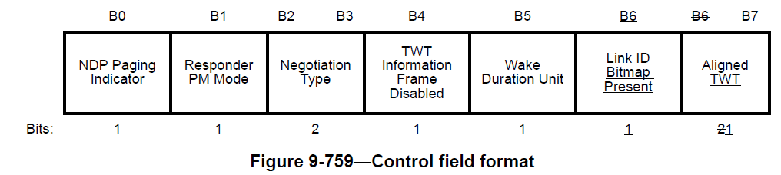
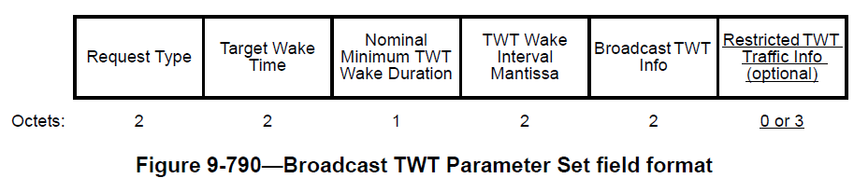
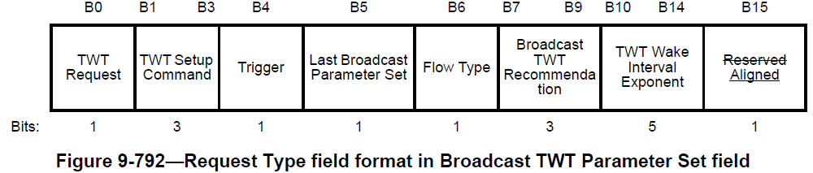
Appendix. Broadcast TWT element

