Slide 1
Some details on NPCA
Date: 2024-07-24
Name | Affiliations | Address | Phone | email
Seongho Byeon | Samsung Electronics |  |  | sh.byeon@samsung.com
Jack Jonghyo Lee
Jaheon Gu
Jinho Choi
Jonghoe Koo
Jungjun Kim
Mingyu Lee
Suhwook Kim
Taeyoung Ha
Youngwan So

Slide 2
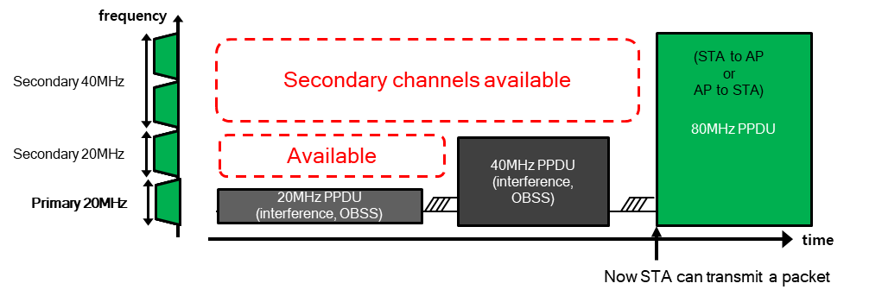
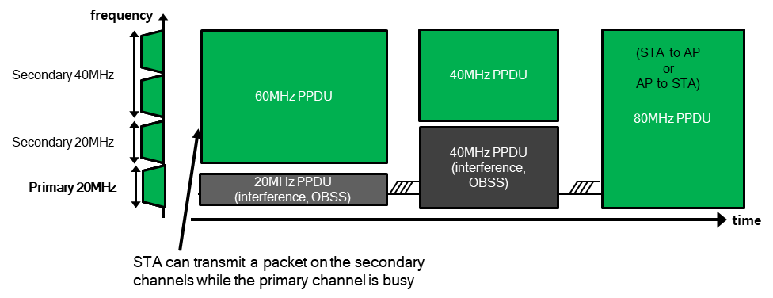
Introduction
One of main objectives for UHR PAR
  At least one mode of operation capable of improving efficient use of the medium
Non-Primary Channel Access (NPCA) agreed in TGbn [1-7]
  TGbn defines a mode of operation that enables a STA to access the secondary channel while the primary channel is known to be busy due to OBSS traffic or other TBD conditions.
    The mode of operation shall not assume that the STA is capable to detect or decode a frame and obtain NAV information of the secondary channel concurrently with the primary channel.
    A BSS shall only have a single NPCA primary channel (name TBD) on which the STA contends while the primary channel of the BSS is known to be busy due to OBSS traffic or other TBD conditions.

Slide 3
Introduction
Some details on NPCA under discussion:
  When an OBSS TXOP and/or a PPDU transmission is detected on the primary channel in the BSS, NPCA-capable STAs will switch to the 20 MHz anchor channel within the secondary channel (i.e., non-primary channel, NPCH), not overlapping with the OBSS transmission
    Whether a non-AP STA can switch to the NPCH outside of its operating bandwidth
    How does NPCA AP STA or non-AP STA initiate its TXOP
    How to synchronize different OBSS views between NPCA AP STA and NPCA non-AP STAs
    How to manage medium synchronization, especially what should be done to protect existing transmissions in NPCH
  NPCA AP and non-AP STAs switch back to the primary channel before the expiration of BasicNAV or the end of OBSS PPDU transmission
    How to manage different switching delay capabilities when NPCA AP and non-AP STAs switch back to the primary channel
In this contribution, we provide details on the above aspect further:
  Standardized criteria for determining when and for how long NPCA STAs switch to NPCH
  Improved coordination how the NPCA AP and non-AP STAs are synchronized

Slide 4

When to switch
Introducing the concept of NPCADuration
  NPCADuration: Time duration that NPCA AP and NPCA STAs perform NPCA
  Along with defining the following conditions, this provides opportunities to solve a variety of problems
    It is less than the primary channel’s BasicNAV set by the OBSS or the duration of OBSS PPDU
    NPCA is terminated autonomously when it expires
    NPCADuration maybe different for each NPCA AP or NPCA STA, but their return timing to the primary channel after the expiration of NPCADuration is set equally for all
      In consideration of the separate capabilities of NPCA switching (back) delay
    Multiple TXOPs can be operated in NPCH within NPCADuration
      TXOP within NPCADuration is initiated by a control frame or the ICF/ICR exchange (e.g., RTS/CTS exchange) between STA and AP
S80
NPCA
P80
RTS
CTS
OBSS PPDU
BA
OBSS PPDU
BA
…
BA
BasicNAV fixed
CCA
BasicNAV
NPCDuration
NPCDuration
NPCDuration
NPCDuration
Switcing delay
    Example: Start NPCA after receiving the CTS of OBSS

Slide 5
When to switch
Introducing the concept of NPCADuration:
  Specific conditions for setting NPCADuration
    Receive PPDU preamble first, and get the information of the PPDU
      OBSS HE/EHT/UHR PPDU detection allows to get TXOP or PPDU duration w/ bandwidth [6]
        OBSS PPDU duration should be longer than a threshold (T1)
        Possible to secure NPCADuration as much as the transmission time of OBSS PPDU or the duration of OBSS TXOP minus switching delay, when the anchor channel is not overlapped
      If a pre-HE preamble including non-HT is received, without ongoing NAV settings, the entire PPDU should be received to obtain MPDU(s)
    Detect OBSS TXOP through ICF/ICR exchange
      OBSS ICF-ICR exchange (e.g., non-HT format RTS/CTS) detection allows NPCA AP and NPCA STAs to set BasicNAV and get the OBSS bandwidth
        OBSS TXOP should be longer than a threshold (T2)
        Possible to secure NPCADuration as much as BasicNAV minus switching delay, when the anchor channel is not overlapped

Slide 6

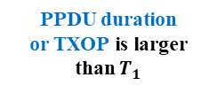
When to switch
Duration of NPCA operation
Preamble
detection
OBSS
HE/EHT/UHR
PPDU*
*[NOTE] Performing NPCA after receiving a Legacy PPDU (i.e., pre-HE PPDU) is TBD
PPDU duration
or TXOP is larger
than $T_{1}$
Reception
ICF/ICR
exchange confirmed
Bandwidth does not overlap with the anchor channel
Wait for the next preamble detection
BasicNAV set and is larger than $T_{2}$
Run NPCADuration
Bandwidth does not overlap with the anchor channel

Slide 7
How to Coordinate
TXOP operation within NPCADuration
  AP has to check which STAs are running NPCA, to schedule PPDUs
  STAs running NPCA also need to verify whether AP is performing NPCA
  Then, AP and STAs performing NPCA can initiate multiple TXOPs within NPCADuration
  ➔ After the start of NPCA,
  we may need to establish a coordinated rule regarding who and how initiates the TXOP

Slide 8
How to Coordinate
Difficulty in coordination
  P1. Information imbalance and asymmetry
    Different NPCA switching delay capabilities among STAs
      Especially, the STAs switching to NPCH outside of its operating bandwidth experience significant delays
    Different view on the OBSS that triggered NPCA (i.e., OBSS hidden from each other)
      May have heterogeneous NPCA duration and available NPCA
    Hidden node problem b/w NPCA AP and NPCA STA
  P2. Medium synch management
    Obligation required to provide a protection for the existing transmissions in NPCH
    Considering the general operation scenario of NPCA, MediumSyncDelay Timer could be too long
    Challenging for AP to determine which STA should be designated as RA of RTS
    Might be harsh for each STA to send RTS only up to dot11MSDTXOPMax trial
  P3. Collisions in the anchor channel
    Immediately after the start of NPCA, simultaneous access by a large number of STAs could result in severe collisions
    Initialized EDCA parameters in NPCH can exacerbate the collision probability
    (e.g., if 10 STAs attempt initial access at the same time in the anchor channel, the probability of collision reaches almost 50%)
[NOTE] Default value of dot11MSDTXOPMax is 1

Slide 9
How to Coordinate
Proposal: After performing an NPCA, we can define a mode of operation that at least the first TXOP operates as a trigger-based TXOP (i.e., exclusively for AP access)
  [P1] The AP can easily identify STAs performing NPCA through ICF-ICR exchange
  [P1] The AP can share its NPCA information (e.g., OBSS info, NPCA duration, etc.) in the trigger frame to facilitate coordination
  [P1] If a STA does not receive any ICF (e.g., trigger frame) from the AP for a certain period time, it needs to terminate NPCA operation
  [P2] If the STA receives ICF and is ED-idle (lower than TBD dBm) on the anchor channel, it can secure medium synchronization (Same goes for the AP regarding ICR)
  [P3] Since only the AP accesses the anchor channel in NPCH, collisions can be eliminated

Slide 10
Example Scenario
ICF may include AP’s NPCA information such as NPCA duration and OBSS info
Trigger-based TXOP
NPCA AP runs EDCA contention on the anchor channel within NPCH
ICF
DL MU PPDU
…
BA
DL
MU PPDU
NPCA
AP
(160 MHz)
S80
OBSS
ICF
OBSS
ICR
OBSS PPDU
Trigger frame maybe BSRP/BQRP/Basic/MU-BAR trigger frame with CS Required field set to true
OBSS BA
P80
NPCA AP initially tries to access the primary channel, but it detects OBSS ICF-ICR exchange
Returning back to the primary channel, NPCA AP joins the contention after BasicNAV expired
CCA
BasicNAV
NPCA duration of AP
NPCA
STAs
(80 MHz or 160 MHz)
S80
ICR
BA
ICR can contain OBSS information and/or NPCH channel info (NPCA duration, RSS, etc.), helping for NPCA AP to schedule NPCA STAs
OBSS
ICF
OBSS
ICR
OBSS PPDU
OBSS BA
P80
NPCA STAs may try to access the primary channel initially, but it detects OBSS ICF-ICR exchange
NPCA is terminated in advance, because of switching latency back to the primary channel
CCA
BasicNAV
Early termination of NPCA
because of longer switching delay
NCPA duration of 80 STA which has the operating bandwidth of 80 MHz
NCPA duration of 80 STA which has the operating bandwidth of 160 MHz

Slide 11
Summary
NPCA duration settings
  Total time that NPCA AP and NPCA STAs perform NPCA
    We can easily define and describe NPCA features (e.g., how to synch up between NPCA STAs)
  Triggered by HE/EHT/UHR OBSS PPDU preamble and/or OBSS TXOP
    Pre-HE is TBD
TXOP operating mode configured as a trigger-based TXOP
  A method to easily solve difficult problems such as:
    Information imbalance and asymmetry
    Medium synch management
    Collisions in the anchor channel
  Sharing the NPCA duration in ICF/ICR on NPCH facilitates the better coordination and synchronization between the AP and STAs performing NPCA
    By adjusting the NPCA duration, the AP can easily control the behavior of STAs

Slide 12
Conclusion
In this presentation, we defined the concept of NPCA duration, providing a starting point to consistently and easily proceed and describe various NPCA features, e.g., NPCA STA synch-up by sharing NPCA duration
Furthermore, during NPCA operation, we examine potential coordination issues and proposed a mode of operation using a trigger-based TXOP to address them

Slide 13
Straw Poll 1
Do you agree to define a “NPCA duration” in 11bn?
Definition: Time duration that NPCA AP or NPCA STA performs NPCA under the condition that the primary channel is busy due to OBSS traffic or other TBD conditions
NPCA duration starts under the condition that the primary channel is busy due to OBSS traffic or other TBD conditions; NPCA duration is less than or equal to the time when the primary channel is busy minus NPCA switching (back) delay
NPCA duration can vary for each NPCA STA, depending on the OBSS view and distinct capabilities of switching delay
NPCA STA may indicate NPCA duration to its peer NPCA STA and update it as needed
One or more TXOPs can be initiated in NPCH within the NPCA duration
Y / N / A

Slide 14
Straw Poll 2
Do you agree to define a mode of operation that makes the first TXOP initiated after starting NPCA as a trigger-based TXOP?
ICF may contain AP’s NPCA information such as NPCA duration
The type of ICF and specific field configuration remains TBD
Y / N / A

Slide 15
References
[1] 11-23/2005r1 Non-primary channel access (NPCA) (Minyoung Park, Intel)
[2] 11-24/0070r2 Some details about non-primary channel access (Yunbo Li, Huawei)
[3] 11-24/0426r0 EDCA for Non-Primary Channel Access (Dongju Cha, LGE)
[4] 11-24/0427r0 Enabling Non-Primary Channel Access (Dongju Cha, LGE)
[5] 11-24/0458r2 Considerations on Non-Primary Channel Access (Salvatore Talarico, Sony)
[6] 11-24/0498r0 Non-Primary Channel Access (NPCA) – Follow Up (Minyoung Park, Intel)
[7] 11-24/0496r1 Secondary Channel Usage Follow Up (Liwen Chu, NXP)
[8] 11-24/1125r0 Considerations on switching for NPCA (Dongju Cha, LGE)
[9] 11-24/1155r0 Further discussions on NPCA (Shawn Kim, WILUS)
[10] 11-24/1218r0 NPCA – Next level discussions (Gaurang Naik, Qualcomm)

