Slide 1
Thoughts on IMMW For the Industry Use
Date: 2024-07-01
Authors:
Name | Affiliations | Address | Phone | Email
Yue Xu | Huawei | Huawei Nanjing R&D Institute, Nanjing, Jiangsu, China, 210012 |  | xuyue57@Huawei.com
Chenhe Ji
Mengshi Hu
Chun Pan
Xiaofei Bai
Xiaofei Bai

Slide 2
Introduction
Based on the IMMW SG PAR document[1] and actual requirements in industrial scenarios, we propose some concerns and corresponding suggestions.

Slide 3
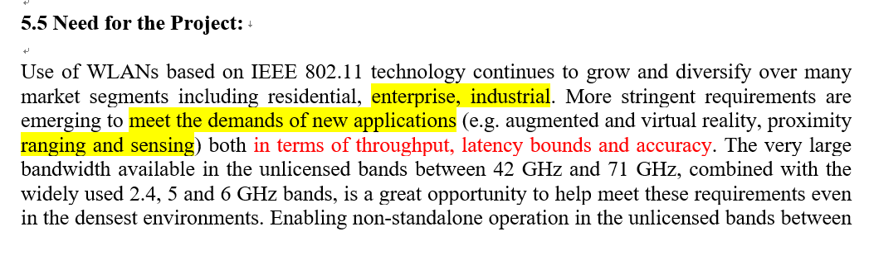
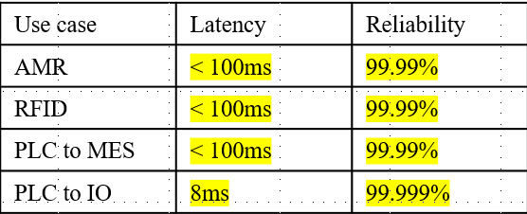
Recap: IMMW SG PAR[1]
PAR
Real [2]
Type | Brief info
AGV / AMR | Including guidance control, process data exchange, video/image, and emergency stop, between robots and a control system,
Robot/drone motion control | Remote operation with haptics communication, programmed robot operation with emergency stop.
IoT Sensors/ WIFI sensing | High-density deployment and Periodical/event-based report of information to the control system.
Use Case | Range | Throughput | Delay (ms) | Reliability
4k UHD Transmission | < 5 m | < 10 Gbps | 10~20 | jitter<5ms
VR | < 10 m | 10~20 Gbps | 5~10 | jitter <5 ms, PER<10E-2
We believe that the content mentioned in the PAR document is matched with the development of application requirements of millimeter waves in industrial scenarios. But these discussions are at a high level. Therefore, we hope to further share some of our details and views on mmwave in industrial scenarios.
AGV: Automated Ground Vehicle
AMR: Autonomous Mobile Robot

Slide 4
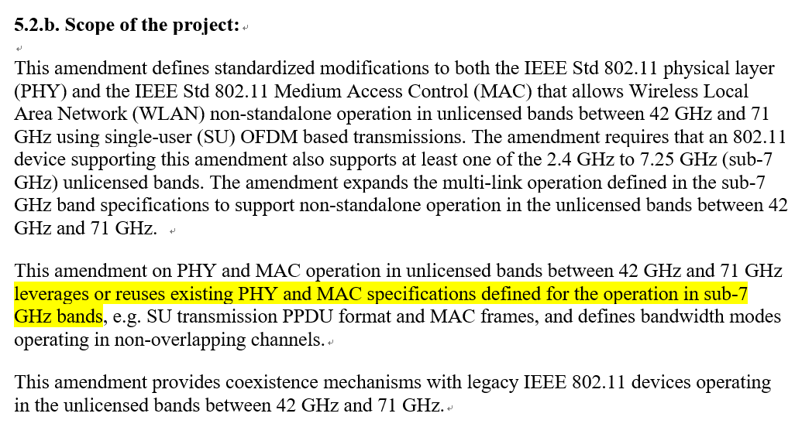
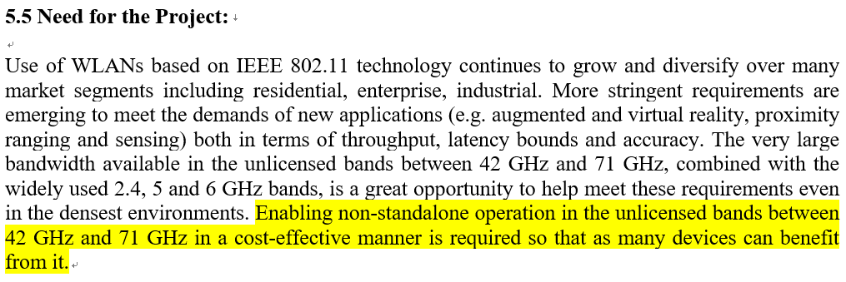
Sharing - 1：The fast deployment
From the PAR, the core idea is the ‘fast deployment’. And we think:
Reuse/Minimum-adjust current baseband architecture
Reuse/Combine current-technique (e.g., Sounding, MLO, Power saving, TWT…)
Design Appropriate Bandwidth/KPIs
The design should be
reasonable to facilitate quick deployment.
different from the existing standards to show the advanced nature.
Bandwidth Concern#1
Throughout/Latency/Reliability Concern#1

Slide 5
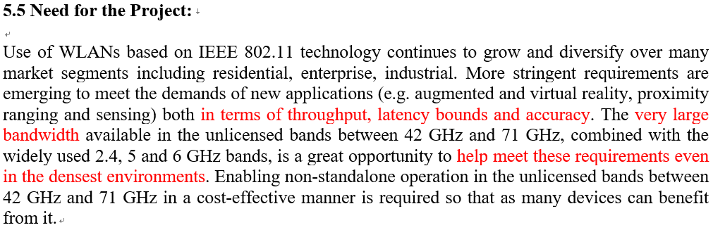

Sharing - 2：The Spatial Stream
AP
STAs
In the MIMO, data is divided into multiple independent spatial flows. More spatial flows indicate more paths for independently processing data and a higher rate.
Setting: 11ax, 160MHz, 45G Band, 16QAM
#SS | throughput
1 | 350 Mbps
2 | 650 Mbps
4 | 1.2 Gbps
Multiple streams can:
- ensure the throughput to help meet traditional and emerging requirements even in the densest environments
- enhance the stability (link optimization).
However, the increase in the number of flows inevitably increases the cost of hardware devices (hindering fast deployment). Meanwhile, the gain accelerate is ‘slowing down’.
The performance of a single flow may not meet the requirements.
The gain efficiency is decreasing.
Spatial Stream Concern#1
Throughout/Latency/Reliability Concern#2

Slide 6

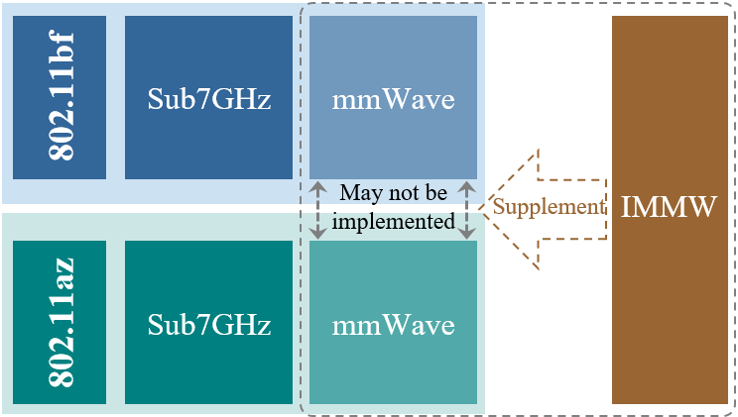
Sharing - 3：The Sensing/Ranging
Sensing and Ranging has been widely discussed (more than 20 uses case in [3]). And, commercial products have already application them without any standardization
Bandwidth | 80MHz | 160MHz | 320MHz | 640MHz | 1280MHz
Distance Resolution (m) | 1.875 | 0.9375 | 0.4688 | 0.2344 | 0.1172
Object Existence Detection
Object Counting
Motion recognition
802.11bf and 802.11az/bk are main IEEE standard for Sensing and Ranging. So, IMMW can be considered to provide support for these technical standards..
More information
More cost
Larger bandwidth
Higher resolution
Less information
Lower cost
Lower bandwidth
Less resolution
[4]
Bandwidth Concern#2

Slide 7
Summary
From the above 3 sharing opinions and corresponding concerns. We would like to provide our suggestions that:
Main Concern | Suggestion
Bandwidth | We recommend a minimum bandwidth of 160 MHz and a maximum bandwidth that is appropriate (fast deployment and standard differentiation) to both meet actual throughput requirements (e.g. 10Gbps@ClientSide) and expand the ecosystem
Spatial Stream | We recommend that the number of spatial streams not be too large. And, no more than 2SS under SU-MIMO is better.

Slide 8
References
[1] 11-24-0116-03-immw-immw-draft-proposed-par
[2] 11-23-1570-00-0uhr-latency-consideration-of-industrial-scenarios
[3] 11-24-0723-01-immw-sensing-and-ranging-in-immw
[4] 11-20-1712-02-00bf-wifi-sensing-use-cases

Slide 9
SP1
Do you agree that Move to add the sentence “It is capable of supporting no more than 2 Spatial Streams.” to the end of the 2nd paragraph of clause 5.2.b of the PAR.?
  -Yes
  -No
  -Abstain

