Slide 1
ML-aided CSI Quantization and Its Application to Smooth Beamforming
Date: 2024-07-01
Authors:

Slide 2
Introduction
During the TGbn session in last May meeting, a new channel state information (CSI) feedback scheme was presented for smooth beamforming [1].
A slight increase in CSI feedback overhead can solve the discontinuity issue in beamforming matrix, leading to significant throughput gain.
  It is optimal maximizing smoothness of beamforming matrix.
  Receiver can enjoy more channel smoothing (~2.5dB).
Following [1], we first present a sub-optimal method for smooth beamforming, which requires no additional CSI feedback.
  And then, we incorporate the machine learning (ML) technique to further reduce CSI feedback overhead.

Slide 3
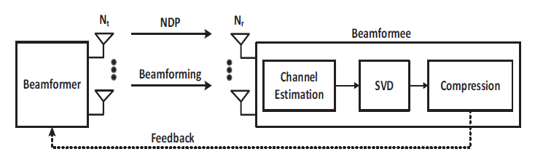
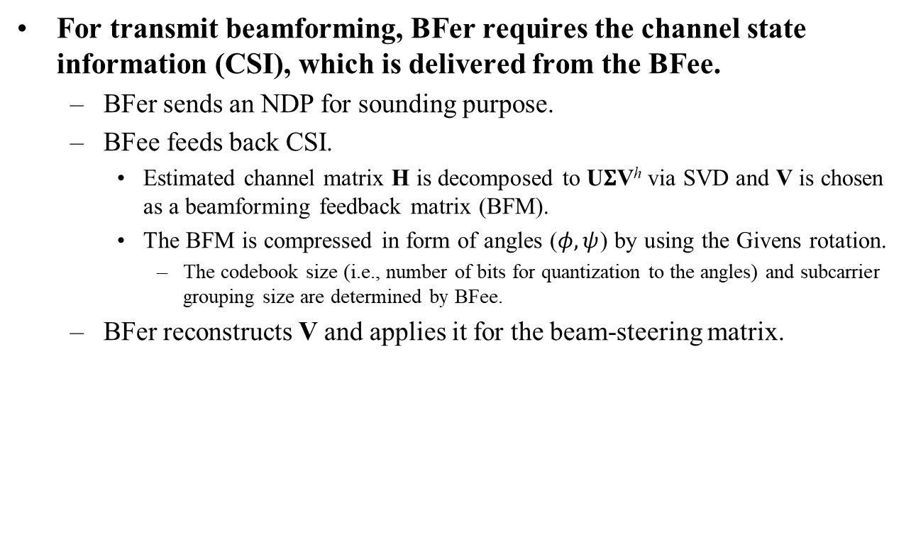
Recap: Beamforming Procedure
For transmit beamforming, BFer requires the channel state information (CSI), which is delivered from the BFee.
  BFer sends an NDP for sounding purpose.
  BFee feeds back CSI.
    Estimated channel matrix H is decomposed to U$Σ$V^{h} via SVD and V is chosen as a beamforming feedback matrix (BFM).
    The BFM is compressed in form of angles ($φ, ψ$) by using the Givens rotation.
      The codebook size (i.e., number of bits for quantization to the angles) and subcarrier grouping size are determined by BFee.
  BFer reconstructs V and applies it for the beam-steering matrix.

Slide 4
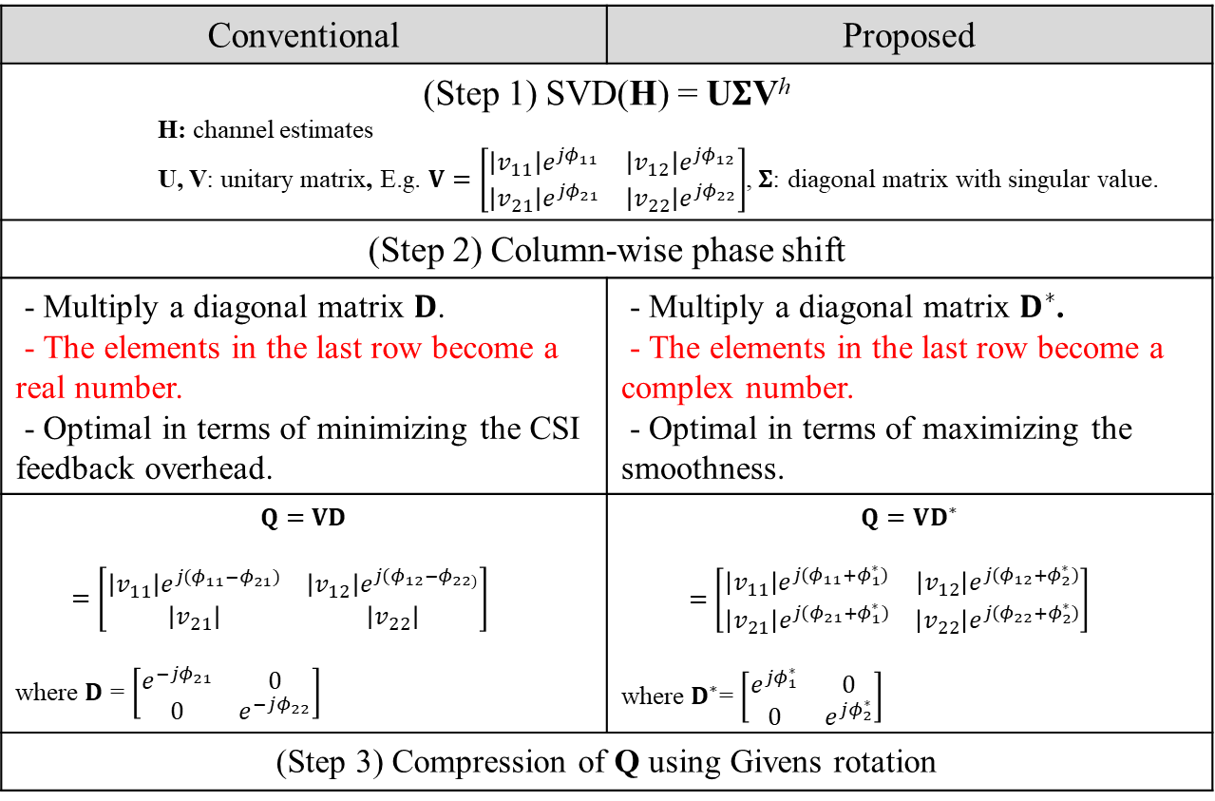
Smooth Beamforming Feedback [1]
Conventional | Proposed
(Step 1) SVD(H) = U$Σ$V^{h} H: channel estimates U, V: unitary matrix, E.g. $V=\left[\begin{matrix}\left|v_{11}\right|e^{jφ_{11}} & \left|v_{12}\right|e^{jφ_{12}} \\ \left|v_{21}\right|e^{jφ_{21}} & \left|v_{22}\right|e^{jφ_{22}}\end{matrix}\right]$, $Σ$: diagonal matrix with singular value.
(Step 2) Column-wise phase shift
- Multiply a diagonal matrix 𝐃. - The elements in the last row become a real number. - Optimal in terms of minimizing the CSI feedback overhead. | - Multiply a diagonal matrix $D^{∗}$. - The elements in the last row become a complex number. - Optimal in terms of maximizing the smoothness.
$$Q=VD$$ $=\left[\begin{matrix}\left|v_{11}\right|e^{j{(φ}_{11}−φ_{21})} & \left|v_{12}\right|e^{j{(φ}_{12}−φ_{22)}} \\ \left|v_{21}\right| & \left|v_{22}\right|\end{matrix}\right]$ where $D$ = $\left[\begin{matrix}e^{−jφ_{21}} & 0 \\ 0 & e^{−jφ_{22}}\end{matrix}\right]$ | $$Q=VD^{∗}$$ $=\left[\begin{matrix}\left|v_{11}\right|e^{j{(φ}_{11}+φ_{1}^{∗})} & \left|v_{12}\right|e^{j{(φ}_{12}+φ_{2}^{∗})} \\ \left|v_{21}\right|e^{j{(φ}_{21}+φ_{1}^{∗})} & \left|v_{22}\right|e^{j{(φ}_{22}+φ_{2}^{∗})}\end{matrix}\right]$ where $D^{∗}$= $\left[\begin{matrix}e^{jφ_{1}^{∗}} & 0 \\ 0 & e^{jφ_{2}^{∗}}\end{matrix}\right]$
(Step 3) Compression of Q using Givens rotation

Slide 5

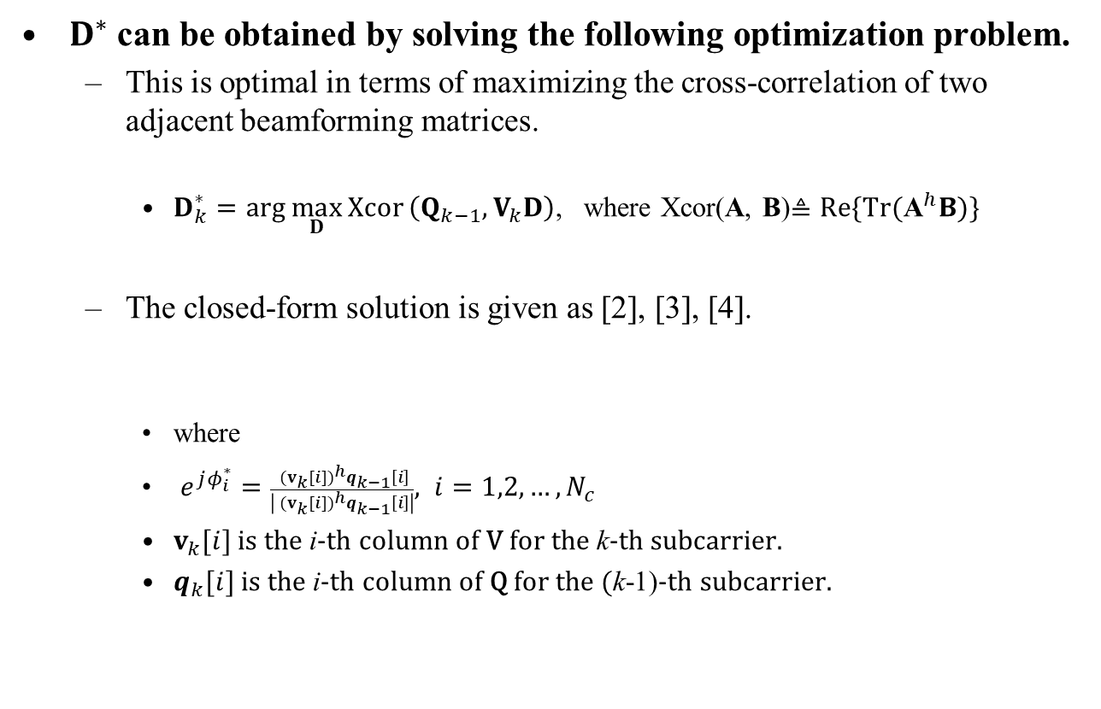
Optimal Method [1] (1/2)
$D^{∗}$ can be obtained by solving the following optimization problem.
  This is optimal in terms of maximizing the cross-correlation of two adjacent beamforming matrices.
    $D_{k}^{∗}=arg \max_{D}{Xcor}\left(Q_{k−1},V_{k}D\right)$, where Xcor(A, B)$≜Re\{\text{Tr}({\text{A}}^{h}B)\}$
  The closed-form solution is given as [2], [3], [4].
    where
    $e^{jφ_{i}^{∗}}=\frac{{ (v_{k}[i])}^{h}q_{k−1}\left[i\right]}{\left|{ (v_{k}[i])}^{h}q_{k−1}\left[i\right]\right|}, i=1,2,…, N_{c}$
    $v_{k}[i]$ is the i-th column of V for the k-th subcarrier.
    $q_{k}[i]$ is the i-th column of Q for the (k-1)-th subcarrier.
$$D_{k}^{∗}=diag\left(e^{jφ_{1}^{∗}},e^{jφ_{2}^{∗}}, …,e^{jφ_{N_{c}}^{∗}}\right)$$

Slide 6
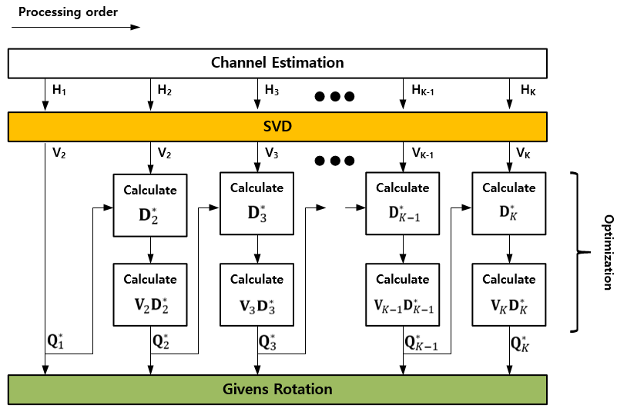
Optimal Method [1] (2/2)
Sequential processing
  The optimization is performed sequentially from the beginning to the end of the subcarriers.

Slide 7
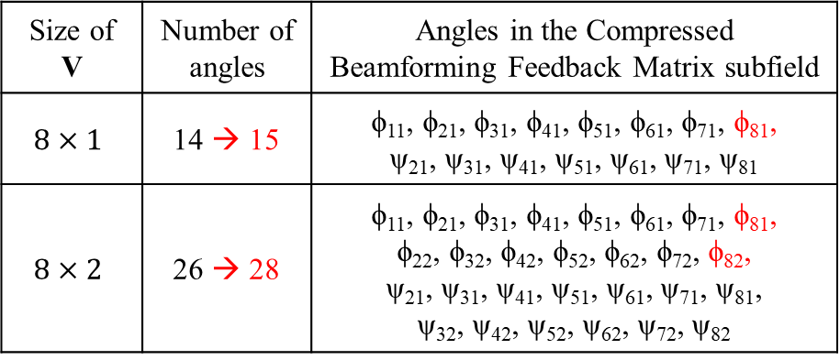

CSI Feedback Overhead
The number of angles is increased by the number of columns in the beamforming matrix ($N_{c}$).
  $N_{c}$numer of $φ_{N_{r}i}$, ($i=1,2,…, N_{c}$) is newly added in the Compressed Beamforming Feedback Matrix subfield.
    E.g., Red marked angles in the table below.
In the next slide, we will show a sub-optimal method that does not require additional CSI feedback overhead.
Size of V | Number of angles | Angles in the Compressed Beamforming Feedback Matrix subfield
$$8×1$$ | 14 → 15 | ϕ₁₁, ϕ₂₁, ϕ₃₁, ϕ₄₁, ϕ₅₁, ϕ₆₁, ϕ₇₁, ϕ₈₁, ψ₂₁, ψ₃₁, ψ₄₁, ψ₅₁, ψ₆₁, ψ₇₁, ψ₈₁
$$8×2$$ | 26 → 28 | ϕ₁₁, ϕ₂₁, ϕ₃₁, ϕ₄₁, ϕ₅₁, ϕ₆₁, ϕ₇₁, ϕ₈₁, ϕ₂₂, ϕ₃₂, ϕ₄₂, ϕ₅₂, ϕ₆₂, ϕ₇₂, ϕ₈₂, ψ₂₁, ψ₃₁, ψ₄₁, ψ₅₁, ψ₆₁, ψ₇₁, ψ₈₁, ψ₃₂, ψ₄₂, ψ₅₂, ψ₆₂, ψ₇₂, ψ₈₂

Slide 8
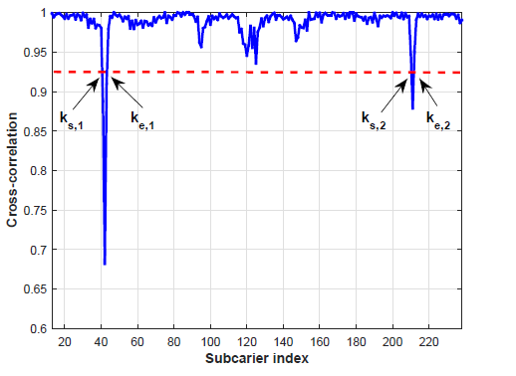

Sub-optimal Method (1/2)
The sub-optimal method consists of two processes:
  (i) Discontinuity detection
  (ii) {ϕ, ψ} angular interpolation across subcarriers to resolve the discontinuity
The discontinuity detection finds subcarrier indices in which the cross correlation between two adjacent beamforming matrices is less than a predefined threshold (T).
  $k_{s}=arg ρ_{min}\left(k\right)<T$
  $k_{e}=arg ρ_{min}\left(k\right)>T$
  where $ρ\left(i,k\right)= \frac{Re\left\{{(v_{k}[i])}^{h}v_{k−1}\left[i\right]\right\}}{\left|{ (v_{k}[i])}^{h}v_{k−1}\left[i\right]\right|}$
  $ρ_{min}\left(k\right)=\min_{i}ρ\left(i,k\right)$ for $i=1,2,…, N_{c}$ .

Slide 9
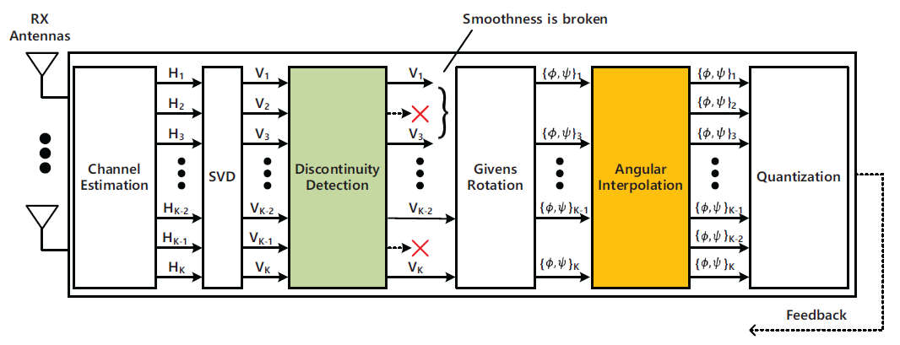

Sub-optimal Method (2/2)
The angular interpolation is performed for consecutive subcarriers, starting at $k_{s}$ and ending at $k_{e}$.
  $$φ^{(k)}=\frac{k−k_{s}}{k_{e}−k_{s}}\left\{mod\left(φ^{(k_{s})}−φ^{(k_{e})}+π, 2π\right)−π\right\}+φ^{(k_{s})}$$
  $$ψ^{(k)}=\frac{k−k_{s}}{k_{e}−k_{s}}\left(ψ^{(k_{s})}−ψ^{(k_{e})}\right)+ψ^{(k_{s})}$$
    where $mod$($, 2π$) is the modulo operation w.r.t. $2π$.
    $φ^{(k)}$ and $ψ^{(k)}$ is the k-th subcarrier for $φ$ and $ψ$ angles, respectively.

Slide 10
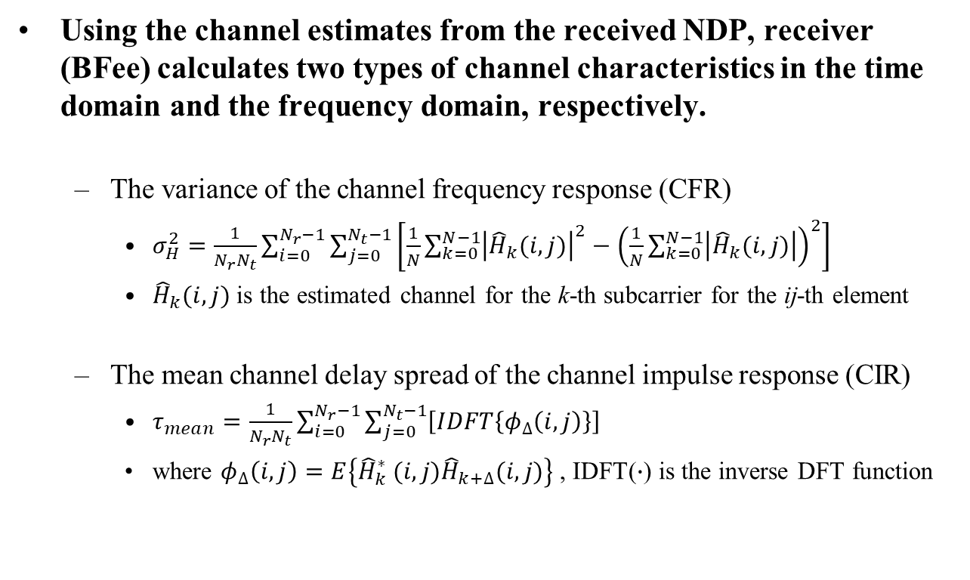
ML-aided CSI Quantization (1/2)
Using the channel estimates from the received NDP, receiver (BFee) calculates two types of channel characteristics in the time domain and the frequency domain, respectively.
  The variance of the channel frequency response (CFR)
    $σ_{H}^{2}=\frac{1}{N_{r}N_{t}}\sum_{i=0}^{N_{r}−1}{\sum_{j=0}^{N_{t}−1}{\left[\frac{1}{N}\sum_{k=0}^{N−1}{{\left|{\hat{H}}_{k}(i,j)\right|}^{2}}−{\left(\frac{1}{N}\sum_{k=0}^{N−1}{\left|{\hat{H}}_{k}(i,j)\right|}\right)}^{2}\right]}}$
    ${\hat{H}}_{k}(i,j)$ is the estimated channel for the k-th subcarrier for the ij-th element
  The mean channel delay spread of the channel impulse response (CIR)
    $τ_{mean}=\frac{1}{N_{r}N_{t}}\sum_{i=0}^{N_{r}−1}{\sum_{j=0}^{N_{t}−1}{\left[IDFT\left\{φ_{∆}\left(i,j\right)\right\}\right]}}$
    where $φ_{∆}\left(i,j\right)=E\left\{{\hat{H}}_{k}^{∗} (i,j){\hat{H}}_{k+∆}(i,j)\right\}$ , IDFT($∙$) is the inverse DFT function

Slide 11
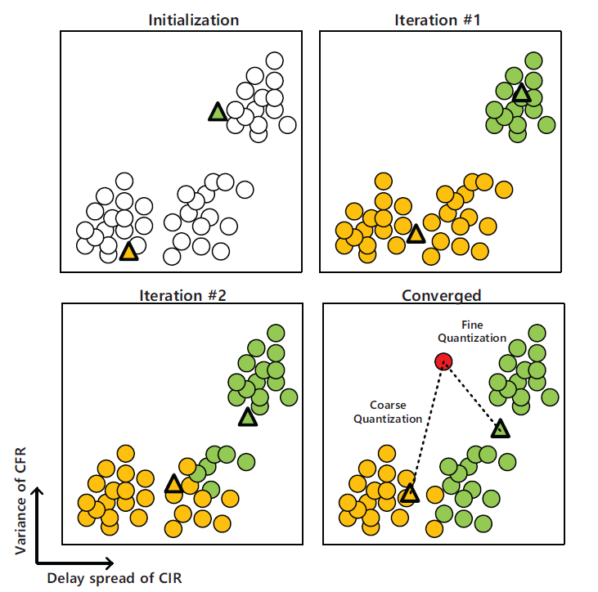
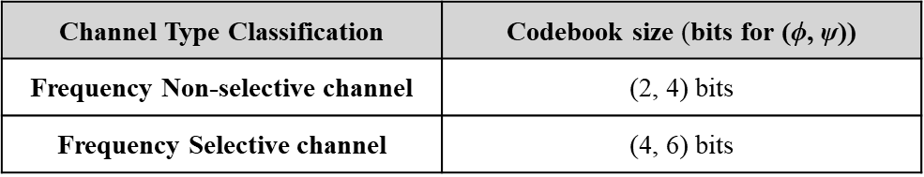
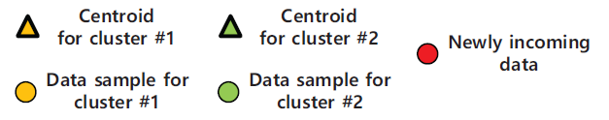

ML-aided CSI Quantization (2/2)
ML classifies the channel selectivity by using an unsupervised learning-based K-means algorithm.
  It finds the two centroids of $\left\{σ_{H}^{2},τ_{mean}\right\}$ in an iterative manner.
  The classification is determined base on the minimum Euclidean distance between $\left\{σ_{H}^{2},τ_{mean}\right\}$ and its two centroids.
    The CSI quantization level is adaptively determined based on channel-type classification result.

Slide 12
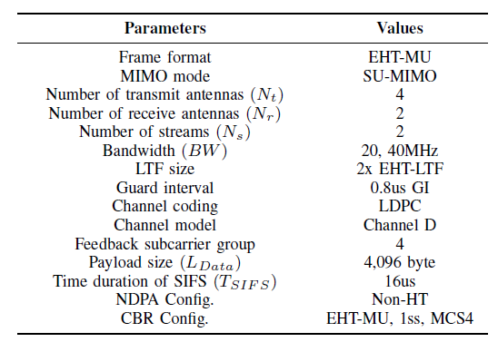

Simulation Parameters
Link level simulator parameters
  In order to consider the CSI feedback overhead, throughput performance is evaluated by
    Throughput (Mbps/Hz) $= \frac{L_{data}\left(1−PER\right)/BW}{T_{NDPA}+T_{NDP}+T_{CBR}+T_{Data}+3T_{SIFS}}$

Slide 13
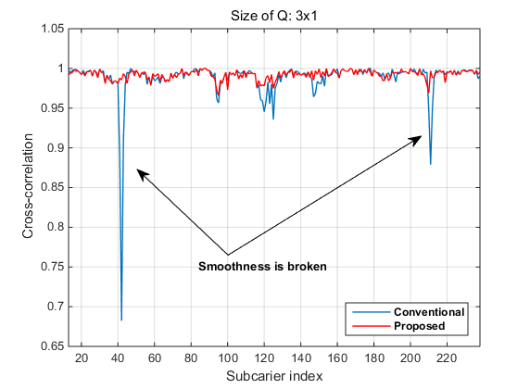
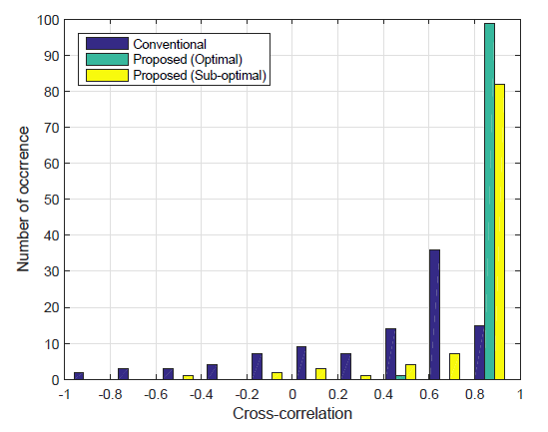
Cross-correlation Comparison
We can see that the cross-correlation of the proposed smooth beamforming method mostly fall in the range of [0, 1] while the conventional method goes over in the range [-1, 0] with non-negligible percentage.
  This verifies the significant smoothness improvement of the proposed two methods.
[Snap-shot]
[Histogram]

Slide 14
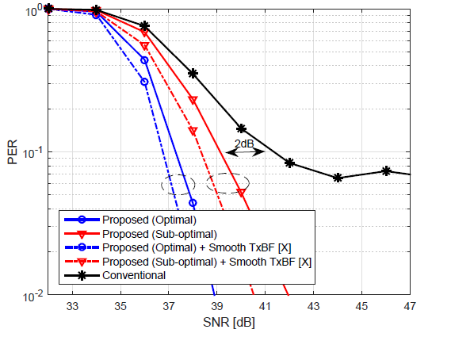
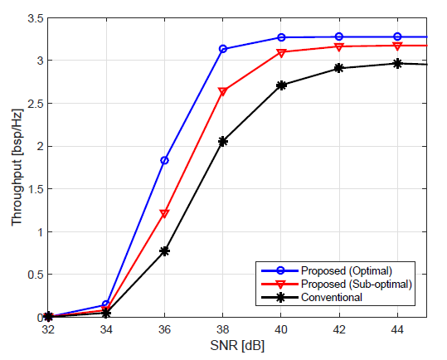
Performance Evaluation (1/3)
We can see that conventional CSI feedback method suffers from severe performance degradation showing error-floor due to the discontinuity of the beamforming matrix.
  The sub-optimal method shows a gain of about 2dB at PER=0.1 compared to the conventional one.
  In case of the optimal method, a gain of about 4dB is obtained at PER = 0.1 compared to conventional one.
    Additional 1dB gain can be obtained by combining the smooth BFer algorithm.

Slide 15
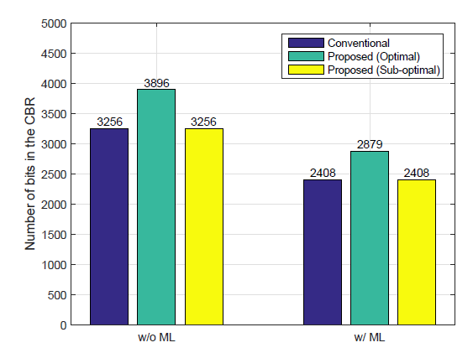
Performance Evaluation (2/3)
When integrating ML-aided CSI quantization, both conventional and proposed methods can reduce the amount of CSI feedback overhead about 27%.
With the conventional CSI method as the baseline,
  The optimal method has only 88% (i.e., 2879/3256) of the baseline.
  It is further reduced to 73% (i.e., 2408/3256) when the sub-optimal method is used.

Slide 16
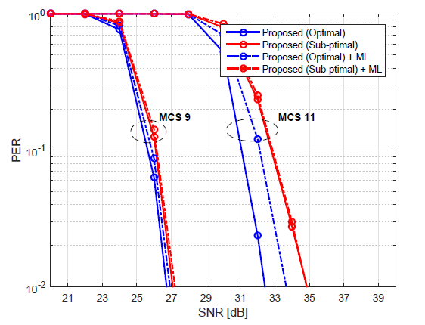

Performance Evaluation (3/3)
Effect of the ML-aided CSI quantization to the performance
  For the sub-optimal method, performance loss is negligible, when applying the ML-aided adaptive quantization scheme.
  For the optimal method, the loss of PER is negligible for MCS 9, while it shows a loss of about 1dB for MCS 11.
    Since the optimal method requires additional CSI (i.e., $φ$ angles), and thus it is more sensitive to the CSI quantization effect, especially for high QAM.

Slide 17
Summary
In this contribution, we presented CSI feedback method for smooth beamforming in both optimal and sub-optimal ways.
  Optimal method
    Additional channel information is feedback to maximize the cross-correlation between adjacent beamforming matrices.
  Sub-optimal method
    A threshold-based adaptive angular interpolation is used to improve smoothness without increasing the CSI feedback overhead.
In order to reduce CSI feedback overhead, the proposed two methods are integrated with the ML-aided CSI quantization.
  The CSI quantization level is dynamically determined by using the K-means based channel type classification results.
The simulation results showed that the proposed optimal / sub-optimal CSI feedback methods for smooth beamforming combined with ML-aided CSI quantization can significantly improve throughput with reduced CSI feedback overhead.

Slide 18
Reference
[1] 802.11-23/1906r1, Channel Information Feedback for Smooth Beamforming – Follow-up, Samsung.
[2] E. Sengul, H. J. Park and E. Ayanoglu, “Bit-Interleaved Coded Multiple Beamforming with Imperfect CSIT,” IEEE Trans. Commun, vol. 57, no. 5, May 2009.
[3] E. Jeon, M. Ahn, S. Kim, W. B. Lee and J. Kim, "Joint Beamformer and Beamformee Design for Channel Smoothing in WLAN Systems," in Proc. IEEE 92nd Veh. Technol. Conf. (VTC2020-Fall), Nov. 2020.
[4] Y. Qui, D. Qu, Da Chen and T. Jiang, “Smoothed SVD-based Beamforming for FBMC/OQAM Systems Based on Frequency Spreading,” in Proc. IEEE Global Communications Conference (GLOBECOM), Dec. 2016.
[5] E. Jeon, M. Kim, M. Ahn, J. Lee, S. Kim, I. Kim and J. Kim, “Machine Learning Aided CSI Feedback for Smooth Beamforming in Next Generation WLANs,” submitted to IEEE Global Communications Conference (GLOBECOM), Dec. 2024.
.

