Slide 1
Some thoughts on preemption

Slide 2
Introduction
A bunch of contributions have kinds of discussion on Preemption feature.
To meet low latency(LL) traffic delay boundary requirement, LL data may be firstly transmitted over normal traffic’s TXOP.
Assuming LL and normal traffic in the same TID queue, LL traffic may be OOO(out of order) delivery under Preemption scheme.
In this contribution, we would like to discuss the issue of OOO delivery on receiver side, and provide some possible solutions.

Slide 3
Use case and the issue of OOO delivery
Use case of OOO delivery
Normal traffic may be buffered in one MPDU TID queue
Normal traffic included a small SN,PN
LL traffic may come into MPDU queue later due to preemption delivery.
LL traffic with a larger SN,PN may be delivered first compared with the normal traffic.
The OOO delivery will happen
The issue of OOO delivery
OOO delivery cause the OOO frames stay in the receive reordering buffer, and thus cause extra buffered delay.

Slide 4
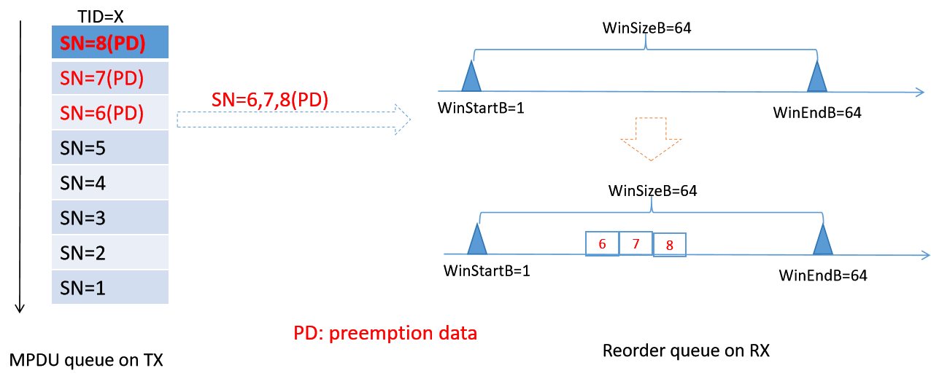
The following figure depicts the OOO delivery

Slide 5
The proposal to address the delay issue
Opt1: Mark each LL traffics in hybrid TID queue
OOO LL traffic should carry LL WinStart_{B}, LL WinSize_{B} information,
Need do some change in current Scoreboard and receive reordering buffer design.
Opt2: Separate LL traffic into at least one dedicated TID queue
One or more dedicated TID queues for DL/UL traffic delivery.
Need to consider whether LL in lower AC/TID queue can preempt the TXOP of the normal traffic in higher AC/TID.
If reusing TID 8--15, need to consider how to compatible with TSPEC.

Slide 6
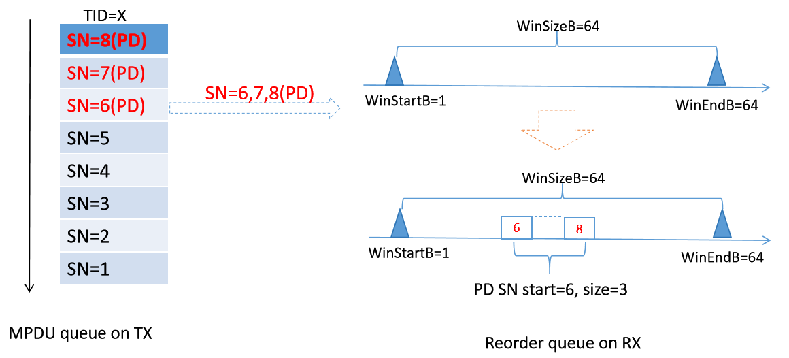
The following figure depicts Opt1(Hybrid TID queue)

Slide 7
Summary
Analyze the OOO delivery use case and the problem under the preemption scheme
Provide two options to address the delay issue when the frames are OOO delivered

Slide 8
THANK YOU ☺

Slide 9
Reference
24/804r0 The transmission of preemption request frame
24/103r1 TXOP level preemption for Low latency application in 802.11bn

Slide 10
SP1
Do you agree to have one or more dedicated TID queue for preemption data delivery?

