Slide 1
MAP coordination follow up

Slide 2
Introduction
A bunch of features under MAP co-ordination scheme well discussed in UHR and TGbn group
  Like C-OFDMA,C-TDMA,C-(r)TWT,C-SR,C-BF,etc.
  We strong believe the leverage of one or more MAP features can attract customer’s eyes with the following benefit:
    Improve the channel utilization
    Increase the throughput
    Reduce the delay
Any MAP co-ordination scheme should be based on the precondition of the overlapping operating channels
In this contribution, we would like to discuss the channel setting under MAP coordination scheme

Slide 3
Recap the channel setting in current implementation
In order to increase the peak throughput, it’s more popular to set a larger bandwidth of the operating channel for each individual APs by default
  Higher ratio of two APs operating on overlapping channel
  To avoid congestion issue on the same P20, the APs may select the define P20,P40,P80 etc.
Therefore, the MAP scheme should take into account the current implementation requirement.

Slide 4
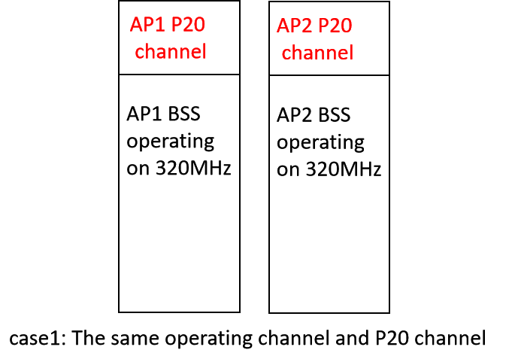
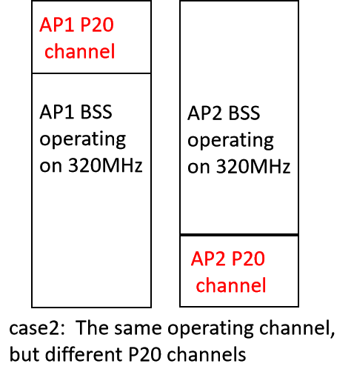
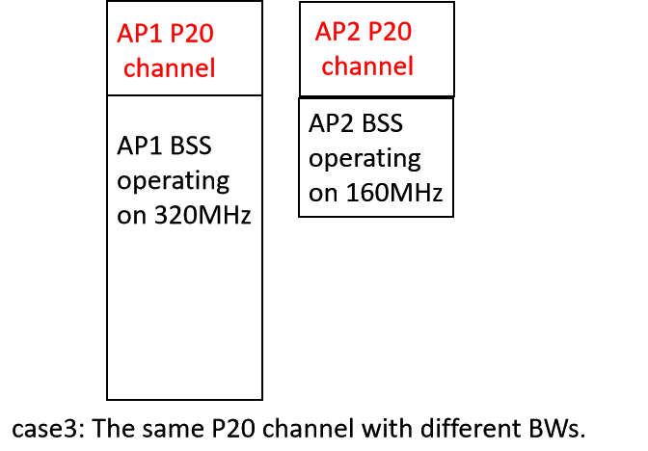
Overlapping operating channel cases(1)

Slide 5
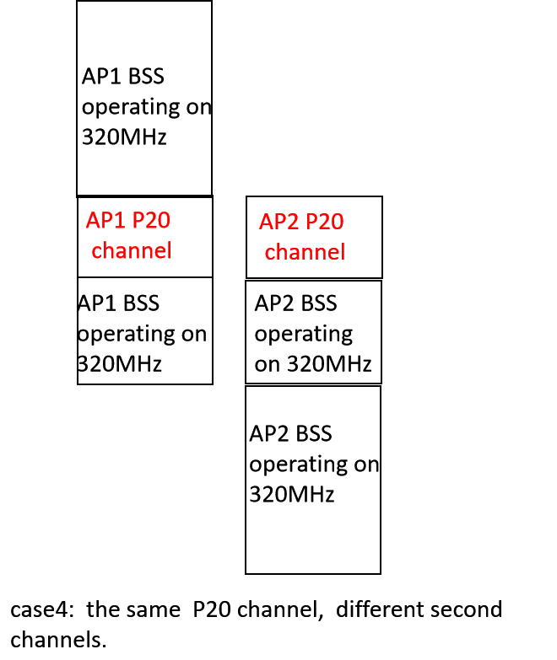
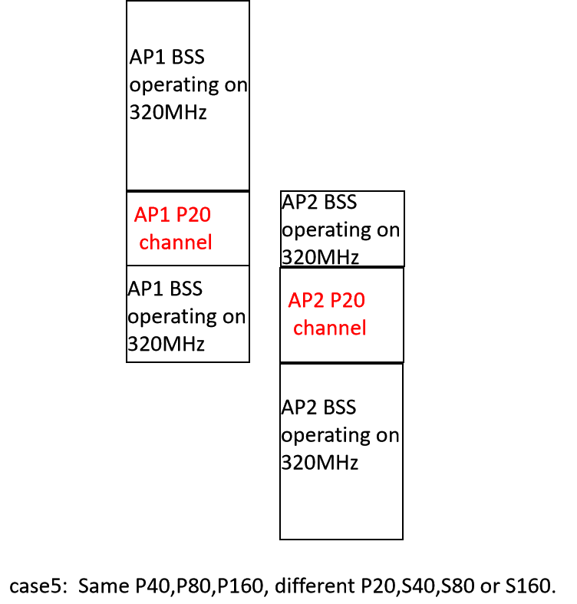
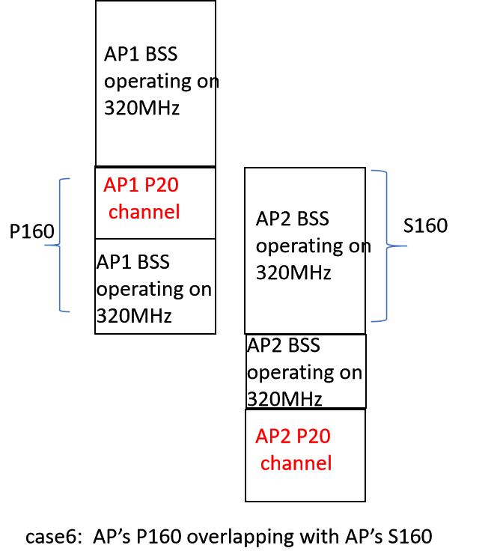
Overlapping operating channel cases(2)

Slide 6
The channel setting for MAP co-ordination scheme
Case 1--5 is simpler
  each AP’s primary channel overlaps with its peer AP operating channel,vice versa.
Case 6 is more complicated
  AP2 need to support concurrent decode capability to decode the PPDU on its non-primary channel
To make the system design more simple, we propose to only consider case1-5 in TGbn MAP coordination scheme.
  Cover most of current use cases
  Simple design will be more attractive to the customers
  Put aside case 6, leave it for next generation

Slide 7
MGMT. and Control frame delivery in MAP scheme
MGMT.and Control frame features 20MHz BW PPDU
  The problem is that the receiver AP can’t receive the 20MHz PPDU if its P20 is different from the transmitter AP’s
  Current baseline already define the non-HT duplicate PPDU for control frame delivery.
  Following the baseline rule, we propose to deliver the control frame and MGMT in non-HT PPDU duplicate format.
  The MGMT. frames may be delivered in MAP discovery, MAP agreement phase.
  The Control frame may be delivered in MAP coordination transmission phase, like MAP Trigger frame, etc.
  Need to take into account the puncture issue if any sub-channel is unavailable.

Slide 8
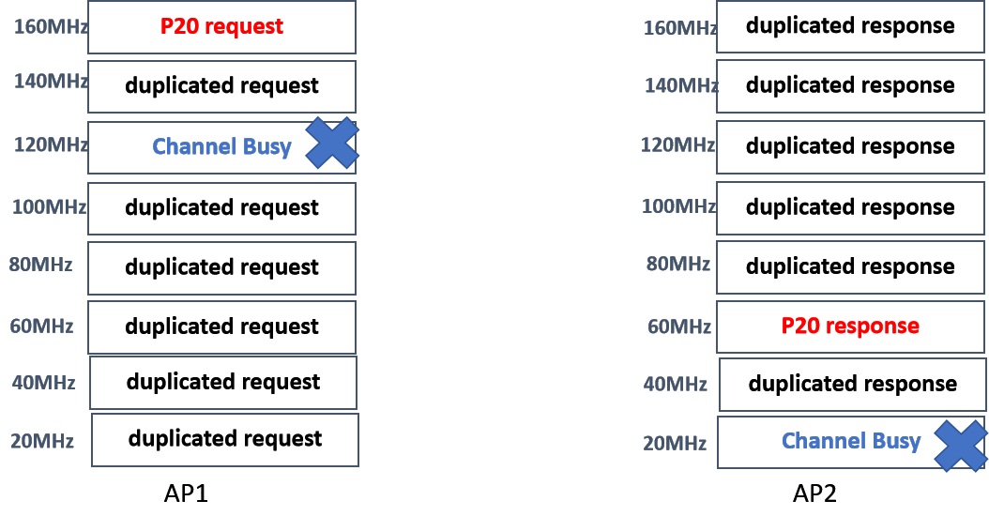
The following figure depicts an example for MGMT. frame delivery in MAP scheme.

Slide 9
MGMT frame delivery in MAP scheme(2)
An alternative option(Opt2) to address APs’ P20 inconsistent issue.
  The transmitter AP only sends MGMT frame(s) on receiver AP’s P20 channel
  The transmitter AP need to switch its P20 to the receiver’s P20 before that MGMT frame delivery.
  The transmitter AP need to indicates the unavailable duration in its P20 during that MGMT frame duration
The comparison between two approach for MGMT frame delivery
 | complexity | the responder’s P20 requirement | Channel utilization
Opt1 | more simple | one or more responders’ P20 on the different sub-channels | Occupy a lot of sub- channels
Opt2 | a little complex | only one responder’s P20 on another sub-channels. | Only the responder’s P20 sub-channel

Slide 10
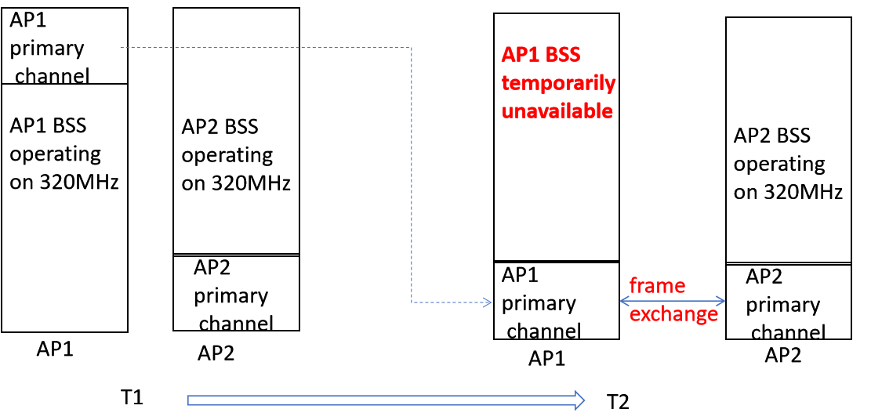
The following figure depicts an another example for MGMT. frame delivery in MAP scheme.

Slide 11
Summary
Discuss different channel setting uses cases in current implementation.
We propose to only consider the case1-5 for MAP coordination scheme.
Propose the control frame delivery in non-HT duplicate PPDU format.
For MGMT frame, we propose non-HT duplicated manner and P20 temporarily channel switch manner.

Slide 12
THANK YOU ☺

Slide 13
Reference
1. 20/560r0 Multi-AP Configuration and Resource Allocation
2. 24/0838 Backhaul Design and Channel Setting for Multi-AP

Slide 14
SP1
Do you agree the following conditions for MAP coordination scheme:
  -Initiator AP and responder AP may have different P20 channels.
  --The P20 channel of initiator AP shall be within the BSS operating channel width of the responder APs, vice versa.
  Note: initiator AP and responder APs affiliate with different AP MLDs.

Slide 15
SP2
Do you agree the initiator AP that operates on different P20 channel from the responder AP should transmit its control frame and MGMT frame in non-HT duplicate PPDU manner so that the responder AP can receive it on its own P20 channel.

