Slide 1
LPI PPDU Puncturing
Follow Up
Nov 2024
Authors:
Name | Affiliation | Phone | email
Pelin Salem | Cisco Systems |  | pmohamed@cisco.com
Brian Hart | Cisco Systems |  | brianh@cisco.com
Malcolm Smith | Cisco Systems
Juan Carlos Zuniga | Cisco Systems
Stephen Orr | Cisco Systems
Jerome Henry | Cisco Systems

Slide 2
The industry is seeking that Simultaneous Composite APs (Indoor SP APs) provide pervasive interoperability for all clients
FCC’s 6 GHz regulations and KDBs created silos
  LPI-only clients can’t talk to SP APs
  SP-only clients can’t talk to LPI APs
  Outdoor APs can only be SPs
The hope/expectation was that all clients be dual certified and could talk to any AP
  But, with early roll-out of LPI-only APs and clients, that hasn’t happened and continues to not happen
The second and most promising solution to have pervasive interoperability is the Simultaneous Composite AP
  See next slide

Slide 3
Simultaneous Composite APs Support All Client Flavors (USA)
… for UNII5/7 control channels
AFC System
(Unchanged)
Required
Simultaneous Composite (LPI+SP) AP
Wired power, not battery powered, integrated antenna, enclosure not weatherized, conspicuously labelled that FCC regulations restrict operation to indoor use only.
Authorized to transmit at max(LPI, SP) power on UNII5/7,
Changes to LPI AP on UNII6/8
6XD (LPI-only) client
6PP (Sub-ordinate) client
Can use LPI client power limits
Can use Subordinate power limits
6CD (Dual) client
6FX (SP-only) client
6VL (VLP-only) device
6FC (Fixed) client
Can use max(LPI, SP) client power limits
Can use SP client power limits (6 dB below limits provided by AFC System)
Can use VLP power limits
Obtains its power limits from the AFC System
Client can connect/associate to AP

Slide 4
However, although allowed for SP APs, PPDU puncturing is currently not allowed for LPI APs
In April 2020, 6GHz LPI was allowed by regulators (indoor only, low power limits, Contention-Based-Protocol (CBP) requirement)
Over 2017-2023, IEEE 802.11ax/be defined PPDU puncturing via preamble puncturing and OFDMA (then Multi-RUs)
  It was assumed that PPDU puncturing could be used in LPI BSSs at 6 GHz to avoid all kinds of interference (incumbents, other unlicensed users)
In August 2023, FCC completely disallowed PPDU Puncturing by LPI BSSs as per “987594 D02 U-NII 6 GHz EMC Measurement v02r01”
In October 2023, FCC relaxed this a little for LPI BSSs, but only for network optimization purposes.
  E.g., To avoid other Wi-Fi systems; but not to avoid incumbents (here, licensed users)

Slide 5
Thus, Simultaneous Composite APs (Indoor SP APs) are not (yet) providing the characteristics that the industry seeks
When LPI power > SP power, the Simultaneous Composite AP chooses to operate as an LPI AP, and it is not allowed to perform preamble puncturing around incumbents
Preamble Puncturing provides valuable spectrum gains (see slides 6-7 and back-up slides 19-22)
For the Simultaneous Composite AP to achieve its goal of providing a complete and perfect replacement to LPI-only and SP-only AP operation, we need to enable preamble puncturing around incumbents
  See [1] for a previous, broader solution, but here we show a simpler and sufficient solution
  // This problem remains even if regulations allow LPI APs to have higher power

Slide 6
Guide for the Following Slide
Please find below a brief guide to clarify the graphics in the following slide and additional similar slides in the back-up.
A-B-C-D(-E-F-G-H) = Each represent a 20MHz subchannel within the main 80/160MHz channel
I = Location of incumbent within 20 MHz (e.g., "I I I" indicates a lower, middle or upper location)
Green = Usable subchannel
Yellow = Tentative use subchannel (usable depending on the exact location of the incumbent within the 20MHz channel)
White/blank = Unusable subchannel
Orange = Subchannel where incumbent is present
P = Primary channel
S = Secondary channel
Center graph = Channel map
Left graph = Channel map with non-punctured scenario
Right graph = Channel map with punctured scenario
AP/RRM system gets to pick the row(s) = AP will decide on which subchannel to be used as primary channel
Punctured scenario
Non-punctured scenario
 | A | B | C | D
 | I I | P | S | S
or | I | P | S | S
or | I I | S | P | S
or | I | S | P | S
or | I I | S | S | P
or | I | S | S | P
 | A | B | C | D
 | I I | P
or | I | P
or | I I I |  | P | S
or | I I I |  | S | P
 | A | B | C | D
 | P | S | S | S
or | S | P | S | S
or | S | S | P | S
or | S | S | S | P

Slide 7
The Problem with Not Having Puncturing and the Benefit of Having It (Mid of 160MHz)
Consider the simple 160 MHz bandwidth case below. ​
An incumbent arrives and is detected via a DFS-like process or channel utilization analysis; LPI BSS can enable puncturing for that 20MHz subchannel for network optimization purposes IFF the interference is due to Wi-Fi (or another unlicensed technology) and not due to an incumbent. This requires higher level of processing compared to simple CCA.​
If the Incumbent appears on subchannel D, up to 140 MHz out of 160MHz can be used; depending on the exact location of the incumbent, perhaps 1-2 adjacent channels are unusable too (pale yellow).​
With puncturing based on behavior acceptable to regulators, we can convert most BSSs to 140 MHz BSSs or close to that​
Non-punctured scenario
 | A | B | C | D | E | F | G | H
 | P | S |  | I I I
or | S | P |  | I I I
or |  |  | P | I
or |  |  | P | I I
or |  |  |  | I I | P | S | S | S
or |  |  |  | I I | SPSS, etc
or |  |  |  | I | P | S | S | S
or |  |  |  | I | S | P | S | S
or |  |  |  | I | S | S | P | S
or |  |  |  | I | S | S | S | P
or |  |  |  | I I I |  |  | P | S
or |  |  |  | I I I |  |  | S | P
Punctured scenario
 | A | B | C | D | E | F | G | H
or | P | S | S | I | S | S | S | S
or | P | S | S | I | S | S | S | S
or | P | S | S | I | S | S | S | S
or | S | P | S | I I I | S | S | S | S
or | S | S | P | I I I | S | S | S | S
or | S | S | S | I I I | P | S | S | S
or | S | S | S | I I I | S | P | S | S
or | S | S | S | I I I | S | S | P | S
or | S | S | S | I I I | S | S | S | P
(Note simplified consideration of incumbent bandwidth after the first three rows)
 | A | B | C | D | E | F | G | H
 | P | S | S | S | S | S | S | S
or | S | P | S | S | S | S | S | S
or | S | S | P | S | S | S | S | S
or | S | S | S | P | S | S | S | S
or | S | S | S | S | P | S | S | S
or | S | S | S | S | S | P | S | S
or | S | S | S | S | S | S | P | S
or | S | S | S | S | S | S | S | P
* AP/RRM system gets to pick the row(s)

Slide 8
Solution – Use AFC info and IEEE Tx PSD mask
Example AFC response
Regulators disallowed PPDU puncturing for LPI BSSs because the LPI BSS has no information about incumbents
However, a Simultaneous Composite AP when operating in LPI mode still has AFC connectivity.
Then, we have a new choice (backwards compatible; no new signaling):
  AP in LPI mode inspects AFC response, and, as usual, itself does not exceed the PSD permitted by the AFC for APs.
  The AP also reports to non-AP STAs their AFC-permitted powers in the punctured channels via the TPE elements
    Current TPEs for a composite AP include max(LPI, SP). However, for a channel punctured due to an incumbent (and without CCA), LPI is not applicable, so AP just reports permitted SP power (new behavior).
    However, REVme-aware LPI clients don’t follow the TPE elements sent by a Simultaneous Composite AP today (they rely on their own regulatory knowledge) – so this is not a sufficient solution
    As well, the AP needs to help ensure LPI clients will meet their regulations
      … Knowing that LPI clients sending punctured PPDUs always need to meet the IEEE punctured mask (>=-20 dBr over most of punctured region), even at their maximum LPI power of -1 dBm /MHz; so -1 dBm/MHz – 20 dBm = -23 dBm/MHz.
      Thus, if the AFC-defined notch is above -23 dBm/MHz for a non-AP STA, then the AP may enable puncturing in Simultaneous Composite AP mode (i.e., even for LPI clients)
      Conversely, if the AFC-defined notch is below -23 dBm/MHz within the punctured region, then the AP cannot help ensure LPI clients will meet their regulations. Still, this is now a tolerably minor corner case. AP might a) reduce BW to avoid puncturing, b) change to SP-only mode, c) stop the BSS, etc.
LPI power with CCA
20 dB
IEEE punctured TX PSD mask
Here we anticipate that LPI punctured operation can be allowed
LPI power with CCA
20 dB
IEEE punctured TX PSD mask
Here the S.C. AP cannot enable punctured operation

Slide 9
Summary
We want the Simultaneous Composite AP:
  To provide service to every class of clients
  To have every 802.11 feature available, including PPDU puncturing
FCC currently does not permit PPDU Puncturing in LPI BSSs as an allowed method to protect incumbents
  If an incumbent occupies the upper or lower half of an 80 MHz channel, the LPI BSS bandwidth drops to 40 MHz
  If an incumbent occupies the upper or lower half of a 160 MHz channel, the LPI BSS bandwidth drops to 80 MHz
However, we see good prospects for FCC allowing PPDU puncturing by LPI APs and clients in the BSSs of Simultaneous Composite APs as long as the AFC response for the punctured channel(s) exceeds the maximum power that LPI APs and clients transmit in the punctured channel
No new protocol is required; just new AP behavior and its TPE element contents

Slide 10
Strawpoll
Do you agree to add the following text to the 11bn SFD:
  11bn shall define a mode of operation whereby a Simultaneous Composite AP in BSS can use its knowledge of AFC-provided regulatory limits and the punctured IEEE Tx PSD mask to enable PPDU Puncturing even for LPI-only non-AP STAs, via changes to the TPE elements’ contents that ensure compliance to the AFC-provided regulatory limits.
  Y / N / A

Slide 11
Reference
[1] 24/0534, “LPI Static Preamble Puncturing”, Pelin Salem (Cisco Systems)

Slide 12
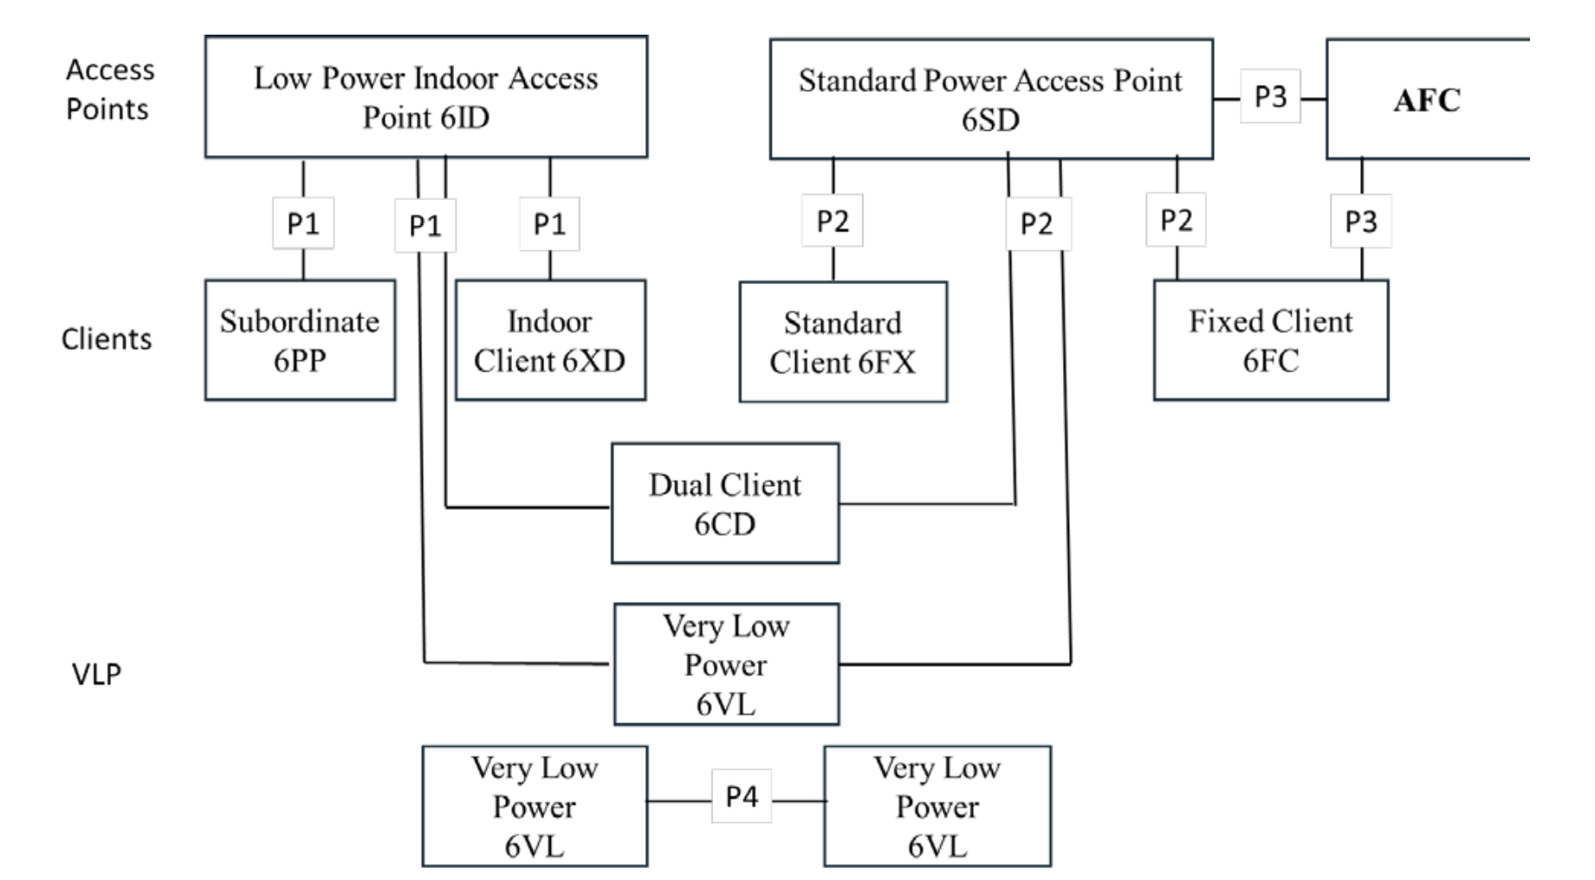
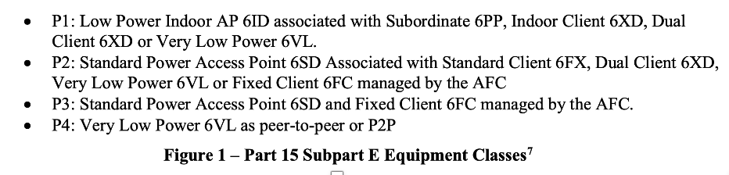
Current 6GHz Equipment Classes (FCC)

Slide 13
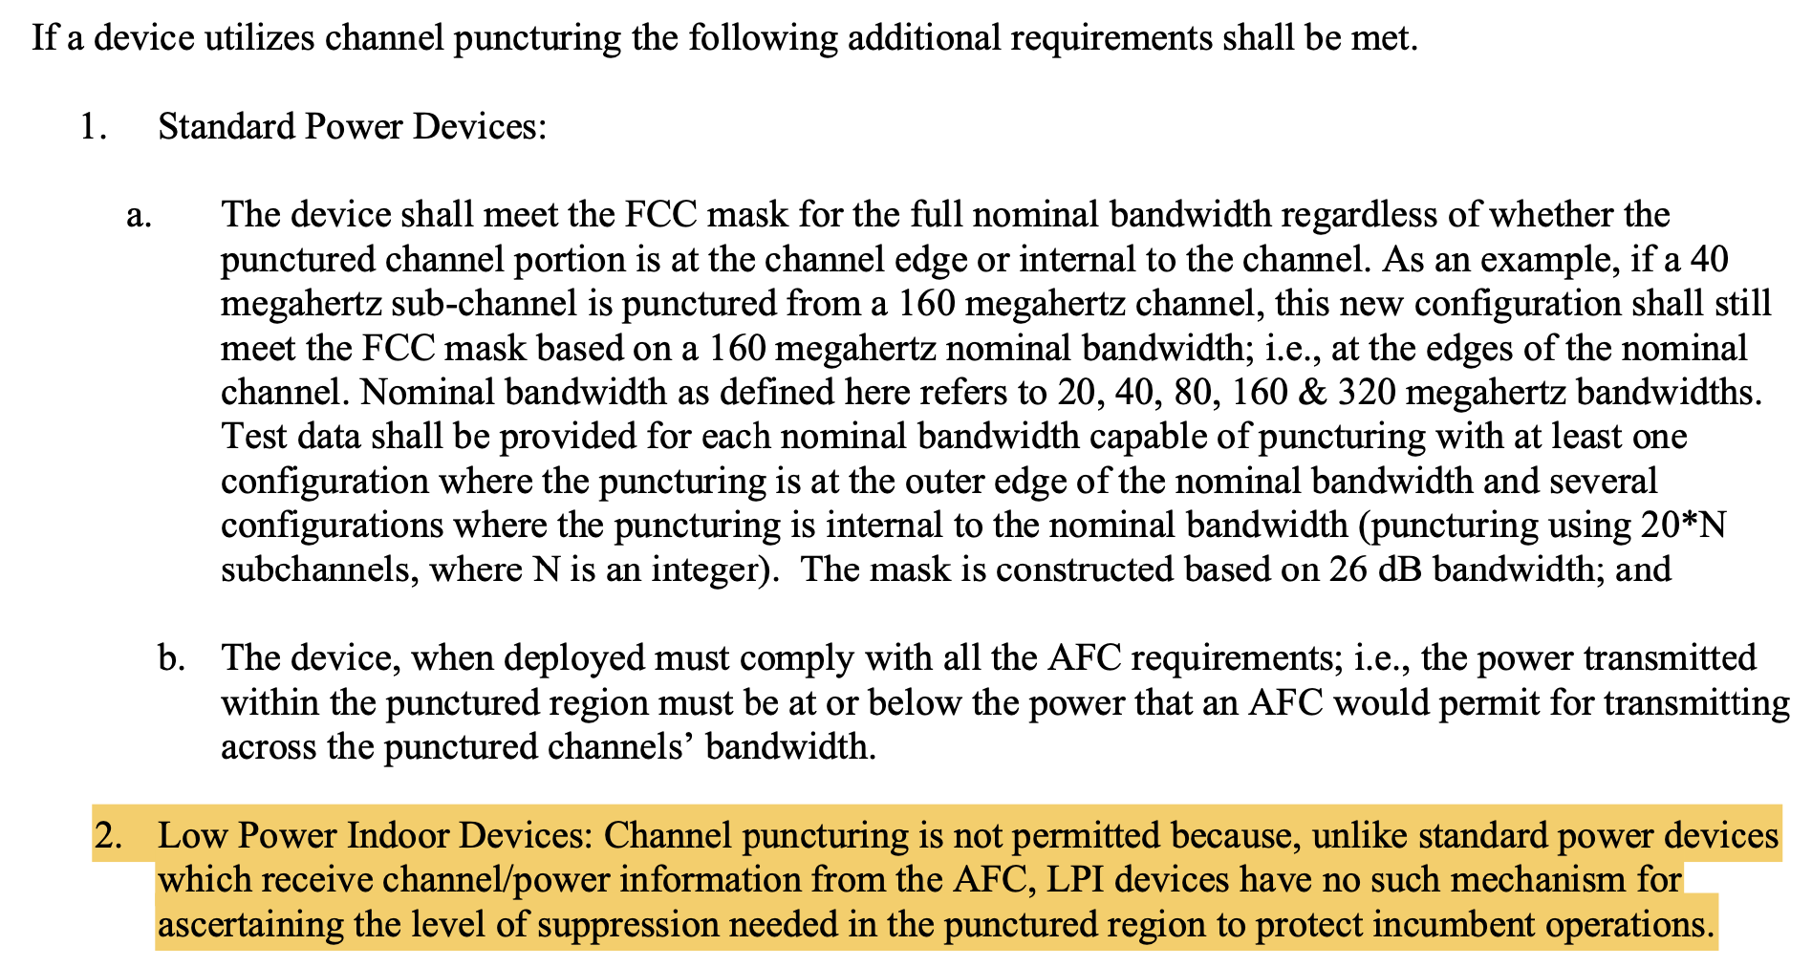
Current Regulatory View (6GHz SP)
Preamble Puncturing is allowed with SP BSSs as per 987594 D02 U-NII 6 GHz EMC Measurement v02r01
FCC: Federal Communications Commission
DFS: Dynamic Frequency Selection
AFC: Automatic Frequency Control
SP: Standard Power

Slide 14
First, LPI was allowed by regulators and
PPDU puncturing was defined by IEEE 802.11
LPI was allowed by regulators
  Based on analysis that it wouldn’t interfere with incumbents because of a) low power operation, b) indoors and c) the requirement to employ a contention-based protocol
IEEE 802.11ax/be defined PPDU puncturing via preamble puncturing and OFDMA (then Multi-RUs)
  And, perhaps naively, some/many/all members assumed that PPDU puncturing could be used in LPI BSSs to avoid all kinds of interference (incumbents, other unlicensed users)
  Various incumbents occupy the 6GHz unlicensed band as follows:
    UNII-5 & 7: Fixed Services (~50k fixed microwave links, private & common carrier purposes such as management of public utilities, backhaul for cell towers and long-distance telephone links), Satellite Services (Fixed Earth-to-Space TV & Radio uplink for voice & data communications, Mobile Space-to-Earth links)
    UNII-6 & 8: Satellite Services, TV and Broadcast Services (Transmission and relay of video signals, local news TV trucks for broadcast and TV entities, special large scale audio usage by venue & sounds production companies).
    Entire 6GHz band: Ultra Wide Band
But this has proved to be incorrect …

Slide 15
Second, FCC denied Channel Puncturing with LPI BSSs
(See backup for SP)
PPDU Puncturing is not allowed with LPI BSSs as per FCC 987594 D02 U-NII 6 GHz EMC Measurement v02r01
LPI: Low Power Indoor EMC: ElectroMagnetic Compatibility CBP: Contention Based Protocol

Slide 16
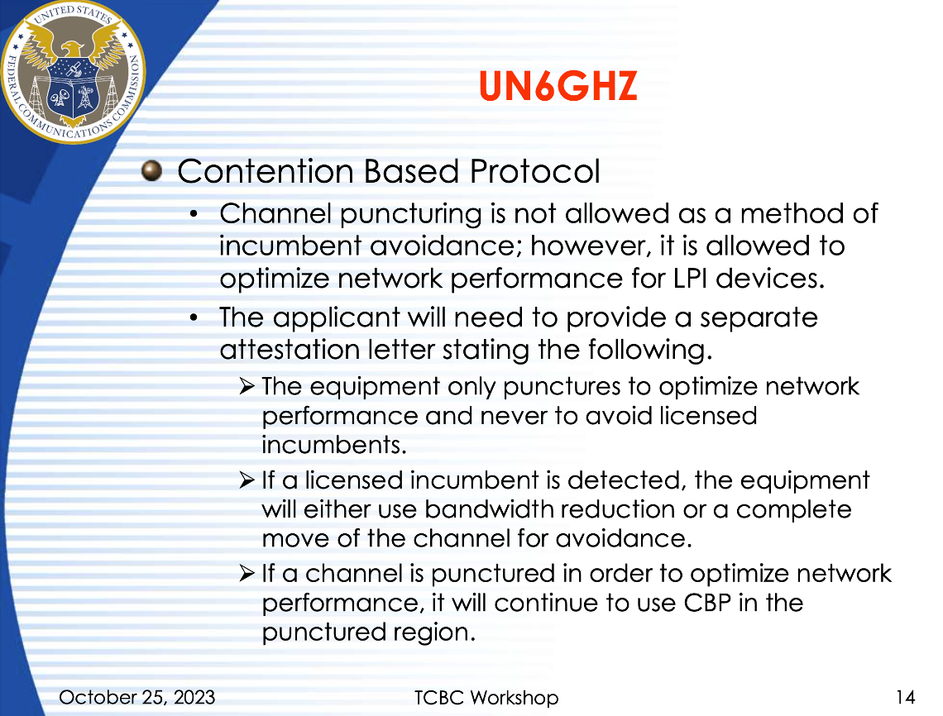
Third, FCC relaxed this position …
Relaxation by FCC in October 2023:
  Preamble Puncturing is allowed with LPI BSSs for network optimization purposes.
LPI: Low Power Indoor EMC: ElectroMagnetic Compatibility CBP: Contention Based Protocol

Slide 17
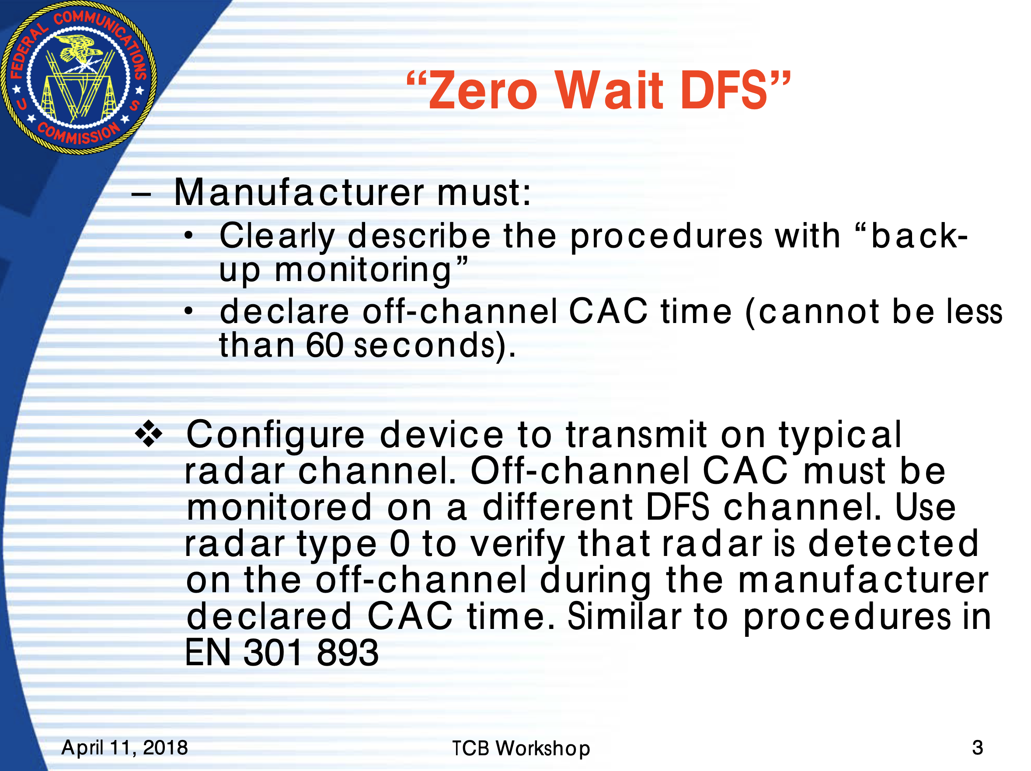
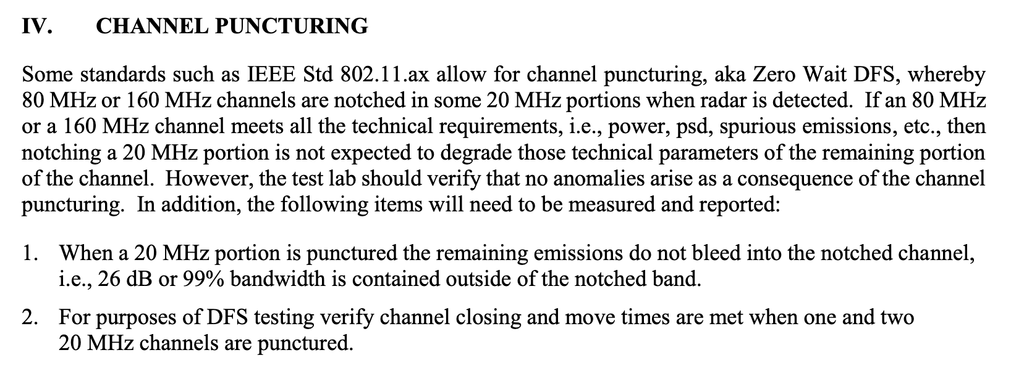
… But this relaxation requires extensive testing and DFS-like signal processing so that incumbents remain protected
Channel Puncturing is called as Zero-wait DFS in 789033 D02 General UNII Test Procedures New Rules v02r01, which is a separate feature that needs to be tested extensively.
789033 D02 General UNII Test Procedures New Rules v02r01

Slide 18
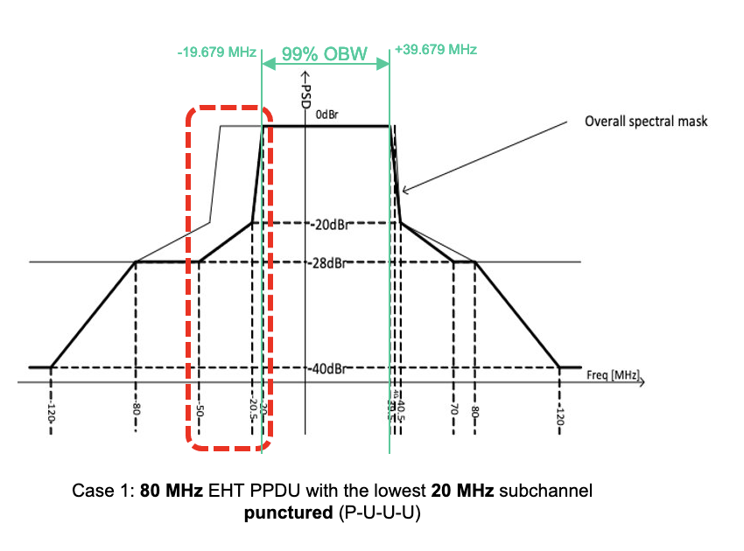
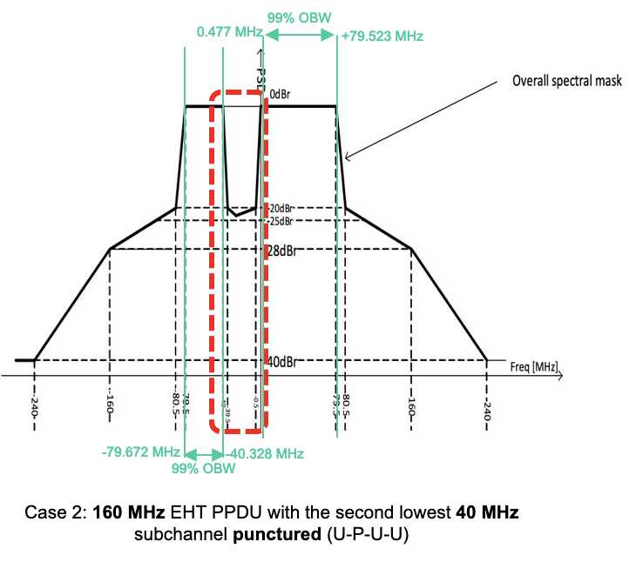
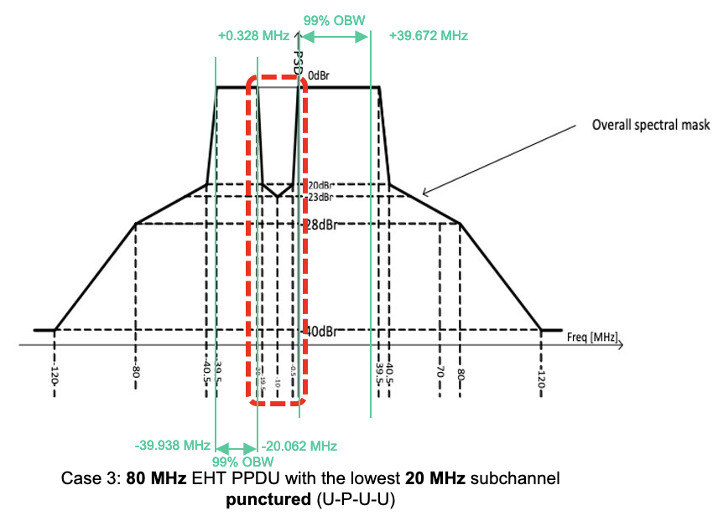
Sidebar: the testing calls out 26 dB or 99%, but 26 dB is challenging for 802.11 whereas 99% is much more achievable
Current IEEE Transmit Spectral Masks with punctured subchannels meet the FCC requirement of 99% bandwidth, but not the 26dB BW (yet, FCC seemingly prioritizes 26dB; we will follow up with the FCC).
789033 D02 General UNII Test Procedures New Rules v02r01

Slide 19
The Problem with Not Having Puncturing and the Benefit of Having It
(Edge of 80MHz)
Consider the simple 80 MHz bandwidth case below.
An incumbent arrives and is detected via a DFS-like process or channel utilization analysis; LPI BSS can enable puncturing for that 20MHz subchannel for network optimization purposes IFF the interference is due to Wi-Fi (or another unlicensed technology) and not due to an incumbent. This requires higher level of processing compared to simple CCA.
If the Incumbent (I) appears on subchannel A, at most 40 out of 80MHz can be used; and, depending on the exact location of the incumbent, perhaps the adjacent channel is unusable too (pale yellow).
With puncturing based on behavior acceptable to regulators, we can convert most BSSs to 60 MHz BSSs or close to that.
Punctured scenario
Non-punctured scenario
 | A | B | C | D
 | I I | P | S | S
or | I | P | S | S
or | I I | S | P | S
or | I | S | P | S
or | I I | S | S | P
or | I | S | S | P
 | A | B | C | D
 | I I | P
or | I | P
or | I I I |  | P | S
or | I I I |  | S | P
 | A | B | C | D
 | P | S | S | S
or | S | P | S | S
or | S | S | P | S
or | S | S | S | P
* AP/RRM system gets to pick the row(s)

Slide 20
The Problem with Not Having Puncturing and the Benefit of Having It
(Inner portion of 80MHz)
If the Incumbent appears on subchannel B, up to 60 MHz out of 80MHz can be used; as before, depending on the exact location of the incumbent, perhaps an adjacent channel is unusable too (pale yellow).
With puncturing based on behavior acceptable to regulators, we can convert most BSSs to 60 MHz BSSs or close to that.
Punctured scenario
Non-punctured scenario
 | A | B | C | D
 | P | I
or | P | I I
or | S | I | P | S
or | S | I | P | S
or | S | I | P | S
or | S | I | S | P
or | S | I | S | P
or | S | I | S | P
 | A | B | C | D
 | P | I
or | P | I I
or |  | I I | P | S
or |  | I | P | S
or |  | I I | S | P
or |  | I | S | P
 | A | B | C | D
 | P | S | S | S
or | S | P | S | S
or | S | S | P | S
or | S | S | S | P
* AP/RRM system gets to pick the row(s)

Slide 21
The Problem with Not Having Puncturing and the Benefit of Having It
(Edge of 160MHz)
Consider the simple 160 MHz bandwidth case below.
An incumbent arrives and is detected via a DFS-like process or channel utilization analysis; LPI BSS can enable puncturing for that 20MHz subchannel for network optimization purposes IFF the interference is due to Wi-Fi (or another unlicensed technology) and not due to an incumbent. This requires higher level of processing compared to simple CCA.
If the Incumbent (I) appears on subchannel A, at most 80 out of 160MHz can be used; and, depending on the exact location of the incumbent, perhaps the adjacent channel is unusable too (pale yellow)
With puncturing based on behavior acceptable to regulators, we can convert most BSSs to 140 MHz BSSs or close to that.
Punctured scenario
 | A | B | C | D | E | F | G | H
 | I I | P | S | S | S | S | S | S
or | I | P | S | S | S | S | S | S
or | I I | S | P | S | S | S | S | S
or | I | S | P | S | S | S | S | S
or | I I | S | S | P | S | S | S | S
or | I | S | S | P | S | S | S | S
or | I I | S | S | S | P | S | S | S
or | I | S | S | S | P | S | S | S
or | I I | S | S | S | S | P | S | S
or | I | S | S | S | S | P | S | S
or | I I | S | S | S | S | S | P | S
or | I | S | S | S | S | S | P | S
or | I I | S | S | S | S | S | S | P
or | I | S | S | S | S | S | S | P
Non-punctured scenario
 | A | B | C | D | E | F | G | H
 | I I | P
or | I | P
or | I I I |  | P | S
or | I I I |  | S | P
or | I |  |  |  | P | S | S | S
or | I I I |  |  |  | S | P | S | S
or | I I I |  |  |  | S | S | P | S
or | I I I |  |  |  | S | S | S | P
 | A | B | C | D | E | F | G | H
 | P | S | S | S | S | S | S | S
or | S | P | S | S | S | S | S | S
or | S | S | P | S | S | S | S | S
or | S | S | S | P | S | S | S | S
or | S | S | S | S | P | S | S | S
or | S | S | S | S | S | P | S | S
or | S | S | S | S | S | S | P | S
or | S | S | S | S | S | S | S | P
* AP/RRM system gets to pick the row(s)

Slide 22
The Problem with Not Having Puncturing and the Benefit of Having It
(Mid-20 MHz within 160 MHz)
If the Incumbent spans subchannels A&B, C&D, or D&E, without puncturing, just 80 MHz out of 160MHz can be used.
With puncturing based on behavior acceptable to regulators, we can convert most BSSs to 120 MHz BSSs
Non-punctured scenario
 | A | B | C | D | E | F | G | H
 | I |  | P | S
or | I |  | S | P
or | I |  |  |  | P | S | S | S
or | I |  |  |  | SPSS, etc | S | S | S
or | P | S | I
or | S | P | I
or |  |  | I |  | P | S | S | S
or |  |  | I |  | SPSS, etc
or | P | S |  | I
or | S | P |  | I
 |  |  | P | I
 |  |  |  | I |  | P
or |  |  |  | I |  |  | P | S
or |  |  |  | I |  |  | S | P
Punctured scenario
 | A | B | C | D | E | F | G | H
 | I |  | P | S | S | S | S | S
or | I |  | S | P | S | S | S | S
or | I |  | S | S | P | S | S | S
or | I |  | SSSPSSSS, etc | P
or | P | S | I |  | P | S | S | S
or | S | P | I |  | S | S | S | S
or | S | S | I |  | P | S | S | S
or | S | S | I |  | SPSS, etc |  |  | S
or | P | S | S | I |  | S | S | S
or | S | P | S | I |  | S | S | S
or | S | S | P | I |  | S | S | S
or | S | S | S | I |  | PSS, etc | S | P
 | A | B | C | D | E | F | G | H
 | P | S | S | S | S | S | S | S
or | S | P | S | S | S | S | S | S
or | S | S | P | S | S | S | S | S
or | S | S | S | P | S | S | S | S
or | S | S | S | S | P | S | S | S
or | S | S | S | S | S | P | S | S
or | S | S | S | S | S | S | P | S
or | S | S | S | S | S | S | S | P
* AP/RRM system gets to pick the row(s)

