Slide 1
Discussion on aspects in DRU operation
Date: 2024-06-18
Authors:
Name | Affiliations | Address | Phone | email
Arik Klein | Huawei |  |  | Arik.Klein@huawei.com
Genadiy Tsodik |  |  |  | Genadiy.tsodik@huawei.com
Shimi Shilo |  |  |  | Shimi.Shilo@huawei.com
Oded Redlich |  |  |  | Oded.Redlich@huawei.com

Slide 2
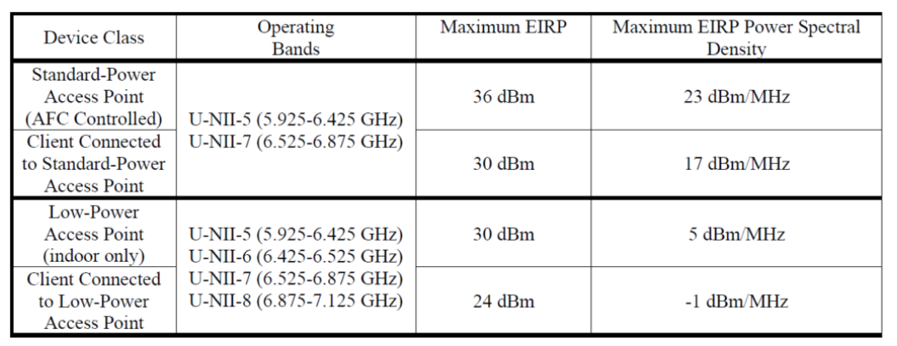
Background
There are strict (and low) EIRP PSD requirements in the 6GHz band for Low Power Indoor APs, limiting both AP and non-AP STAs
The solution proposed in 11bn PHY
is using a Distributed tone RU (DRU),
where the tones of the allocated RU
are spread across specific BW
(distributed BW)
  Current tone plan design defines transmission on a set of consecutive tones (RU) which means ~13 tones within each 1MHz
This results in smaller number of tones within each 1MHz and thus total transmitted power of the STA may increase while keeping the maximal (regulated) EIRP PSD value
For example, if 26-tone RU (~2MHz) is spread across 20MHz BW, it allows additional gain of ~10dB

Slide 3
PHY Principles of DRU
The Distributed tone RU (DRU) feature is widely discussed in TGbn PHY and has been accepted as a solution for the limit of maximal EIRP PSD regulation in the 6GHz band (TGbn SFD, Motion #1)
Although the detailed design is still under debate, there are some common principles that we may assume for this discussion:
  DRU is currently defined for UL transmissions
  There are several Distributed BWs that might be supported, 20/40/80/160MHz, and the Distributed BW, across which the DRU is allocated, may be smaller than the operating BW
    For example, Operating BW is 80MHz whereas the distributed BW is 40MHz. This means that the tones of 26- tone RU are spread across the 40MHz of a DRU
  There will be no mixture between Regular RU (RRU) and DRU when allocated within the same distributed BW (BW values are still being discussed)
  DRU is applicable only for UHR portions of the TB PPDU, starting with UHR-STF field; the Legacy Preamble and Signal Fields will be transmitted in regular mode (no tone distribution) over the entire operational BW

Slide 4
MAC aspects of DRU Operation
At this stage, the MAC perspective of DRU operation has not been analyzed or discussed
There might be several MAC aspects that need to be considered w.r.t. DRU operation, including
  Decision on RRU vs. DRU allocation per non-AP STA
  Uplink Power control

Slide 5


Tx Power calculation in TB PPDU
In order to understand the aspect related to selection of RU type, we want to review the Tx power calculation in TB PPDU
An HE non-AP STA is required to calculate the UL TX power of a TB PPDU based on the following factors:
  Target RSSI value (set by the AP)
  RU size (set by the AP)
  AP Tx power (set by the AP)
  Max EIRP PSD value (set by regulation)
According to [1] , an HE STA shall calculate its transmit power, based on Target RSSI, AP TX Power and Received RSSI values, as follows:
  Where:

Slide 6
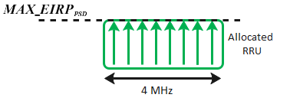
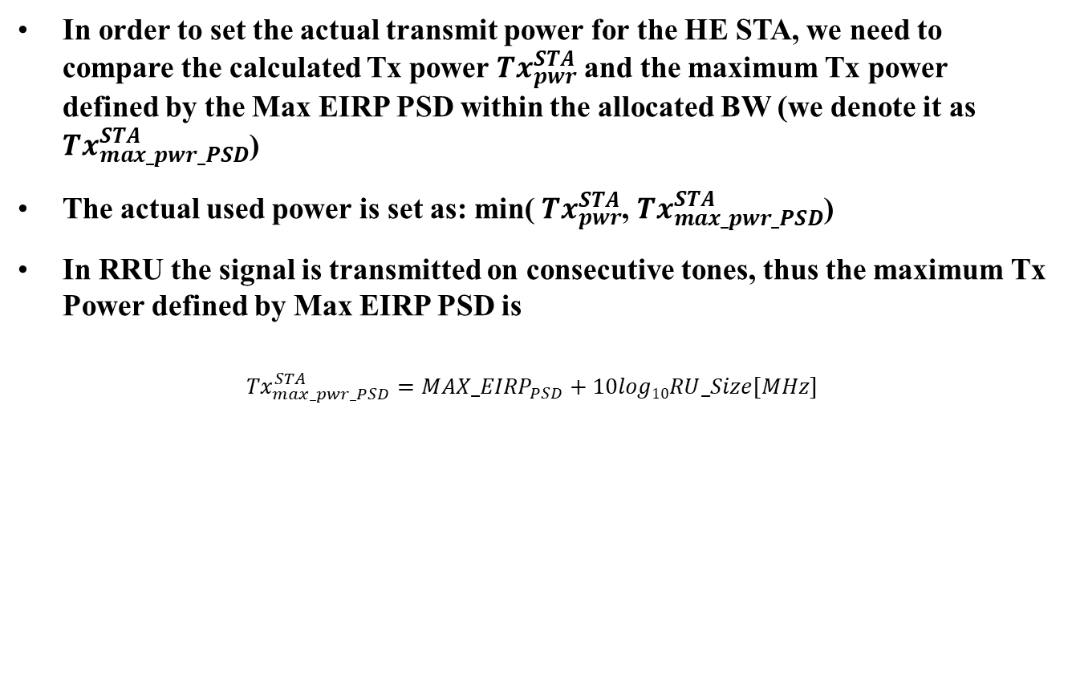
Impact of Max EIRP PSD on Tx Power in RRU
In order to set the actual transmit power for the HE STA, we need to compare the calculated Tx power ${Tx}_{pwr}^{STA}$ and the maximum Tx power defined by the Max EIRP PSD within the allocated BW (we denote it as ${Tx}_{max_pwr_PSD}^{STA}$)
The actual used power is set as: min( ${Tx}_{pwr}^{STA}$, ${Tx}_{max_pwr_PSD}^{STA}$)
In RRU the signal is transmitted on consecutive tones, thus the maximum Tx Power defined by Max EIRP PSD is
$${{Tx}_{max_pwr_PSD}^{STA}=MAX_EIRP}_{PSD}+10log10RU_Size[MHz]$$

Slide 7
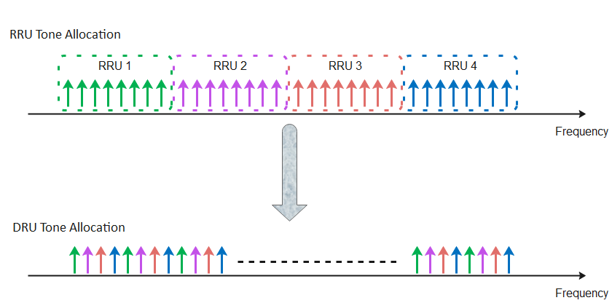
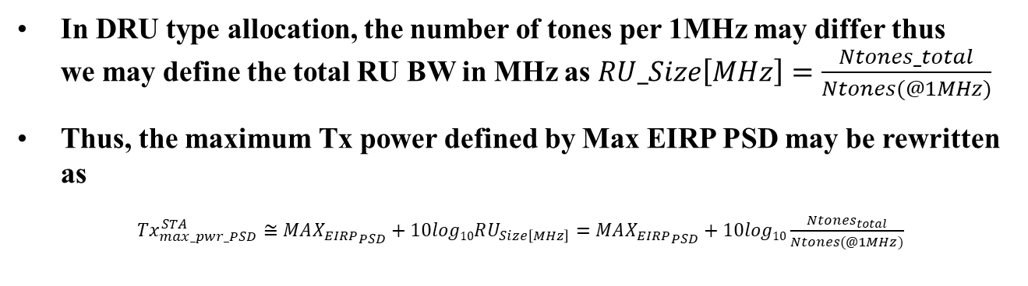
Impact of Max EIRP PSD on Tx Power in DRU
In DRU type allocation, the number of tones per 1MHz may differ thus
we may define the total RU BW in MHz as $RU_Size\left[MHz\right]=\frac{Ntones_total}{Ntones(@1MHz)}$
Thus, the maximum Tx power defined by Max EIRP PSD may be rewritten as
${Tx}_{max_pwr_PSD}^{STA}≅{MAX_{EIRP}}_{PSD}+10log10RU_{Size\left[MHz\right]}={MAX_{EIRP}}_{PSD}+10log10\frac{Ntones_{total}}{Ntones(@1MHz)}$

Slide 8
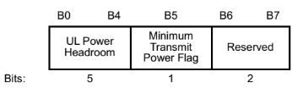

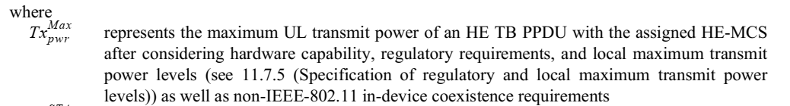
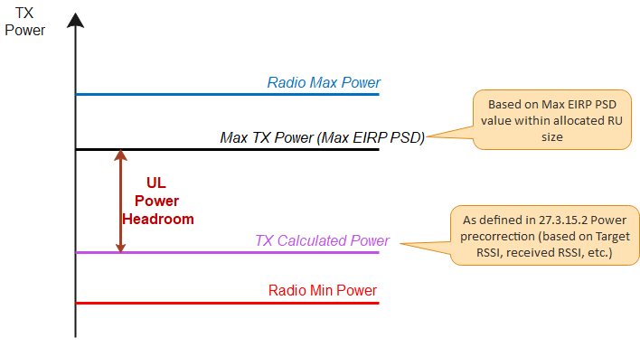
Uplink Power Headroom Indication
The UL Power Headroom (UPH) is reported by the non-AP HE STA in the Frame Header of any Data frame or Management frame transmitted in TB PPDU

Slide 9
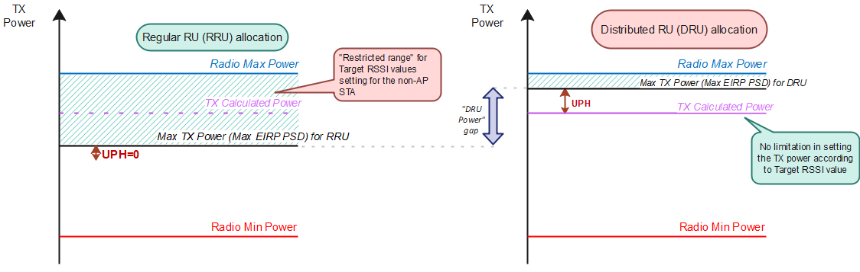

Uplink Power Headroom is insufficient
In case that RRU is allocated and the actual transmit power of a non-AP STA is bounded by Transmit power corresponding to Max EIRP PSD, for any value of calculated transmit power that is in the range: ${Tx}_{max_pwr_PSD}^{STA}≤{Tx}_{pwr}^{STA} <{Tx}_{Radio_max_pwr}^{STA}$
  UL Power Headroom is 0
  The STA will not increase its output power with respect to Target RSSI value (see figure on the left)
The AP does not know which factor bounds the Max power.
  In such a case, DRU allocation for the non-AP STA might help (see figure on the right)

Slide 10
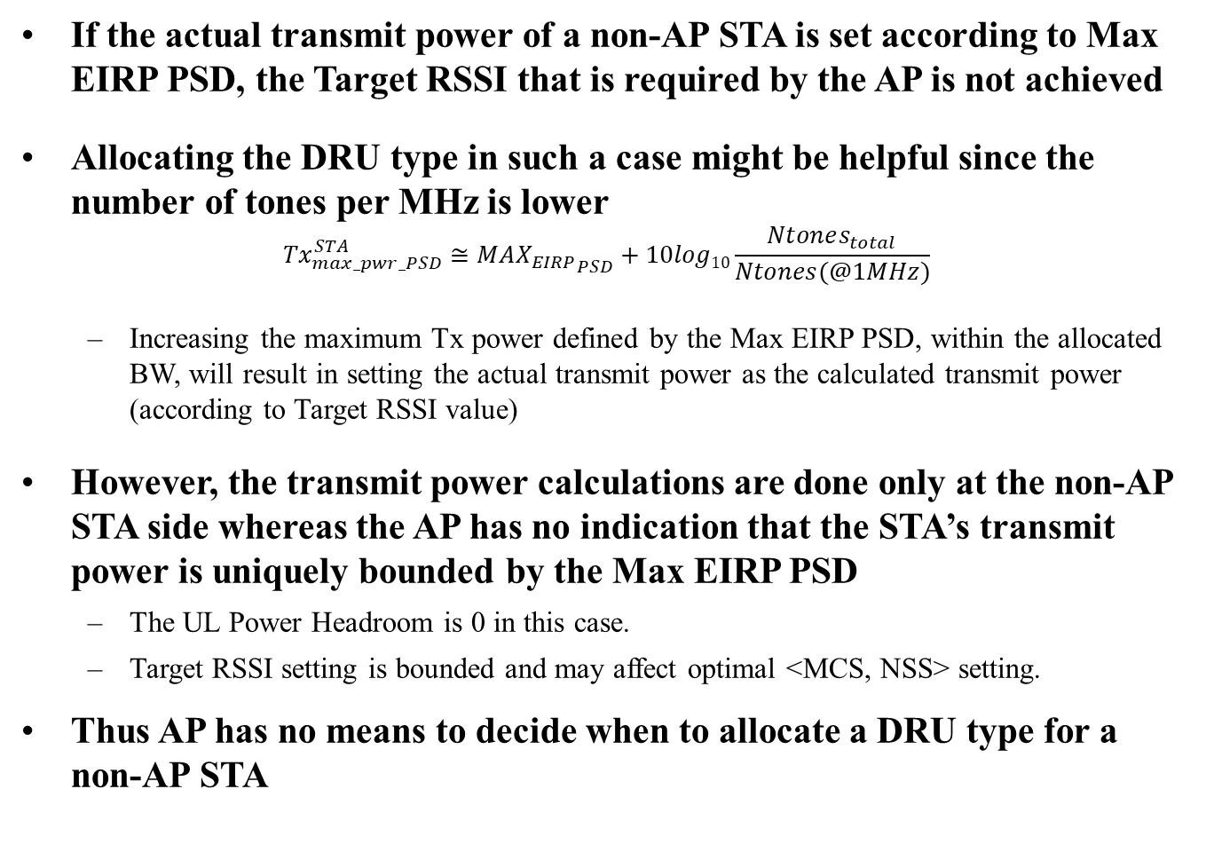
Problem Statement
If the actual transmit power of a non-AP STA is set according to Max EIRP PSD, the Target RSSI that is required by the AP is not achieved
Allocating the DRU type in such a case might be helpful since the number of tones per MHz is lower
$${Tx}_{max_pwr_PSD}^{STA}≅{MAX_{EIRP}}_{PSD}+10log10\frac{Ntones_{total}}{Ntones(@1MHz)}$$
  Increasing the maximum Tx power defined by the Max EIRP PSD, within the allocated BW, will result in setting the actual transmit power as the calculated transmit power (according to Target RSSI value)
However, the transmit power calculations are done only at the non-AP STA side whereas the AP has no indication that the STA’s transmit power is uniquely bounded by the Max EIRP PSD
  The UL Power Headroom is 0 in this case.
  Target RSSI setting is bounded and may affect optimal <MCS, NSS> setting.
Thus AP has no means to decide when to allocate a DRU type for a non-AP STA

Slide 11
Summary
The DRU feature is accepted in TGbn PHY as a solution for bounded uplink transmit power due to Maximal EIRP PSD regulation in the 6GHz band
We’ve shown that the AP doesn’t have sufficient information to decide when to allocate the DRU type (over RRU)
  Ineffective DRU allocation may have a negative impact on link adaptation and even lead to lower throughput in some scenarios
The non-AP STA may assist the AP to effectively allocate the required RU type by adding a relevant indication to the TB PPDU
  NOTE (for future discussion): DRU may also have an impact on scheduler complexity and link adaptation at the AP side

Slide 12
Reference
[1] IEEE 802.11 REVme D5.0, section 27.3.15.2 Power Precorrection

