Slide 1
Analysis on the over puncturing of LDPC
Date: 06/19/24
Name | Affilations | Address | Email
Xiaogang Chen | Spreadtrum Communications, USA | 2680 N 1st St. San Jose, CA. 95134 | Xiaogang.chen1@unisoc.com
Chunyu Hu
William Li

Slide 2
Problem statement
The criteria below are used to avoid over-puncturing in LDPC.
1st threshold: the number of punctured parities per CW is less than 30% of the total parity bits per CW;
2nd threshold: the number of punctured parities per CW is less than 10% of the total parity bits per CW if the number of shortening bits is less than a code rate dependent threshold;
Extra symbol (n_SD_short) is added if either criteria above is triggered.

Slide 3
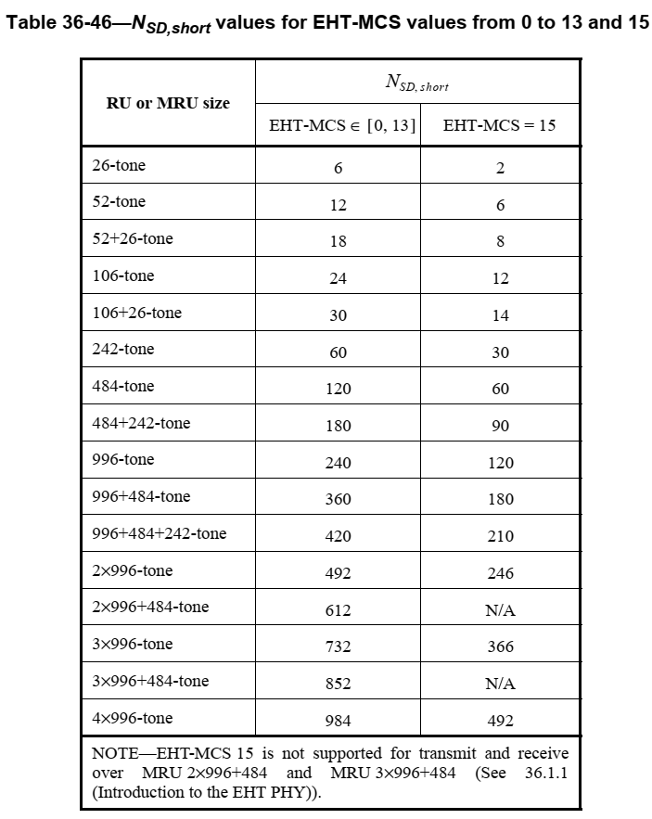
Problem analysis (1/3)
Before 11ax, a whole symbol is added if over puncturing is triggered.
Nsd = 52/108/234/468 for 20/40/80/160MHz.
The current Nsd_short is shown below:
All the small RU/MRU has Nsd_short much less than 52 (minimum value in 11ac/n)

Slide 4
Problem analysis (2/3)
If using the two threshold in page 2 as “golden rule”, then all the small RU/MRU will be risky on over puncturing especially if lower MCS is used.
The extra symbol is only added one time and no further checking is done.
Excel sheet below lists the combinations with over puncturing for small RU/MRU in 1SS.

Slide 5
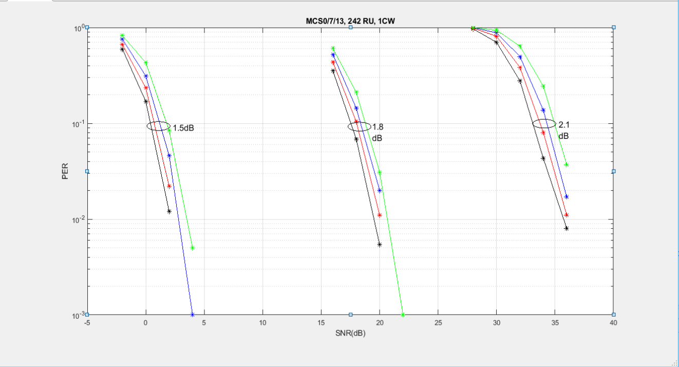
Problem analysis (3/3)
Puncturing introduces 0.5~2dB loss depends on puncturing ratio (10%-30%) [1]
Blk: 0% Punc; Red: 10% Punc; Blue: 20% Punc; Green: 30% Punc.
Note: sims is for 1 CW (1944) in ChDNLoS 4x2x1.
Shortening can compensate the performance loss.

Slide 6
Discussions on the solutions (1/2)
Opt.1:
Continue use the two threshold as “golden rule”;
Adjust the N_sd_short for small RU/MRU (26/52/106/106+26/52+26);
E.g. for small RU/MRU, always add a full symbol instead of quarter symbol.
Allow multiple extra symbols.
Change the 1 bits to 2/3 bits to indicate multiple extra symbols.
Opt.1 is
Simple change in spec and implementation;
Significantly reduce or eliminate the over puncturing.
Opt.2 re-evaluate the two threshold and come up with new rules to address over puncturing.
Extensive simulation is required.

Slide 7
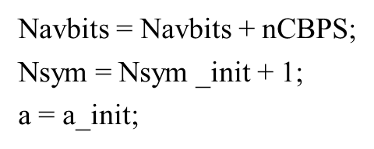
Discussions on the solutions (2/2)
With Opt.1, The changes are
The two updates below will be simplified
This simplified version just need to be done multiple times if more extra symbol is allowed.
PE Disambiguity need one extra bit.

Slide 8
Summary
Propose to reduce or remove the combination of over puncturing in small RU/MRU for LDPC.
Opt.1 is preferable.

Slide 9
SP
Do you agree to reduce (or remove) the combinations that introduce over puncturing in LDPC for small RU/MRU?
The solution to reduce these combination is TBD.
Candidate solution is opt.1 in page 6.

Slide 10
Reference
[1] 11-23-0667-01-0uhr-revisiting-of-the-rate-matching-for-ldpc

