Slide 1
Follow up on the PAPR of pilot in the OFDMA Transmission
Date: 06/18/24
Authors | Affiliations | Address | Email
Xiaogang Chen | Spreadtrum Communications, USA | 2680 N 1st St. San Jose, CA. 95134 | Xiaogang.chen1@unisoc.com
William Li
Chunyu Hu

Slide 2
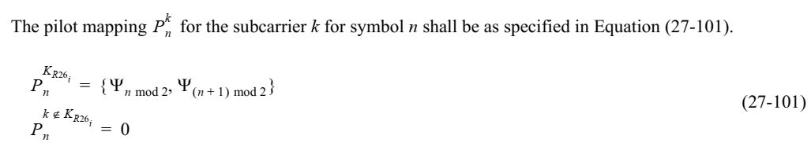
Recap of the issue in [1]
  Taking pilot design of 26-tone RU as an example:
  In one OFDM symbol, the pilot sequence is the same for different 26-tone RUs.
  If AP schedules multiple 26-tone RUs for multiple STAs, there are several repeated “templet” of pilot sequence.
    If AP schedules 36 STAs and each of which is allocated with a 26-tone RU in one symbol, the frequency domain repeated pilots will generate peaks in the time domain.

Slide 3
PAPR of the EHT data field
Simulation configurations:
2/4Tx antenna; 1/2/4 SS.
80/160/320MHz.
QPSK randomized data.
5000 symbols are simulated.
Simulated options:
  Opt1: 11be;
  Opt2: Fully randomized pilot sequence in each symbol;
  Opt3: 11be + per user phase rotation. Rotation is chosen from [1 -1 –j j].
X dB clipping: cap the amplitude of IQ sample to be a value equals to X dB of the average amplitude while preserving the phase.
Note: The results of 1Tx is shown in [1]

Slide 4
PAPR
CCDF of 80MHz PPDU with 36 user (26 tone RU) and 16 users (52 tone RU).

Slide 5
EVM - 80MHz PPDU 2x2
With a reasonable clipping threshold, the EVM can be considerably improved for 26 and 52 tone RU.
EVM(dB) with different clipping levels
Clipping level /RU size | 7dB Clipping |  | 8dB Clipping |  | 9dB Clipping
 | 11be pilots | 11be pilots + phaseRot | 11be pilots | 11be pilots + phaseRot | 11be pilots | 11be pilots + phaseRot
RU26 | -31.49 | -35.18 | -35.74 | -41.3 | -40.85 | -48.37
RU52 | -35.16 | -36.16 | -40.84 | -42.34 | -47.69 | -50.06
RU106 | -36.47 | -36.60 | -42.83 | -42.99 | -50.55 | -50.89

Slide 6
EVM - 160MHz PPDU 2x2
With a reasonable clipping threshold, the EVM can be considerably improved for 52 tone RU.
EVM(dB) with different clipping levels
Clipping level /RU size | 7dB Clipping |  | 8dB Clipping |  | 9dB Clipping
 | 11be pilots | 11be pilots + phaseRot | 11be pilots | 11be pilots + phaseRot | 11be pilots | 11be pilots + phaseRot
RU52 | -33.23 | -35.25 | -37.92 | -40.99 | -43.47 | -47.78
RU106 | -36.17 | -36.43 | -42.31 | -42.77 | -49.83 | -50.41
RU242 | -35.67 | -35.89 | -41.96 | -42.33 | -49.72 | -50.21

Slide 7
EVM - 320MHz PPDU 2x2
With a reasonable clipping threshold, the EVM can be considerably improved for 106, 242, 484 tone RU.
EVM(dB) with different clipping levels
 | 7dB Clipping |  | 8dB Clipping |  | 9dB Clipping
 | 11be pilots | 11be pilots + phaseRot | 11be pilots | 11be pilots + phaseRot | 11be pilots | 11be pilots + phaseRot
RU106 | -35.34 | -36.03 | -41.13 | -42.24 | -47.96 | -49.69
RU242 | -35.16 | -35.67 | -41.13 | -42.00 | -48.19 | -49.61
RU484 | -35.14 | -35.79 | -41.20 | -42.19 | -48.28 | -49.88

Slide 8
Observation 1
For OFDMA transmission with 16 or 36 users, phase rotation on the pilot tone shows consistent gain to reduce EVM especially for higher QAM.

Slide 9
EVM - 80MHz PPDU 4x2
With a reasonable clipping threshold, the EVM can be considerably improved for 26 tone RU.
EVM(dB) with different clipping levels
Clipping level /RU size | 7dB Clipping |  | 8dB Clipping |  | 9dB Clipping
 | 11be pilots | 11be pilots + phaseRot | 11be pilots | 11be pilots + phaseRot | 11be pilots | 11be pilots + phaseRot
RU26 | -36.95 | -38.85 | -42.42 | -45.28 | -48.80 | -52.77
RU52 | -38.93 | -39.40 | -45.03 | -45.66 | -52.34 | -53.44
RU106 | -39.54 | -39.62 | -45.95 | -46.06 | -53.92 | -54.08

Slide 10
EVM - 80MHz PPDU 4x4
With a reasonable clipping threshold, the EVM can be considerably improved for 26, 52 tone RU.
EVM(dB) with different clipping levels
Clipping level /RU size | 7dB Clipping |  | 8dB Clipping |  | 9dB Clipping
 | 11be pilots | 11be pilots + phaseRot | 11be pilots | 11be pilots + phaseRot | 11be pilots | 11be pilots + phaseRot
RU26 | -34.57 | -38.23 | -38.72 | -44.15 | -43.90 | -51.47
RU52 | -38.18 | -39.22 | -43.83 | -45.40 | -50.57 | -53.03
RU106 | -39.53 | -39.63 | -45.85 | -46.01 | -53.62 | -54.07

Slide 11
Observation 2
Per stream CSD and SE matrix jointly affect the PAPR (may be destructively...)
  Similar results for 160/320MHz which are not listed.
Phase rotation on the pilot tone still shows consistent gain.

Slide 12
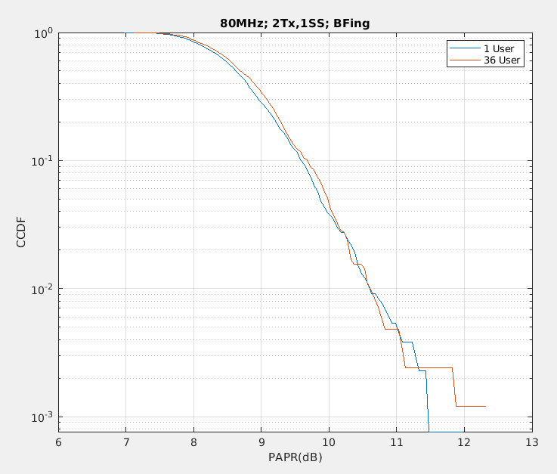
PAPR - 80MHz PPDU 2x1 BFing
Bfing from multiple users randomize the pilots.

Slide 13
Observation 3
As expected, Bfing naturally randomize the phase of pilots in different RUs and PAPR doesn’t degrades with the increase of number of users in OFDMA.

Slide 14
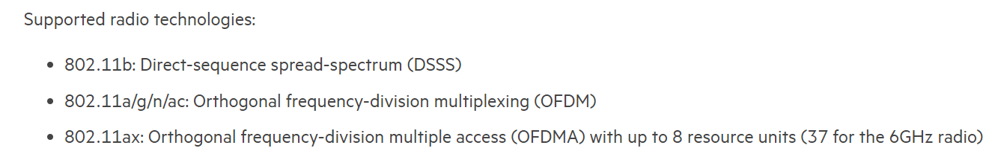
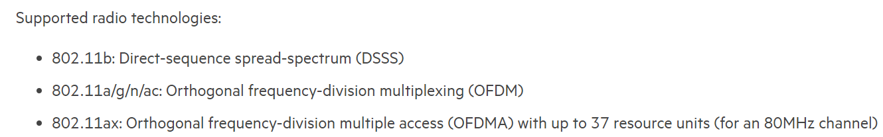
Q/As from the previous presentation [1]
How many users in OFDMA is reasonable assumption?
  16 user is a popular configuration;
  36/37 is present in some APs. Screenshot captured from two AP models are shown below:

Slide 15
Q/As from the previous presentation [1]
There are non-standardized solution but this issue is indeed a design issue in standard.
PAPR issue, if identified, have always been solved in standard with randomized phase rotation:
  MCS14/15, HE-SIGB, HE/EHT-LTF.
Any non-standardized solution will leave vendor to
  1st, be aware of the issue;
  2nd, explore their own solution, while standard can do an easy patch.
Non-standardized solution (only if we want to push to implementation)
  Implicitly rotate the phase of pilot and the corresponding LTF or even rotate the phase of the whole RU and LTF together;
    Much more complex than standardized solution;
    PAPR of LTF will unexpectedly degraded.
  Change the SE matrix per RU to randomize the pilot pattern;
    Direct mapping is popular for 2Tx 2SS, 4Tx 4SS, etc.

Slide 16
Summary
Observations:
  The PAPR degradation is obvious as the number of users increased in OFDMA transmission in 80/160/320MHz PPDU for different antenna/ss configurations;
  The per RU pilot phase rotation shows consistent gain.

Slide 17
SP
Do you support that a per RU phase rotation is applied to the pilot tone in OFDMA transmission?
  The pattern of phase rotation is TBD. (e.g. [1 -1 j -j])

Slide 18
Reference
[1] 11-23-1374-00-0uhr-pilots.

