Slide 1
July Plenary Session Agenda
Date: 2024-07-17
Authors:

Slide 2
Abstract
Agenda for 2024 July Plenary

Slide 3
IEEE 802.11
Enhanced Data Privacy Task Group
Chair: Carol Ansley
Vice Chairs: Jerome Henry Antonio de la Oliva
Secretary: Stéphane Baron
Technical Editor: Po-Kai Huang

Slide 4
Registration for the July IEEE 802 plenary session
This meeting is part of the July IEEE 802 plenary session
You must pay the registration fee whether attending in-person or remotely
If you have not already done so, you can register here:
https://cvent.me/dkO9BB
If you do not intend to register for this session you must leave this meeting
and, if you have logged attendance on IMAT, email the 802.11 chair or vice chairs to have your attendance cancelled

Slide 5
Attendance, etc.
Reminders to attendees:
  Sign in for attendance tracking
  Noises off
  No recordings

Slide 6
Essential Patent Claims
  Participants shall inform the IEEE (or cause the IEEE to be informed) of the identity of each holder of any potential Essential Patent Claims of which they are personally aware if the claims are owned or controlled by the participant or the entity the participant is from, employed by, or otherwise represents
  Participants should inform the IEEE (or cause the IEEE to be informed) of the identity of any other holders of potential Essential Patent Claims
  Early identification of holders of potential Essential Patent Claims is encouraged

Slide 7
Inform IEEE of Essential Patent Claims
Cause an LOA to be submitted to the IEEE SA (patcom@ieee.org); or
Provide the chair of this group with the identity of the holder(s) of any and all such claims as soon as possible; or
Speak up now and respond to this Call for Potentially Essential Patents
If anyone in this meeting is personally aware of the holder of any patent claims that are potentially essential to implementation of the proposed standard(s) under consideration by this group and that are not already the subject of an Accepted Letter of Assurance, please respond at this time by providing relevant information to the WG Chair

Slide 8
Additional patent-related information
The patent policy and the procedures used to execute that policy are documented in the:
      IEEE SA Standards Board Bylaws (http://standards.ieee.org/develop/policies/bylaws/sect6-7.html#6)
      IEEE SA Standards Board Operations Manual (http://standards.ieee.org/develop/policies/opman/sect6.html#6.3)
  Material about the patent policy is available at http://standards.ieee.org/about/sasb/patcom/materials.html
If you have questions, contact the IEEE SA Standards Board Patent Committee Administrator at patcom@ieee.org

Slide 9
Other Guidelines for IEEE Working Group Meetings
All IEEE SA standards meetings shall be conducted in compliance with all applicable laws, including antitrust and competition laws.
  Don’t discuss the interpretation, validity, or essentiality of patents/patent claims.
  Don’t discuss specific license rates, terms, or conditions.
    Relative costs of different technical approaches that include relative costs of patent licensing terms may be discussed in standards development meetings.
      Technical considerations remain the primary focus.
  Don’t discuss or engage in the fixing of product prices, allocation of customers, or division of sales markets.
  Don’t discuss the status or substance of ongoing or threatened litigation.
  Don’t be silent if inappropriate topics are discussed. Formally object to the discussion immediately.
---------------------------------------------------------------
For more details, see IEEE SA Standards Board Operations Manual, clause 5.3.10 and
Antitrust and Competition Policy: What You Need to Know at http://standards.ieee.org/develop/policies/antitrust.pdf

Slide 10
Participation in IEEE 802 Meetings
Participation in any IEEE 802 meeting (Sponsor, Sponsor subgroup, Working Group, Working Group subgroup, etc.) is on an individual basis
• Participants in the IEEE standards development individual process shall act based on their qualifications and experience. (https://standards.ieee.org/develop/policies/bylaws/sb_bylaws.pdf section 5.2.1)
• IEEE 802 Working Group membership is by individual; “Working Group members shall participate in the consensus process in a manner consistent with their professional expert opinion as individuals, and not as organizational representatives”. (subclause 4.2.1 “Establishment”, of the IEEE 802 LMSC Working Group Policies and Procedures)
• Participants have an obligation to act and vote as an individual and not under the direction of any other individual or group. A Participant’s obligation to act and vote as an individual applies in all cases, regardless of any external commitments, agreements, contracts, or orders.
• Participants shall not direct the actions or votes of any other member of an IEEE 802 Working Group or retaliate against any other member for their actions or votes within IEEE 802 Working Group meetings, see https://standards.ieee.org/develop/policies/bylaws/sb_bylaws.pdf section 5.2.1.3 and the IEEE 802 LMSC Working Group Policies and Procedures, subclause 3.4.1 “Chair”, list item x.
By participating in IEEE 802 meetings, you accept these requirements. If you do not agree to these policies then you shall not participate.
(Latest revision of IEEE 802 LMSC Working Group Policies and Procedures: http://www.ieee802.org/devdocs.shtml)

Slide 11
IEEE-SA standards activities shall allow the fair & equitable consideration of all viewpoints
The IEEE-SA Standards Board Bylaws (clause 5.2.1.3) specifies that “the standards development process shall not be dominated by any single interest category, individual, or organization”
  This means no participant may exercise “authority, leadership, or influence by reason of superior leverage, strength, or representation to the exclusion of fair and equitable consideration of other viewpoints” or “to hinder the progress of the standards development activity”
This rule applies equally to those participating in a standards development project and to that project’s leadership group
Any person who reasonably suspects that dominance is occurring in a standards development project is encouraged to bring the issue to the attention of the Standards Committee or the project’s IEEE-SA Program Manager

Slide 12
IEEE SA Policy and Rules Documents
IEEE Code of Ethics
  http://www.ieee.org/about/corporate/governance/p7-8.html
IEEE Standards Association (IEEE-SA) Affiliation FAQ
  http://standards.ieee.org/faqs/affiliation.html
Antitrust and Competition Policy
  http://standards.ieee.org/resources/antitrust-guidelines.pdf
Letter of Assurance Form
  http://standards.ieee.org/develop/policies/bylaws/sect6-7.html#loa
  https://development.standards.ieee.org/myproject/Public//mytools/mob/loa.pdf
IEEE-SA Patent Committee FAQ & Patent slides
  http://standards.ieee.org/board/pat/faq.pdf and http://standards.ieee.org/board/pat/pat-slideset.ppt
The current version of the IEEE-SA Standards Board Bylaws is available at:
  http://standards.ieee.org/develop/policies/bylaws/index.html (HTML version)
  http://standards.ieee.org/develop/policies/bylaws/sb_bylaws.pdf (PDF version)
The current version of the IEEE-SA Standards Board Operations Manual is available at:
  http://standards.ieee.org/develop/policies/opman/index.html (HTML version)
  http://standards.ieee.org/develop/policies/opman/sb_om.pdf (PDF version)

Slide 13
IEEE SA Copyright Policy
By participating in this activity, you agree to comply with the IEEE Code of Ethics, all applicable laws, and all IEEE policies and procedures including, but not limited to, the IEEE SA Copyright Policy.
  Previously Published material (copyright assertion indicated) shall not be presented/submitted to the Working Group nor incorporated into a Working Group draft unless permission is granted.
  Prior to presentation or submission, you shall notify the Working Group Chair of previously Published material and should assist the Chair in obtaining copyright permission acceptable to IEEE SA.
  For material that is not previously Published, IEEE is automatically granted a license to use any material that is presented or submitted.

Slide 14
IEEE SA Copyright Policy
    The IEEE SA Copyright Policy is described in the IEEE SA Standards Board Bylaws and IEEE SA Standards Board Operations Manual
      IEEE SA Copyright Policy, see
      Clause 7 of the IEEE SA Standards Board Bylaws
      https://standards.ieee.org/about/policies/bylaws/sect6-7.html#7
      Clause 6.1 of the IEEE SA Standards Board Operations Manual
      https://standards.ieee.org/about/policies/opman/sect6.html
    IEEE SA Copyright Permission
      https://standards.ieee.org/content/dam/ieee-standards/standards/web/documents/other/permissionltrs.zip
    IEEE SA Copyright FAQs
      http://standards.ieee.org/faqs/copyrights.html/
    IEEE SA Best Practices for IEEE Standards Development
      http://standards.ieee.org/develop/policies/best_practices_for_ieee_standards_development_051215.pdf
    Distribution of Draft Standards (see 6.1.3 of the SASB Operations Manual)
      https://standards.ieee.org/about/policies/opman/sect6.html
Secretary to record that copyright policy slides were presented

Slide 15
Successful Hybrid Meeting Protocols
In-room Attendees
  In Webex choose connect without audio before you join
  Use the Webex queue to indicate you want to speak
  Wait to hold the microphone to make a comment
  Repeat any questions that are inadvertently asked away from the microphone
  Remote Attendees
  Join Webex and set Webex audio as ‘music’
  Use the Webex queue to indicate you want to speak

Slide 16
TGbi Agenda – July 18, 2024 – AM1
Administrative
Agenda approval – approved by unanimous consent (18 participants on-line, 11 participants in the room)
  Teleconference Schedule: Every week or Every other week?
    Wednesday 10amEDT
  Discussion
    24/1291r0, Jerome Henry – straw poll – passed by unanimous consent
    24/1298, Domenico Ficara – straw poll – passed by unanimous consent
    24/1284, Javier Contreras - presented
    24/1304, Phil Hawkes
    24/46r3, Jouni Malinen – 24/1319r0 due to server issues – straw poll - failed
    Motion uncontroversial CID Resolutions – Motion #46
    Timeline Update – completed
    Any other topics?
Adjourn

Slide 17
TGbi Agenda – July 17, 2024 – PM2
Administrative
Agenda approval – approved by unanimous consent (24 participants on-line, 6 participants in the room)
  Plenary schedule:
    Thursday AM1 – 24/46r3 Jouni, Timeline Update
  Discussion
    24/1291r0, Jerome Henry - presented
    24/1284, Javier Contreras - skipped
    24/1298, Domenico Ficara - presented
    24/1304, Phil Hawkes
    Any other topics?
Recess

Slide 18
TGbi Agenda – July 16, 2024 – PM2
Administrative
Agenda approval – approved by unanimous consent (26 participants on-line, 12 participants in the room)
  Plenary schedule:
    Wednesday PM2 – 24/1291, 24/1284, 24/1298, Phil Hawkes
    Thursday AM1 – 24/46r3 Jouni, Timeline Update
  Discussion
  Okan Followup – straw poll run
  24/1249 – Po-Kai – presented, straw poll run
  24/1278 Antonio de la Oliva – presented, straw poll run
  24/1162 Stephane Baron - presented
  Any other topics?
Recess

Slide 19
TGbi Agenda – July 16, 2024 – AM2
Administrative
Agenda approval – approved by unanimous consent (29 participants on-line, 12 participants in the room)
  Approval of accumulated minutes – Motion #45 – approved by unanimous consent
  Plenary schedule:
    Tuesday PM2 – 24/1278 Antonio de la Oliva, 24/1162 Stephane Baron
    Wednesday PM2 – 24/1291, 24/1284, 24/1298, Phil Hawkes
    Thursday AM1 – 24/46r3 Jouni, Timeline Update
  Discussion
  straw poll for Po-Kai’s CRs – completed
  24/1105r0 Ugo Campiglio/Domenico Ficara – completed, straw poll passed
  Okan Mutgan - presented
  24/1249 – Po-Kai
  Any other topics?
Recess

Slide 20
TGbi Agenda – July 15, 2024 – AM1
Administrative
Agenda approval – approved by unanimous consent (17 participants on-line, 10 participants in the room)
  Approval of accumulated minutes: to be done Tuesday
  Plenary schedule:
    Tuesday AM2 – motion minutes approval, straw poll for Po-Kai’s CRs, 24/1105r0 Ugo Campiglio/Domenico Ficara, Okan Mutgan
    Tuesday PM2 – 24/1278 Antonio de la Oliva, 24/1162 Stephane Baron, Phil Hawkes
    Wednesday PM2 –
    Thursday AM1 – 24/46r3 Jouni, Timeline Update
  Discussion
  24/1176 – Editorial CIDs – Po-Kai Huang - presented
  24/1181 – 12.14.6 CR – Po-Kai Huang - presented
  24/1112 – 12.14.1-3 CR – Po-Kai Huang - presented
  Any other topics?
Adjourn ad hoc

Slide 21
Timeline
TG use case start: March 2021
Use case completion: February 2022
Features identified: September 2022
Comment collection: May 2024
LB initial: January 2025
LB re-circ: July 2025
MDR: July 2025
Ballot Pool: September 2025
SA ballot: January 2026
SA re-circ: March 2026
802.11/LMSC approval: May 2026
RevCom/SASB approval: July 2026

Slide 22
Motion # 45
Approve the prior session minutes and teleconference minutes:
24/925r1 (May Interim minutes), 24/1160r0 (July telecon)
Mover: Jerome Henry
Second: Po-Kai Huang
Approved by unanimous consent, Y N A

Slide 23
Motion # 46
Approve directing the Editor to create a Draft 0.5 with the texts and CID resolutions that have reached consensus within the group during this plenary.
Specifically:
11-24/1176r1 (SP results: Y:22 / N:0 / A:4), 14 CIDs : 1043, 1189, 1192, 1230, 1231, 1233, 1242, 1307, 1331, 1401, 1471, 1487, 1499, 1507
11-24/1181r1 (SP results: Y:20 / N:0 / A:6), 9 CIDs : 1465, 1466, 1467, 1468, 1469, 1470, 1472, 1473, 1496
11-24/1112r1 (SP results: Y:20 / N:0 / A:6), 31 CIDs : 1404, 1405, 1406, 1407, 1408, 1409, 1410, 1162, 1310, 1311, 1061, 1308, 1411, 1412, 1413, 1414, 1415, 1416, 1417, 1418, 1419, 1309, 1420, 1421, 1422, 1423, 1424, 1425, 1391, 1400, 1306
11-24/1282r3 (SP results: Y:16/ N:2/ A:6), 2 CIDs : 1041, 1042
11-24/1249r3 (SP result : unanimous consent), 1 CID: 1497
11-24/1298r3 (SP result : unanimous consent), : 1030, 1095, 1096, 1116, 1117, 1175, 1347, 1348, 1349, 1353, 1354, 1355, 1358
11-24/1291r2 (SP result : unanimous consent), : 1010, 1029, 1120, 1141, 1142, 1177, 1178, 1284, 1285, 1286, 1287, 1288, 1291, 1292, 1293, 1294, 1295, 1296, 1359, 1360, 1361
Mover: Jerome Henry
Second: Jarkko Kneckt
Approved by unanimous consent, 21 Yes, 1 No, 0 A Provisional until verified

Slide 24
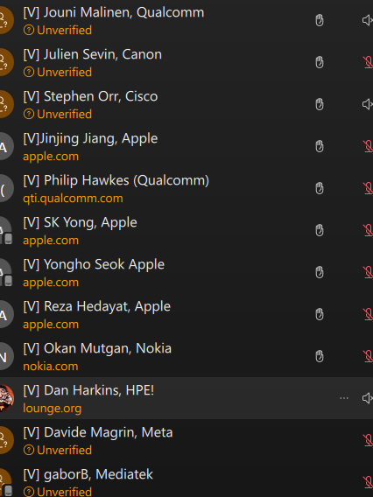
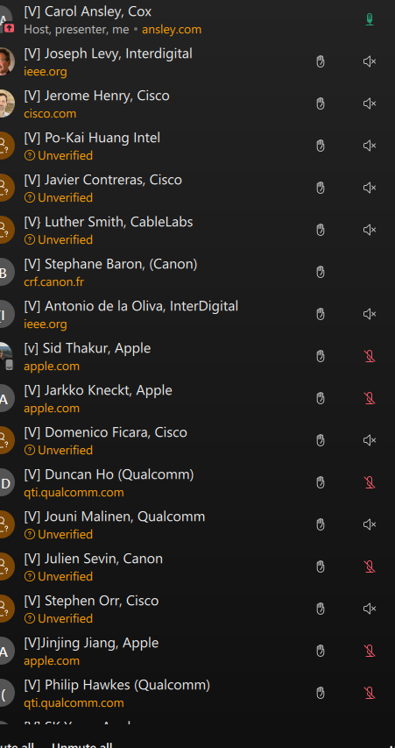
Yes votes
Dan Harkins voted No

Slide 25
Organizing Plan
Continuing call for submissions
Submissions can include use cases and/or issue identification
Develop a Use Case/Requirement Document based on submissions
Develop a Draft based on approved features

Slide 26
Amendment title
Standard for Information technology--Telecommunications and information exchange between systems Local and metropolitan area networks--Specific requirements Part 11: Wireless LAN Medium Access Control (MAC) and Physical Layer (PHY) Specifications-- Amendment: Enhanced service with user privacy protection

