Slide 1
Bidirectional TXOP Sharing
Date: 2024-07-15
Authors:

Slide 2
Abstract
There were some discussions[2-4] for enhancing P2P and TXOP sharing for 11bn devices
However, pre-11bn STAs cannot support 11bn’s enhanced TXOP sharing
In this document, a bidirectional TXOP sharing for 11bn, considering legacy coexistence, is proposed

Slide 3
Background
802.11bn PAR[1] defined enhancing P2P operations and low-latency
In 11be, Triggered TXOP sharing, which supports P2P operation and low latency, was adopted.
There were some contributions to enhance TXOP sharing and P2P operation for real time applications like XR.
In [2], needs for bidirectional P2P were discussed
In [3], TXOP sharing in hidden node environment was discussed
In [4], concept of TXOP sharing for XR use cases was discussed
There were some contributions to enhance QoS considering a legacy - UHR coexistence topology
In [5], [6] and [7], discussed for enhancing QoS for the coexistence topology (‘Proxy SCS’)
This document discusses a bidirectional TXOP sharing operation considering the coexistence topology

Slide 4
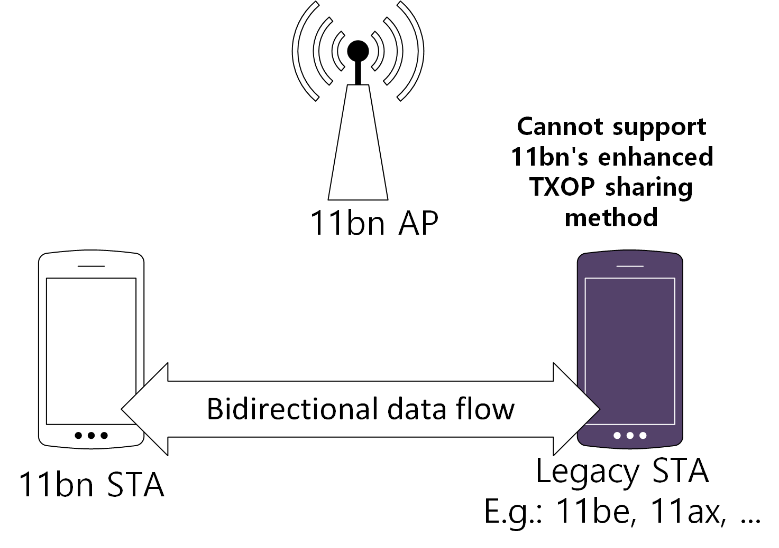
Problem statement
Problem 1: Pre-11bn STAs will not support 11bn’s enhanced TXOP sharing feature for low latency
Problem 2: Some of pre-11bn devices may not use features that can reduce the channel access latency
To enhance channel access for legacy STAs, 11bn should define a new data transmission method supporting legacy STAs
Which is a new data transmission method jointly using TF and TXS

Slide 5
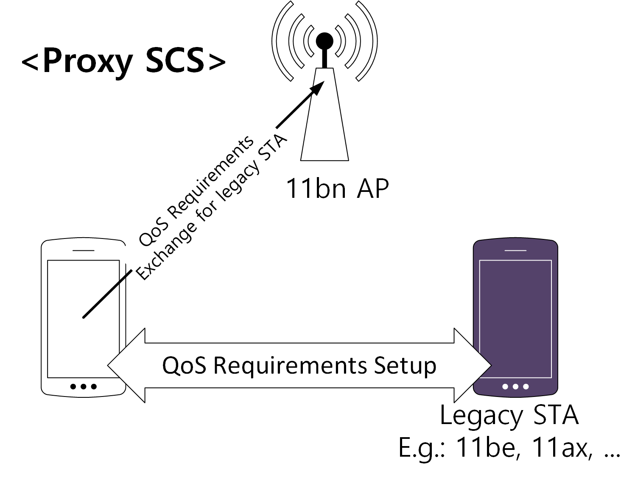
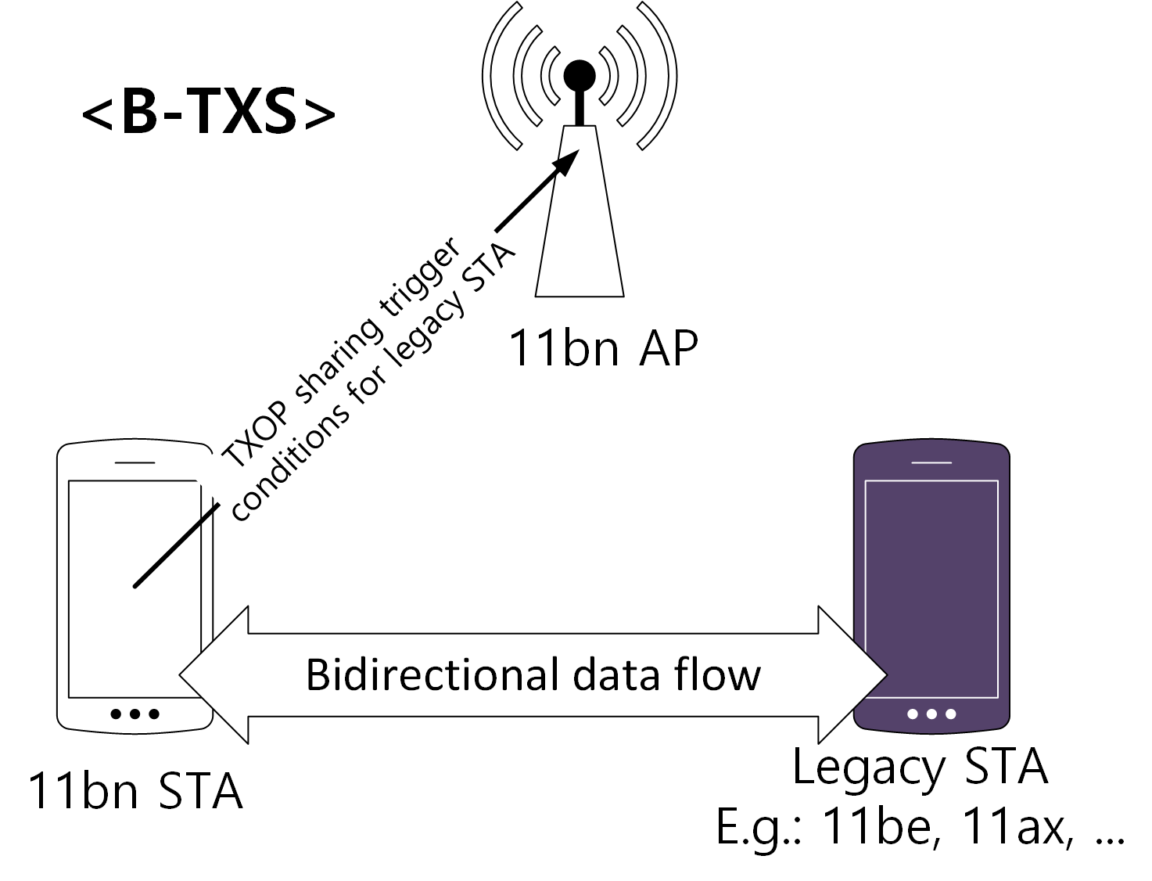
TXOP sharing considering legacy coexistence
When there is a device which does not support 11bn, it will not support 11bn’s enhanced TXOP sharing.
In 11bn, some QoS enhancement methods to support legacy STAs were discussed
Proxy SCS
With Proxy SCS methods, 11bn STAs can setup the QoS requirements for legacy STAs
Similarly, this contribution proposes a bidirectional TXS (B-TXS) method.
11bn STAs can setup a B-TXS session for legacy STAs
B-TXS session can provide low latency data forwarding period between 11bn and legacy STAs
May reuse proxy SCS procedure

Slide 6
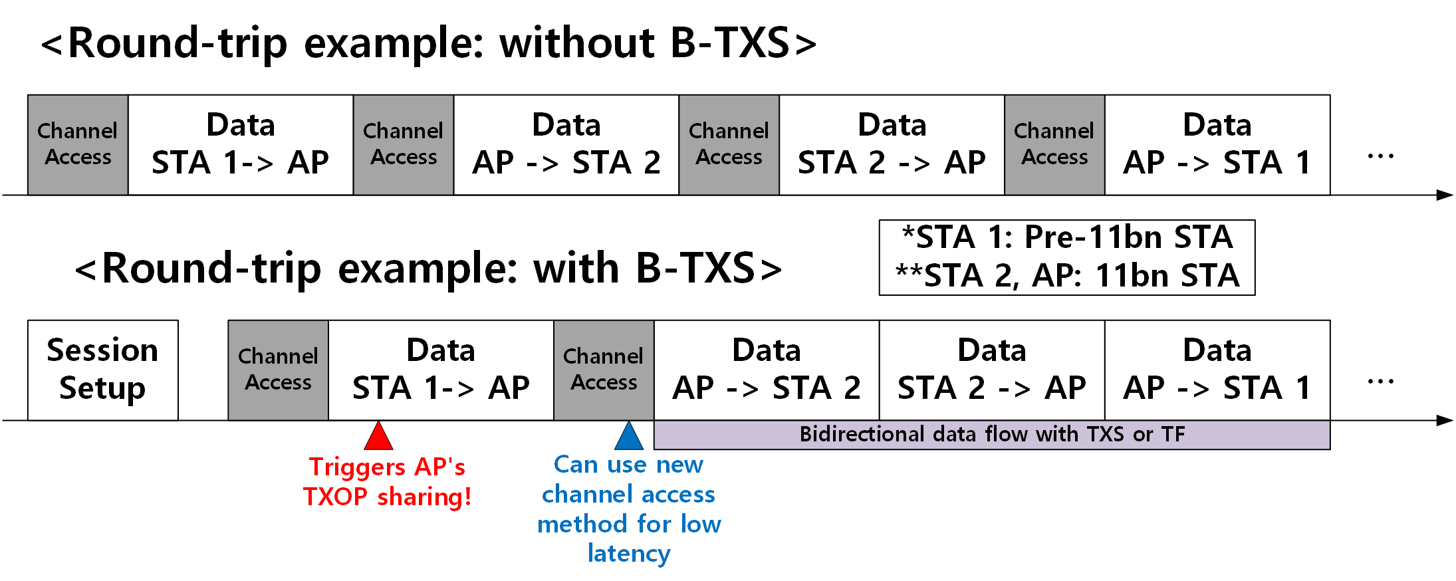
B-TXS for legacy coexistence environment
Like proposed proxy SCS methods, 11bn STA can setup TXS session with its associated AP
11bn non-AP STA and AP can setup B-TXS session for legacy non-AP STA
With the setup, channel access delay between 11bn non-AP STA and legacy non-AP STA can be reduced!
STA 2
STA 1

Slide 7
B-TXS for legacy coexistence environment
To avoid complexity, 11be adopted Triggered TXOP sharing (TXS) feature[8].
Similarly, 11bn can consider reusing 11be’s TXS for supporting bidirectional data flow with low complexity for B-TXS

Slide 8
B-TXS – Conceptional Operation
STA 1 and AP (supports 11bn) setup a B-TXS session for legacy STA (STA 2)
AP receives frames from STA 2. Then, if the frames meet specific conditions in the B-TXS session, AP gains TXOP.
In the gained TXOP of AP, data flow between STA 1, AP and STA 2 can be performed
AP can coordinate appropriate TF scheduling or TXS scheduling
Repetitive channel access for bidirectional data exchange can be avoided!
*Please note: this document’s purpose is not to define the detailed operations. The detailed operations can be discussed further.

Slide 9
Summary
This document proposed B-TXS procedure for bidirectional data communication between two non-AP STAs considering legacy coexistence
A B-TXS session can be established between 11bn AP and 11bn non-AP STA to support legacy non-AP STA
With the proposed method, pre-11bn non-AP STA can also experience latency enhancement of 11bn
With proposed method, TXOP sharing which reduces channel access delay, can be supported in legacy coexistence scenarios

Slide 10
References (1)
[1] UHR proposed PAR, https://mentor.ieee.org/802.11/dcn/23/11-23-0480-02-0uhr-uhr-proposed-par.pdf
[2] 24/0403r2, “Managed on-channel P2P communication”, https://mentor.ieee.org/802.11/dcn/24/11-24-0403-02-00bn-managed-on-channel-p2p-communication.pptx
[3] 24/0668r1, “Data Forwarding within TXOP for XR Use Cases”, https://mentor.ieee.org/802.11/dcn/23/11-23-0249-01-0uhr-extended-txop-sharing.pptx
[4] 23/1387r0, TXOP sharing extensions for XR use-cases, https://mentor.ieee.org/802.11/dcn/23/11-23-1387-00-0uhr-txop-sharing-extensions-for-xr-use-cases.pptx
[5] 23/1885r1, End-to-end QoS with SCS, https://mentor.ieee.org/802.11/dcn/23/11-23-1885-01-00bn-end-to-end-qos-with-scs.pptx
[6] 23/1958r0, Proxy QoS management for XR use cases, https://mentor.ieee.org/802.11/dcn/23/11-23-1958-00-00bn-proxy-qos-management-for-xr-use-cases.pptx
[7] 24/0073r0, Thoughts on Proxy SCS, https://mentor.ieee.org/802.11/dcn/24/11-24-0073-00-00bn-thoughts-on-proxy-scs.pptx

Slide 11
References (2)
[8] 23/1312r8, AP assisted SU PPDU Tx for 11be R1, https://mentor.ieee.org/802.11/dcn/20/11-20-1312-08-00be-triggered-su-ppdu-for-11ber1.pptx

