Slide 1
802.11 Working Group Opening Report
July 2024
Authors:
Date: 2024-07-15

Slide 2
Introduction
This presentation, together with the reports cited herein, forms the opening report of the IEEE 802.11 Working Group for July 2024
“Mx.y.z” terminology indicates that the item was on the tentative agenda for the Monday 802.11 plenary, and was agenda item x.y.z.

Slide 3



M1.3 Meeting Decorum
Please observe proper decorum in meetings
No photography or recording
Press (i.e., anyone reporting publicly on this meeting) must announce their presence
In-person attendees:
  Laptop / tablet speakers and cell phone ringers off
  Join Webex using “no audio” option
  Wear your badge in the meeting areas (helps hotel staff improve the general security)
Remote attendees must mute when not speaking
All attendees use Webex chat to enter the queue

Slide 4
M2.2.1 Summary of Liaisons
Liaisons received since May 2024:
From ETSI ISG F5G on F5G Advanced Use Cases Release 3 (11-24/1087r0):
Please consider the use cases in the attached document for the further development of your organization’s specifications.
Liaisons website, see https://grouper.ieee.org/groups/802/11/Liaisons/Liaisons-and-External-Communications.html

Slide 5
M2.3 Recent and anticipated 802 EC actions
July 2024
P802.11bf (WLAN Sensing) PAR extension
P802.11REVmf (Maintenance) revision PAR
IMMW SG recharter & extension
ELC SG
P802.11REVme (Maintenance) conditional approval for RevCom
P802.11bh (Random and Changing MAC Addresses) conditional approval for RevCom
P802.11be (Extremely High Throughput) conditional approval for RevCom
November 2024
P802.11bq (Integrated mmWave) PAR

Slide 6
M2.3 IEEE SA Standards Board (SASB)
September 24-26, 2024 – NesCom/RevCom/SASB
(August 16, 2024, submission deadline)
P802.11bf (WLAN Sensing) PAR extension
P802.11REVmf (Maintenance) PAR
P802.11REVme (Maintenance) approval
P802.11bh (Random and Changing MAC Addresses) approval
P802.11be (Extremely High Throughput) approval
December 9-11, 2024 – NesCom/RevCom/SASB
(October 21, 2024, submission deadline)
P802.11bq (Integrated mmWave) PAR

Slide 7
M3.1 802.11 Working Group Session Documents
WG Session Reports
WG Agenda | https://mentor.ieee.org/802.11/dcn/24/11-24-0998
Opening report | https://mentor.ieee.org/802.11/dcn/24/11-24-0999
Snapshot slides | https://mentor.ieee.org/802.11/dcn/24/11-24-1147
1st vice chair | https://mentor.ieee.org/802.11/dcn/24/11-24-0990
2nd vice chair | https://mentor.ieee.org/802.11/dcn/24/11-24-1002
Treasurer | https://mentor.ieee.org/802-ec/dcn/24/ec-24-0007
Chair's Supplementary Material | https://mentor.ieee.org/802.11/dcn/24/11-24-1000
Motions | https://mentor.ieee.org/802.11/dcn/24/11-24-0995
Session report | https://mentor.ieee.org/802.11/dcn/24/11-24-1270
Previous Session Minutes | https://mentor.ieee.org/802.11/dcn/24/11-24-0714

Slide 8
M3.2 Joint meetings and Reciprocal Credit
Reciprocal credit is provided to 802.11 voters for attendance at: 802.18 (.11 credit for .18 attendance and .18 credit for the .11 attendance during the 2 .18 timeslots), 802.19, 802.24, 802.1, and the 802 JTC1 SC.
For the July 2024 session, reciprocal credit is given for other WG/TAG meetings which occur during the WG11 session, Monday July 15, 2024 10:30am Montreal time to Friday, July 19, 2024 noon Montreal time.
The July 2024 session DOES count towards voting credit.
NOTE: 12 meeting slots required for 75%.

Slide 9
M3.2 802.18 details
See https://www.ieee802.org/18/
Meeting times: Tuesday 2024-07-16 AM2 and Thursday 2024-07-18 AM1
See https://ieee802.org/802tele_calendar.html
Agenda
  Presentation: “Hybrid sharing on the upper 6 GHz band”, Dr Steve Leach, Ofcom
  Review the following consultation, petition for rulemaking, and liaison statement:
    CEPT ECC: Draft revision of ERC Report 25 ECA Table (European Table of Frequency Allocations and Applications in the frequency range 8.3 kHz to 3000 GHz)
    Canada RABC: RSS-248, issue 3, “Radio Local Area Network (RLAN) Devices Operating in the 5925-7125 MHz Band”
  Discuss the latest topics related to spectrum and regulation in Europe, North America, and Asia Pacific

Slide 10
M3.2 802.19 details
See https://www.ieee802.org/19/
Meeting times: Monday 2024-07-15 PM2 and Thursday 2024-07-18 EVE

Slide 11
M3.2 Other 802 WG meetings
IEEE 802 website: https://www.ieee802.org/
  Includes links to all WG webpages
Consolidated calendar: https://ieee802.org/802tele_calendar.html
Documents: 802.11, 15, 18, 19, 24: https://mentor.ieee.org/802/bp/StartPage

Slide 12
M4.1.1/W2.6 IEEE 802.11 Groups
Type | Group | WG & Infrastructure
WG | WG11 | The IEEE 802.11 Working Group
SC | ARC | Architecture
SC | COEX | Coexistence
SC | PAR | PAR review
802 SC | JTC1 | ISO/IEC JTC1/SC6
Type | Group | Amendments/Revision
TG | BE | Extremely High Throughput
TG | BF | WLAN Sensing
TG | BH | Randomized MAC Addresses (RCM)
TG | BI | Enhanced Data Privacy Protection (EDP)
TG | BK | 320 MHz Positioning
TG | BN | Ultra High Reliability
TG | BP | Ambient Power
TG | ME | Revision (REVme)
Type | Group | New Work
SC | WNG | Wireless Next Generation
SC | AIML | AI/ML in 802.11
SG | IMMW | Integrated Millimeter Wave
AHG | ITU | ITU Liaison

Slide 13
M4.1.2 /W2.6 PAR Expiration/Renewal Schedule
Project | PAR Expiration Date
P802.11 (REVme) | 31 DEC 2025
P802.11be | 31-DEC 2025
P802.11bf | 31-DEC 2024
P802.11bh | 31-DEC 2025
P802.11bi | 31-DEC 2025
P802.11bk | 31-DEC 2026
P802.11bn | 31 DEC 2027
P802.11bp | 31 DEC 2028
PAR Extension Request – on EC agenda for July 2024
http://www.ieee802.org/11/PARs/index.html

Slide 14
M4.1.3 /W2.6 802.11 WG Appointed positions
WG Secretary – Stephen McCann & Volker Jungnickel
Treasurer – Jon Rosdahl
ANA Authority – Robert Stacey
WG Technical Editor – Emily Qi

Slide 15
M4.1.3 /W2.6 Officers
Cat | Group | Chair | Vice Chair | Technical Editor | Secretary
WG |  | Robert STACEY | Jon ROSDAHL, Stephen MCCANN | Emily QI | Stephen MCCANN Volker JUNGNICKEL
SC | ARC | Mark HAMILTON | Joseph LEVY |  | Joseph LEVY
SC | Coex | Marc EMMELMANN | Sebastian MAX, Manish KUMAR |  | Guido HIERTZ
SC | PAR | Jon ROSDAHL | Michael MONTEMURRO |  | Michael MONTEMURRO
SC | WNG | Jim LANSFORD | Lei WANG |  | Lei WANG
SC | AIML | Xiaofei WANG | Ming GAN, Gaurang NAIK |  | Liangxiao XIN
TG | ME | Michael MONTEMURRO | Mark HAMILTON, Mark RISON | Emily QI, Edward AU | Jon ROSDAHL
TG | BC | Marc EMMELMANN | Hitoshi MORIOKA, Stephen MCCANN | Carol ANSLEY | Xiaofei WANG
TG | BE | Alfred ASTERJADHI | Laurent CARIOU, Matthew FISCHER | Edward AU | Jason Yuchen GUO
TG | BF | Tony Xiao HAN | Sang KIM, Assaf KASHER | Claudio DA SILVA | Leif WILHELMSSON
TG | BH | Mark HAMILTON | Peter YEE, Stephen ORR | Carol ANSLEY | Peter YEE
TG | BI | Carol ANSLEY | Jerome HENRY, Antonio DE LA OLIVA | Po-Kai HUANG | Stephane BARON
TG | BK | Jonathan SEGEV | Ali RAISSINIA, Assaf KASHER | Roy WANT | Dibakar DAS
TG | BN | Alfred ASTERJADHI | Laurent CARIOU, Jianhan LIU, Kiseon RYU | Ross Jian YU | Yusuke ASAI
TG | BP | Bo SUN | Steve SHELLHAMMER, Rakesh TAORI | Yinan QI | Sebastian MAX
SG | IMMW | Laurent CARIOU |  |  | Volker JUNGNICKEL
AHG | ITU | Hassan YAGHOOBI |  |  | Richard KENNEDY
New since last session

Slide 16
M4.1.4 /W2.6 IEEE 802.11 Revisions
802.11
-2020
802.11
-2016
802.11
-2012
802.11
-2007
802.11
-2003
11aq
Pre Association
Discovery
11aa
Video Transport
11k
RRM
11s
Mesh
11e
QoS
MAC
11u
WIEN
11v
Network
Management
11h
DFS & TPC
IEEE
Std
802.11
-1997
11ak
General Link
11ae
QoS Mgt Frames
11z
TDLS
11i
Security
11d
Intl roaming
11ai
Fast Initial Link
Setup
11w
Management
Frame
Security
11r
Fast Roam
11f
Inter AP
11n
High
Throughput
(>100 Mbps)
11ah
Sub 1 GHz
11af
TV Whitespace
11j
JP bands
11a
54 Mbps
5GHz
PHY & MAC
11aj
China millimeter
wave
11ac -VHT
>1 Gbps @ 5GHz
11p
WAVE
11y
Contention
Based
Protocol
11g
54 Mbps
2.4GHz
11b
11 Mbps
2.4GHz
11ad - VHT
>1 Gbps @ 60GHz
Notes:
doc.: IEEE 802.11-11/0483r0
May 2011
Bruce Kraemer (Marvell)
Page 16

Slide 17
M4.1.4 /W2.6 IEEE 802.11 Standards Pipeline
MAC
802.11
COR 1
802.11
-2020
802.11bc
BCS + COR2
802.11az
NGP
802.11bi
EDP
802.11bk
320MHz Pos
802.11
REVme
ITU Liaison
(ITU) AHG
WNG
802.11ba
WUR
IMMW SG
802.11bn
UHR
802.11be
EHT
802.11bb
LC
802.11bp
AMP
802.11ax
HEW
802.11bh
RCM
802.11ay
NG60
802.11bf
SENS
Liaison
MAC & PHY
802.11bd
NGV
Liaison Topics
Discussion Topics
TIG/Study
groups
TG without
Approved draft
WG
Letter Ballot
SA
Ballot
Published
Amendment
Published
Standard
Notes:
doc.: IEEE 802.11-11/0483r0
May 2011
Bruce Kraemer (Marvell)
Page 17

Slide 18
M4.1.5 /W2.6 Summary of ballots and comment collections
Type | Label | Group | Opened (mm-dd) | Dur (d) | # Comments | Ballot Group | Approve | Disapprove | Abstain | Return % | Approve % | Result
T | 1st Recirc WG | TGbk | 04-10 | 16 | 134 | 559 | 321 | 10 | 53 | 69 | 97 | Pass
T | Initial SA | TGbh | 04-09 | 30 | 209 | 153 | 120 | 12 | 6 | 90 | 91 | Pass
T | Initial SA | TGbf | 05-08 | 30 | 207 | 162 | 110 | 12 | 2 | 77 | 90 | Pass
T | 1st Recirc SA | TGbe | 05-16 | 15 | 180 | 180 | 136 | 11 | 3 | 83 | 92 | Pass
T | CC49 | TGbi | 05-28 | 30 | 527 |  |  |  |  |  |  | N/A
T | 2nd Recirc SA | TGme | 06-18 | 15 | 257 | 135 | 106 | 8 | 5 | 88 | 92 | Pass
T | 1st Recirc SA | TGbh | 07-03 | 10 | 115 | 153 | 119 | 11 | 5 | 88 | 91 | Pass

Slide 19
M4.1.6 /W2.6 Current Membership Status
Last updated following May session
Status | Number
Aspirant | 111
Potential Voter | 64
Voter | 572
Ex Officio Voter | 9
Definitions:
  Aspirant: a member who has attended 1 qualifying meeting
  Potential Voter: a member who has attended 2 qualifying meetings and will become a voter at the start of the next plenary they attend
  Ex Officio Voter: a voter who has voting rights by virtue of their membership of the 802 EC and has requested to be recorded as an ex officio voter in 802.11

Slide 21
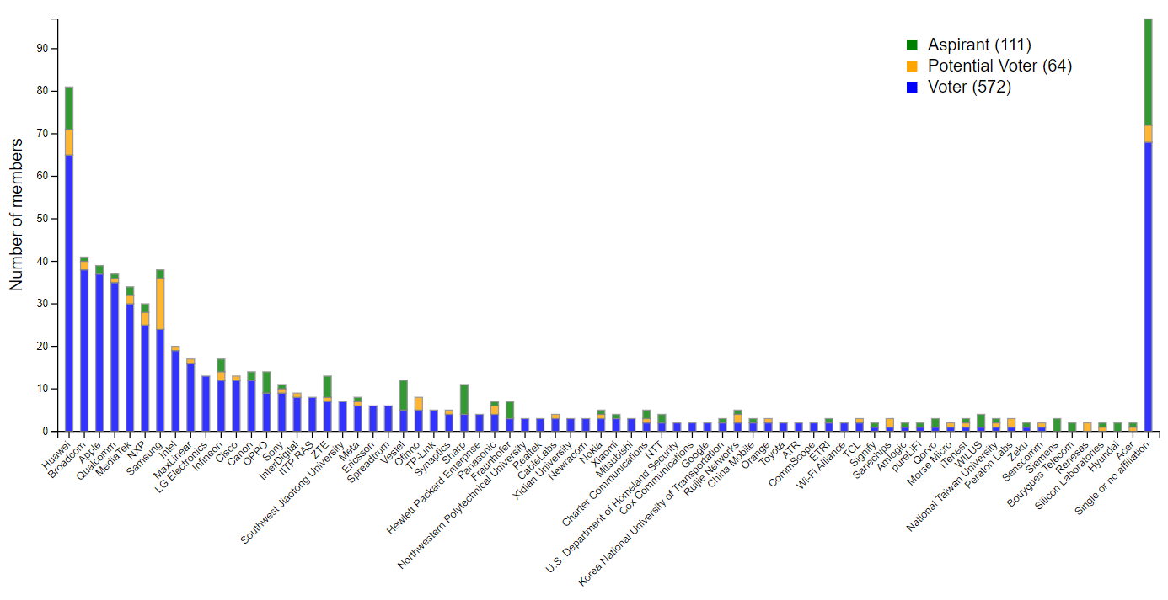
Members by affiliation

Slide 22
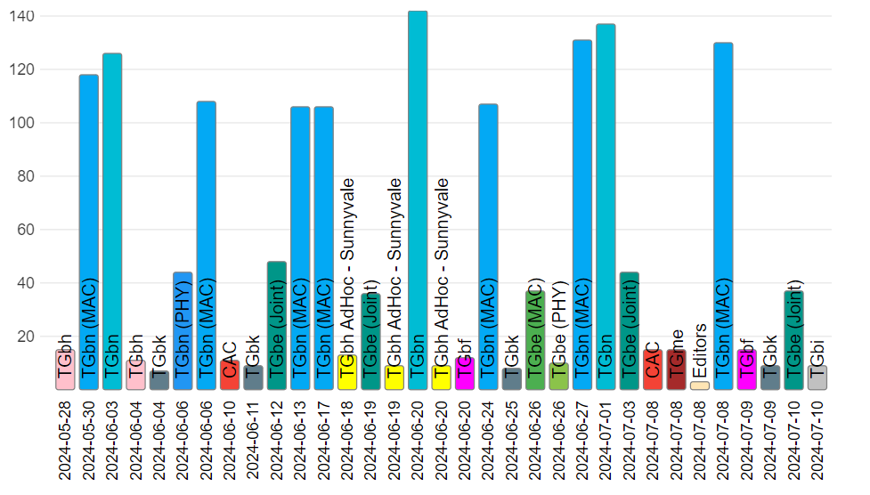
Attendance by subgroup (May to July)

Slide 23
M6.4 Announcements: 2024 July Designation of Individual experts
Individual experts who attend electronically for a specific purpose/presentation can be designated as such by the WG Chair and receive a registration fee waiver and limited attendance rights.
See section 5 in https://mentor.ieee.org/802-ec/dcn/17/ec-17-0090-25-0PNP-ieee-802-lmsc-operations-manual.pdf ,
  The Working Group Chair may designate specific individual experts who are allowed to participate in Working Group discussions via electronic means during an in-person meeting for the benefit of the group. These individuals are not considered to be attending the meeting and so they are not required to pay meeting fees and they do not get participation credit. The participation of these individuals should be limited to specific technical topics. Such participation shall be documented in the minutes of the Working Group meeting.
The individuals listed below are hereby designated as specific individual experts on their respective topics and subject to the restrictions and benefits described in the 802 OM.
  Rosario Garroppo, University of Pisa, WNG Tue AM1
  Sumit Roy, sroy@uw.edu, WNG Tue AM1 or PM2
  Hao Yin, haoyin@uw.edu, WNG Tue AM1 or PM2
  Tom Henderson, tomh@tomh.org, WNG Tue AM1 or PM2
For WNG, attendance for each is limited to the WNG timeslot in which the respective presentation is scheduled.

Slide 24
M6.4 Announcements: Joint IEEE 802 / ITU-T SG15 Workshop
The 9th Joint IEEE 802/ITU-T SG15 Workshop was held Saturday July 13, 2024
Agenda
  Opening Remarks
  ​Session 1: Exploration of Optical PHYs Addressing 800 Gb/s and Beyond
  Session 2: Access and In-Premises Networks ​
  Session 3: Synchronization and TSN
  Session 4: YANG and Data Modelling
  ​Wrap-up, Takeaways, Closing
Summary to the EC here.
A recording of the session is available here.

Slide 25
Additional Reference material

Slide 26
Comment Resolution Resources
Comment resolution resources
  See https://mentor.ieee.org/802.11/dcn/13/11-13-0230-05-0000-comment-resolution-tutorial.ppt
  See https://mentor.ieee.org/802.11/dcn/11/11-11-1625-02-0000-comment-resolution-guide.doc
There are many examples of good practice for documentation of comment analysis and resolution; ensures there is a record of comment consideration and agreed resolution
  https://mentor.ieee.org/802.11/dcn/18/11-18-0237-00-000m-cid-177.docx
  https://mentor.ieee.org/802.11/dcn/18/11-18-0930-00-000m-cid-1007.docx
  https://mentor.ieee.org/802.11/dcn/18/11-18-0669-04-000m-revmd-mac-comments-assigned-to-hamilton.docx
  https://mentor.ieee.org/802.11/dcn/18/11-18-1410-00-00ax-lb233-cr-spatial-reuse.docx

Slide 27
Motion and other templates
WG11 templates
  Motions: see https://mentor.ieee.org/802.11/dcn/22/11-22-1967-01-0000-working-group-motions-templates.pptx
  Liaison: see https://grouper.ieee.org/groups/802/11/Rules/2018-03 Liaison submission template.docx
802 LMSC templates
  Motions: https://mentor.ieee.org/802-ec/dcn/16/ec-16-0170-04-00EC-802-ec-motion-template.pptx
  CSD: https://mentor.ieee.org/802-ec/dcn/18/ec-18-0064-01-0PNP-csd-template-in-doc-format.doc
  Liaison: https://mentor.ieee.org/802-ec/dcn/17/ec-17-0012-01-00EC-802-liaison-template.docx

