Slide 1
802.11 July 2024 WG Motions
Date: 2024-07-18
Authors:

Slide 2
Abstract
This document is a composite of all working group motions and straw polls that are brought to the July 2024 802.11 WG plenary meeting.
Revisions
R0 Draft motions for the mid-week plenary
R1 Update to draft mid-week plenary motions
R2 Results of mid-week plenary motions
R3 Draft motions for the closing plenary

Slide 3
WeDNESDAY (JULY 17)

Slide 4
Motion 1: P802.11bk Re-circulation Letter Ballot
Having approved comment resolutions for all of the comments received from LB286 on P802.11bk D2.0 as contained in documents 11-24-754r5, 11-24-951r1, 11-24-958r2, 11-24-1073r1, 11-24-966r4, 11-24-954r4, and 11-24-1080r1, instruct the editor to prepare D3.0 incorporating these resolutions and,
approve a 15 day Working Group Recirculation Ballot asking the question “Should P802.11bk D3.0 be forwarded to SA Ballot?”
Moved by Jonathan Segev on behalf of TGbk
Result: Yes: 180, No: 1, Abstain: 16 (Motion passes)
[TGbk result: Moved: Christian Berger, 2nd: Roy Want, Result: 9/0/0]

Slide 5
Motion 2: P802.11bq PAR approval
Believing that the PAR contained in the document referenced below meets IEEE-SA guidelines,
request that the PAR contained in https://mentor.ieee.org/802.11/dcn/24/11-24-1312-01-immw-draft-p802-11bq-par.pdf be posted to the IEEE 802 Executive Committee (EC) agenda for WG 802 preview and EC approval to submit to NesCom.
Moved by Laurent Cariou on behalf of IMMW SG, Second: Volker Jungnickel
Result: Yes: 183, No: 15, Abstain: 23 (Motion passes)
[IMMW SG result: Moved: Abhishek Patil, 2nd: Ming Gan, Result: 137/33/28]

Slide 6
Motion 3: P802.11bq CSD Approval
Believing that the CSD contained in the document referenced below meets IEEE-SA guidelines,
request that the CSD contained in https://mentor.ieee.org/802.11/dcn/24/11-24-0549-05-immw-immw-draft-proposed-csd.docx be posted to the IEEE 802 Executive Committee (EC) agenda for WG 802 preview and EC approval to submit to NesCom.
Moved by Laurent Cariou on behalf of IMMW SG, Second: Volker Jungnickel
Result: Yes: 179, No: 11, Abstain: 27 (Motion fails/passes)
[IMMW SG result: Moved: Abhishek Patil, 2nd: Tian Bin, Result: 141/29/18]

Slide 7
FRIDAY (JULY 19)

Slide 8
Straw Poll: July Plenary
  1. How many people would like to come back to this venue?
    Yes - xx
    No – xx
  2. Did you go to the social?
    Yes – xx
    No – xx
  3. If you attended the social, did you enjoy it?
  Yes – xx
    No - xx

Slide 9
Motion 4: WG 802.11 Operations Manual
Move to approve submission https://mentor.ieee.org/802.11/dcn/22/11-22-1638-04-0000-802-11-operations-manual.docx as the WG 802.11 Operations Manual.
Moved by Stephen McCann, Second: Joseph Levy
Result: Yes: xx, No: xx, Abstain: xx (Motion fails/passes)

Slide 10
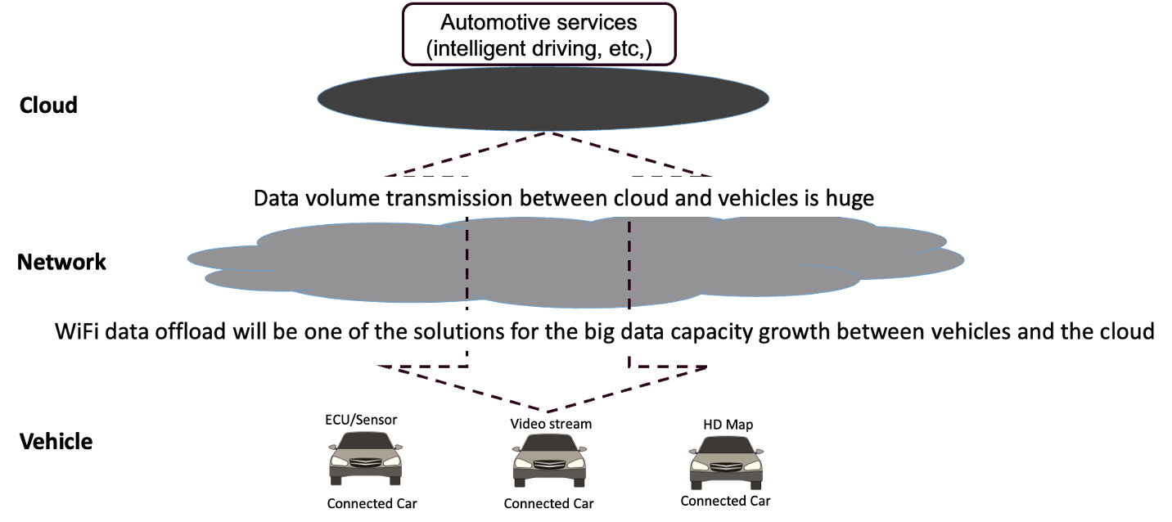
Automotive TIG: Background
Connected vehicles have become large producers and consumers of data
Offloading data from cellular to WLAN
may offer a faster and more cost-effective
solution for connected vehicles
Requirements such as fast association & authentication, seamless AP handover, optimized roaming algorithm, etc., are essential for WLAN data offload for automotive
Wi-Fi could also help as backhaul link for vehicle connectivity during motion:
  Targeted scope: Wi-Fi connectivity in areas with already externally accessible Wi-Fi APs such as downtowns…
However, current IEEE standards still have gaps to satisfy the WLAN data offload for automotive
      Camera generates data (500~3500) Mbit/s/camera
      RADAR generates data (0.1~15) Mbit/s/RADAR
100 petabytes of data is transferred to the cloud monthly

Slide 11
WLAN Data Offload for Automotive: scope of work
Discuss contributions in the areas of, but not limited to:
  Use cases and requirements
  Key performance indicators
  Technical approaches and 802.11 standard gaps in the areas such as protocols in association & authentication, seamless AP handover, optimized roaming algorithm etc.
  Alternative solutions
Final report (estimate: July 2025) will summarize the contributions and recommendations
These discussions will inform the TIG on the need and timing of requesting formation of a SG at a future 802.11 meeting
Previous WNG presentations: 24/1134r1, 24/0793r1, 24/0415r1, 24/1062r3, 24/1290r1, 24/1062r2, 24/0378r0

Slide 12
Motion 5: Automotive (AUTO) TIG
Request to approve formation of an Automotive (AUTO) TIG to investigate:
• Use cases, current and planned mechanisms in 802.11 for vehicle connectivity to external APs
Gaps between requirements and standards for automotive connectivity to external APs
• Recommendations to address gaps
The TIG is to complete a report on these topics at or before the July 2025 session.
Background – https://mentor.ieee.org/802.11/dcn/24/11-24-1290-01-0wng-strawpoll-joint-automotivetig.potx
Moved: Azin Neishaboori, Seconded: Jing Ma
Result: Yes: xx, No: xx, Abstain: xx (Motion fails/passes)
[WNG SC: Straw poll results: Y:85 / N:15 / A: 17]

Slide 13
Motion 6: P802.11 conditional forward to RevCom
Approve document https://mentor.ieee.org/802.11/dcn/24/11-24-1141-01-000m-p802-11revme-report-to-ec-on-conditional-approval-to-forward-draft-to-revcom.pptx as the report to the IEEE 802 Executive Committee on the requirements for conditional approval to forward P802.11REVme to RevCom and
request the IEEE 802 Executive Committee to conditionally approve forwarding P802.11REVme to RevCom and grant the WG chair editorial license.
Moved by Mike Montemurro on behalf of TGme, Second: xx
Result: Yes: xx, No: xx, Abstain: xx (Motion fails/passes)
[TGme: Moved: Mark Hamilton, 2nd: Stephen McCann, Result: 9/0/0]

Slide 14
Motion 7: P802.11be conditional forward to RevCom
Approve document 11-24-1283r2 as the report to the IEEE 802 Executive Committee (EC) on the requirements for conditional approval to forward P802.11be D7.0 to RevCom, and
request the IEEE 802 EC to conditionally approve forwarding P802.11be D7.0 to RevCom and grant the WG chair editorial license.
Moved by Alfred Asterjadhi on behalf of TGbe, Second: xx
Result: Yes: xx, No: xx, Abstain: xx (Motion fails/passes)
[TGbe: Moved: Abhishek Patil, 2nd: Binita Gupta, Result: 68/0/5]

Slide 15
Motion 8: P802.11be CSD confirmation
Confirm the CSD in https://mentor.ieee.org/802-ec/dcn/19/ec-19-0063-00-ACSD-p802-11be.docx.
Moved by Alfred Asterjadhi, Second: xx
Result: Yes: xx, No: xx, Abstain: xx (Motion fails/passes)

Slide 16
Motion 9: P802.11bh conditional forward to RevCom
Approve document 11-24/1317r2 as the report to the IEEE 802 Executive Committee (EC) on the requirements for conditional approval to forward P802.11bh D6.0 to RevCom, and
request the IEEE 802 EC to conditionally approve forwarding P802.11bh D6.0 to RevCom and grant the WG chair editorial license.
Moved by Mark Hamilton on behalf of TGbh, Second: xx
Result: Yes: xx, No: xx, Abstain: xx (Motion passes)
[TGbh: Moved: Jerome Henry, 2nd: Jouni Malinen, Result: 8/0/1]

Slide 17
Motion 10: P802.11bh CSD confirmation
Confirm the CSD in https://mentor.ieee.org/802-ec/dcn/22/ec-22-0088-00-ACSD-p802-11bh.pdf.
Moved by Mark Hamilton, Second: xx
Result: Yes: xx, No: xx, Abstain: xx (Motion fails/passes)

Slide 18
Motion 11: P802.11bh D5.0 to the WBA
Liaise P802.11bh D5.0 to the Wireless Broadband Alliance (WBA).
Moved by Mark Hamilton, Second: xx
Result: Yes: xx, No: xx, Abstain: xx (Motion fails/passes)

