Slide 1
Further Considerations for DRU Design
Date: 2024-06-14
Authors:

Slide 2
Introduction
To overcome PSD limitations for LPI devices in 6 GHz, distributed resource units (dRU) was introduced in [2].
In [2], It was shown that deploying dRU can boost the transmit power of UL OFDMA by up to 11.14 dB.
Given the existing framework of regular resource units (rRU) in 11ax, current research primarily aims to convert rRU to dRU, considering factors such as size, bandwidth distribution, puncturing, and the hybrid integration of rRU and dRU [3-13].
Notably, existing dRU designs are unable to achieve the maximum transmit power boost of 11.14 dB for 20 MHz spreading bandwidth.
This contribution addresses additional considerations in designing a dRU tailored specifically for 20 MHz spreading bandwidth reaching for a maximum transmit power gain of 11.14 dB.

Slide 3
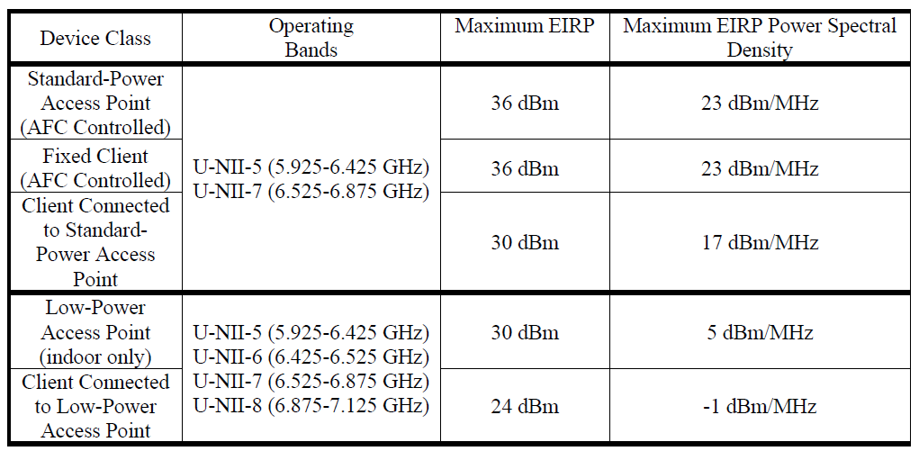
Background: FCC Regulations on Low-Power Indoor Usage in the 6GHz Band
Strict PSD requirement of -1dBm/MHz will cause reduced UL coverage range and UL/DL power imbalance
The dRU concept is simply spreading the allocated tones to each STA across wider bandwidth reducing #tones per 1 MHz being assigned to each user.

Slide 4
Background
Distributed Resource Units (DRU) boosts uplink OFDMA transmission power, especially in 6 GHz LPI scenarios.
The concept is simply spreading/distributing the allocated tones to each STA across wider bandwidth reducing tones per 1 MHz being assigned to each user.
In [2], it was shown that DRU can boost the transmit power of UL by 11.14 dB.

Slide 5
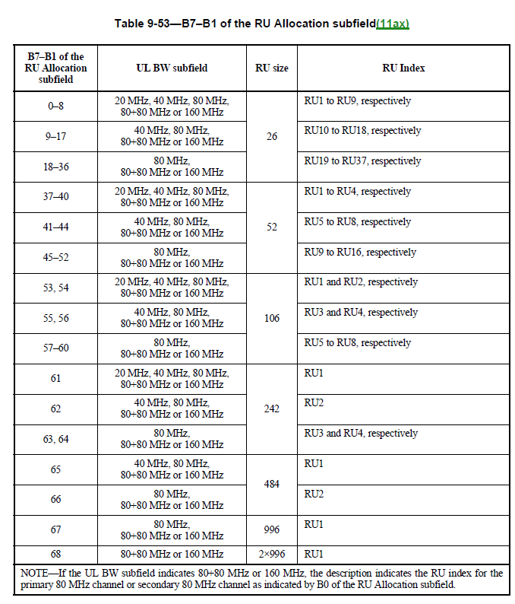
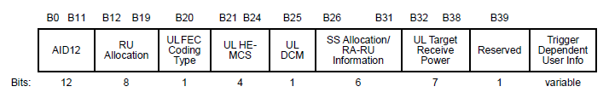
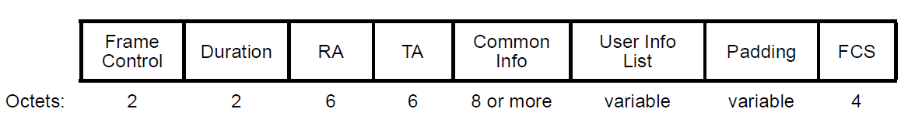
Background: Resource Allocation Mechanism for rRUs in 11ax
UIF 1
UIF N
Trigger Frame
AP
UL PPDU
STA1
UL PPDU
STA N

Slide 6
Background: Example of a Trigger Frame Signaling for dRU
Trigger frame for both rRU and dRU modes
The existing RU Allocation indices subfield can be reused for dRU allocation
UIF 1
UIF N
Trigger Frame
Using the same RU indices as rRU (Same table)
The dRU/rRU mode selection can be communicated through common Info subfield

Slide 7
Problem: Supporting Maximum Power Boost for 20 MHz PPDU
Motivation:
dRU sizes are considered the same as rRU design in 11 ax to minimize the OFDMA architecture of 11ax deploying dRU and signaling complexity.
26-tones DRU is the smallest size DRU still send 2 tones per MHz and push to send 3 dB less per tone compared to maximum power boost of 11.14 dB
11.14 dB power boost may be achievable for 20 MHz Spread BW by designing dRU with less than 26 tones
However, there is no straightforward mechanism for deploying under 26 tones dRU
  The trigger frame design is more complicated as the new dRU size are not available in the RU index table.
    More combination: more memory required at AP
Power Boost vs number of tones per MHz [11].
RU Size | BW20 |  | BW40 |  | BW80
 | #Tone/MHz | Power Boost (dB) | #Tone/MHz | Power Boost (dB) | #Tone/MHz | Power Boost (dB)
DRU26 | 2 | 8.13 | 1 | 11.14 | 1 | 11.14
DRU52 | 3 | 6.37 | 2 | 8.13 | 1 | 11.14
DRU106 | 6 | 3.56 | 3 | 6.37 | 2 | 8.13
DRU242 | N/A | N/A | 7 | 2.69 | 4 | 5.12
DRU484 | N/A | N/A | N/A | N/A | 7 | 2.69
DRU996 | N/A | N/A | N/A | N/A | N/A | N/A

Slide 8
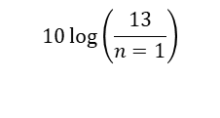






Tone Disabling for DRU (1)
To improve the power boost, the STA can disable some of the tones of 26 tones DRU. Disabling a tone means transmitting zero energy on the tone.
The STA can use either odd or even tones of 26 tones DRU.
  Example: for 26 tones DRU 20MHz spreading BW the power boost is 8.13 dB. By selecting odd/even excluding other rest, as shown in the figure maximum power boost of 11.14 dB is achievable.
n =1
Disabled
$$10\log\left(\frac{13}{n=1}\right)$$
1 MHz
$${\text{P}}_{Tone,Max}$$
$$1$$
$$2$$
$$k=13$$
$$11.14 dB$$
$${\text{PSD}}_{Max}$$
f
20 MHz

Slide 9
Tone Disabling for DRU (2)
The STA can indicate tone disabling of 26-DRU to the AP by sending a request frame which can include Odd/Even tones disabled flag.
The AP can allocate a 26 tone DRU to the STA and know that only odd/even tones will be used for uplink transmission by STA
Without any modification in Trigger frame, STA can transmit with maximum achievable power boost of 11.14 dB using tone disabling.
26-tone dRU to STA 1
26-tone dRU to STA 2
MBA
STA1
STA 2
TF
AP
Power Boost: 8.13 dB
TB PPDU
STA1
Power Boost: 11.14 dB
STA 2
Frame
TB PPDU
Disable odd tones
for 26-tone dRU

Slide 10
Conclusion
Maximum gain of 11.14 dB is no achievable for 20 MHz PPDU based on the current scheme of DRU design reusing the same size of rRU.
The highest power boost for 20 MHz PPDU based on rRU design can be achieved for 26-tone DRU which is equal to 8.13 dB.
We introduce a solution to disable some tones (odd/even) which lead to less number of tones per MHz.

Slide 11
References
https://mentor.ieee.org/802.11/dcn/23/11-23-1117-00-0uhr-DRU-signaling-for-uhr.pptx
https://mentor.ieee.org/802.11/dcn/23/11-23-0037-00-0uhr-uhr-feature-to-overcome-psd-limitations-distributed-tone-resource-units.pptx
https://mentor.ieee.org/802.11/dcn/23/11-23-1988-02-00bn-considerations-on-DRU-design-and-application.pptx
https://mentor.ieee.org/802.11/dcn/23/11-23-1115-00-0uhr-cfo-impact-and-pilot-design-for-DRU.pptx
https://mentor.ieee.org/802.11/dcn/23/11-23-1447-00-0uhr-cfo-impact-and-pilot-design-for-DRU-follow-up.pptx
https://mentor.ieee.org/802.11/dcn/23/11-23-1448-00-0uhr-further-considerations-on-DRU.pptx
https://mentor.ieee.org/802.11/dcn/23/11-23-1511-01-0uhr-pilot-tone-allocation-and-other-considerations-of-tone-distributed-rus-for-uhr.pptx
https://mentor.ieee.org/802.11/dcn/23/11-23-1516-00-0uhr-use-case-for-distributed-rus-in-downlink.pptx
https://mentor.ieee.org/802.11/dcn/23/11-23-1919-00-00bn-DRU-proposal.pptx
https://mentor.ieee.org/802.11/dcn/23/11-23-2200-00-00bn-distribution-bandwidth-of-DRU.pptx
https://mentor.ieee.org/802.11/dcn/23/11-23-2020-01-00bn-high-level-perspective-on-distributed-tone-ru-for-11bn.pptx
https://mentor.ieee.org/802.11/dcn/23/11-23-2021-00-00bn-principle-and-methodology-for-DRU-tone-plan-design.pptx
https://mentor.ieee.org/802.11/dcn/23/11-23-1516-00-0uhr-use-case-for-distributed-rus-in-downlink.pptx

