Slide 1
EPCS Priority Access for Additional Use Cases
Date: 2024-12-18

Slide 2
Abstract
This presentation discusses the need for EPCS Priority Access to support additional use cases

Slide 3
Background
EPCS (Emergency Preparedness Communications Service) Priority Access features were specified in IEEE 802.11be for supporting National Security and Emergency Preparedness (NSEP) Communications
The use case required non-AP MLD to be successfully authenticated and associated with an AP MLD before EPCS Priority Access can be enabled
AP MLD can grant the EPCS Priority Access once it verifies that non-AP MLD has the authority to use the features
Either non-AP MLD or AP MLD can request and tear down the EPCS Priority Access
This feature is optional in IEEE 802.11be

Slide 4
Use Case I and Requirements
During emergencies, network congestion may prevent users with emergency preparedness responsibilities from (re)associating. Enabling their access requires that STAs capable of obtaining EPCS Priority Access (i.e., those configured to be authorized for the service) should be able to transmit management frames for authentication and association with higher priority than normal STAs
  Failure to support the above will prevent EP personnel, whose mission is to help the citizens during emergencies and save lives, from performing their responsibilities
The current solution in IEEE 802.11be does not support the above use case
  The scope in IEEE 802.11be was limited and it was appropriate at that time
Given the market acceptance of the EPCS features, it is essential that we address this use case in IEEE 802.11bn

Slide 5
Use Case II and Requirements
Use Case II: During crisis situation, WLAN may become congested with traffic from general public and users authorized for priority at several levels. To ensure authorized EPCS users can communicate to fulfill their emergency responsibilities, network may need to restrict access. Such restrictions could apply to public users with an exemption for EPCS users to ensure their ability to communicate.
  Form of Preemption: process of terminating (or degrading) lower priority communications in favor of higher priority communications
  Our aim is to provide mechanism that gives benefits of preemption, as defined, through controlled management of channel access
IEEE 802.11 networks should provide means to enable access control with an exemption on behalf of EPCS STAs
  Current EPCS priority in IEEE 802.11be only provides probabilistic advantage via EDCA
  Controlled access could provide critical advantage for NS/EP personnel under extreme conditions
Given the new regulatory and existing service requirements, it is important that we address the above in IEEE 802.11bn

Slide 6
Regulatory Update in USA
Federal Communication Commission (FCC) within United States released a new Report and Order (FCC-22-36) addressing the Wireless Priority Service (WPS) (a.k.a., NSEP Priority Service) in 2022
  Report and Order (R&O) specifies operation of priority service on public wireless communications networks
A few highlights on Wireless Priority Service (WPS)
  Explicitly authorizes WPS preemption of public communications
    Preemption: process of terminating or degrading lower priority communications in favor of higher priority communications
  Expressly permits priority voice, video, and data sessions
  Expressly authorizes priority signaling (registration, invocation)
  Expands WPS eligibility to include additional users
  Clarifies that higher priority users take precedence over those with lower priority
    Five (5) priority levels were defined in earlier R & O
Note: Wireless Priority Service (WPS) is not mandated by the FCC

Slide 7
3GPP Cellular Network Approach to Support Use Cases
Cellular networks support concept of Access Class Barring
  Every station is assigned one of ten base access classes
  Select stations are also assigned one of a small set of elevated access classes
    e.g., access classes for network management, those making emergency (e.g., 911, 112) calls
  When network load increases, Base Station can (probabilistically) bar some classes from gaining access
    Base station broadcasts barring factors for ten base access classes
    User devices generate random number – only those with number less than barring factor are allowed attempt network access
    Select stations with an elevated access class are exempt from access class barring test
NS/EP users have dedicated access class that gives them exemption from access class barring
  This is analogy with desirable characteristics. Implementation within WLAN is TBD.

Slide 8
Example Priority Services Offered in Various Countries
In Belgium, Blue Light Mobile service enables priority communications for users with national security and emergency preparedness responsibilities
  Priority involves both exemption network management controls for both lower- and higher-priority users and preemption of other traffic on behalf of higher-priority users
In Czech Republic, mobile crises communications service provides priority for three user classes and four priority levels
  Traffic assigned to priority levels based on user class and situation (e.g., crisis or non-crisis)
  Service includes variety of priority actions, e.g., calls at highest priority level can preempt lower-priority and non-priority calls other than emergency (i.e., 112) calls.
In Denmark, priority communications program provides preferential network access for first responders and individuals supporting critical infrastructure
  Supports two priority levels, one that includes preferential access by authorized users and another that, when declared, restricts network access by (i.e., preempts) non-priority users

Slide 9
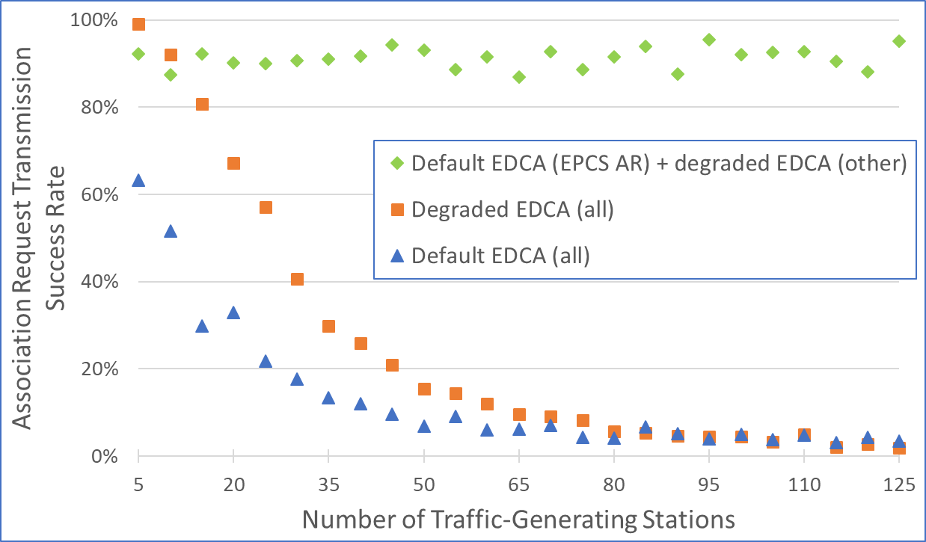
What is problem during Pre-Association?
During high network overload situations, our simulation shows that all STAs suffer when attempting to send an Association Request (AR) (using AC_VO) while with a small change in EDCA parameters results in successful transmission
  Blue circles show adverse impact of competing traffic on transmission of a single Association Request frame with no priority (even with 10 retries)
  Orange squares show benefit with small change in EDCA parameters resulting in advantage for small number of users sending association requests (10 retries)
Discrete event MAC-layer simulation
For each run, total traffic generating stations broken down as: 41.7% voice, 16.6% video, 41.7% best effort, plus 20 stations sending association request
Channel Bandwidth: 20 Mhz
EDCA Parameters (AIFSN, CWmin-CWmax)
  Default: AC_VO: 2, 3-7; AC_VI: 2, 7-15; AC_BE: 3, 15-1023
  Degraded: AC_VO: 4, 7-15; AC_VI: 4, 15-31; AC_BE: 5, 31-1023
    AR transmitted using corresponding AC_VO parameters

Slide 10
Pre-Association EPCS Priority
Candidate Approaches
Send advantaged EDCA parameters for unassociated non-AP MLDs that have EPCS active
  Using Beacon Frame
  Using a dedicated Public Action Frame (TBD)
Allocate resources to STAs affiliated with unassociated non-AP MLDs that have EPCS active
  Using TUA (Ref: IEEE 802.11REVme D7.0 Clauses 10.2.5, 26.5.2, 26.5.4)
Note: “EPCS Active” state needs to be specified with a MIB variable. Non-AP MLDs provisioned to use EPCS would have this variable set (e.g. EPCSActivated)
  MIB variable is set via a provisioning interface by a service provider or other responsible entity on devices for which AAA server is also being provisioned to authorize EPCS
  Concept used in existing features that have “Implemented” and “Activated” states defined as MIB variables (e.g., QoSMap, SSPNInterface)

Slide 11
Advantaged EDCA using Beacon Frame
Add optional multi-link element that carries EDCA parameters to be used by STAs affiliated with unassociated non-AP MLDs with EPCS activated
  AP broadcasts normal EDCA and advantaged EDCA parameters
    Advantaged EDCA parameters to be used by STAs affiliated with unassociated non-AP MLDs and normal EDCA parameters to be used by non-EPCA STAs
    Advantaged EDCA parameters do not need to be carried in every Beacon frame (e.g., send in every third or fourth beacon)
      Send only when conditions warrant (e.g., AP senses severe overload conditions, AP is triggered by external source)
  Advantaged EDCA does not need to be full multi-link element or full set of EDCA parameters
    Only include AC_VO parameter, which is used for management frames
Pros:
  Reuses existing Beacon frame and processing logic
  Allows AP MLD to control pre-association priority by whether frame is sent
  Allows AP MLD to manage priority using EDCA parameter values
Cons:
  Beacon bloating

Slide 12
Advantaged EDCA Using Public Action Frame
Specify a public action frame to send advantaged EDCA parameters to be used by STAs affiliated with unassociated non-AP MLDs with EPCS activated
  Addressing options
    Broadcast: AP MLD sends frame like a Beacon
      All .11bn STAs interpret frame after reception; those without EPCS activated take no action
    Multicast: AP MLD sends frame to multicast AID for unassociated STAs
      All unassociated .11bn STAs interpret frame after reception; those without EPCS activated take no action
Pros
  Avoids Beacon bloating with additional EDCA parameters
  Allows AP MLD to control pre-association priority by whether frame is sent and how often
  Allows AP MLD to manage priority using EDCA parameter values
Cons
  Need to specify a new frame

Slide 13
Using Triggered Uplink Access
Build on existing TUA that provides means for AP to allocate resources to unassociated STAs using a dedicated AID
  Define AID to address STAs affiliated with unassociated non-AP MLDs with EPCS activated
  AP periodically allocates resources to STAs affiliated with unassociated non-AP MLDs with EPCS activated by sending a Trigger frame to the dedicated AID
    Send only when conditions warrant (e.g., AP senses overload conditions, AP is triggered by external source)
    Those STAs compete among themselves for the allocated resources
Pros
  AP has complete control of whether to allocate resources and how much to allocate
  Builds on existing capability for allocating resources to unassociated STAs (via AID 2045) (See Clause 26.11 in REVme specification)
Cons
  Requires TUA to be supported

Slide 14
Discussion
Perceived Problem
  Without prior authorization, rogue STAs without EPCS activated could use the advantaged EDCA parameters or the allocated TUA resources
    Response:
      Any station that wants to ignore specification can do so, independent of this feature
      AP MLD can determine if STAs are EPCS authorized (after a limited number of exchanges) and take appropriate action
  Note 1: Definition of RADIUS attributes for EPCS authorization is in progress in IETF and WBA
  Note 2: EPCS is specified to be used by authorized stations on managed networks, where service provider can set their policies

Slide 15
Straw Poll -1
SP1: Do you agree to include the following in TGbn SFD:
  Define an optional mechanism that enables relatively higher priority channel access for non-AP STAs affiliated with non-AP MLDs that have EPCS activated for transmission of management frames prior to Robust Security Network Association (RSNA) if applicable otherwise prior to (Re)Association with the AP MLD?
  Notes:
  1. The AP MLD advertises whether non-AP MLDs with EPCS activated are allowed to use the feature (e.g., enabling it when triggered to do so by an external entity in response to an emergency declaration)
  2. The mechanism is TBD
  3. Whether and/or how the mechanism is applied during each of the phases of the (re)association process is TBD 4. “EPCS activated” indicates non-AP MLDs that have been provisioned to use EPCS by a responsible external entity
Y –
N -
A -

Slide 16
Straw Poll -2
SP2: Do you agree to include the following in TGbn SFD:
Do you agree to define an optional access control mechanism to prioritize some EPCS STAs w.r.t. other EPCS STAs?
Note: Per use case requirement 2 and FCC Report and Order 22-36
Y –
N -
A -

Slide 17
References
IEEE 802.11be Draft 7.0: https://www.ieee802.org/11/private/Draft_Standards/11be/Draft%20P802.11be_D7.0.pdf
FCC Review of Rules and Requirements For Priority Services, FCC-22-36, https://www.fcc.gov/document/fcc-modernizes-and-improves-its-priority-services-rules-0
https://mentor.ieee.org/802.11/dcn/22/11-22-1074-01-0wng-priority-access-fcc-r-o-and-additional-use-cases.pdf
Information on the Belgium Blue Light Mobile service was found in the following sources (Last viewed May 2024): https://www.astrid.be/en/services/blue-light-mobile, (in English), https://www.astrid.be/sites/public/files/2024-02/BLM_userguide_jan2024_NL.pdf (in Dutch), https://www.criticalcomms.com/content/news/belgium-astrid-launches-the-next-generation-of-its-blue-light-mobile-service (in English), https://www.criticalcomms.com/content/news/belgium-astrid-launches-the-next-generation-of-its-blue-light-mobile-service (in English)
Information on the mobile crisis communications services within the Czech Republic was found in the following sources (Last viewed: May 2024): http://www.hzscr.cz/soubor/04-krizova-komunikace-rezim-kompatibility-pdf.aspx (in Czech) and § 18 - Communication of the Integrated Rescue System (netstranky.cz) (in Czech).
Information on the mobile crisis communications services within Denmark was found in the following sources (Last viewed: May 2024): Beskrivelse af mobilprioriteringsordningen__CFCS_juli 2019 (in Danish) and vejledning-til-prioriteringsordningen-i-4g-netvark.pdf (cfcs.dk) (in Danish)
Description of access class barring: Performance analysis of access class barring for next generation IoT devices - ScienceDirect

Slide 18
BACKUP – Collisions between Priority Traffic
20 Stations Sending EPCS Association Requests
10 Stations Sending EPCS Association Requests

