Slide 1
June 2024
Considerations on NPCA for reliability
Date: 2024-06-05
Authors:
Name | Affiliations | Address | Phone | email
Si-Chan Noh | Newracom |  |  | sc.noh@newracom.com
Joonsoo Lee |  |  |  | js.lee@newracom.com

Slide 2
Introduction
In 802.11bn, many contributions have been discussed to improve reliability, reduce latencies, increase throughput at different SINR levels, and reduce power consumption
The Non-Primary Channel Access (NPCA) has been proposed and details are still under discussed to increase medium efficiency with increasing operating bandwidth [1-10]
  It can increase BW efficiency by allowing STAs to Tx/Rx in NPCA available channels when the primary channel is BUSY
This contribution discuss some considerations in the context of reliability on NPCA
  Frequent channel switching
  Identify BW of OBSS TXOP
  NPCA primary channel is BUSY

Slide 3
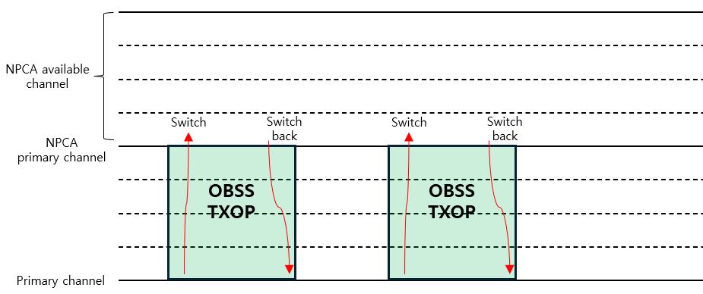
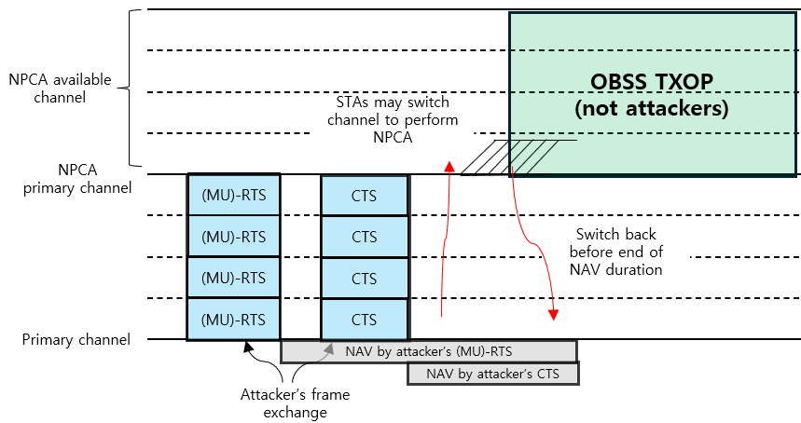
Frequent channel switching on NPCA
When NPCA STAs (i.e., capable of NPCA) try to perform NPCA, frequent channel switching may lead to power drainage of the NPCA STAs which means increased power consumption
Potential scenarios of frequent channel switching :
  The NPCA STAs switch channels when primary channel is BUSY without any conditions
    If the NAV duration of the primary channel is too short, the NPCA STAs may switch back to the primary channel earlier
  An attacker initiates an attack to cause ‘power drainage’ of NPCA STAs
    It can be an improper case that misleads the NPCA STAs into performing NPCA

Slide 4
Frequent channel switching on NPCA
Potential approaches :
  Set the criteria for NAV duration
    Ex) When the NPCA STAs overhearing OBSS’s (MU)-RTS/CTS, compare the estimated NAV duration with the criteria
      Estimated NAV duration of OBSS’s signal >= criteria : move to the NPCA primary channel to perform NPCA
      Estimated NAV duration of OBSS’s signal < criteria : stay in the primary channel
      This approach may prevent frequent channel switching of NPCA STAs and lead to power saving
  Allowing the NPCA STAs switch to NPCA primary channel when overhearing signals from reliable OBSS AP listings
    Ex) APs configured in a Multi-AP coordination set can be listed as reliable OBSS AP listing
      When the NPCA STAs overhear frames from reliable OBSS APs on the list, they can move to the NPCA primary channel
      When the NPCA STAs overhear frames from other APs not on the reliable OBSS AP list, staying in the primary Channel
      This approach may reduce the recognition of fake primary channel BUSY states caused by attackers and prevent frequent channel switching, which saves NPCA STA’s power consumption

Slide 5
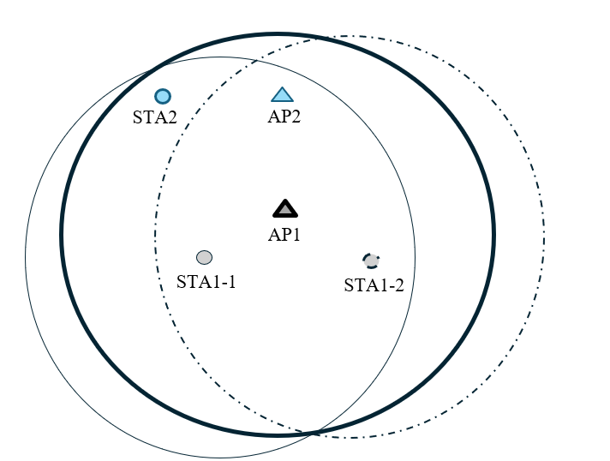
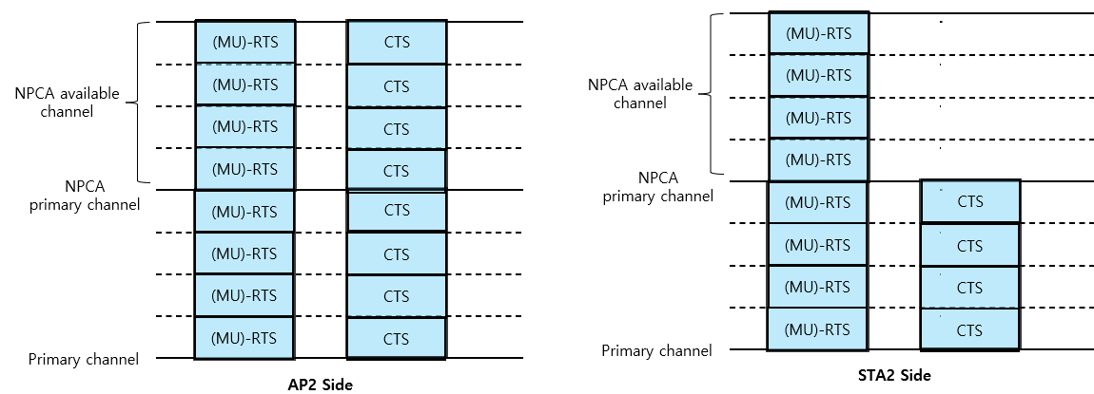
Identify BW of OBSS TXOP on NPCA
The NPCA STAs have different views of channel when switching to NPCA primary channel after a control frame exchange(e.g., MU-RTS/CTS) of an OBSS
  When the AP1 transmits control frame on 160MHz BW to STA1-1 and STA1-2
    The STA1-1 transmits 80MHz CTS
    The STA1-2 transmits 160MHz CTS
The view of channel status at AP2 and STA2 side
  Through the current baseline :
    The AP2 may not to perform NPCA due to
    the NPCA available channel is BUSY from
    the OBSS control frame exchange
    The STA2 may think it is possible to perform NPCA
    and switching channel due to only P80 is occupied
    from the OBSS control frame exchange
Potential approach :
  When the information of UL BW subfield in MU-RTS
  covers the NPCA primary channel, do not perform NPCA
  for the sake of simplicity

Slide 6
BUSY NPCA primary channel
We can consider some scenarios when the both primary and NPCA primary channel are BUSY due to OBSS signals
In this scenario, not performing NPCA is baseline
However, not performing NPCA due to the NPCA primary channel is being BUSY may not align with the purpose of the NPCA which is discussed to enhance BW efficiency
  To better provide opportunities for NPCA, we can consider how to set the NPCA primary channel appropriately
Potential approaches :
  Consider designating the NPCA primary channel to account for the possibility of it being covered by OBSS PPDU
    For example, considering channel width of occupied OBSS PPDU
  More details about how to designate NPCA primary channel is TBD

Slide 7
Summary
We discuss some considerations in terms of reliability when performing NPCA
  Frequent channel switching
  Identify BW of OBSS TXOP
  NPCA primary channel is BUSY
We need to consider how to allow reliable NPCA to align with the goals of UHR
Slide 7

Slide 8
Reference
[1] 23/0961r0, UHR Secondary Channel Access
[2] 23/2005r1, Non-Primary Channel Access (NPCA)
[3] 24/0495r0, Non-Primary Channel Access (NPCA) - Follow up
[4] 24/70r2 Some details about non-primary channel access
[5] 24/538r1 SP-based non-primary channel access
[6] 23/0034r1, Non-Primary Channel Utilization
[7] 23/1288r0, Non-Primary Channel Utilization Follow-up
[8] 23/2023r1, Further discussion on Non-primary Channel Access
[9] 23/0631r1, Secondary channel usage and secondary 20MHz channel backoff
[10] 24/0496r1, Secondary Channel Usage Follow up
Slide 8

