Slide 1
Enhancement of BSR Follow-up
Date: 2024-06-01
Authors:

Slide 2
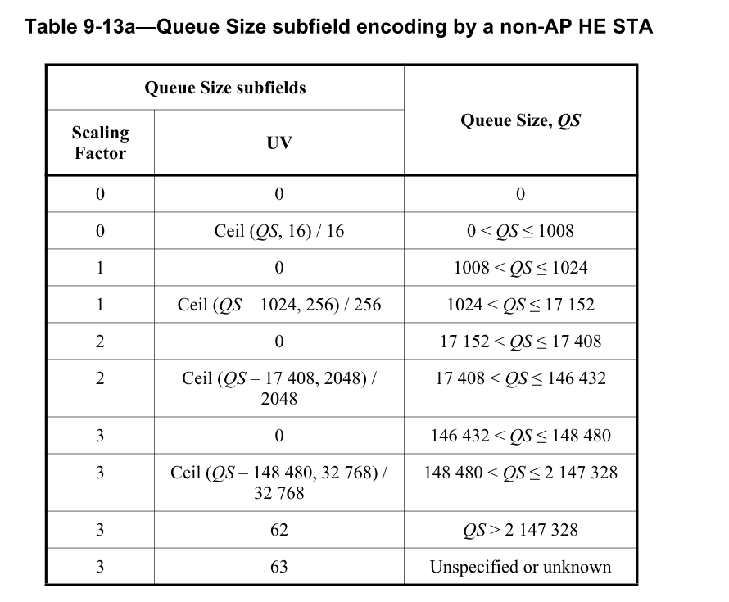
Recap of Buffer Status Report
In 23-2007, the current buffer status report (BSR) problem is introduced, and the corresponding solution and straw polls were discussed
11bn SFD has adopted the text as below
TGbn enables per-TID buffer size reporting of a larger queue in UHR
Note: It is an optional feature.
Note: In the baseline, the maximum approximate per-TID queue size to report is 2,147,328 octets
In this contribution, further analysis between two different solutions is discussed
A-ctrl as QoS Ctrl extension
A-ctrl only

Slide 3
A-ctrl as QoS Ctrl Extension
In 23-2007, we propose a design to add a new A-ctrl as the QoS ctrl extension to report a larger queues size
For a non-AP STA to report queue size larger than 2,147,328 octets, the first step is to set the QS subfield <SF, UV> to <3, 62>
The non-AP STA can carry another subfield defined in A-ctrl field with the same TID in the same frame to indicate an accurate and larger queue size which is above the QS currently can support

Slide 4
A-ctrl as QoS Ctrl Extension Example
A-ctrl design example 1, keep the SF as the same as 32,768 (SF0) in QS subfield
QS = 2,147,328 + SF0*(UVE+1), UVE max is 254
the maximum QS to be reported is 10,503,168
UVE = 255 reserved for indication of QS > 10,503,168
UVE = ceil ((QS - 2,147,328)/SF0) - 1
A-ctrl design example 2, increase the SF to 32,768*4 (SF1)
QS = 2,147,328 + SF1*(UVE+1), UVE max is 254
the maximum QS to be reported is 35,570,688
UVE = 255 reserved for indication of QS > 35,570,688
UVE = ceil ((QS - 2,147,328)/SF1) – 1
The SF applied in the A-ctrl UVE is by default with no extra indication
Control ID value | Meaning | UV extension (UVE)
TBD | Extension of UV in QoS QS subfield | 8 bits
NOTE: For 6GHz, the max AMPDU size is calculated based on Nss=8
39200 (N_DBPS)*396 (symbols for max PPDU length) /8 (bits/byte) * 8 (Nss) = 15,523,200 bytes (max AMPDU size defined in 11be Table 9-34)
39200 is from 11be Table 36-86 MCS13 N_DBPS

Slide 5
A-ctrl only Design I with Maximum Scaling = 32768
Design
SF 3 bits + UV 6 bits
SF = 0, 1,2, 3
Scaling = 16, 256, 2048, 32768 (Same granularity as QoS control)
SF = 4, 5, 6, 7 (with UV < 62)
Scaling = 32768
SF = 7 with UV = 62, 63 for QS > maximum, and unknown
Maximum QS is 10,535,936
SF = 0, 1, 2, 3 (partially) are the same as the QoS ctrl design
SF | UV, Unscaled Value (6 bits) | QS, Queue size
3 | 0 | 146432 < QS ≤ 148480
3 | Ceil (QS – 148480, 32768) / 32768 | 148,480 < QS ≤ 2212864
4 | Ceil (QS – 2212864, 32768) / 32768 | 2212864 < QS ≤ 4310016
5 | Ceil (QS – 4310016, 32768) / 32768 | 4310016 < QS ≤ 6407168
6 | Ceil (QS – 6407168, 32768) / 32768 | 6407168< QS ≤ 8504320
7 | Ceil (QS – 8504320, 32768) / 32768 | 8504,320 < QS ≤ 10535936
7 | 62 | QS > 10535936
7 | 63 | Unspecified or unknown

Slide 6
A-ctrl only Design II with Maximum Scaling = 32768
Design
SF 2 bits + UV 8 bits
SF = 0, 1,2, 3 (with UV < 254)
Scaling = 16, 256, 2048, 32768 (Same granularity as QoS control)
SF = 3 with UV = 254, 255 for QS > maximum, and unknown
Maximum QS is 8,884,224
SF | UV, Unscaled Value (8 bits) | QS, Queue size
0 | 0 | 0
0 | Ceil (QS, 16) / 16 | 0 < QS ≤ 4080
1 | 0 | 4080 < QS ≤ 4096
1 | Ceil (QS-4096, 256) / 256 | 4096 < QS ≤ 69376
2 | 0 | 69376 < QS ≤ 69632
2 | Ceil (QS-69632, 2048) / 2048 | 69632 < QS ≤ 591872
3 | 0 | 591872 < QS ≤ 593920
3 | Ceil (QS – 593920, 32768) / 32768 | 593920 < QS ≤ 8884224
3 | 254 | QS > 8884224
3 | 255 | Unspecified or unknown

Slide 7
Comparison I
Assumption: Legacy reported queue size under the same granularity as the QoS Control QS field
A-ctrl only design II has better granularity for QS < 593,920
Maximum SF = 32768
Comparison criteria
Required A-control length and maximum reported QS
SF = 32768 | A-ctrl as QoS Ctrl Extension | A-control I (SF +UV) | A-control II (SF +UV)
A-ctrl length | 8 bits | 3 + 6 = 9 bits | 2 + 8 = 10 bits
Maximum reported QS | 10,503,168 | 10,535,936 | 8,884,224

Slide 8
A-ctrl only Design with Maximum Scaling = 32768*4
Design
SF 3 bits + UV 6 bits
SF = 0, 1,2, 3
Scaling = 16, 256, 2048, 32768 (Same granularity as QoS control)
SF = 4, 5, 6, 7 (with UV < 62)
Scaling = 32768*4
SF = 7 with UV = 62, 63 for QS > maximum, and unknown
Maximum QS is 35,537,920
SF = 0, 1, 2, 3 (partially) are the same as the QoS ctrl design
SF | UV, Unscaled Value | QS, Queue size
3 | 0 | 146432 < QS ≤ 148480
3 | Ceil (QS – 148480, 32768) / 32768 | 148480 < QS ≤ 2212864
4 | 0 | 2212864 < QS ≤ 2245632
4 | Ceil (QS – 2245632, 32768*4) / 32768*4 | 2245632 < QS ≤ 10634240
5 | Ceil (QS – 10634240, 32768*4) / (32768*4) | 10634240 < QS ≤ 19022848
6 | Ceil (QS – 19022848, 32768*4) / (32768*4) | 19022848 < QS ≤ 27935744
7 | Ceil (QS – 27935744, 32768*4) / (32768*4) | 27935744 < QS ≤ 35537920
7 | 62 | QS > 35537920
7 | 63 | Unspecified or unknown

Slide 9
Comparison II
Assumption: Legacy reported queue size under the same granularity as the QoS Control QS field
Maximum SF = 32768*4
Comparison criteria
Required A-control length and maximum reported QS
SF = 32768*4 | A-ctrl as QoS Ctrl Extension | A-control only (SF +UV)
A-ctrl length | 8 bits | 3 + 6 = 9 bits
Maximum reported QS | 35,570,688 | 35,537,920

Slide 10
Parsing Complexity and Potential Baseline Change
Similar parsing efforts required for both solutions
[A] pre-HE and HE STA has different scaling in BSR of QoS control
[B] Reporting of a larger queue size is optional in UHR so that UHR STA still can use QoS control only to report BSR
[C] TID is carried in QoS control
Current baseline limits the HT control to be the same when the same type frames are carried in A-MPDU
No change of current rules is preferred
 | A-ctrl as QoS Ctrl Extension | A-Ctrl Only
Non-AP STA generation identification [A] | Yes (pre-HE) | Yes (pre-HE)
QoS Ctrl BSR Support [B] | Yes | Yes
QoS ctrl + A-ctrl parsing together [C] | Yes | Yes

Slide 11
Proposal
To support a larger queue size report, propose to define an A-ctrl subfield as the extension of the QS subfield of the QoS control field in the same frame when QoS control and A-ctrl carry the same TID
No change to current encoding of QS subfield for HE STA, no backward capability issue
The extension is only needed when the QS subfield is not enough for a queue size report
When QoS control and A-ctrl carry different TIDs in the same frame, they report BSR of the two TIDs independently, and the A-ctrl’s BSR starts from the maximum QS which the QoS control can report
A proposed design UVE with default SF 32768*4, 14-bit length
HT-control can carry both UVE and UPH A-ctrl in TB-PPDU
Maximum reported QS is 35,570,688
The reserved bits are for potential future change
Control ID value | Meaning | UV extension (UVE)
TBD | Extension of UV in QoS QS subfield | 14 bits
TID | Unscaled Value | Reserved
Bits:
4
8
2

Slide 12
Limited Number of Left Control IDs
Until 11be, only 5 control IDs, 10~14 left in Control ID subfield of HT control HE variant
In UHR, a Control ID may be shared with another Control subfield proposal in A-ctrl when they have similar properties
To save Control ID usage
To share the same Control ID, it is necessary to consider many constraints such as subfield length and different usage scenarios

Slide 13
Straw Poll 1
Do you agree to define a Control subfield in A-ctrl to report a larger per TID queue size?
The Control subfield consists of at least a TID subfield and an unsigned value subfield to report the larger queue size (QS) of the TID
When the QoS Control with the same TID is not present in the same MPDU, the addition of the Control subfield is to report a QS of the TID that the Control subfield carries
When the QoS Control with the same TID and a QS subfield is present in the same MPDU, the QS subfield is set to value 254 and the Control subfield is to report a QS of the TID
TBD if the Control subfield shares the control ID with other Control subfield proposals in UHR
Note: The baseline rules which regulate HT control field to be the same in all MPDUs of the same frame type in an A-MPDU do not change
Note: Encoding of the baseline QS subfield in QoS Control does not change.

Slide 14
backup

Slide 15
A-ctrl only Design II with Maximum Scaling = 32768
Design
SF 2 bits + UV 7 bits
SF = 0, 1,2, 3 (with UV < 126)
Scaling = 16, 256, 2048, 32768 (Same granularity as QoS control)
SF = 3 with UV = 126, 127 for QS > maximum, and unknown
SF | UV, Unscaled Value (7 bits) | QS, Queue size
0 | 0 | 0
0 | Ceil (QS, 16) / 16 | 0 < QS ≤ 2032
1 | 0 | 2032 < QS ≤ 2048
1 | Ceil (QS-2048, 256) / 256 | 2048 < QS ≤ 34560
2 | 0 | 34560 < QS ≤ 34816
2 | Ceil (QS-18,432, 2048) / 2048 | 34816 < QS ≤ 294912
3 | 0 | 294912 < QS ≤ 296960
3 | Ceil (QS – 149,504, 32768) / 32768 | 296960 < QS ≤ 4392960
3 | 126 | QS > 4392960
3 | 127 | Unspecified or unknown

Slide 16
Problem Statement
With more bandwidth in 6GHz and higher MCS introduced in 802.11, the report is easily exceeded within a PPDU
For example, a 5.484 ms PPDU with 320MHz, 2SS, and HE MCS8, the data can be carried are 2,328,480 octets
The QS size in that PPDU cannot be reported accurately
Note that the QS subfield in QoS control field contains the data within the PPDU and the data waiting to be transmitted
For TB PPDUs, AP cannot allocate enough resources to a non-AP STA with inaccurate BSR and then the throughput may drop
Furthermore, in UHR, the throughput is to be increased by at least 25% so that the problem is getting worse in following generations of 802.11

Slide 17
Thoughts
Considering the limited size of QS subfield and backward capabilities, it is better to add another field to extend the reported queue size other than to further update the QS subfield encoding by a larger granularity
Granularity increase also causes less accurate BSR
Instead of using current BSR in A-ctrl, to define an A-ctrl subfield as an extension of QS subfield is a more promising way
no change to current encoding of QS subfield for HE STA, no backward capability issue
the extension is only needed when QS subfield is not enough

