Slide 1
Enhancement of BSR Follow-up
Date: 2024-06-01
Authors:

Slide 2
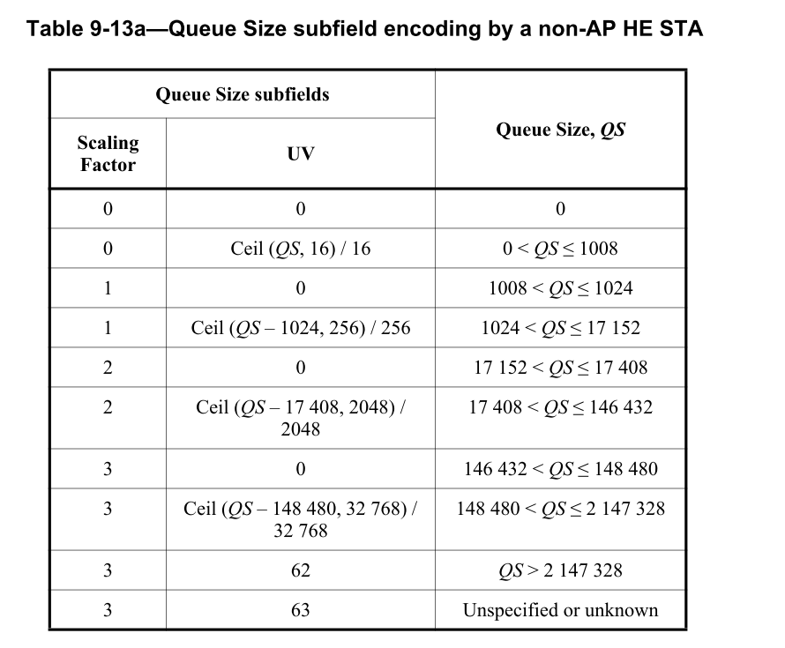
Recap of Buffer Status Report
In 23-2007, the current buffer status report (BSR) problem is introduced, and the corresponding solution and straw polls were discussed
11bn SFD has adopted the text as below
  TGbn enables per-TID buffer size reporting of a larger queue in UHR
    Note: It is an optional feature.
    Note: In the baseline, the maximum approximate per-TID queue size to report is 2,147,328 octets
In this contribution, further analysis between two different solutions is discussed
  QoS control + A-ctrl
  A-ctrl only

Slide 3
QoS control + A-ctrl Design
In 23-2007, we propose a design to add a new A-ctrl working together with the QoS ctrl to report a larger queues size
For a non-AP STA to report queue size larger than 2,147,328 octets, the first step is to set the QS subfield <SF, UV> to <3, 62>
The non-AP STA can carry another subfield defined in A-ctrl field in the same frame to indicate an accurate and larger queue size which is above the QS currently can support

Slide 4
QoS control + A-Ctrl Design Example
A-ctrl design example 1, keep the SF as the same as 32,768 (SF0) in QS subfield
  QS = 2,147,328 + SF0*(UVE+1), UVE max is 254
    the maximum QS to be reported is 10,503,168
    UVE = 255 reserved for indication of QS > 10,503,168
  UVE = ceil ((QS - 2,147,328)/SF0) - 1
A-ctrl design example 2, increase the SF to 32,768*4 (SF1)
  QS = 2,147,328 + SF1*(UVE+1), UVE max is 254
    the maximum QS to be reported is 35,570,688
    UVE = 255 reserved for indication of QS > 35,570,688
  UVE = ceil ((QS - 2,147,328)/SF1) – 1
The SF applied in the A-ctrl UVE is by default with no extra indication
Control ID value | Meaning | UV extension (UVE)
TBD | Extension of UV in QoS QS subfield | 8 bits
NOTE: For 6GHz, the max AMPDU size is calculated based on Nss=8
39200 (N_DBPS)*396 (symbols for max PPDU length) /8 (bits/byte) * 8 (Nss) = 15,523,200 bytes (max AMPDU size defined in 11be Table 9-34)
39200 is from 11be Table 36-86 MCS13 N_DBPS

Slide 5
A-ctrl only Design I with Maximum Scaling = 32768
Design
  SF 3 bits + UV 6 bits
  SF = 0, 1,2, 3
    Scaling = 16, 256, 2048, 32768 (Same granularity as QoS control)
  SF = 4, 5, 6, 7 (with UV < 62)
    Scaling = 32768
  SF = 7 with UV = 62, 63 for QS > maximum, and unknown
  Maximum QS is 10,535,936
SF = 0, 1, 2, 3 (partially) are the same as the QoS ctrl design
SF | UV, Unscaled Value (6 bits) | QS, Queue size
3 | 0 | 146432 < QS ≤ 148480
3 | Ceil (QS – 148480, 32768) / 32768 | 148,480 < QS ≤ 2212864
4 | Ceil (QS – 2212864, 32768) / 32768 | 2212864 < QS ≤ 4310016
5 | Ceil (QS – 4310016, 32768) / 32768 | 4310016 < QS ≤ 6407168
6 | Ceil (QS – 6407168, 32768) / 32768 | 6407168< QS ≤ 8504320
7 | Ceil (QS – 8504320, 32768) / 32768 | 8504,320 < QS ≤ 10535936
7 | 62 | QS > 10535936
7 | 63 | Unspecified or unknown

Slide 6
A-ctrl only Design II with Maximum Scaling = 32768
Design
  SF 2 bits + UV 8 bits
  SF = 0, 1,2, 3 (with UV < 254)
    Scaling = 16, 256, 2048, 32768 (Same granularity as QoS control)
  SF = 3 with UV = 254, 255 for QS > maximum, and unknown
  Maximum QS is 8,884,224
SF | UV, Unscaled Value (8 bits) | QS, Queue size
0 | 0 | 0
0 | Ceil (QS, 16) / 16 | 0 < QS ≤ 4080
1 | 0 | 4080 < QS ≤ 4096
1 | Ceil (QS-4096, 256) / 256 | 4096 < QS ≤ 69376
2 | 0 | 69376 < QS ≤ 69632
2 | Ceil (QS-69632, 2048) / 2048 | 69632 < QS ≤ 591872
3 | 0 | 591872 < QS ≤ 593920
3 | Ceil (QS – 593920, 32768) / 32768 | 593920 < QS ≤ 8884224
3 | 254 | QS > 8884224
3 | 255 | Unspecified or unknown

Slide 7
Comparison I
Assumption: Legacy reported queue size under the same granularity as the QoS Control QS field
  A-ctrl only design II has better granularity for QS < 593,920
Maximum SF = 32768
Comparison criteria
  Required A-control length and maximum reported QS
SF = 32768 | Baseline QoS + A-ctrl | A-control I (SF +UV) | A-control II (SF +UV)
A-ctrl length | 8 bits | 3 + 6 = 9 bits | 2 + 8 = 10 bits
Maximum reported QS | 10,503,168 | 10,535,936 | 8,884,224

Slide 8
A-ctrl only Design with Maximum Scaling = 32768*4
Design
  SF 3 bits + UV 6 bits
  SF = 0, 1,2, 3
    Scaling = 16, 256, 2048, 32768 (Same granularity as QoS control)
  SF = 4, 5, 6, 7 (with UV < 62)
    Scaling = 32768*4
  SF = 7 with UV = 62, 63 for QS > maximum, and unknown
  Maximum QS is 35,537,920
SF = 0, 1, 2, 3 (partially) are the same as the QoS ctrl design
SF | UV, Unscaled Value | QS, Queue size
3 | 0 | 146432 < QS ≤ 148480
3 | Ceil (QS – 148480, 32768) / 32768 | 148480 < QS ≤ 2212864
4 | 0 | 2212864 < QS ≤ 2245632
4 | Ceil (QS – 2245632, 32768*4) / 32768*4 | 2245632 < QS ≤ 10634240
5 | Ceil (QS – 10634240, 32768*4) / (32768*4) | 10634240 < QS ≤ 19022848
6 | Ceil (QS – 19022848, 32768*4) / (32768*4) | 19022848 < QS ≤ 27935744
7 | Ceil (QS – 27935744, 32768*4) / (32768*4) | 27935744 < QS ≤ 35537920
7 | 62 | QS > 35537920
7 | 63 | Unspecified or unknown

Slide 9
Comparison II
Assumption: Legacy reported queue size under the same granularity as the QoS Control QS field
Maximum SF = 32768*4
Comparison criteria
  Required A-control length and maximum reported QS
SF = 32768*4 | Baseline QoS + A-ctrl | A-control only (SF +UV)
A-ctrl length | 8 bits | 3 + 6 = 9 bits
Maximum reported QS | 35,570,688 | 35,537,920

Slide 10
Parsing Complexity and Potential Baseline Change
Similar parsing efforts required for both solutions
  [A] pre-HE and HE STA has different scaling in BSR of QoS control
  [B] Reporting of a larger queue size is optional in UHR so that UHR STA still can use QoS control only to report BSR
  [C] TID is carried in QoS control
Current baseline limits the HT control to be the same when the same type frames are carried in A-MPDU [D]
 | QoS Ctrl + A-Ctrl | A-Ctrl Only
Non-AP STA generation identification [A] | Yes (pre-HE) | Yes (pre-HE)
QoS Ctrl BSR Support [B] | Yes | Yes
QoS ctrl + A-ctrl parsing together [C] | Yes | Yes
Enable different HT control contents of the same frame type MPDUs in A-MPDU (enablement can be limited to BSR only to reduce RX complexity) [D] | Yes | Yes

Slide 11
Proposal
To support a larger queue size report, propose to define an A-ctrl subfield cooperating with the QS subfield of the QoS control field in the same frame
  No change to current encoding of QS subfield for HE STA, no backward capability issue
  The extension is only needed when the QS subfield is not enough for a queue size report
A proposed design UVE with default SF 32768*4, 10-bit length
  HT-control can carry both UVE and UPH A-ctrl (14 bits + 12 bits < 30 ) in TB-PPDU
  Maximum reported QS is 35,570,688
  The reserved bits are for potential future change
Control ID value | Meaning | UV extension (UVE)
TBD | Extension of UV in QoS QS subfield | 10 bits
Unscaled Value | Reserved
Bits:
8
2

Slide 12
Straw Poll
Do you agree to define an A-ctrl subfield cooperating with the QS subfield of the QoS control field in the same frame to report a larger per TID queue size?
  Note: Encoding of the current QS subfield does not change.

Slide 13
backup

Slide 14
A-ctrl only Design II with Maximum Scaling = 32768
Design
  SF 2 bits + UV 7 bits
  SF = 0, 1,2, 3 (with UV < 126)
    Scaling = 16, 256, 2048, 32768 (Same granularity as QoS control)
  SF = 3 with UV = 126, 127 for QS > maximum, and unknown
SF | UV, Unscaled Value (7 bits) | QS, Queue size
0 | 0 | 0
0 | Ceil (QS, 16) / 16 | 0 < QS ≤ 2032
1 | 0 | 2032 < QS ≤ 2048
1 | Ceil (QS-2048, 256) / 256 | 2048 < QS ≤ 34560
2 | 0 | 34560 < QS ≤ 34816
2 | Ceil (QS-18,432, 2048) / 2048 | 34816 < QS ≤ 294912
3 | 0 | 294912 < QS ≤ 296960
3 | Ceil (QS – 149,504, 32768) / 32768 | 296960 < QS ≤ 4392960
3 | 126 | QS > 4392960
3 | 127 | Unspecified or unknown

Slide 15
Analysis
Maximum and unspecified uses two entries of larger SF (=7) so that range is further reduced
A-ctrl only design cannot utilize existing information carried in QS of QoS ctrl

Slide 16
Problem Statement
With more bandwidth in 6GHz and higher MCS introduced in 802.11, the report is easily exceeded within a PPDU
  For example, a 5.484 ms PPDU with 320MHz, 2SS, and HE MCS8, the data can be carried are 2,328,480 octets
    The QS size in that PPDU cannot be reported accurately
    Note that the QS subfield in QoS control field contains the data within the PPDU and the data waiting to be transmitted
For TB PPDUs, AP cannot allocate enough resources to a non-AP STA with inaccurate BSR and then the throughput may drop
Furthermore, in UHR, the throughput is to be increased by at least 25% so that the problem is getting worse in following generations of 802.11

Slide 17
Thoughts
Considering the limited size of QS subfield and backward capabilities, it is better to add another field to extend the reported queue size other than to further update the QS subfield encoding by a larger granularity
  Granularity increase also causes less accurate BSR
Instead of using current BSR in A-ctrl, to define an A-ctrl subfield as an extension of QS subfield is a more promising way
  no change to current encoding of QS subfield for HE STA, no backward capability issue
  the extension is only needed when QS subfield is not enough

