Slide 1
Some thought on the data plane of seamless roaming

Slide 2
Introduction
A bunch of seamless roaming contributions discussed with following aspects in UHR and TGbn
  Based on PTKSA shared solution
  Based on FT enhancement solution
  Context shared solution
  Set-up links with two AP MLDs during roaming
Regardless any design of control plane, we focus on the DL data plane enhancement for seamless roaming in this contributions

Slide 3
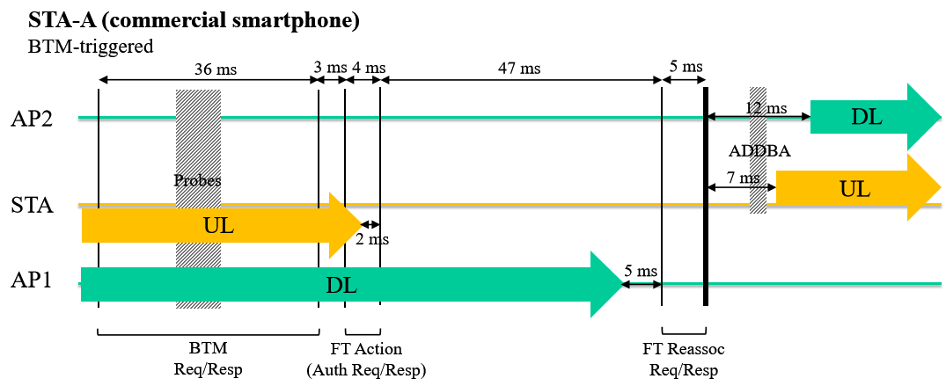
Recap the service interruption issue on FT feature
The following figure depicts the exactly service interruption issue based on FT protocol(Copy from Reference1). That’s, the totally duration is up to 22ms(5ms+5ms+12ms), that’s, 22 buffered packets are dropped on AP1 (based on the customer’s test method as bellow).
Customer’s test method
  UDP DL traffic flows from the bridge on DS to the STA with the iperf tool (small packets every 1ms).
  Calculate the number(N) of data missing during roaming, and then the interruption delay equal to N ms (N*1ms).

Slide 4
Recap a kind of implementation of VBSS
switch
At the beginning, STA(non-AP MLD) associate with AP1(AP MLD1).
Once the network detect the STA move far from AP1(on Router1)
  e.g. RSSI is dropped from -40dbm to -50dbm.
The network will clone AP1(AP11) on router2 when the old link quality is still good.
  DS switches to new AP1
  Context transfer(PN,SN) along with PTK from AP1 to AP11.
  Deliver all the buffered data to STA via AP1, and then close AP1.
  AP11 on Router2 becomes a new serving AP
AP1 following STA’s movement moves from Router1 to Router2 in the same ESS, and it’s a network dominant roaming solution.
  STA isn’t aware of the roaming happened
DS
Router1
Router2
-50dbm
-50dbm
STA

Slide 5
The status of roaming delay in different networks
11r: the interruption delay is about 20ms
VBSS: Known from the commercial market, the interruption delay is less than 10ms.
11bn seamless roaming: It will be attractive to the customer only if the interruption delay can be less than 5ms(or 0 packets lost).
  Note: Assuming the backhaul is wired backhaul(Interruption delay in wireless backhaul, who cares?)

Slide 6
The comparison between different roaming directions
802.11r
  It features STA dominant roaming framework
  STA decides to re-associate with another AP based very week RSSI(-75dbm),
VBSS
  It features AP dominant roaming framework
  DS switches and AP1 drains the buffered data to STA at the very early stage, e.g. -50dbm
  No need to consider the data missing issue on AP1
Proposals in TGbn
  Some contribution propose to continue to deliver the buffered data to STA via AP1(bad quality link) after DS switching.
  It will cause a higher transmission failure issue via a bad quality link, the lower interruption delay requirement can’t be met.
  Worse case, no much gain compared with current FT protocol.
switch
DS
AP1
AP2
-75dbm
-40dbm
STA
Conclusion
If TGbn still walk on the STA dominant roaming direction, we should consider to deliver partial or all the buffered data via AP2.

Slide 7
The proposal on data plane enhancement
The network should recycle or copy the buffered data from AP1 and sends them to STA via AP2.
  E.g. transmit a portion of buffered data via AP1(at T1). Meanwhile, copy the the leftover buffered data from AP1 to AP2, and then transmits the leftover buffered data via AP2(at T2, T2> T1) .
  E.g. transmit all the buffered data via AP1(at T1),Meanwhile, copy all the buffered data from AP1 to AP2, and re-transmitted the data via AP2(at T2, T2>T1).
Other aspects
  STA may retrieve AP1’s DL buffer status and decide whether to receive buffered DL data via AP1 during roaming procedure
  STA may provide some threshold on the number of data it intends to receive via AP1 during the roaming procedure.

Slide 8
The follow figure depicts the buffered data delivery during roaming
Copy buffered data to AP2(T1)
20
...
4
3
2
1
20
...
4
3
2
1
switch
DS
AP1
AP2
-75dbm
-50dbm
T1
T2
STA

Slide 9
BA session & BA context transfer topic
Recap the context transfer and performance status in VBSS
  Context transfer: only include PN,SN
  In some demonstration, deleting BA on AP1 and setting up a new BA on AP2 after the roaming procedure(single ACK mode during roaming procedure) won’t cause the performance drop issue.
The proposal on BA session during roaming procedure
  Simpler way: single ACK mode during roaming procedure
  Reference 1 agrees with the extra gain after applying the BA transfer operation, but BA transfer operation makes the implementation become more complicated, it should be an optional procedure.
  Other option: BA re-negotiation is also possible during roaming based on Reference 3 .

Slide 10
PTKSA & PTKSA transfer topic
If the group agree the PTKSA can transfer from one AP MLD to another
  Then it’s possible for a non-AP MLD to receive the same buffered data via two links that are set up with AP MLD1 and AP MLD2 respectively.
If the group disagree that the PTKSA transfer between two AP MLDs
    Then the non-AP MLD should receive the buffered data using PTK1 via AP1.
    And the non-AP MLD should switch its PTK from PTK1 to PTK2 to receive the buffered data via AP2.

Slide 11
Summary
We analyse the status and make some comparison between different roaming solution
Provide some ideas on data plane enhancement solution for seamless roaming
Provide some thought on BA session and PKTSA transfer

Slide 12
THANK YOU ☺

Slide 13
Reference
24/0679r0 thoughts-on-functionality-and-security-architecture-for-uhr-seamless-roaming.pptx
24/0349r3 enhanced-fast-bss-transition.pptx
24/480r0 Details on Context Transfer and Data Forwarding under FT Protocol

