Slide 1
Initial Discussion on Possible LDPC
Improvements in WLAN
Date: 2024-05-15
Authors:
Name | Affiliations | Address | Phone | Email
Wei Lin | Huawei |  |  | lin.linwei@huawei.com
Ming Gan
Ross Jian Yu
Yan Xin

Slide 2
Discussion on Current WLAN LDPC Codes
The current 11n LDPC codes were designed and introduced for 802.11n in around 2004.
  There are 4 code rates (1/2, 2/3, 3/4, 5/6) and 3 code lengths (648, 1296, 1944) supported in Wi-Fi systems since then → Highest Rate = 5/6, Longest Length = 1944
  The 12 different LDPC matrices were designed individually for each rate and length, i.e., they don’t share the same base matrix or set of permutation coefficients.
Since the invention of 11n LDPC codes, multiple LDPC codes were introduced for various industrial scenarios, e.g., 5G NR, 11ad/ay, DVB, ATSC 3.0, PON, etc.
  Among the various industrial LDPC codes, 5G NR LDPC codes can support very large range of rates and lengths with 2 base matrices and 2 set of permutation coefficients.
  BG1 of size 46 x 68 can support rates of 1/3 ≤ R ≤ 8/9, and information lengths of 308 ≤ K ≤ 8448
  BG2 of size 42×52 can support rates of 1/5 ≤ R ≤ 2/3, and information lengths of 40 ≤ K ≤ 3840
The 11n LDPC length of 1944 were designed for BW ≤ 40M, Streams ≤ 4, and Mod ≤ 64QAM
  In Wi-Fi 8, the highest throughput can be achieved with largest BW >= 320M, 8 spatial streams, 4096QAM, thus the number of LDPC codewords can be very large with current length-1944 LDPC

Slide 3
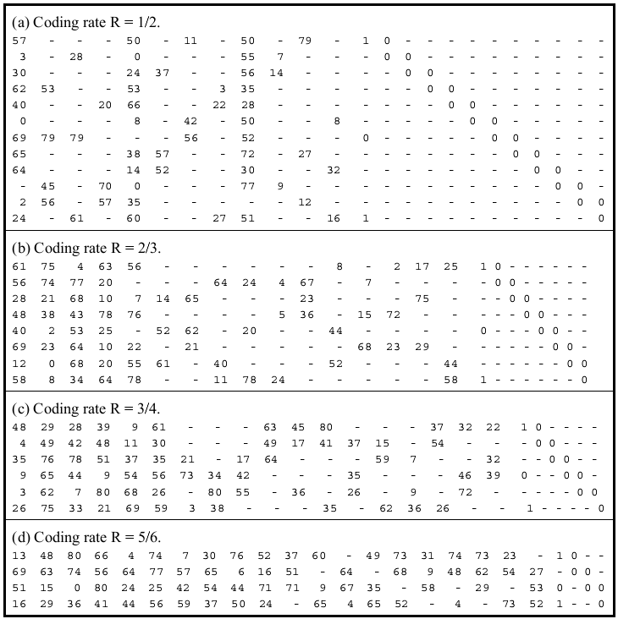
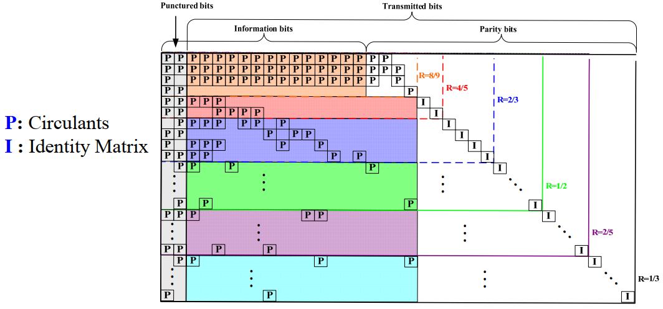
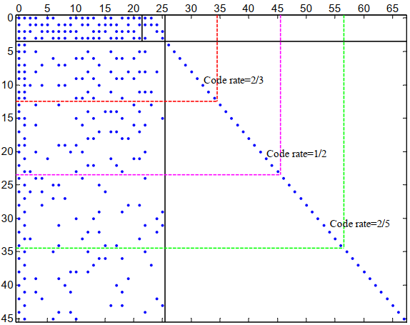
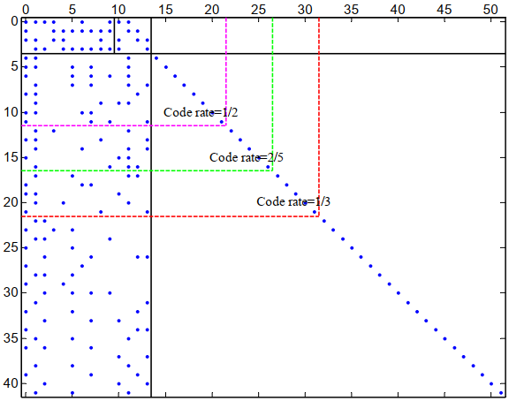
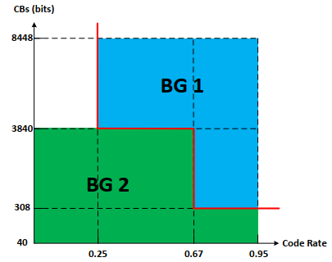
11n LDPC vs. NR LDPC: Code Structures
11n LDPC, Length = 1944, Z = 81
NR LDPC BG1: 1/3 ≤ R ≤ 8/9, 308 ≤ K ≤ 8448
NR LDPC BG2: 1/5 ≤ R ≤ 2/3, 40 ≤ K ≤ 3840

Slide 4
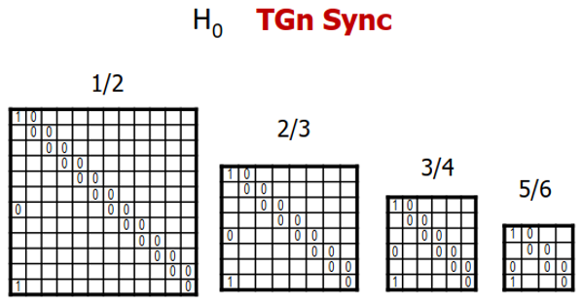
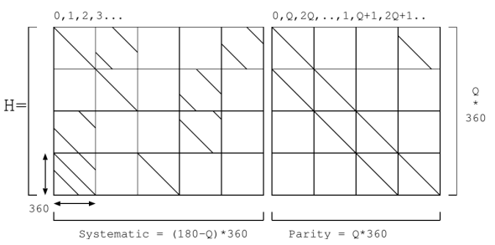
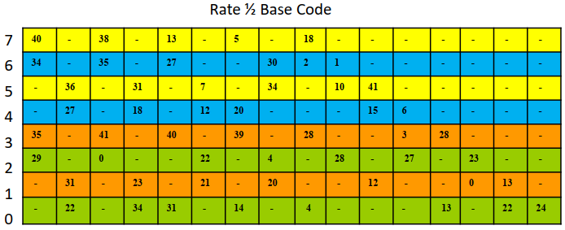
Industrial LDPC: Classic QC-LDPC
There are currently two major LDPC structures widely employed in industry
  Classic QC-LDPC (11n/11ad/DVB) and Raptor-Like QC-LDPC (5G NR)
Classic QC-LDPC (11n/11ad/DVB) → Repeat Accumulate + Quasi Cyclic
  Classic QC-LDPC codes are widely employed in various standards, they are implementation friendly and good performance for fixed rates/lengths
  Classic QC-LDPC codes are not convenient for rate/length compatible, e.g., require a individually designed H matrix for each rate and length (12 matrices in 11n), and significant performance loss occurs for shortening or puncturing
RA
RA
RA
11ad/ay LDPC Code
Parity-Check Part of WLAN LDPC Codes
DVB-S2 LDPC Code

Slide 5
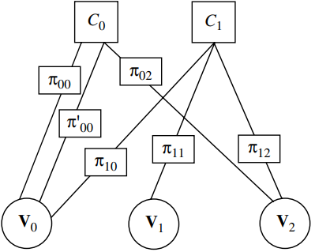
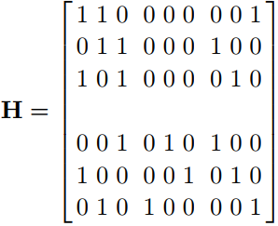
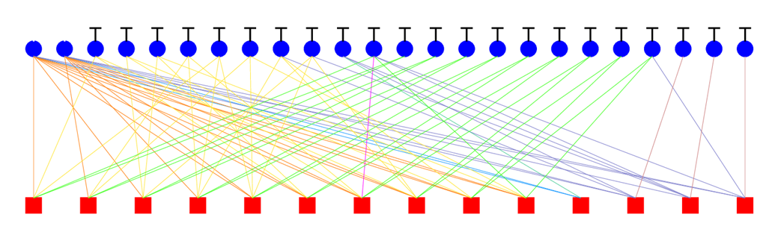
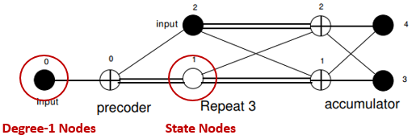
Industrial LDPC: Raptor-Like QC-LDPC
Raptor-Like QC-LDPC → Protograph + Multi-Edge Type + Accumulate Repeat Accumulate
  Protograph: a Tanner graph with a relatively small number of nodes → Protograph design & Lifting optimization
    P-EXIT chart analysis (Liva2007) → different protographs having same degree distribution may have different thresholds
    The Protograph-based LDPC codes can be extended to long lengths through different lifting sizes with single base matrix → decoding threshold can guarantee the performance
  Multi-Edge Type: edges are better controlled by categorizing into several different types
    Can avoid weak local combinations of nodes → e.g., all connections to a particular CN being made to VNs of smallest degree
  ARA & MET: state nodes in conjunction with degree-1 nodes → improve performance with controlled complexity
  Raptor-Like QC-LDPC codes can accommodate various rates and lengths with a single base matrix, and also can obtain very good performance under shortening and puncturing
State Nodes
Degree-1 Nodes
Protograph
Multi-Edge Type (MET)
Accumulate Repeat Accumulate (ARA)

Slide 6
11n LDPC vs. NR LDPC: Performance
NR LDPC codes are the most popular recent-designed LDPC codes in wireless domain, thus we compare the 11n LDPC with NR LDPC to have a perspective on the possible improvements
  Performances of 11n LDPC and NR LDPC are compared at longest 11n LDPC length N = 1944 and longest NR LDPC info. length k = 8448, respectively.
Simulation settings: BPSK + AWGN, only 1944 LDPC considered for 11n LDPC
  Layered Normalized Min-Sum (Alpha = 0.75) Decoder with 8 iterations are employed
  The plotted SNRs are not adjusted to the true SNRs for PAM modulations (3dB smaller due to factor of 2)
For each of the four 11n LDPC rates (1/2, 2/3, 3/4, 5/6), four curves are plotted for comparisons
  Curve 1: Rate-R 11n LDPC with k = 1944*R and single codeword
  Curve 2: Rate-R NR LDPC with k = 1944*R and single codeword, the BGs (BG1 or BG2) and lifting parameters (Z) are selected according to the code selection rule of 5G NR
  Curve 3: Rate-R 11n LDPC with k = 1944*R*Num ≈ 8448, and Num codewords
  Curve 4: Rate-R NR LDPC with k = 8448 (longest supported info. bits in a single codeword) and single codeword, the codeword length N = 8448/R.

Slide 7
11n LDPC vs. NR LDPC: R = 1/2
For K = 972, N = 1944 11n LDPC code and NR LDPC code (BG2 with Z = 104), the NR LDPC outperforms 11n LDPC for around 0.6 dB at BLER = 10⁻³
For K = 8448, N = 16896 NR LDPC code (BG1 with Z = 384) and 9 codewords of 11n 1944 LDPC code, the NR LDPC outperforms 11n LDPC for around 1.2 dB at BLER = 10⁻³
The performance of 9 codewords of 11n 1944 LDPC code is obtained by scaling the performance of single codeword
FER_Num = 1 – (1 – FER_1)^{Num}

Slide 8
11n LDPC vs. NR LDPC: R = 2/3
For K = 1296, N = 1944 11n LDPC code and NR LDPC code (BG2 with Z = 144), the NR LDPC performs similar to 11n LDPC at BLER = 10⁻³
For K = 8448, N = 12672 NR LDPC code (BG1 with Z = 384) and 7 codewords of 11n 1944 LDPC code, the NR LDPC outperforms 11n LDPC for around 0.5 dB at BLER = 10⁻³
The performance of 7 codewords of 11n 1944 LDPC code is obtained by scaling the performance of single codeword
FER_Num = 1 – (1 – FER_1)^{Num}

Slide 9
11n LDPC vs. NR LDPC: R = 3/4
For K = 1458, N = 1944 11n LDPC code and NR LDPC code (BG1 with Z = 72), the NR LDPC outperforms 11n LDPC for around 0.25 dB at BLER = 10⁻³
For K = 8448, N = 11264 NR LDPC code (BG1 with Z = 384) and 6 codewords of 11n 1944 LDPC code, the NR LDPC outperforms 11n LDPC for around 0.5 dB at BLER = 10⁻³
The performance of 6 codewords of 11n 1944 LDPC code is obtained by scaling the performance of single codeword
FER_Num = 1 – (1 – FER_1)^{Num}

Slide 10
11n LDPC vs. NR LDPC: R = 5/6
For K = 1620, N = 1944 11n LDPC code and NR LDPC code (BG1 with Z = 80), the NR LDPC outperforms 11n LDPC for around 0.45 dB at BLER = 10⁻³
For K = 8448, N = 10138 NR LDPC code (BG1 with Z = 384) and 6 codewords of 11n 1944 LDPC code, the NR LDPC outperforms 11n LDPC for around 0.7 dB at BLER = 10⁻³
The performance of 6 codewords of 11n 1944 LDPC code is obtained by scaling the performance of single codeword
FER_Num = 1 – (1 – FER_1)^{Num}

Slide 11
Summary
With the increase of codeword lengths, the NR LDPC outperforms the longest 11n LDPC at various code rates → over 1 dB at rate-1/2
Coding gain of NR LDPC over 11n LDPC is largest for rate-1/2, and varies for different rates → the main reason is that the longest NR LDPC keep the same info. bits of 8448, and the code length decrease with the increase of rate
  For longest NR LDPC, N = 16896 for R = 1/2, N = 12672 for R = 2/3, N = 11264 for R = 3/4, N = 10138 for R = 5/6
11be supports largest BW >= 320M, 8 spatial streams, 4096QAM, however, the highest rate of 11n LDPC is 5/6, while NR LDPC can support rate as high as 8/9

Slide 12
Thank You

Slide 13

Appendix: SNR for real and complex signals
Es/N0, Eb/N0 and SNR:
  Es/N0 = (Eb*R)/N0
  Es/N0 and SNR:
  When Tsym = Tsamp,
    For complex signals (QPSK): Es/N0 = SNR
    For real signals (BPSK): Es/N0 = 0.5*SNR
  To in line with the industrial custom, our SNRs are actually Es/N0 for BPSK, and the real SNR of BPSK shall be 2*Es/N0
QPSK & QAMs
BPSK & PAMs
Source: Robert G. Gallager, Principles of Digital Communication Gallager, 2008

