Slide 1
Negotiation for R-TWT Coordination: Follow up
Date: 2025-03-11
Authors:
Name | Affiliation | Address | Phone | Email
SunHee Baek | LG Electronics | 19, Yangjae-daero 11gil, Seocho-gu, Seoul 137-130, Korea |  | sunhee.baek@lge.com
Jinsoo Choi |  |  |  | js.choi@lge.com
Insun Jang |  |  |  | insun.jang@lge.com
Yelin Yoon |  |  |  | yl.yoon@lge.com
Geonhwan Kim |  |  |  | geonhwan.kim@lge.com
DongJu Cha |  |  |  | dongju.cha@lge.com
Eunsung Park |  |  |  | esung.park@lge.com
Dongguk Lim |  |  |  | dongguk.lim@lge.com
Jinyoung Chun |  |  |  | jiny.chun@lge.com
Insik Jung |  |  |  | insik0618.jung@lge.com
HanGyu Cho |  |  |  | hg.cho@lge.com
Sanggook Kim |  | 10225 Willow Creek Rd, San Diego, CA, USA |  | sanggook.kim@lge.com

Slide 2
Introduction
Motions for the R-TWT coordination in Multi-BSS were passed.
Motion 48) Define mechanisms that enable APs to coordinate their rTWT schedule(s) and/or to ensure that one AP provides the protection of the rTWT schedule(s) of the other AP.
Note – TBD mechanisms including negotiation between 2 APs and advertisement.
Motion 281) For negotiation over the wireless medium, an AP that requests protection for its R-TWT schedule(s) via negotiations with another AP includes information carried in TBD fields of the Broadcast TWT Parameter Set field corresponding to each R-TWT schedule being negotiated in a TBD individually addressed Management frame that it transmits to the other AP.
In this contribution, we suggest the signaling details for the R-TWT schedule coordination between an CR-TWT requesting AP and CR-TWT responding AP.
The CR-TWT requesting AP means an AP initializes to request the R-TWT coordination.
The CR-TWT responding AP means an AP responds the R-TWT coordination request from CR-TWT requesting AP.

Slide 3
Overview
During the R-TWT coordination, APs exchange the schedule information for R-TWT to coordinate it.
The fields with the Broadcast TWT Parameter set are the appropriate methods to contain the R-TWT schedule information for the R-TWT coordination between APs.
While negotiating the R-TWT SP(s) between AP and the associated STA, the (sub)fields indicating the R-TWT schedule are included within the Broadcast TWT Parameter Set field.
The type of TWT Parameter Set field and element for R-TWT coordination isn’t limited to the Broadcast TWT Parameter Set field and TWT element in this contribution.
Main Point

Slide 4
Signaling for R-TWT Coordination
The below information within the Broadcast TWT Parameter Set field is used.
The fields to indicate the schedule information can be reused in the R-TWT coordination.
Target Wake Time, Nominal Minimum TWT Wake Duration TWT Wake Interval Mantissa, TWT Wake Interval Exponent, Broadcast TWT Persistence
The TWT can be set based on the neighboring AP’s TSF/TBTT obtained from the overhearing Beacon frame.
The Broadcast TWT ID subfield identifies requested R-TWT schedules during the R-TWT coordination.
The ID would be the same ID with which the requesting AP announces the R-TWT schedule in its BSS
The AP received the coordination request can responds the coordination result(e.g., Accept or Reject) about each R-TWT schedule corresponding to each Broadcast TWT ID.

Slide 5
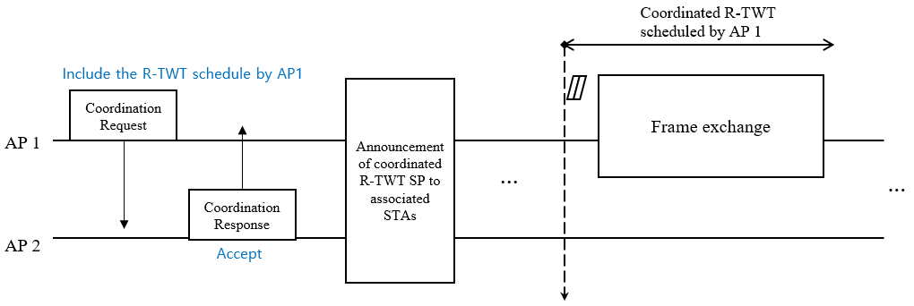
R-TWT Coordination Procedure
The frame for R-TWT coordination can be exchanged by including the TWT Parameter set(s) for Coordination Request or Coordination Response.
AP 1 → AP 2: Coordination Request for the R-TWT schedule information of AP 1
AP 2 → AP 1: Coordination Response to accept the received Coordination Request

Slide 6
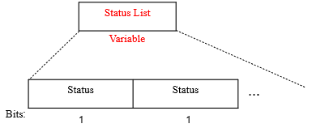
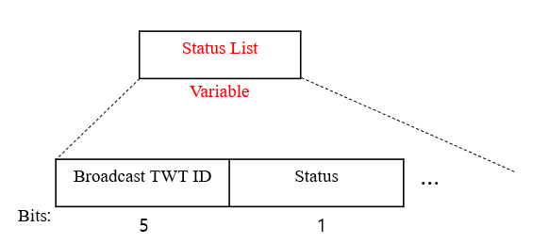
Enhancement on R-TWT Coordination Response
Basically, a TWT response can indicate whether the R-TWT schedule within TWT request accept, reject, or suggestion to protect the schedule through the value of the TWT Setup Command subfield in the Broadcast TWT Parameter Set field.
However, there can be a way to reduce overhead based on a status(e.g., accept or reject).
The status only indicates accept or reject to protect the R-TWT schedule corresponding the Broadcast TWT ID within its BSS.
The Status List field can be defined by the same numbers of TWT Parameter Set field with requested Co-RTWT schedule.
The order of the Status field within the Status List field is same with the order of the TWT Parameter Set field within the Co-RTWT request frame.
Alternatively, the Status List field can be defined by consisting of 2-tuple {Broadcast TWT ID subfield, Status subfield}.

Slide 7
Conclusion
In this contribution, we propose a negotiation signaling details and procedures for R-TWT schedule(s) coordination between an AP and neighboring AP.
Necessary fields within the Broadcast TWT Parameter Set field for R-TWT coordination between APs
Procedure of R-TWT coordination between APs
The exchanged frame includes the TWT Parameter set(s) corresponding to the Coordination Request(s) or the Coordination Response(s)
Enhanced Version of the R-TWT Coordination Response based on Status (Accept or Reject)

Slide 8
Straw Poll 1
Do you agree to add the following text to the TGbn SFD?
A Co-RTWT Requesting AP, shall include one or more Co-RTWT Parameter Set fields corresponding to each requested R-TWT schedule in the TBD individually addressed management frame used for the request to the Co-RTWT Responding AP. The Co-RTWT Parameter Set field includes the following :
Target Wake Time field
Broadcast TWT ID field
Broadcast TWT Persistence field
TWT Wake Interval Mantissa field
TWT Wake Interval Exponent field
Nominal Minimum TWT Wake Duration field
TBD other fields

Slide 9
Straw Poll 2
Do you agree to add the following text to the TGbn SFD?
Define a Status field (TBD exact name) to indicate that a Co-RTWT responding AP accepts or rejects each R-TWT schedule requested by Co-RTWT requesting AP in the TBD individually addressed Management frame transmitted to the Co-RTWT requesting AP in response to the TBD individually addressed Management frame that initiates the negotiation.
The TBD individually addressed Management frame that carries the Status field doesn’t include the corresponding Co-RTWT Parameters.

Slide 10
References
[1] 23/771 Coordinated of R-TWT Protection in Multi-BSS
[2] 23/226 Coordination of R-TWT for Multi-AP Deployment
[3] 23/250 AP coordination with R-TWT
[4] 23/291 R-TWT Multi-AP Coordination
[5] 23/293 Follow-up on TWT-based Multi-AP Coordination
[6] 23/297 rTWT for Multi-AP
[7] 23/355 Enhanced R-TWT and M-AP operation
[8] 23/771 Coordinated R-TWT Protection in Multi-BSS
[9] 23/860 Further thoughts on coordinated TWT
[10] 23/1087 Announcement for R-TWT Coordination
[11] 23/2022 R-TWT for multi-AP follow up
[12] 24/171 TGbn Motions List-Part 1
[13] 24/1966 PDT MAC CRTWT
[14] 24/2045 Detailed Text Proposal on Cr-TWT

