Slide 1
Integrating WUR into 11bn
Date: 2024-05-13
Authors:

Slide 2
Motivation
11bn UHR aims to
  improve reliability
  support further reduced low latency traffic
  further increase peak throughput
  improve power saving capabilities
  improve network efficiency
Introducing 802.11ba WUR to 11bn
  Power saving while supporting low-latency traffic
  There is a trade-off with throughput and efficiency

Slide 3
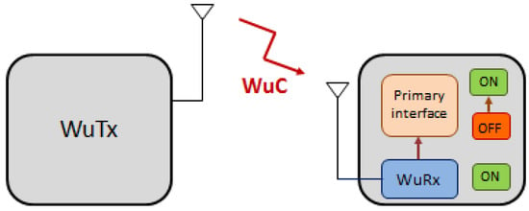
Brief Recap on 802.11ba (1)
The 802.11ba WUR is a companion radio to the primary connectivity radio or the main radio (MR) that supports 802.11 standards such as non-HT, HT, VHT, or HE
  The main radio would stay in deep sleep mode most of the time and only turn on to transfer data when the WUR receives a wake-up message.
WUR requirements [1]
  The wake-up frames carry only control information that can trigger a transition of the primary connectivity radio out of sleep.
  The WUR meets the same range requirement as the primary connectivity radio
  The WUR devices coexist with legacy IEEE 802.11 devices in the same band
  The WUR has an expected active receiver power consumption of less than one milliwatt.

Slide 4
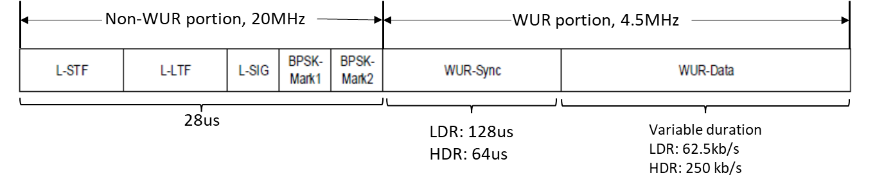
Brief Recap on 802.11ba (2)
[2]
WUR PPDU structure
  Non-WUR portion: OFDM signaling, 20MHz
    Coexisting with other 802.11 devices operating in the same frequency band
  WUR portion: OOK signaling, 4.5MHz
    Sync: for WUR PPDU detection, data rate detection, timing alignment, 2us/logic bit
    Data: LDR(mandatory)/HDR; Manchester coding, 2us or 4us per encoded bit
WUR FDMA PPDU
  40MHz and 80MHz support
WUR MAC frame types
  Beacon, Discovery, Wake-up, Short Wake-up, Vendor Specific
  4-24 bytes, LDR: 0.668-2.972ms, HDR: 0.22-0.796ms

Slide 5
Method 1: WUR as Companion Radio to UHR
Introduce WUR as is to UHR
  UHR devices are equipped with a WUR as companion radio
  May need to extend WUR FDMA PPDU support to 160MHz and 320MHz
Power saving benefit
  MR in listen mode (55~80mw) vs. various sleep modes (deep: 0~100uw with >3ms sleep-to-active latency; shallow: ~1mw, <500us; micro: ~5mw, <100us) [3]
  WUR <1 mw
Issues with efficiency and throughput
  LDR WUR frames could be up to 3ms
    WUR FDMA PPDU helps, but not enough
    What if WUR PPDUs don’t need all the available bandwidth?
  If a WUR frame is sent every 200ms, the WUR network utilization time is 1.5%
    But what about more APs or more frequent WUR frames at different times?

Slide 6
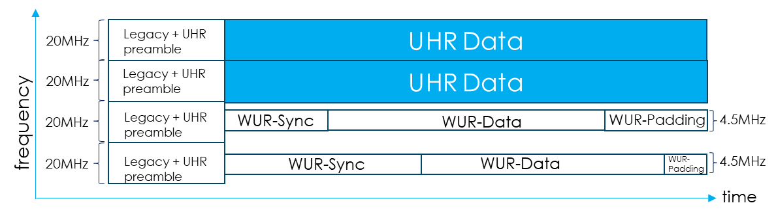
Method 2: A-PPDU with WUR signals
Aggregate WUR PPDUs with UHR PPDUs for improved efficiency, throughput, latency while reaping the power saving benefit
  Simultaneous WUR and UHR transmission for better utilization of the available bandwidth
  Flexible to accommodate low-latency UHR traffic
Feasibility in the PHY perspective
  Very feasible in 20MHz subchannel-level aggregation
    FDMA, not OFDMA, but
    Transmit spectrum mask assures that the mutual interference level is as low as not mixing WUR and UHR signals
  RU-level aggregation is more efficient, but needs further feasibility study

Slide 7
Summary
WUR as a companion radio could benefit UHR devices with huge power saving
Enabling A-PPDU with WUR signals integrate the WUR feature to UHR with more flexibility and improved efficiency
More study is needed on feasibility, signal generation, signaling, etc.

Slide 8
References
IEEE 802.11-16/1045r9, “A PAR Proposal for Wake-up Radio,” Jul. 2016.
IEEE P802.11-REVme™/D5.0: Wireless LAN Medium Access Control (MAC) and Physical Layer (PHY) Specifications, February 2024
IEEE 802.11-15/0314r2, “Sleep States in IEEE 802.11ax Simulation Scenarios,” March 2015.

Slide 9
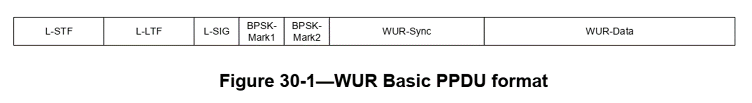
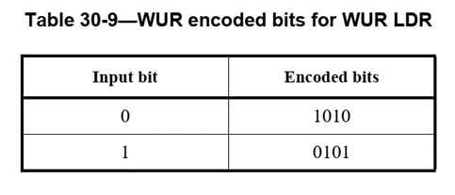
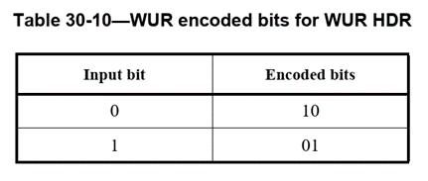
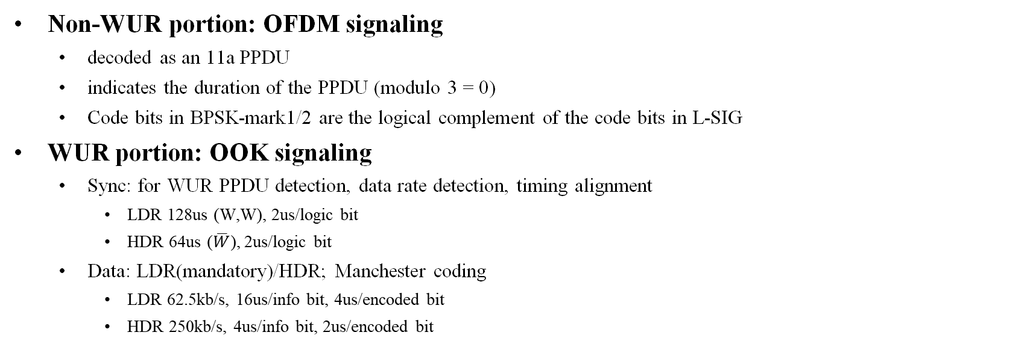
Appendix - More on 802.11ba (1)
[2]
Non-WUR portion: OFDM signaling
  decoded as an 11a PPDU
  indicates the duration of the PPDU (modulo 3 = 0)
  Code bits in BPSK-mark1/2 are the logical complement of the code bits in L-SIG
WUR portion: OOK signaling
  Sync: for WUR PPDU detection, data rate detection, timing alignment
    LDR 128us (W,W), 2us/logic bit
    HDR 64us ($\overline{W}$), 2us/logic bit
  Data: LDR(mandatory)/HDR; Manchester coding
    LDR 62.5kb/s, 16us/info bit, 4us/encoded bit
    HDR 250kb/s, 4us/info bit, 2us/encoded bit
[2]

Slide 10
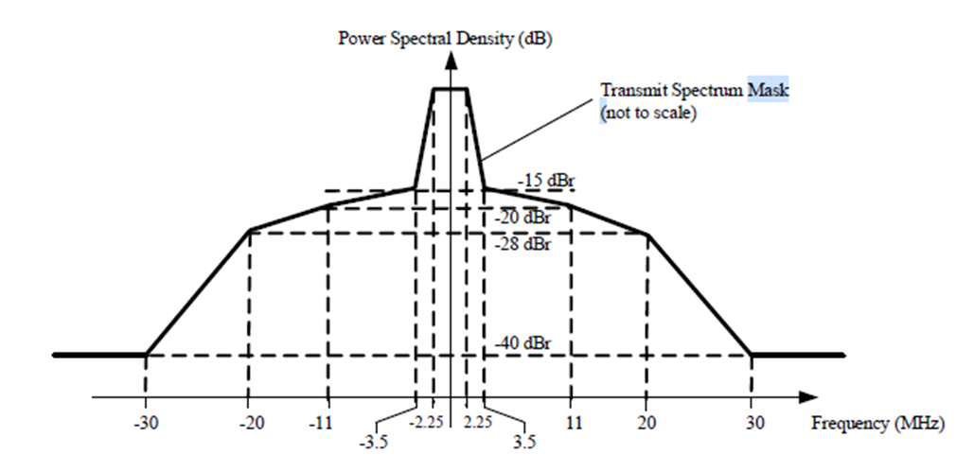
Appendix - More on 802.11ba (2)
[2]
OOK signals
  Effective 4.5MHz bandwidth
  2us or 4us ON/OFF
WUR MAC frame types
  Beacon, Discovery, Wake-up, Short Wake-up, Vendor Specific
  4-24 bytes, LDR: 0.668-2.972ms, HDR: 0.22-0.796ms
WUR FDMA PPDU
  40MHz and 80MHz support

