Slide 1
Interference Mitigation for Improved Reliability – Link Adaptation Perspective
Date: May 3, 2024
Authors:

Slide 2
Introduction
In previous contributions [1-4] we proposed a new transmission scheme, in which ‘Interference Mitigation (IM) pilots’ are inserted within the data field for facilitating RX beamforming in the receiver side, as an efficient approach for interference mitigation. Mitigation of interference can result in improved performance and reduced latency, thus contributing to the ultra high reliability goal of TGbn.
In this contribution we analyze this approach from the link adaptation perspective. This analysis addresses some concerns that were recently raised:
  How do we decide when to apply IM pilots given that we don’t know in advance which PPDUs will suffer from interference?
  Wouldn’t we lose significant performance due to the overhead associated with IM pilots?

Slide 3
Recap: Interference Mitigation PHY level results
Simulation configuration: 4 RX antennas, 1 desired SS transmitted by 1 antenna, 1 interfering SS, SIR=10dB, 106-tone RU, 20% IM pilot subcarriers (20 IM pilot SCs out of 102 data SCs), TGn-D NLOS, 1000 data bytes
IM scheme eliminates the PER curves’ error floors when SNR>SIR, and as a result goodput is significantly improved despite IM pilots’ overhead.

Slide 4
Link Adaptation Perspective
We examine the goodput and PER vs. MCS corresponding to the LA search dimension, for a specific channel scenario with SNR=25dB.
LA optimization criterion: MCSopt=argmax(Goodput(MCS)).
  Optional additional constraint: PER < PER_limit due to retransmission’s heavier penalty on total throughput.
As shown in previous results, the IM scheme significantly improves the maximum goodput in the presence of interference and slightly degrades maximum goodput without an interferer.

Slide 5
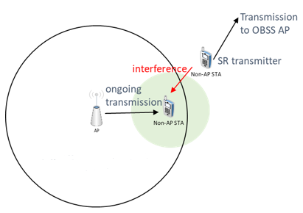

Random interference activity modeling (1)
Presumably, the start and end times of an interferer are random.
We use a simplified two-state mixed channel in order to model the random presence or absence of the interferer
Independently, per PPDU, we either apply the interference presence or absence channel conditions with probabilities $P_{i}$ and $1−P_{i}$, respectively. We test the cases of $P_{i}=0\%,10\%, 25\%,50\%,75\%,100\%$
  Note that the IM scheme can mitigate interference that starts and ends anywhere within the PPDU.
An example scenario which generates a two-state mixed channel: interference due to spatial reuse.
  Probability of interference corresponds to the interferer transmission utilization

Slide 6
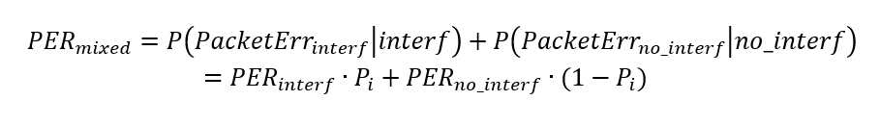

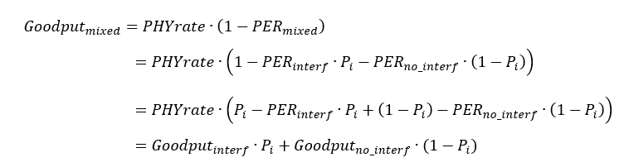
Random interference activity modeling (2)
The corresponding PER and Goodput of the mixed channel:
We define LA efficiency as the ratio between goodput of a practical LA and a Genie LA that is able to predict the CSI and set the best MCS per PPDU:

Slide 7
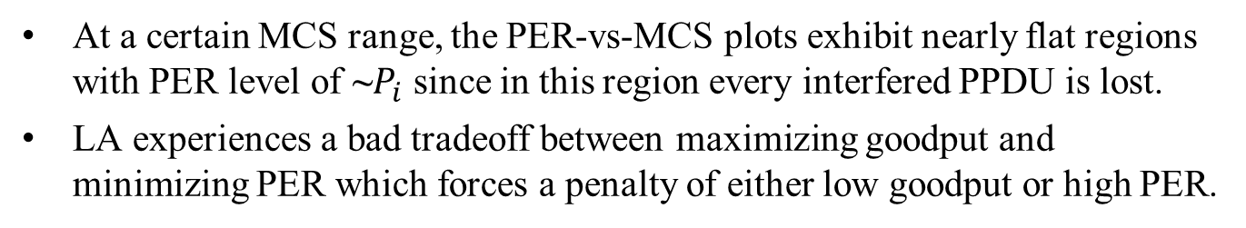
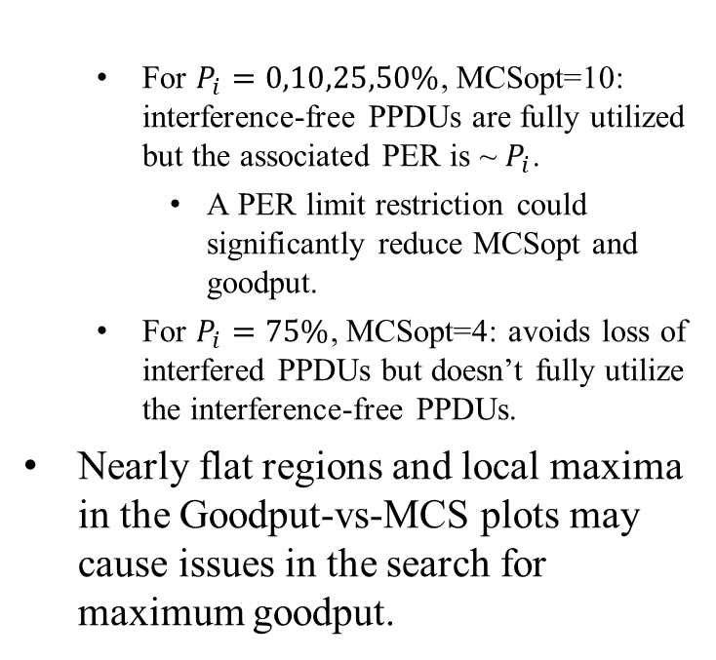
Link Level results: IM not applied
At a certain MCS range, the PER-vs-MCS plots exhibit nearly flat regions with PER level of ~$P_{i}$ since in this region every interfered PPDU is lost.
LA experiences a bad tradeoff between maximizing goodput and minimizing PER which forces a penalty of either low goodput or high PER.
  For $P_{i}=0,10,25,50\%$, MCSopt=10: interference-free PPDUs are fully utilized but the associated PER is ~ $P_{i}$.
    A PER limit restriction could significantly reduce MCSopt and goodput.
  For $P_{i}=75\%$, MCSopt=4: avoids loss of interfered PPDUs but doesn’t fully utilize the interference-free PPDUs.
Nearly flat regions and local maxima in the Goodput-vs-MCS plots may cause issues in the search for maximum goodput.

Slide 8
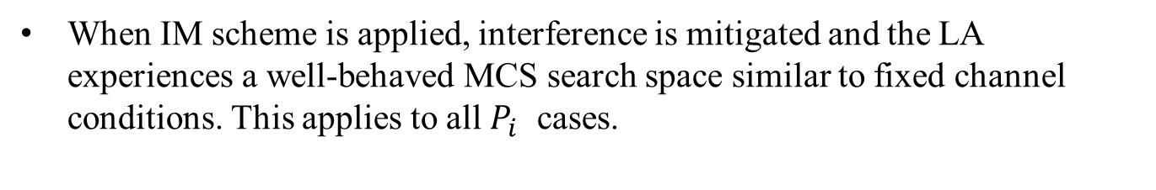
Link Level results: IM applied
When IM scheme is applied, interference is mitigated and the LA experiences a well-behaved MCS search space similar to fixed channel conditions. This applies to all $P_{i}$ cases.
Improved maximum goodputs
  Detailed in following slides.
PER-vs-MCS flat regions are eliminated. As a result, PER that corresponds to maximum goodput is relatively low.
A good tradeoff between Goodput and PER allows achieving low PER (increased reliability) with low penalty in goodput.
Goodput-vs-MCS flat regions are eliminated, enabling efficient search for MCS that maximizes goodput.

Slide 9
IM enabled/disabled selection
How is the selection between IM enabled and IM disabled carried out?
Adaptive approach:
  Refer to this selection as another dimension in the link adaptation TX parameters’ search space for goodput maximization along with: MCS, Nss, CP length, etc.
    Combine IM selection with the ACK guided trial-and-error based search. Example concepts:
      During IM disabled: Probe a higher MCS along with IM enabled.
      During IM enabled: Probe current MCS along with IM disabled.
    For trigger based uplink: The receiving AP can apply on-going and link independent monitoring of interference that can further serve the IM selection decision.
Fixed approach:
  If link reliability is more important than utilizing maximum throughput, IM enabled can be applied as a fixed configuration.

Slide 10
Results summary table (No PER limit)
 | Interferer probability | 0% | 10% | 25% | 50% | 75% | 100%
IM disabled | Optimum MCS | 10 | 10 | 10 | 10 | 4 | 4
 | Goodput in optimum MCS [Mbps] | 45.4 | 40.9 | 34.1 | 22.7 | 16.9 | 16.1
 | PER in optimum MCS [%] | 5 | 14.5 | 28.7 | 52.5 | 11.8 | 15.8
 | Genie LA Goodput [Mbps] | 45.4 | 42.5 | 38.1 | 30.8 | 23.4 | 16.1
 | LA efficiency [%] | 100 | 96.2 | 89.4 | 73.8 | 71.9 | 100
IM enabled | Optimum MCS | 10 | 10 | 9 | 9 | 9 | 9
 | Goodput in optimum MCS [Mbps] | 36.3 | 34.1 | 33 | 31.9 | 30.8 | 29.6
 | PER in optimum MCS [%] | 5.7 | 11.2 | 3.3 | 6.7 | 10 | 13.3
 | Genie LA Goodput [Mbps] | 36.3 | 35.6 | 34.6 | 32.9 | 31.3 | 29.6
 | LA efficiency [%] | 100 | 95.8 | 95.5 | 96.8 | 98.3 | 100
 | IM Goodput gain (fixed) [%] | -20.2 | -16.6 | -3.1 | 40.4 | 82.4 | 83.8
 | IM Goodput gain (adaptive) [%] | 0 | 0 | 0 | 40.4 | 82.4 | 83.8

Slide 11
Results summary table with PER limit (1)
PER limit = 20%
PER limit = 10%
 | Interferer probability | 0% | 10% | 25% | 50% | 75% | 100%
IM disabled | Optimum MCS | 10 | 10 | 5 | 4 | 4 | 4
 | Goodput in optimum MCS [Mbps] | 45.4 | 40.9 | 21.8 | 17.6 | 16.9 | 16.1
 | PER in optimum MCS [%] | 5 | 14.5 | 14.5 | 7.9 | 11.8 | 15.8
IM enabled | Optimum MCS | 10 | 10 | 9 | 9 | 9 | 9
 | Goodput in optimum MCS [Mbps] | 36.3 | 34.1 | 33 | 31.9 | 30.8 | 29.6
 | PER in optimum MCS [%] | 5.7 | 11.2 | 3.3 | 6.7 | 10 | 13.3
 | IM Goodput gain (fixed) [%] | -20.2 | -16.6 | 51.5 | 81 | 82.4 | 83.8
 | Interferer probability | 0% | 10% | 25% | 50% | 75% | 100%
IM disabled | Optimum MCS | 10 | 8 | 4 | 4 | 3 | 3
 | Goodput in optimum MCS [Mbps] | 45.4 | 34.5 | 18.4 | 17.6 | 12.6 | 12.6
 | PER in optimum MCS [%] | 5 | 9.9 | 3.9 | 7.9 | 1.1 | 1.5
IM enabled | Optimum MCS | 10 | 9 | 9 | 9 | 9 | 8
 | Goodput in optimum MCS [Mbps] | 36.3 | 33.7 | 33 | 31.9 | 30.8 | 29.5
 | PER in optimum MCS [%] | 5.7 | 1.3 | 3.3 | 6.7 | 10 | 4.1
 | IM Goodput gain (fixed) [%] | -20.2 | -2.2 | 79.8 | 81 | 143.9 | 134.8

Slide 12
Results summary table with PER limit (2)
PER limit = 5%
PER limit = 1%
 | Interferer probability | 0% | 10% | 25% | 50% | 75% | 100%
IM disabled | Optimum MCS | 10 | 4 | 4 | 3 | 3 | 3
 | Goodput in optimum MCS [Mbps] | 45.4 | 18.8 | 18.4 | 12.7 | 12.6 | 12.6
 | PER in optimum MCS [%] | 5 | 1.6 | 3.9 | 0.7 | 1.1 | 1.5
IM enabled | Optimum MCS | 9 | 9 | 9 | 8 | 8 | 8
 | Goodput in optimum MCS [Mbps] | 34.2 | 33.7 | 33 | 30.1 | 29.8 | 29.5
 | PER in optimum MCS [%] | 0 | 1.3 | 3.3 | 2 | 3 | 4.1
 | IM Goodput gain (fixed) [%] | -24.8 | 79.1 | 79.8 | 138 | 136.4 | 134.8
 | Interferer probability | 0% | 10% | 25% | 50% | 75% | 100%
IM disabled | Optimum MCS | 9 | 3 | 3 | 3 | 2 | 2
 | Goodput in optimum MCS [Mbps] | 42.5 | 12.7 | 12.7 | 12.7 | 9.6 | 9.5
 | PER in optimum MCS [%] | 0.1 | 0.1 | 0.4 | 0.7 | 0.1 | 0.2
IM enabled | Optimum MCS | 9 | 8 | 7 | 7 | 7 | 7
 | Goodput in optimum MCS [Mbps] | 34.2 | 30.6 | 25.6 | 25.6 | 25.6 | 25.6
 | PER in optimum MCS [%] | 0 | 0.4 | 0 | 0.1 | 0.1 | 0.2
 | IM Goodput gain (fixed) [%] | -19.6 | 140.5 | 101.6 | 102.3 | 168 | 168

Slide 13
Summary
IM provides significant goodput gains in interference scenarios
IM is very friendly to the link adaptation mechanism in scenarios of randomly varying channel conditions due to interference
  Allows a low penalty trade-off between maximizing goodput and keeping the PER low.
  Allows fast convergence to optimal MCS and improved steady state stability.
  Allows high LA efficiency by fully utilizing channel conditions of interfered PPDU and interference-free PPDUs using the same MCS.
The gains of mitigating the interferer are much more significant than the loss due to IM pilots overhead.

Slide 14
References
[1] 11-23-1490r0: Physical Layer Reliability Improvements (Shimi Shilo et al)
[2] 11-23-1943r1: Physical Layer Reliability Improvements – Follow Up (Shimi Shilo et al)
[3] 11-24-107r0: PHY Layer Interference Mitigation for Improved Reliability (Shimi Shilo et al)
[4] 11-24-437r0: Interference Mitigation for Improved Reliability – More Insights (Shimi Shilo et al)
Notes:
at least one mode of operation capable of improved support, compared to 802.11be, for applications with stringentworst-case latency and jitter requirementscompared to 802.11be // i.e., avoid “worst-case”

