Slide 1
Trigger-based spatial reuse and P2P transmission
Date: 2024-09-01
Authors:
Name | Affiliation | Address | Phone | Email
Liuming Lu | OPPO |  |  | luliuming@oppo.com
Chaoming Luo
Dong Wei
Liangxiao Xin
Ning Gao
Yapu Li
Liuming Lu (OPPO)

Slide 2
Introduction
UHR takes enhancement of WLAN reliability for both an isolated BSS and overlapping BSSs as a main Objective[1]
to improve efficient use of the medium
to increase throughput at different SINR levels (Rate-vs-Range)
to reduce latency and jitter
to improve Peer-to-Peer (P2P) operation
IEEE 802.11bn task group has agreed to define multi-AP Coordinated Spatial Reuse (CSR) operation to improve system performance.
This contribution analyzes a P2P scenario for trigger-based spatial reuse (or CSR) from the dimensions of increasing throughput and improving efficient use of the medium, and proposes candidate key functions for CSR to be considered .

Slide 3
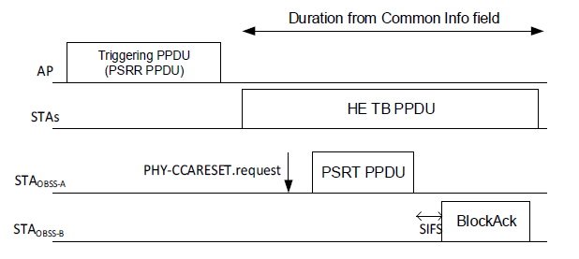
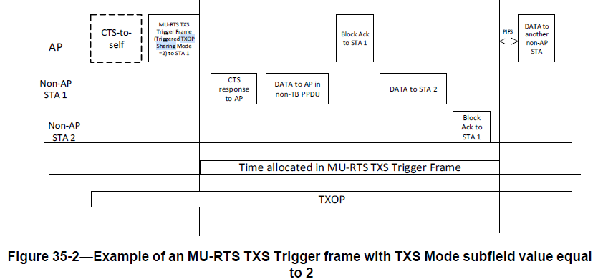
Recap: HE/EHT SR & EHT TXS
HE/EHT spatial reuse
1. OBSS PD-based spatial reuse
Type1: allows a STA to ignore inter-BSS PPDUs using a non-spatial reuse group(non-SRG) OBSS PD level.
Type2: allows a STA to ignore inter-BSS PPDUs that are identified as being SRG PPDUs, using an SRG OBSS PD level.
2. Parameterized Spatial Reuse（PSR）-based spatial reuse
EHT TXOP Sharing (TXS)
An HE STA initiates an SR transmission (i.e. transmit an PSRT PPDU) during an PSR opportunity for the duration of an ongoing PPDU (i.e. HE TB PPDU) that is triggered by the Trigger frame of the PSRR PPDU.
The transmit power of the PSRT PPDU is limited to avoid interfering with the reception of the ongoing PPDU at the recipient
The STA shall not transmit an PSRT PPDU that terminates beyond the PPDU duration of the ongoing PPDU.
Figure 1: PSR-based spatial reuse
TXOP sharing with mode2 allows a scheduled STA to transmit PPDU to the AP and to another STA by within the allocated time shared by the AP.

Slide 4
Issues
PD/PSR-based spatial reuse
although PD/PSR-based spatial reuse operation increases the opportunity of the STAs to access the medium, they are not scheduled or coordinated operation.
The tools cannot be used to schedule the transmissions among STAs by reusing the medium based on the STAs’ requirements for the traffic to be delivered.
TXOP sharing with mode2 for P2P transmission
Hidden node issue would be serious if the distance between a non-AP STA and its P2P peer is relatively shorter than the distance between the non-AP STA and AP.
Excessive channel protection would result in inefficient use of the medium for P2P transmission.

Slide 5
Objectives
The coordinated spatial reuse is proposed to be introduced in P2P scenario. The main objectives are described as follows:
The coordinated spatial reuse operation can be used as a tool to schedule the transmissions among STAs by reusing the medium based on the STAs’ requirements for the traffic to be delivered.
The SR transmission should not interfere with the reception of the ongoing PPDU at the recipient for another transmission. The appropriate STAs for SR transmission need to be selected based on the distribution of the STAs and the intended transmit power for the STAs.
The coordinated spatial reuse operation should be helpful for increasing aggregate throughput of the system and/or reducing the latency and jitter for the delivery of the traffic.

Slide 6




Scenarios to be considered
Use of WLAN P2P communications is increasing in a wide range of deployment scenarios, which are competing with infrastructure WLAN usage for the same medium resources. This requires better coordination between neighboring APs and between P2P networks [4]
Edge server
AP
Render data
Pose data
Pose data
Render data
HMD
HMD
Mobile Device
PC
Mobile Device
The distance between the mobile device and HMD is relatively shorter than the distance between the mobile and AP or the distance between the PC and AP.
The transmission between the mobile and HMD have no/little interference with the reception of the ongoing PPDU at the AP for the transmission between the PC/another mobile and AP if appropriate PC/mobiles are selected for the transmission.

Slide 7
An example for trigger-based spatial reuse
AP obtains an TXOP and sends a trigger frame(TBD) for CSR:
The trigger frame allocates resources for and solicits one TB PPDU transmission to PC.
simultaneously the trigger frame allocates/shares some of resources for one or more PPDUs to HMD
Targets: 1. the P2P transmission should not interfere with the reception of ongoing TB PPDU at the recipient. 2. to increase aggregate throughput of the system and/or reduce the latency and jitter for the delivery of the traffic
Figure: an example of the trigger-based spatial reuse

Slide 8
Summary
This contribution analyzes a P2P scenario for trigger-based spatial reuse (or CSR) from the dimensions of increasing throughput and improving efficient use of the medium, and proposes candidate key functions for CSR to be considered .
The trigger-based spatial reuse for P2P scenario can be regarded as an extension of multi-AP Coordinated Spatial Reuse.

Slide 9
References
[1] UHR proposed PAR, https://mentor.ieee.org/802.11/dcn/23/11-23-0480-01-0uhr-uhr-proposed-par.pdf
[2] Draft P802.11REVme_D7.0
[3] Draft P802.11be_D7.0
[4] TXOP sharing extensions for XR use-cases, https://mentor.ieee.org/802.11/dcn/23/11-23-1387-01-0uhr-txop-sharing-extensions-for-xr-use-cases.pptx
[5] Coordinated Spatial Reuse Design Details，https://mentor.ieee.org/802.11/dcn/24/11-24-1389-00-00bn-coordinated-spatial-reuse-design-details.pptx
Liuming Lu (OPPO)

Slide 10
SP
SP : Do you support to specify a new type of trigger frame for trigger-based spatial reuse in 11bn?
the trigger frame allocates resources for and solicits one or more TB PPDU.
the trigger frame allocates some of resources for one or more non-TB PPDUs simultaneously.
The format of the trigger frame is TBD
Liuming Lu (OPPO)

