Slide 1
Consideration on Relay operation for 11bn
Date: 2024-06-17
Authors:
Name | Affiliation | Address | Phone | Email
Liuming Lu | OPPO |  |  | luliuming@oppo.com
Chaoming Luo
Liangxiao Xin
Ning Gao
Yapu Li
Liuming Lu (OPPO)

Slide 2
Introduction
UHR takes enhancement of WLAN reliability as a main Objective[1]
improving efficient use of the medium
increasing throughput at different SINR levels (Rate-vs-Range)
improving the tail of the latency distribution and jitter
The relay operation has been proposed in 11bn to improve RvR (Rate-vs-Range) for increasing throughput and range extension in a large number of contributions [2], but during the discussion members has some concerns on the scenario that remains to be resolved by a new relay operation and the benefits from it .
This contribution further analyzes the suitable scenarios for a new relay operation mainly from the dimensions of reducing latency and improving efficient use of the medium, and proposes candidate key functions for the new relay operation to be considered .

Slide 3
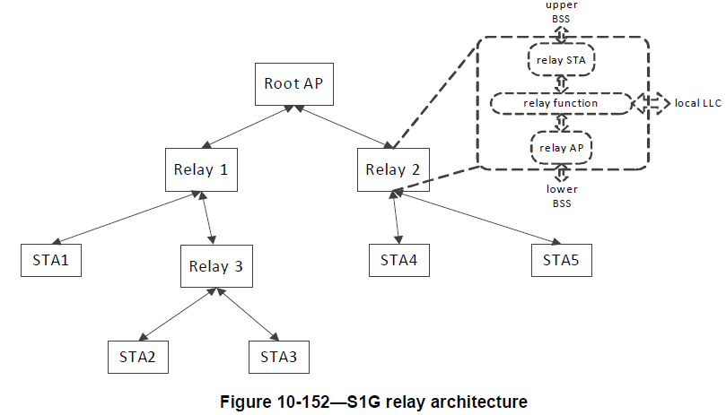
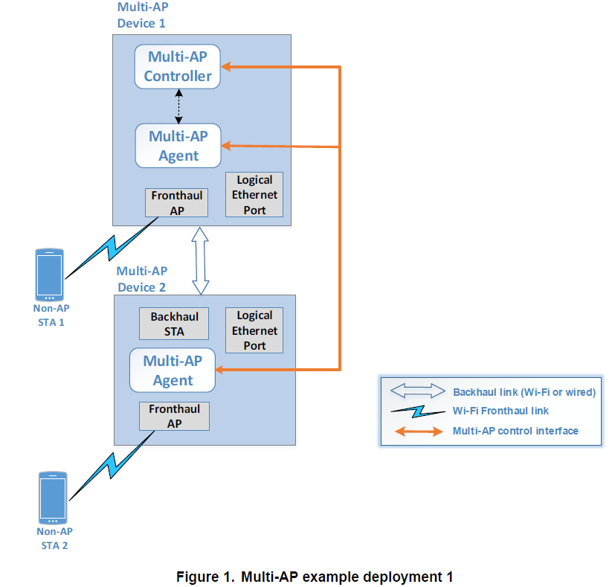
Recap: Current Relay operation for Wi-Fi
S1G relay operation [3]
Wi-Fi Easy mesh [4]
defines the mechanism to route traffic between Wi-Fi access points within the Multi-AP network.
Multi-AP network consists of two types of logical entities:
Multi-AP Controller: implements logic for controlling the fronthaul APs and backhaul links
Multi-AP Agent: executes the commands received from the Multi-AP Controller, and reports measurements and capabilities data
TXOP sharing for relay operation is not covered.
A S1G relay forwards frames between an relay AP and a relay non-AP STA.
An S1G relay consists of an S1G relay AP, an S1G relay STA and a relay function.
TXOP sharing for S1G relay operation
S1G STA uses TXOP sharing to transmit one data frame to the S1G relay and then the S1G relay transmit the frame to root AP in the same TXOP.
Limited to the scenario that the S1G relay STA and S1G relay AP are operating in same primary channel
Notes:
As a reference

Slide 4
Recap: Relay operation discussed in 11bn
Relay operation that has recently been discussed focuses on improving RvR (Rate-vs-Range) for increasing throughput and range extension
Two types of relay architectures
Relay link (or Intra-Link Relay) to provide better end-to-end QoS with simple relay processing[5, 6]
  Simple protocol for fast relay discovery, connection and management
  Dedicated relay device or regular non-AP STA with relay function
Multi-link Relay (or cross-Link Relay) for the coverage expansion and the seamless roaming [7, 8]
  Relay device consists of a relay STA (or named backhaul STA) and a relay AP
  Relay transmission using the different Links for Tx and Rx of Relay Node
Concerns
What scenarios are needed to be resolved by a relay operation in 11bn?
Easymesh has the advantage of improving through and range extension, and has widely been deployed. What are the advantages of the new relay operation over existing relay techniques (e.g. Easymesh)?

Slide 5




Scenarios to be considered
XR compute offloading over wireless links is a key capability to scale the adoption of XR devices and applications. Three topologies have been proposed for this scenario.[9]
A large amount of real-time uplink and downlink traffic with low latency requirement needs to be delivered between HMD and edge server/PC
HMD as a IOT device may have limited capabilities (e.g. narrow bandwidth, limited TX. Power) in terms of the reduction of its cost.
A relay device may be helpful for the improvement of the communication between HMD and edge server/PC.
A new mode of TXOP sharing initiated by AP and executed by the relay device and HMD can be used to schedule the uplink and downlink transmission of the low-latency traffic.
Edge server
AP
AP
A new type of relay device and new mode of TXOP sharing can be considered to resolve the issues in this scenario
Pose data
Render data
Pose data
Render data
HMD
HMD
PC
Relay Device
Relay Device

Slide 6
Proposals for Relay operation in 11bn
An relay device where affiliated STAs include an relay AP and an relay STA
A logical entity that is capable of supporting an relay AP and an relay STA.
Relay AP and relay STA are operating on different primary channels
Relay AP uses a channel width that is the same or narrower than the channel width of the AP with which the relay STA is associated, e.g., the AP is an root AP.
Trigger-based TXOP sharing(TXS) is supported for the relay device
new modes of TXS are suggested to be considered.
e.g. a mode of TXS, where uplink and downlink PPDUs can be delivered simultaneously during the TXOP.
An example of the new mode of TXOP sharing proposed
Notes:
multi-link device: [MLD] A logical entity that is capable of supporting more than one affiliated station (STA) and can operate using one or more affiliated STAs, and that presents one medium access control (MAC) data service and a single MAC service access point (MAC SAP) to the logical link control (LLC) sublayer.

Slide 7
Advantages of the proposed relay operation
Qualitative contrast of the proposed relay operation with other types
Relay operation | TXOP sharing | KPI for delivery of low latency traffic | Medium Usage efficiency | Rate-vs-Range
S1G relay operation | TXOP sharing with incomplete support Non-TB TXOP sharing | Low Hop-by-hop channel access TXOP sharing with limited capability, such as hidden node issue | Low TXOP-level coordinated transmission between relay AP and STA is not support if they are operating on different primary channel | Medium
EasyMesh | Not supported | Medium Independent hop-by-hop channel access | Medium TXOP-level coordinated transmission across fBSS and bBSS is not supported | High Support coverage expansion for large area with full function APs [5]
Relay operation proposed in 11bn | TXOP sharing with complete support, such as TB TXOP Sharing | High TXOP-level scheduling | High C-TDMA/FDMA can be considered High-efficient spectrum utilization | Medium

Slide 8
Summary
The suitable scenarios are analyzed for a new relay operation to be proposed from the dimensions of reducing latency and improving efficient use of the medium besides improving RvR (Rate-vs-Range)
This contribution also proposes candidate key functions for the new relay operation to be considered in 11bn.
A relay device forwards frames between an AP and a non-AP STA.
The relay device is a logical entity that is capable of supporting an relay AP and an relay STA
The operating channel(s) of relay AP is within the operating channel(s) of the AP with which the relay STA is associated
Trigger-based TXOP sharing is supported by the relay device between the AP and non-AP STA
Relay architecture is TBD
Trigger-based TXOP sharing procedure is TBD.

Slide 9
References
[1] UHR proposed PAR, https://mentor.ieee.org/802.11/dcn/23/11-23-0480-01-0uhr-uhr-proposed-par.pdf
[2] tgbn-mar-2024-meeting-agenda, https://mentor.ieee.org/802.11/dcn/24/11-24-0235-14-00bn-tgbn-mar-2024-meeting-agenda.pptx
[3] Draft P802.11REVme_D5.0
[4]Wi-Fi EasyMesh, https://www.wi-fi.org/zh-hans/discover-wi-fi/wi-fi-easymesh
[5] UHR Rate-vs-Range Enhancement with Relay, https://mentor.ieee.org/802.11/dcn/22/11-22-1908-01-0uhr-uhr-rate-vs-range-enhancement-with-relay.pptx
[6] Relay for 11bn, https://mentor.ieee.org/802.11/dcn/23/11-23-1840-02-00bn-relay-for-11bn.pptx
[7] Relay Operation Follow-up, https://mentor.ieee.org/802.11/dcn/24/11-24-0074-01-00bn-relay-operation-follow-up.pptx
[8] Discussion on 11bn Relay Operation, https://mentor.ieee.org/802.11/dcn/24/11-24-0385-01-00bn-discussion-on-11bn-relay-operation.pptx
[9] TXOP sharing extensions for XR use-cases, https://mentor.ieee.org/802.11/dcn/23/11-23-1387-01-0uhr-txop-sharing-extensions-for-xr-use-cases.pptx
Liuming Lu (OPPO)

Slide 10
SP
SP : Do you support to specify a relay mechanism in 11bn?
A relay device forwards frames between an AP and a non-AP STA.
The relay device is a logical entity that is capable of supporting more than one STA
STAs affiliated with the relay device include an relay AP and an relay STA
The operating channel(s) of the relay AP is within the operating channel(s) of the AP with which the relay STA is associated
Trigger-based TXOP sharing is supported by the relay device between the AP and non-AP STA
Relay architecture is TBD
Trigger-based TXOP sharing procedure is TBD.
Liuming Lu (OPPO)

