Slide 1
The need for groupcast AID signaling
Authors:
Date: 2024-05-10
Name | Affiliations | Address | Phone | Email
Antonio de la Oliva | InterDigital |  |  | aoliva@it.uc3m.es
Joseph Levy | InterDigital

Slide 2
Current status of discussion
IEEE 802.11bi TG is actively looking to define mechanisms that modify parameters in frames that are transmitted over the air and that may be used to identify/track a user.
Two key parameters that have been identified are: the MAC Address and the AID. There are other parameters of potential concern, but the AID poses a challenge.
AID is an 11 bits identifier (there are also AID12 and AID13 versions), but the maximum AID value is limited to 2007. At initial association a STA will receive an AID from the AP. Most AP assign AID sequentially.

Slide 3
Modification of AID
Some ideas discussed in TGbi regarding AID?
        11bi is considering modifying the AID of EP STAs every epoch
        How the AID should be modified has not been agreed:
        Some members suggest providing AIDs to all EP STAs for every epoch
        Others suggest self-generation based on algorithms
        For signaling:
        assuming an epoch of 1s (shorter in 604r7)
        considering action frame of 32 bytes (as example, taken from 604r7)
        yields to a maximum (2000 STAs) of 512kbps devoted for this purpose

Slide 4
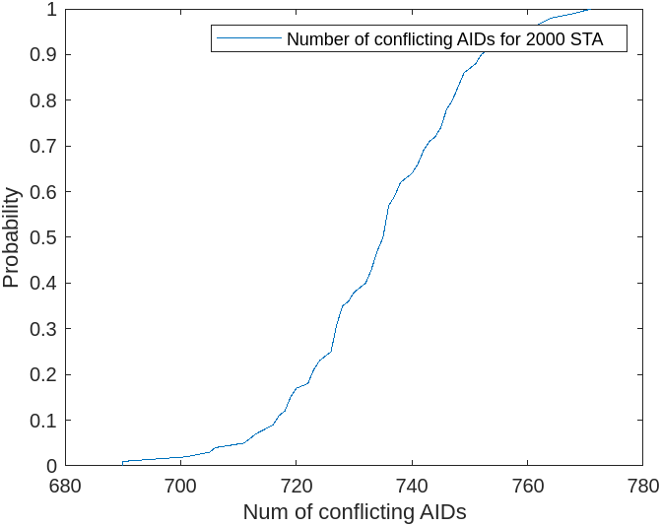
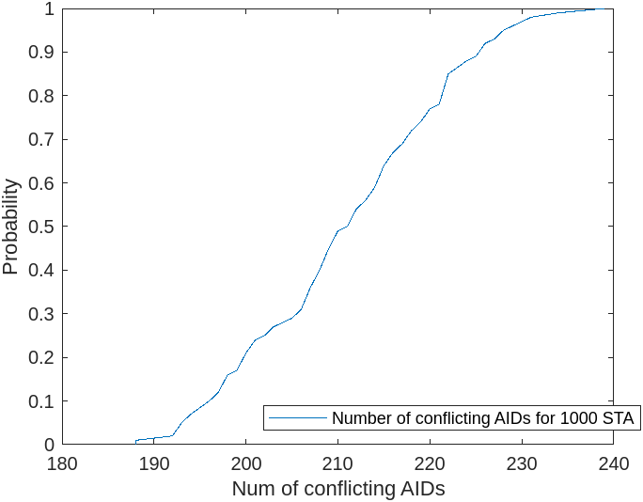
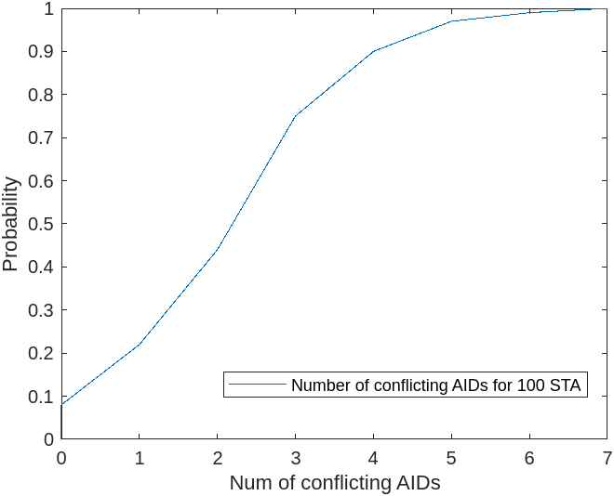
Algorithm based AID
If an algorithm-based approach is used, basically every EP STA decides its own AID based on some PRF or similar (not clear yet how)
If we consider the probability of collision of AIDs we have the following graphs (simple analysis), showing the number of STAs which will generate a repeated AID (e.g., 2000 EP STAs in an AP, all generating a random new AID).

Slide 5
Groupcast communication of conflicting AIDs
Looking at first graph, out of 2000 STAs, with high probability less than 780 STAs will generate a repeated AID, so 2000-780 will generate a valid one -> It is possible to simply advertise new parameters for the 780 STAs in groups
It is possible to have the AP generate the AIDs of these 780 and choose different seeds for the AID. A group STAs can use a common seed and then only one message will be required for each group of STAs
The higher the number of EP STAs in the BSS being served by the AP, the greater the benefit of this approach.

Slide 6
Conclusion
We can have better mechanisms to advertise AIDs than simply allocating them on each epoch
If algorithmic generation of AID is done, we can advertise new seeds to groups of STAs
This will highly reduce the number of messages required in the solution

