Slide 1
Co-BF Recap and Way Forward
Date: 2024-05-11
Authors:

Slide 2
Background
Multi-AP coordination (MAPC) is one of the most discussed protocol enhancement for 802.11bn.
MAPC may enable the development of new features, among them Coordinated Beamforming (Co-BF).
Co-BF enables a framework for inter-BSS spatial domain coordination with radiation beams (towards own users to serve) and nulls (towards neighboring users to mute).
Co-BF has been already extensively discussed in TGbe [1-5], UHR SG [6-10], and TGbn [11-16].

Slide 3
Objectives of this contribution
Recap of existing Co-BF key proposals
When is Co-BF useful?
Why do we need Co-BF?

Slide 4
Recap of existing Co-BF key proposals
 | TGbe | UHR SG | TGbn
Inter-BSS/OBSS coordination set establishment and maintenance | [1], [3] | [9], [10] | [11]
CSI acquisition from devices both in own and inter-BSS/OBSS | [1], [3], [4] | [7], [10] | [11], [15]
Allocation and communication of nulling capabilities to enable concurrent transmissions without power reduction | [1], [3], [4] |  | [16], [11], [15]
Performance | [2], [5] | [6], [8], [9] | [12], [13], [14], [16]

Slide 5
When is Co-BF useful?
Dense scenarios with high interference
There must be inter-BSS interference to null
where, in addition, the STAs in OBSS have delay-sensitive traffic
Nulls should be placed towards delay-sensitive STAs
where, in addition, the served STAs enjoy high SNRs
Placing a radiation null reduces the degrees of freedom (d.o.f.) for beamforming, and thus the beamforming gain, penalizing cell-edge STAs
where, in addition, the number of spatial streams to serve is reasonably smaller than the available d.o.f. at the antenna array in the AP
As for the Shannon-Hartley theorem, multiplexing gains are linear, while SINR gains are logarithmic in terms of capacity, and the later gains should not come at the expense of the former

Slide 6
Why do we need Co-BF?
To improve worst-case latency by making devices in OBSS “invisible” to each other, thus enforcing full spatial reuse and significantly reduce contentions
C-SR is a simpler mechanisms, but it entails power reduction which might be detrimental in dense environment [8].
Preemption is effective but it significantly impacts halted transmission.
MLO reduces latency by operating in multiple links, however, in dense scenarios, worst-case latency (99th-percentile) may deteriorate, as MLO tend to occupy all the available links occasionally leading overlapping delay-sensitive devices to wait [18].

Slide 7
Why do we need Co-BF?
Co-BF may empower already existing functionalities and frames in IEEE 802.11 for addressing UHR PAR objectives
Multiple antennas in current Wi-Fi products are a fact, exploiting them for nulling is a better opportunity than for boosting beamforming gain (limited by EIRP regulation).
Additional overhead for CSI acquisition of inter-BSS devices can be limited
Triggering and performing CSI acquisition of inter-BSS devices is possible building on existing frameworks

Slide 8
Co-BF: simulation assumptions [17]
Deployment:
2 ceiling-mounted APs 4x2 antenna array
16 broadband STAs file transfer protocol (FTP) traffic
8 low-latency STAs augmented reality (AR) traffic
Uplink scheduling:
APs spatially multiplex as many STAs as possible of a class per TXOP
Use remaining DoF (max 4) to suppress interference from low-latency STAs
Broadband FTP3 model
File size = 0.5 MB
Offered traffic = 100 Mbps
Per STA traffic
time
Latency-sensitive AR model
File size = 32 bytes
Constant arrival rate, frequency = 10 ms
Per STA traffic
time

Slide 9
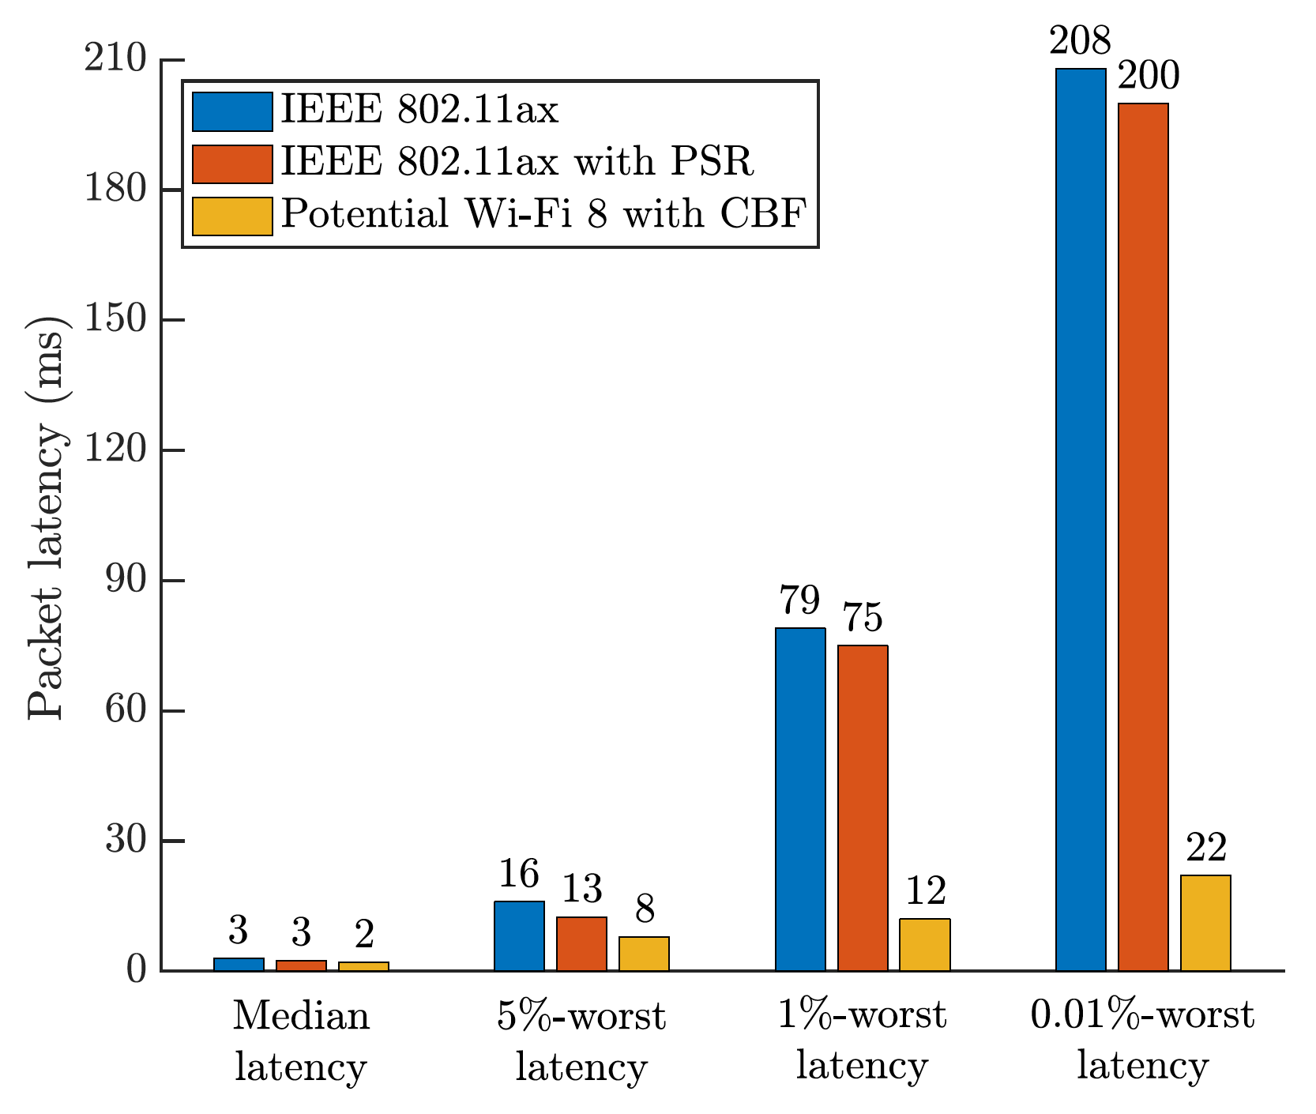
Co-BF: potential delay reduction [17]
A system w/ or w/o spatial reuse
struggles to keep low latency
latency often < 3 ms, but it can sometimes exceed 200 ms
A system with CBF
more aggressive spectrum access
inter-BSS interference mitigation
~10x worst-case latency reduction* for delay sensitive traffic (e.g. augmented reality traffic!)
IEEE 802.11ax/be w/o SR
IEEE 802.11ax/be with SR
Potential IEEE 802.11bn with Co-BF
* Throughput for broadband traffic almost preserved

Slide 10
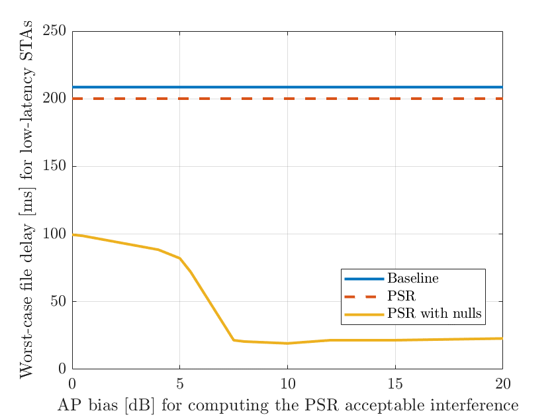
Co-BF: delay reduction even with imperfect nulling [5]
Co-BF nulling attenuation ~8-10 dB, is sufficient to improve worst-case latency [5].
This can lead to a reduction of CSI acquisition overhead.
The worst-case latency benefits are also present with limited Co-BF nulling attenuation
Inter-BSS delay-sensitive devices take anyhow advantage of the advertised spatial reuse opportunity
However, collisions are possible and affect the performance of the devices in the BSS that has granted the spatial reuse opportunity through Co-BF
IEEE 802.11ax/be w/o SR
IEEE 802.11ax/be with SR
Potential IEEE 802.11bn with Co-BF
Nulling attenuation [dB]

Slide 11
Co-BF summary
Co-BF is key for reducing worst-case delay in Wi-Fi, and to enable delay sensitive applications in dense scenarios.
Co-BF features has been already extensively studied in TGbe, UHR SG and TGbn, we should capitalize on the effort and further work on defining the details of the feature.
Co-BF may build upon and empower already existing mechanisms in IEEE 802.11 to fulfill the UHR PAR objectives.
Nulling and associated CSI estimation precision may be relaxed to reduce overhead and complexity.

Slide 12
Straw poll
Do you believe coordinated beamforming with null steering should be considered for inclusion in the 802.11 TGbn Specification Framework Document (SFD)?
Yes
No
Abstain

Slide 13
References 1/2
[1] “Coordinated Null Steering for EHT”, 19/0811.
[2] “Performance of Coordinated Null Steering in 802.11be”, 19/1212.
[3] “Coordinated Beamforming/Null Steering in 802.11be”, 19/1594.
[4] “Downlink spatial reuse parameter framework with coordinated Beamforming/Null Steering for 802.11be”, 19/1779.
[5] “Performance of parameterized spatial reuse (PSR) with coordinated beamforming/null steering for 802.11be”, 20/0091.
[6] “Nulling Performance of Coordinated Beamforming”, 23/1193r2.
[7] “Null Beam Steering Based Spatial Reuse”, 23/0855r1.
[8] “Performance of C-BF and C-SR”, 22/0776r1.
[9] “System Level Simulation of Co-BF and Joint Tx”, 22/1821r1.
[10] “Obtaining OBSS channel Information for Multi-AP operation”, 23/0854r0.

Slide 14
References 2/2
[11] “Coordinated Spatial Nulling (C-SN) Concept”, 24/0011r0.
[12] “Coordinated Spatial Nulling (C-SN) Simulations”, 24/0012r0.
[13] “Coordinated Spatial Re-Use and Coordinated Spatial Nulling Follow-Up”, 24/0635r0.
[14] “Residual Interference in CBF”, 24/0142r1.
[15] “TXOP Sharing for C-BF transmission”, 24/0387r0.
[16] “Zero MUI Coordinated BF”, 23/1998r0.
[17] A. Garcia-Rodriguez et al. “IEEE 802.11 be: Wi-Fi 7 strikes back”, in IEEE Communications Magazine, vol. 59, no. 4, pp. 102-108, April 2021.
[18] M. Carrascosa-Zamacois et al. “Understanding Multi-link Operation in Wi-Fi 7: Performance, Anomalies, and Solutions,” 2023 IEEE 34th Annual International Symposium on Personal, Indoor and Mobile Radio Communications (PIMRC), Toronto, ON, Canada, 2023.

Slide 15
Appendix

Slide 16
Recap of existing Co-BF key proposals
Inter-BSS/OBSS coordination set establishment and maintenance
Coordination approaches:
Fully coordinated [11]
Half-coordinated with sharing and shared APs [11], [1], [3], [9], [10]
Evolving the inter-BSS set in 802.11ax, [1], [3] propose the inter-BSS coordination set, which:
contains the IDs of all nodes that form part of the inter-BSS coordination set,
is configured and updated on the fly in a semi-static manner, and
is kept in the memory of each of those nodes

Slide 17
Recap of existing Co-BF key proposals
CSI acquisition from devices both in own and inter-BSS/OBSS
Extending existing trigger frames to address inter-BSS/OBSS devices [3], [4], [7], [10], [11].
Extending NDPA/NDP frames to address inter-BSS/OBSS devices [3], [10], [11].
Extending RTS/CTS frames to address inter-BSS/OBSS devices [4], [7], [15].

Slide 18
Recap of existing Co-BF key proposals
Allocation and communication of nulling capabilities in both UL and DL:
UL: building upon already existing IEEE 802.11ax PSR [3].
DL:
Building upon a PSR-like extension for DL [4].
Building upon IEEE 802.11be Triggered TXOP sharing (TXS) framework [15].

Slide 19
Recap of existing Co-BF key proposals
Performance (1/2)
Residual interference in Co-BF [6], [14] due to
Interference on the legacy preamble
Interference on the GI
Can be treated with [14]:
Extending the beamforming over the legacy preambles
Extending LTFs to separate the effect of the APs in the channel and noise estimation process
Nulling and CSI acquisition precision [5], [8]
Limited nulling accuracy is still beneficial and may lead to overhead and complexity reduction

Slide 20
Recap of existing Co-BF key proposals
Performance (2/2)
Co-BF vs C-SR [8], [12]
In C-SR inter-BSS separation plays a role
In C-SR enforced power reduction may reduce the benefits of spatial reuse

